Slide 1







Review 3:
Part 4
Notes:
Để nguyên trang bìa như này, chỉ thay đổi tên bài trong quá trình làm. Logo của sách Wonderful World

Slide 2
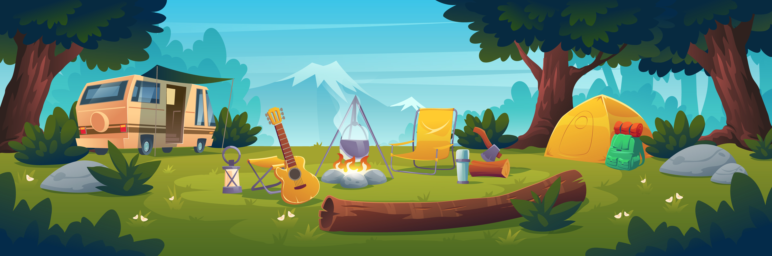

01
WARM-UP

Slide 3
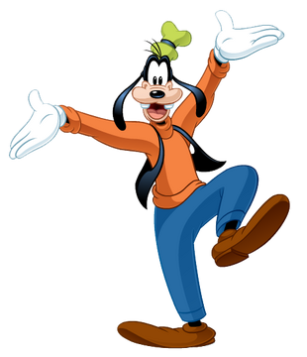
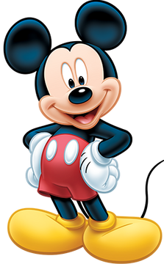
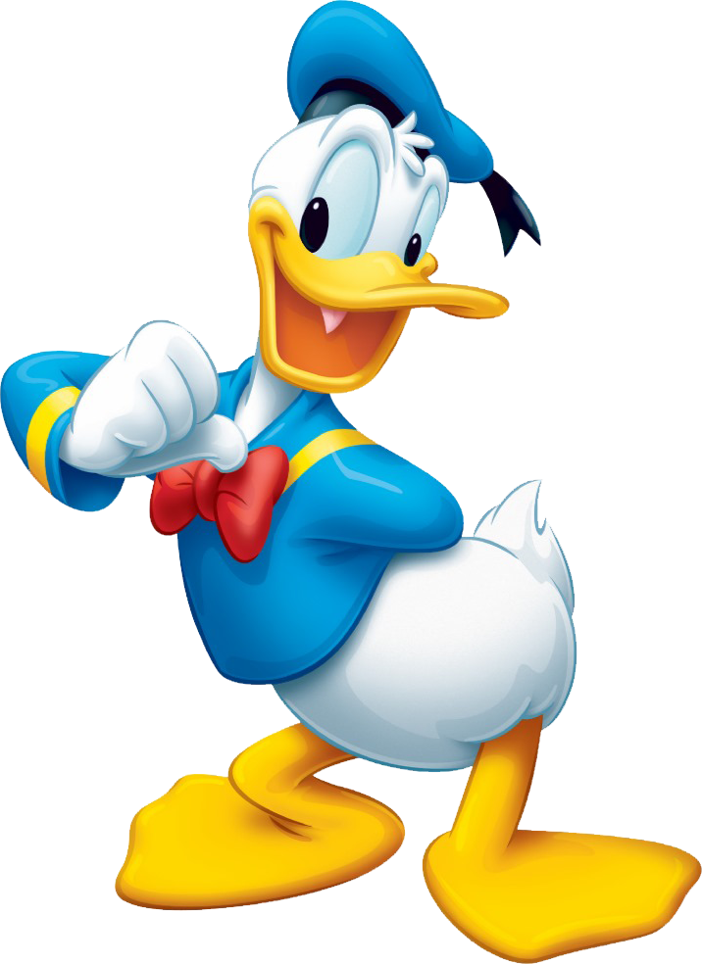
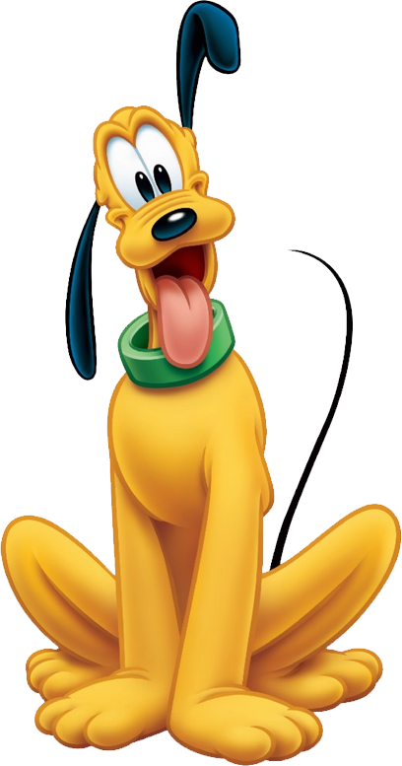
Pick A Character!
Next

Slide 4

  garden
back

Slide 5

  beach
back

Slide 6

  forest
back

Slide 7
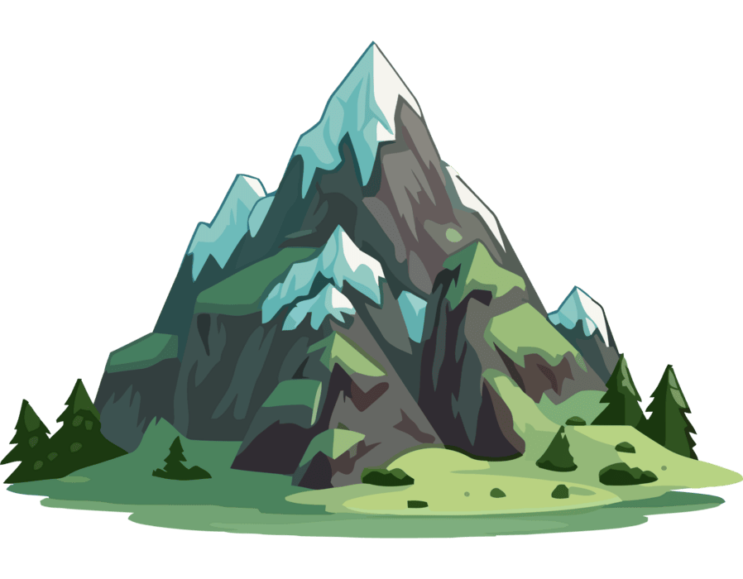
  mountain
back

Slide 8
02
PRACTICE

Slide 9
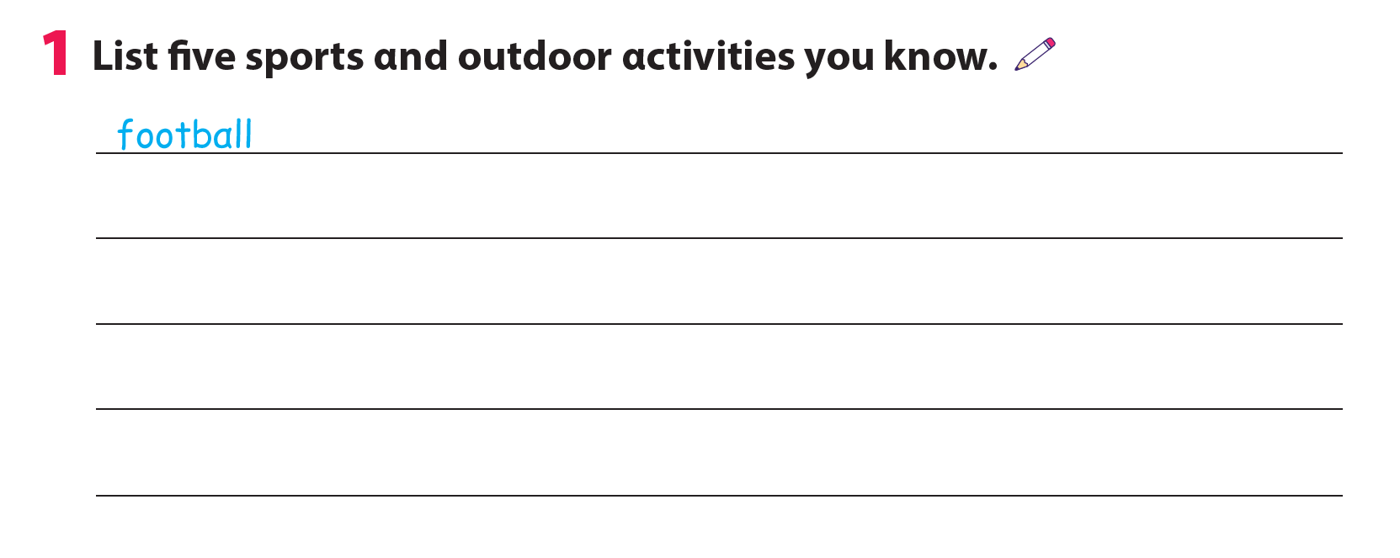
ice hockey
ride a bike
baseball
tennis
skiing

Slide 10
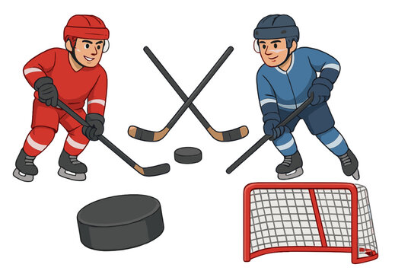
Ice hockey

Slide 11
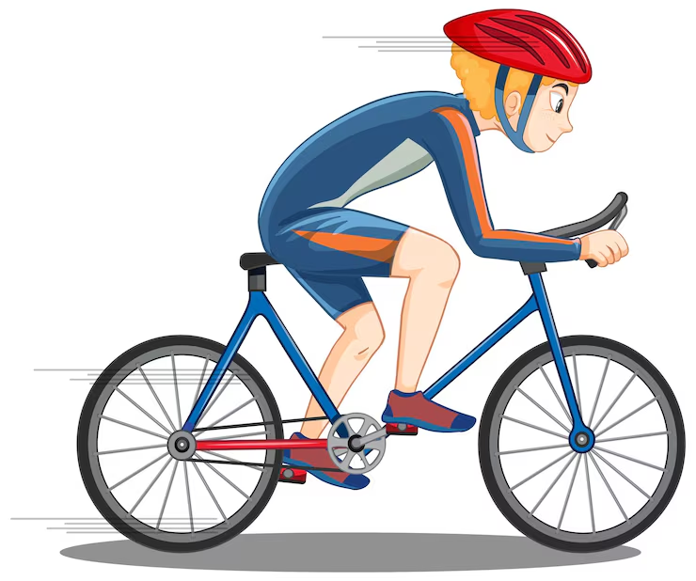
Ride a bike

Slide 12

Baseball

Slide 13
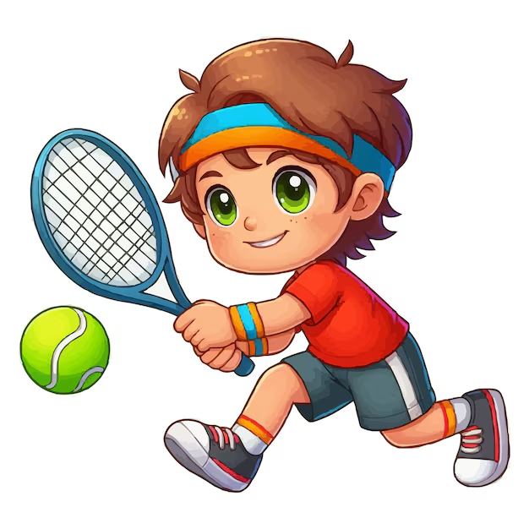
Tennis

Slide 14
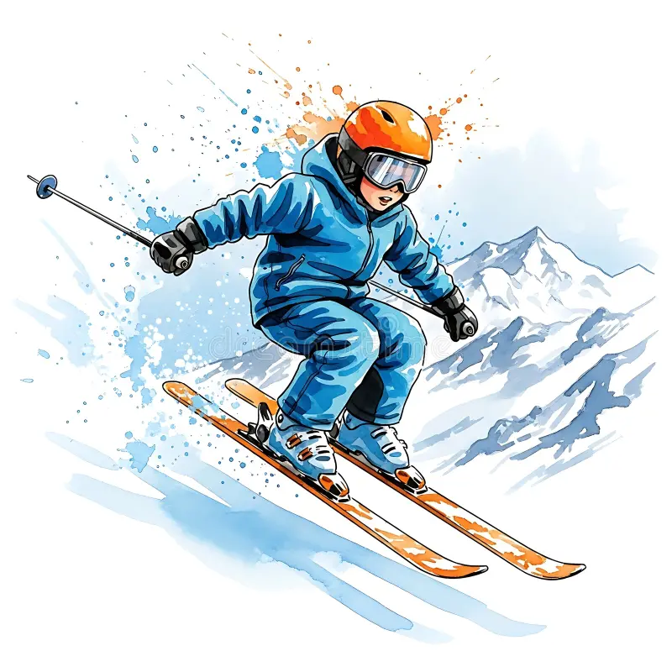
Skiing

Slide 15
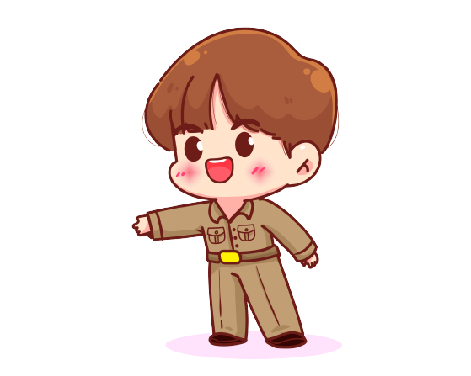

2. Talk about a place you want to visit and activities you want to do.
What cαn we do on the mountαin?
Let's go to the mountαin!

Slide 16
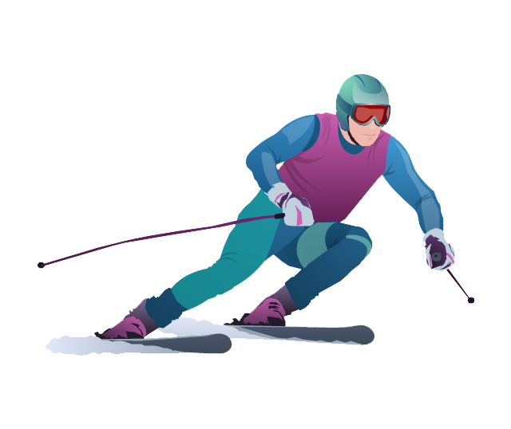
2. Talk about a place you want to visit and activities you want to do.
We cαn ski on the mountαin, but we can't go camping. It's very cold in winter.

Slide 17
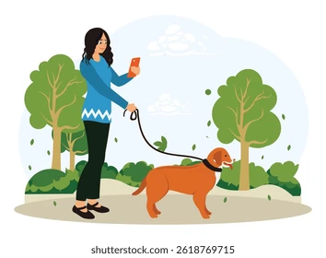
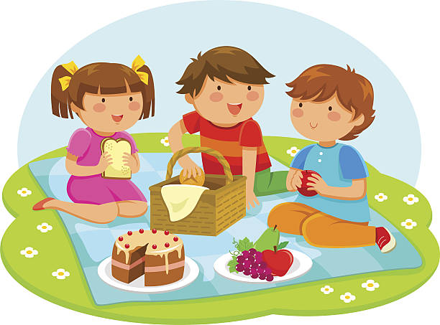
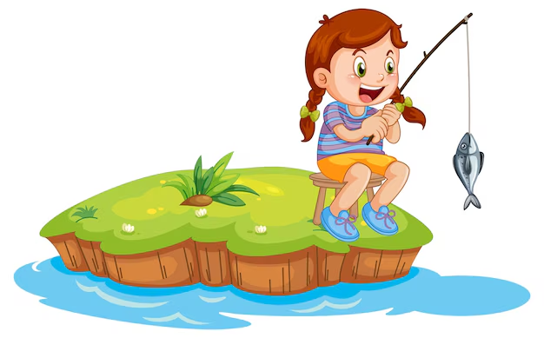
2. Talk about a place you want to visit and activities you want to do.

Slide 18
03
ASSESSMENT

Slide 19
Circle the correct answer
It’s____. We can go swimming.
cold B. hot C. snowy
Can we have a picnic in the _____? Yes, we can.
park B. mountain C. pool
3. What can we do on the mountain? – We can ______.
go hiking B. go swimming C. play football
4. In ice hockey, there are _____ teams.
one B. two C. three

