Slide 1








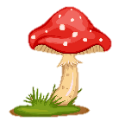
Review 3:
Part 2
Notes:
Để nguyên trang bìa như này, chỉ thay đổi tên bài trong quá trình làm. Logo của sách Wonderful World

Slide 2
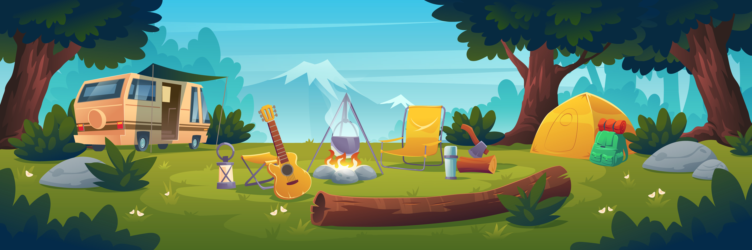

01
WARM-UP

Slide 3
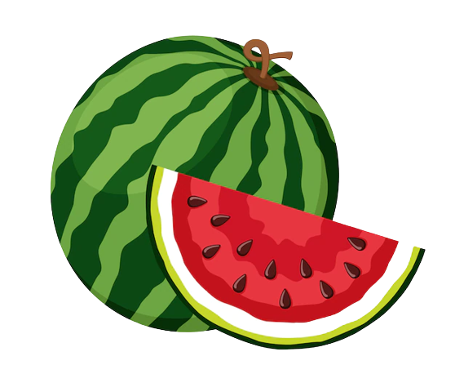





What’s your favourite fruit?

Slide 4
Pick one!
Next

Slide 5

They are _____ a game in the garden.
  playing
back

Slide 6
We can _____ swimming!
  go
back

Slide 7
What can we do ____ the mountain?
  on
back

Slide 8
Where ____ we go camping?
  can
back

Slide 9
We can have a picnic today because it’s _______
  warm / sunny
back

Slide 10
02
PRACTICE

Slide 11
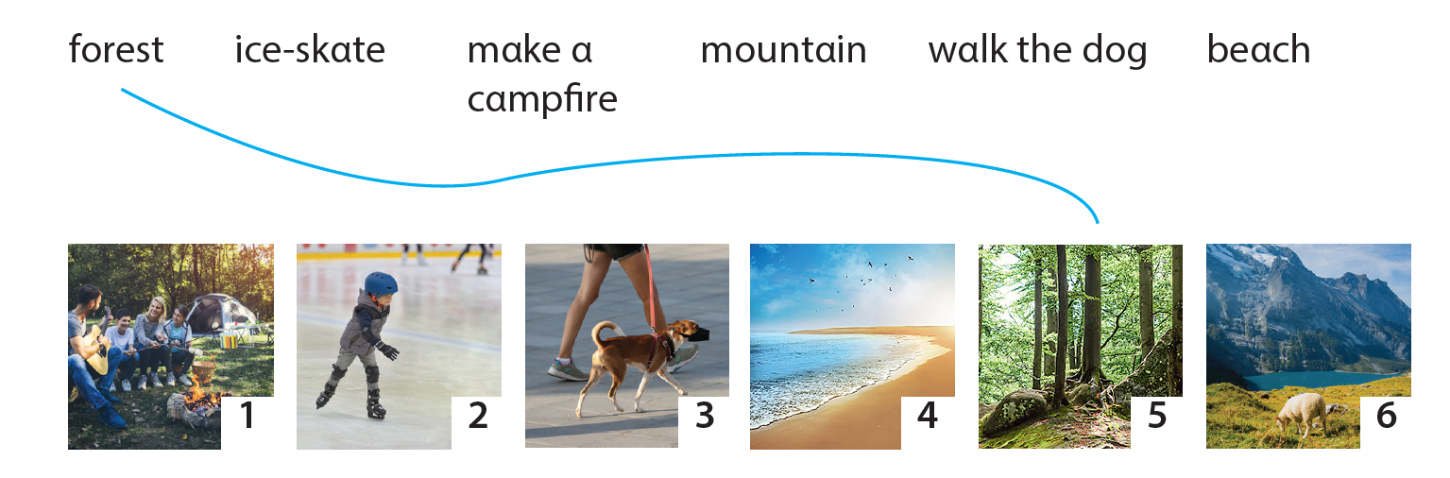
1. Match!
1
2
3
4
6

Slide 12
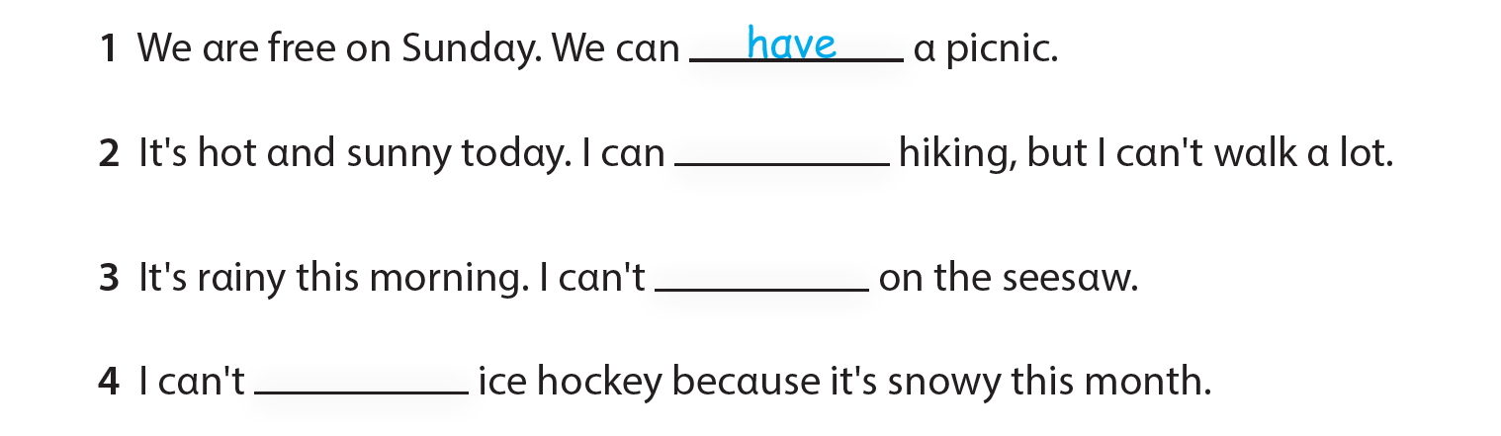
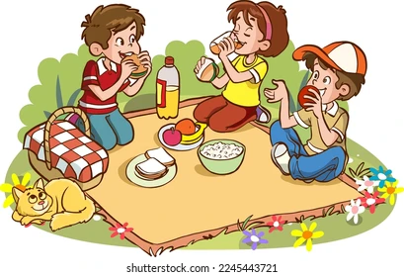
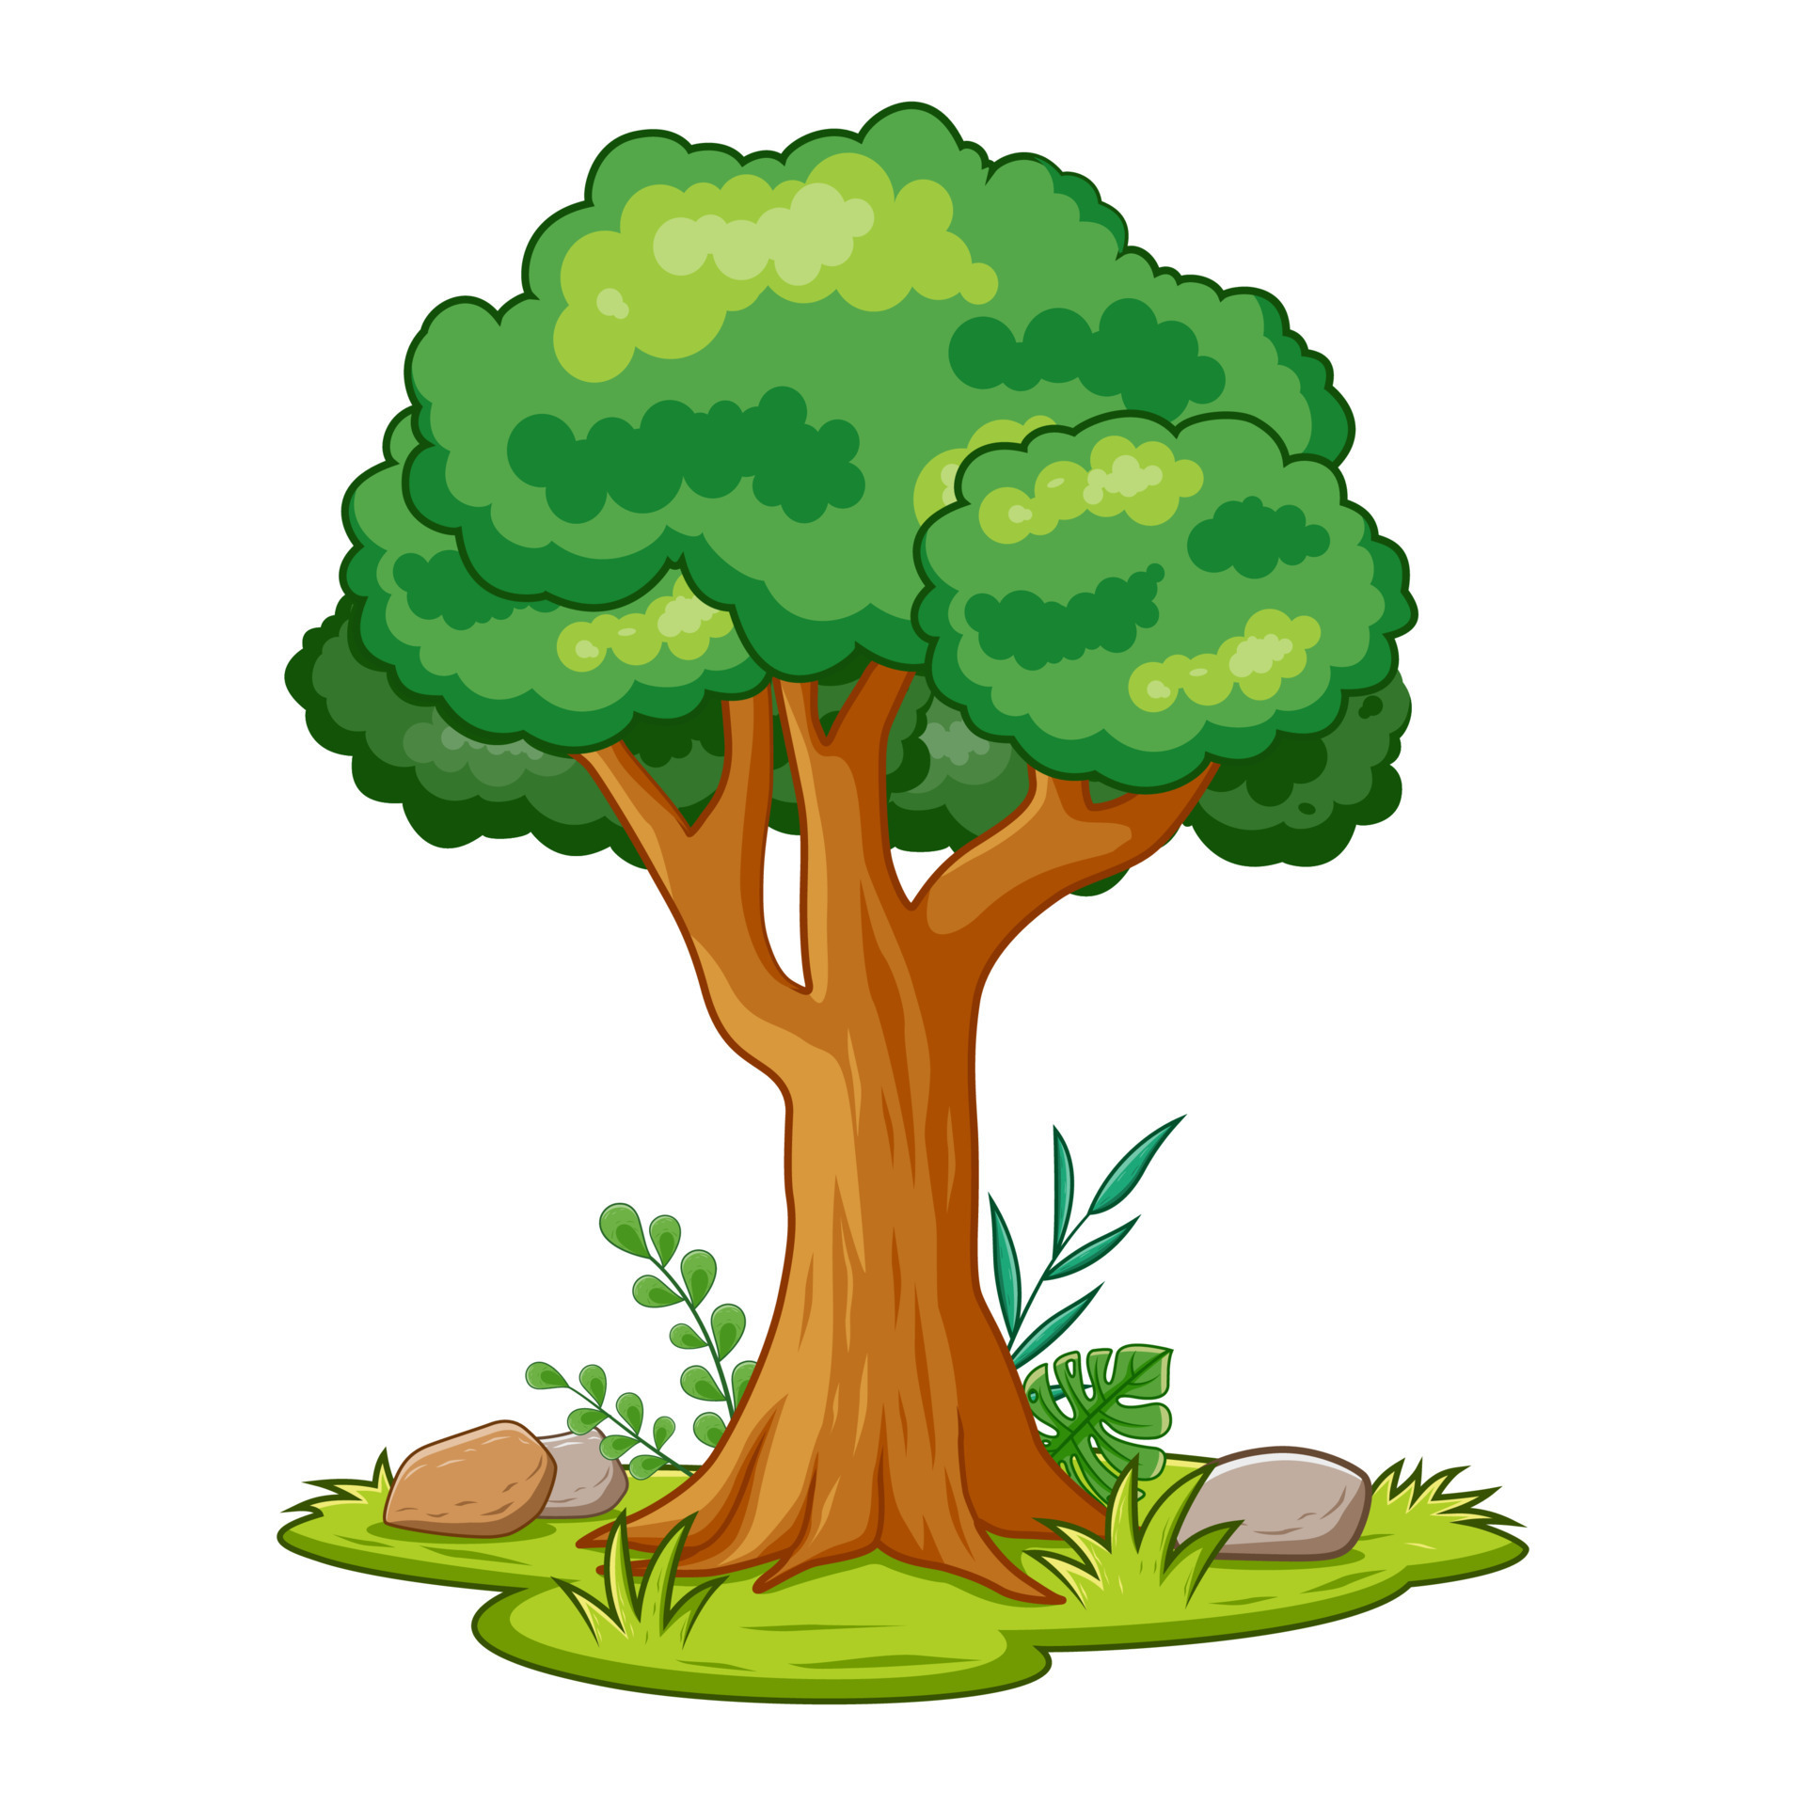

2. Write and Say. Use ONE word for each blank.

Slide 13
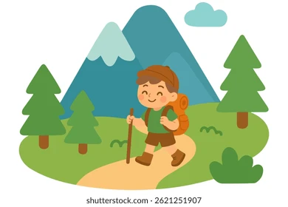
2. Write and Say. Use ONE word for each blank.
go

Slide 14
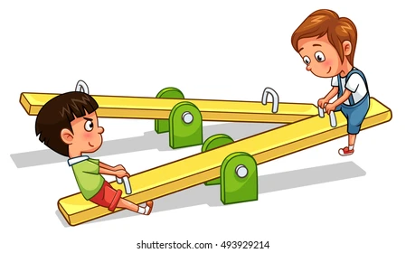
2. Write and Say. Use ONE word for each blank.
play

Slide 15
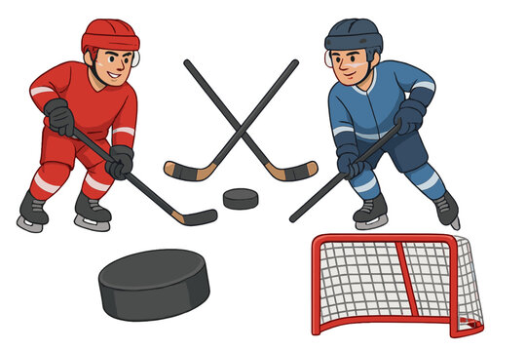
2. Write and Say. Use ONE word for each blank.
play

Slide 16
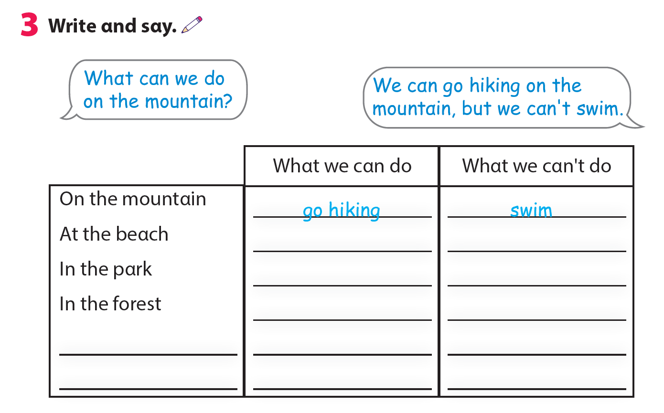
swim
go skiing
have a picnic
go hiking
ride a bike
play ice hockey

Slide 17
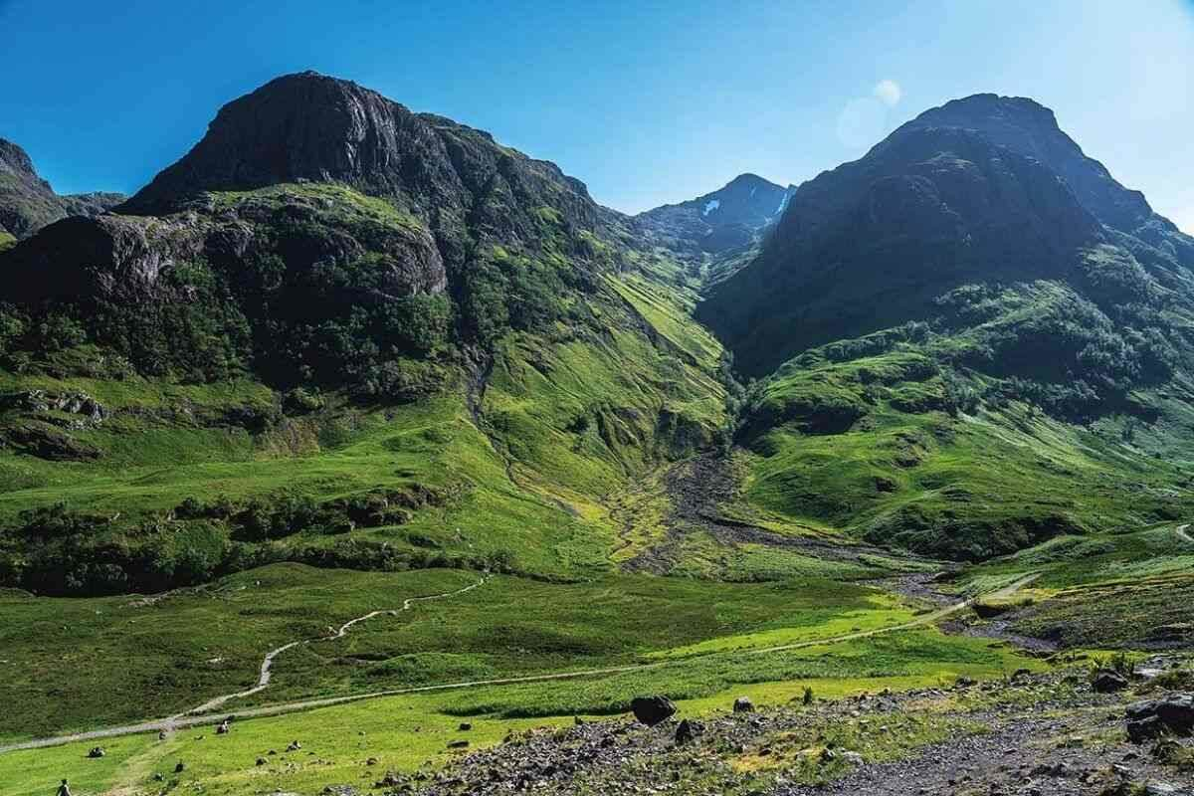
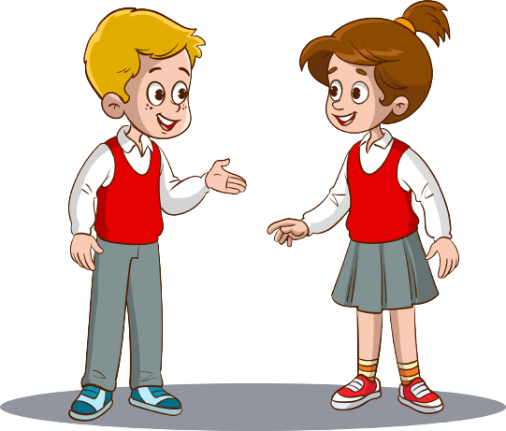
We can go hiking on the mountain, but we can’t swim.
What can we do on the mountain?

Slide 18
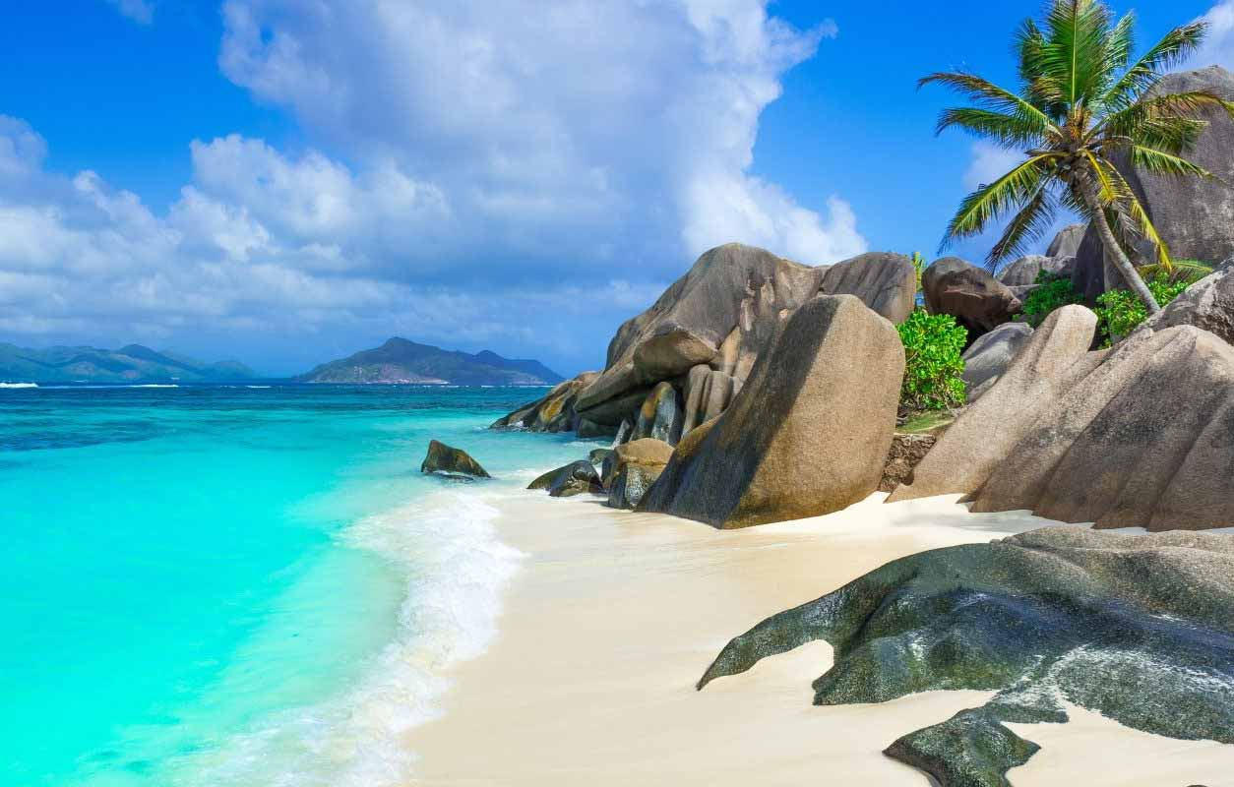
We can swim at the beach, but we can’t go skiing.
What can we do at the beach?

Slide 19
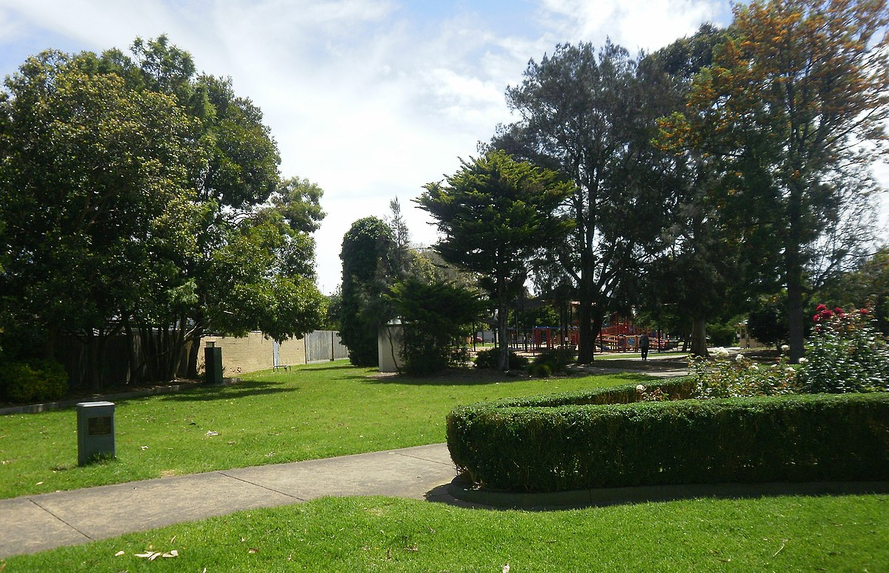
We can have a picnic in the park, but we can’t play ice hockey.
What can we do in the park?

Slide 20
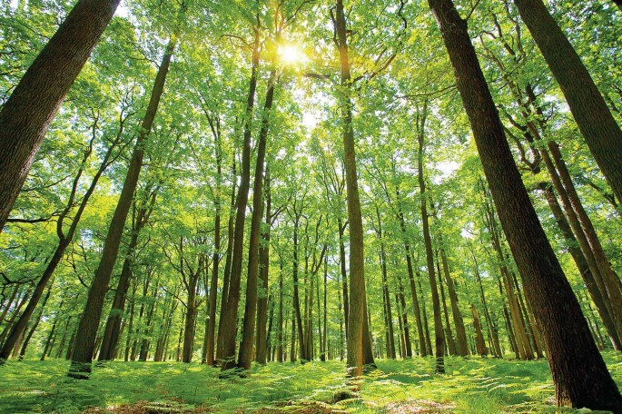
We can ride a bike in the forest, but we can’t swim.
What can we do in the forest?

Slide 21
03
ASSESSMENT

Slide 22
Circle the correct answer
It’s____. We can go skiing.
sunny B. warm C. snowy
Can we go hiking on the _____? Yes, we can.
park B. mountain C. forest
3. We can’t go skiing today because it’s _______.
sunny B. cold C. snowy
4. We can pitch a _______ and have a picnic.
park B. tent C. beach
5. It’s cold today. I’m wearing a ________.
coat B. pool C. forest

Slide 23


Thank you
& goodbye!

