Slide 1









Review 3
Part 1

Slide 2
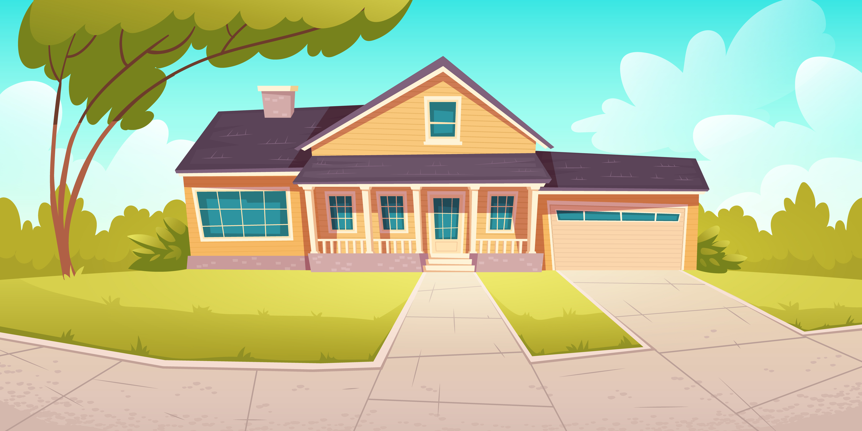
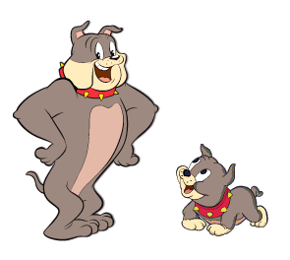
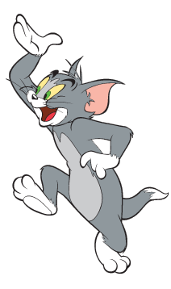
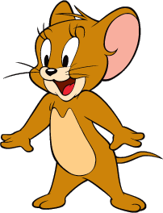
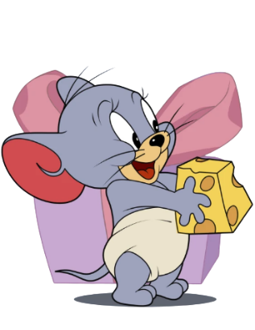
Warm - up
Tom and Jerry Puzzle!

Slide 3

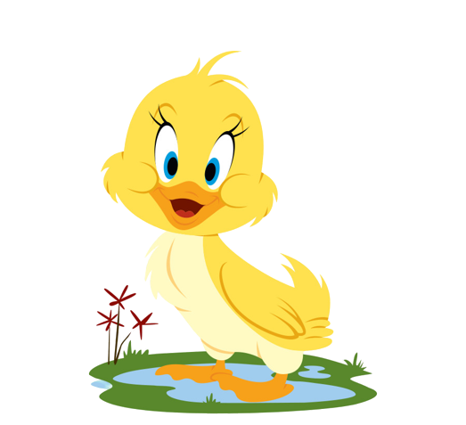
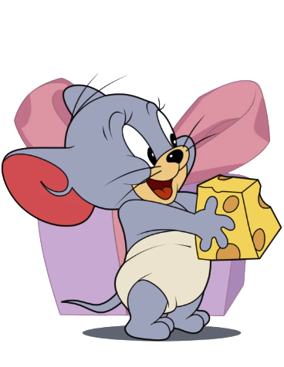
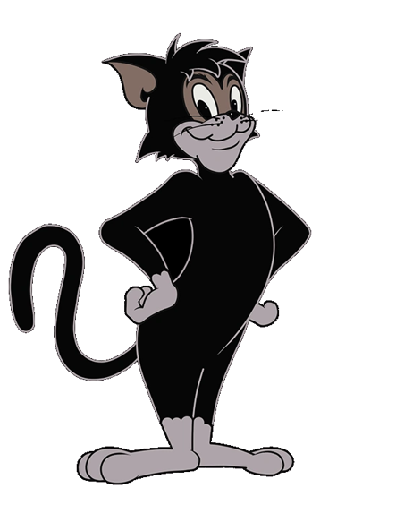
Pick A Character!
Next

Slide 4

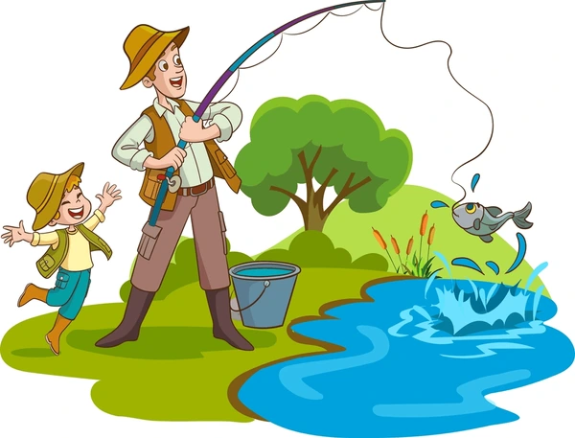
What are they doing?
They are going fishing.
BACK

Slide 5
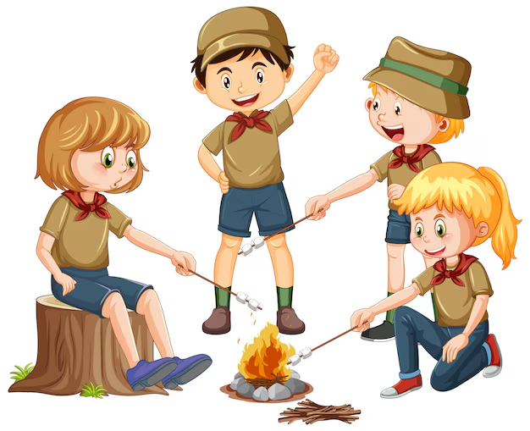
What are they doing?
They are making a campfire.
BACK

Slide 6
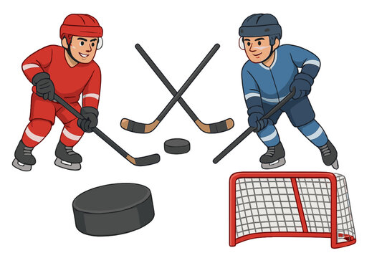
What is he doing?
He is playing ice hockey.
BACK

Slide 7
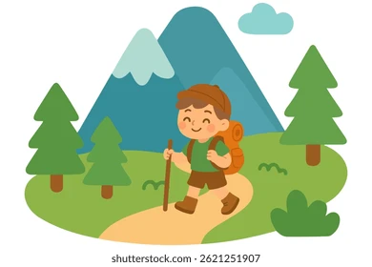
What are they doing?
They are going hiking.
BACK

Slide 8
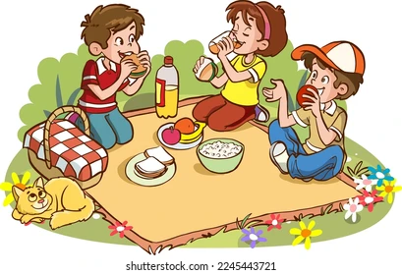
What are they doing?
They are having a picnic.
BACK

Slide 9
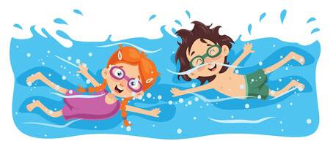
What are they doing?
They are going swimming.
BACK

Slide 10
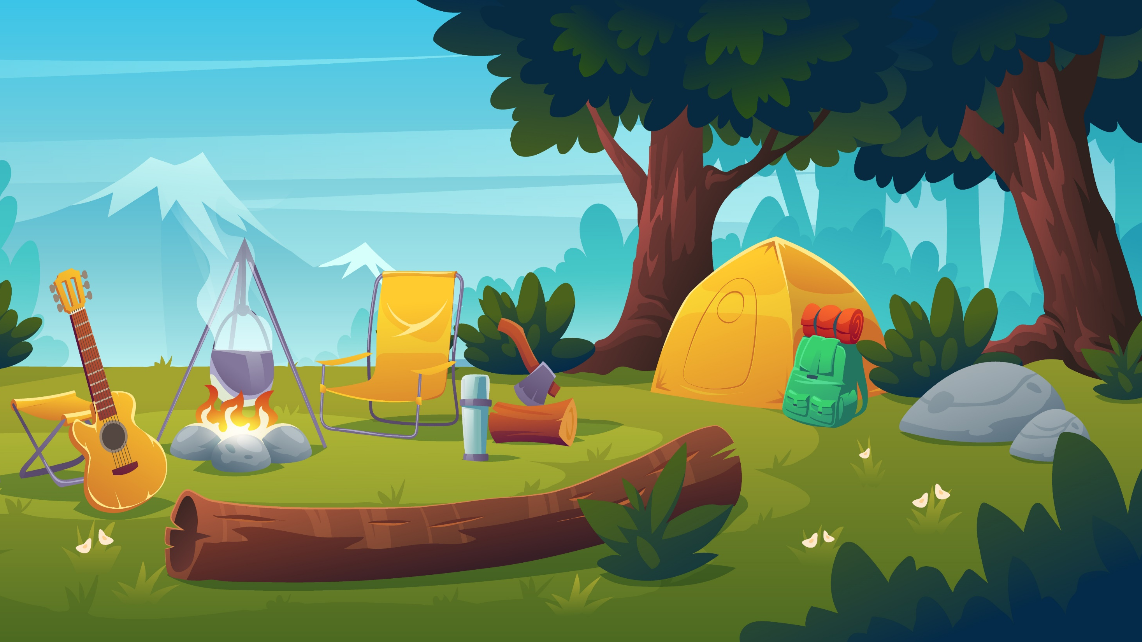
02
PRACTICE

Slide 11

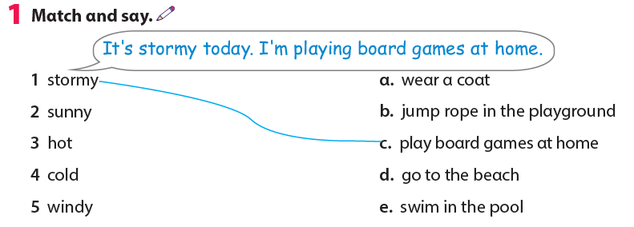

Slide 12
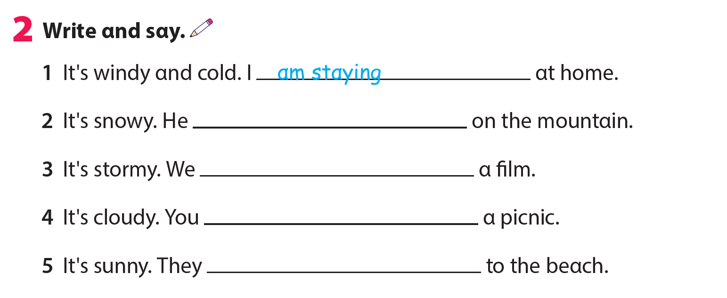
is skiing
are watching
are having
are going

Slide 13
3. Let’s talk!
We can go to the beach today.
It’s cool.
Because it’s warm!
We can go hiking on the mountain.

Slide 14
03
ASSESSMENT

Slide 15

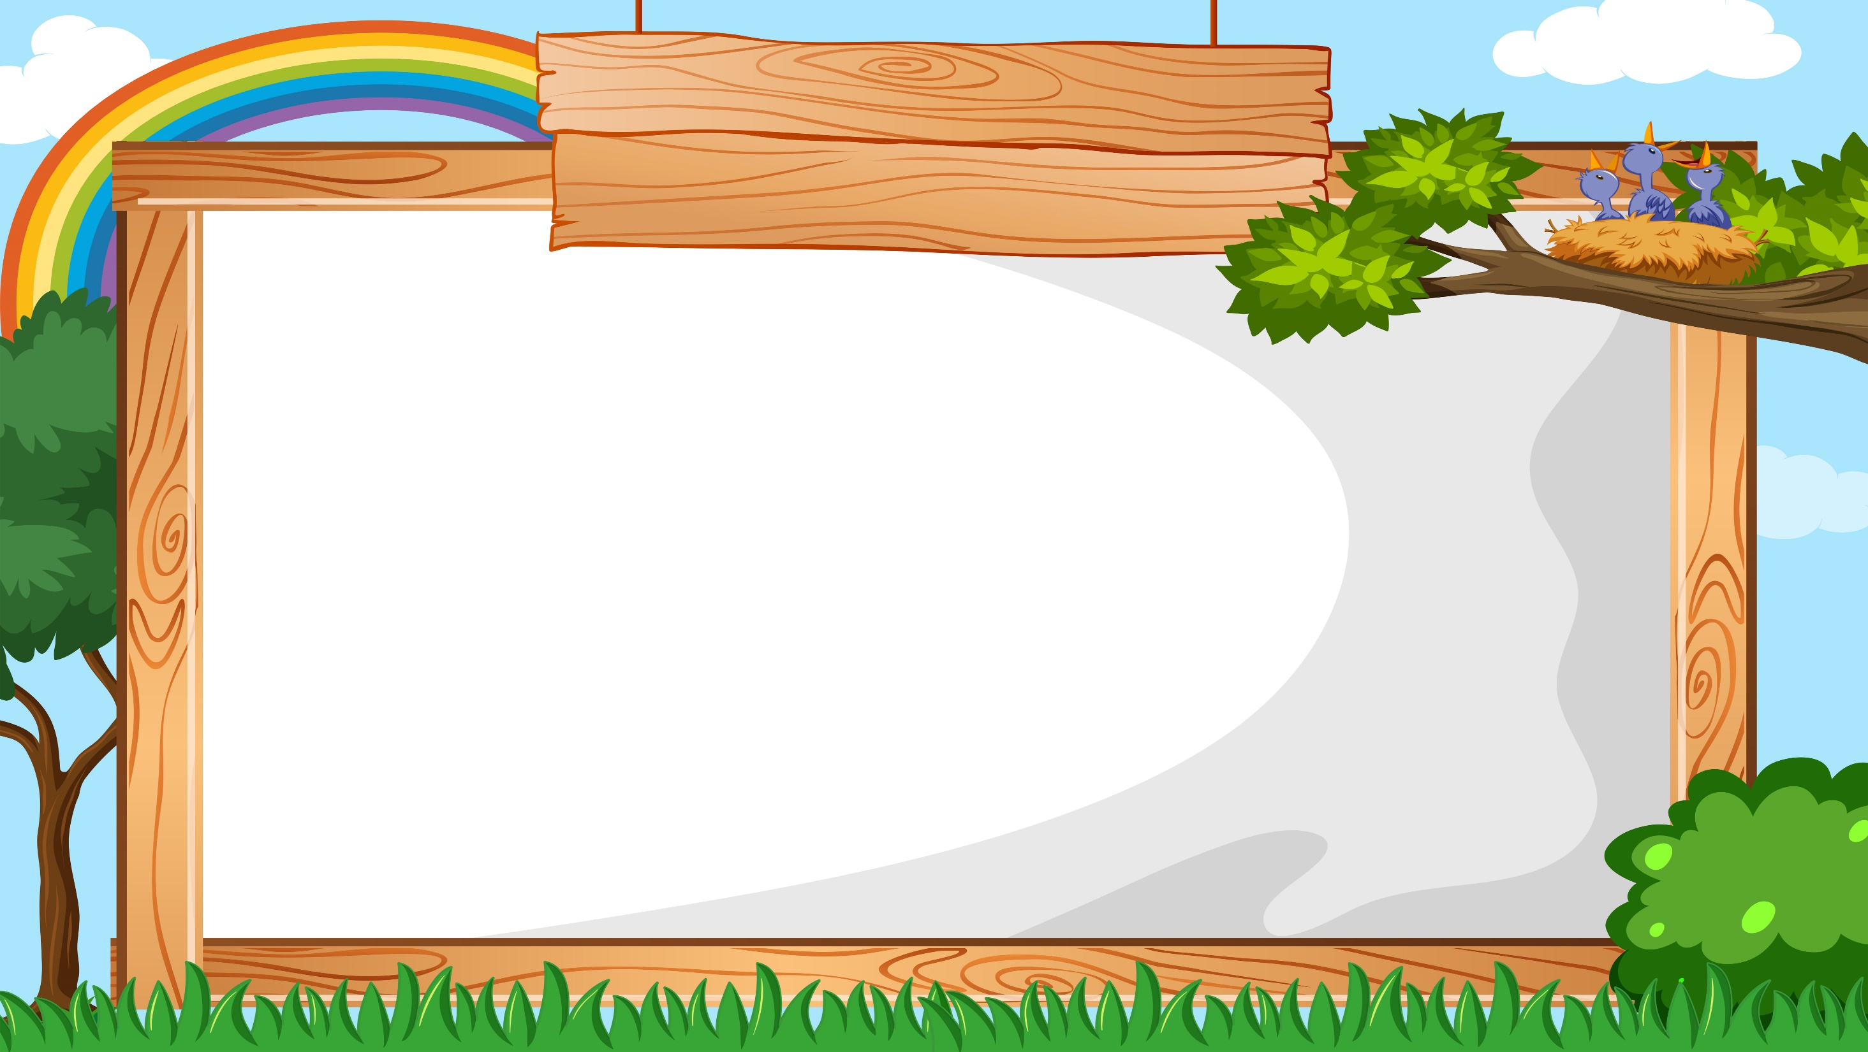
Reorder and write.
1 fishing / go / We / can/ today/ cool/ it’s/ because/.
2 I / sea/ swimming / am / the / in /.
3 do / What / we / park / in / can / the /?
We can go fishing today because it’s cool.
I am swimming in the sea.
What can we do in the park?

Slide 16



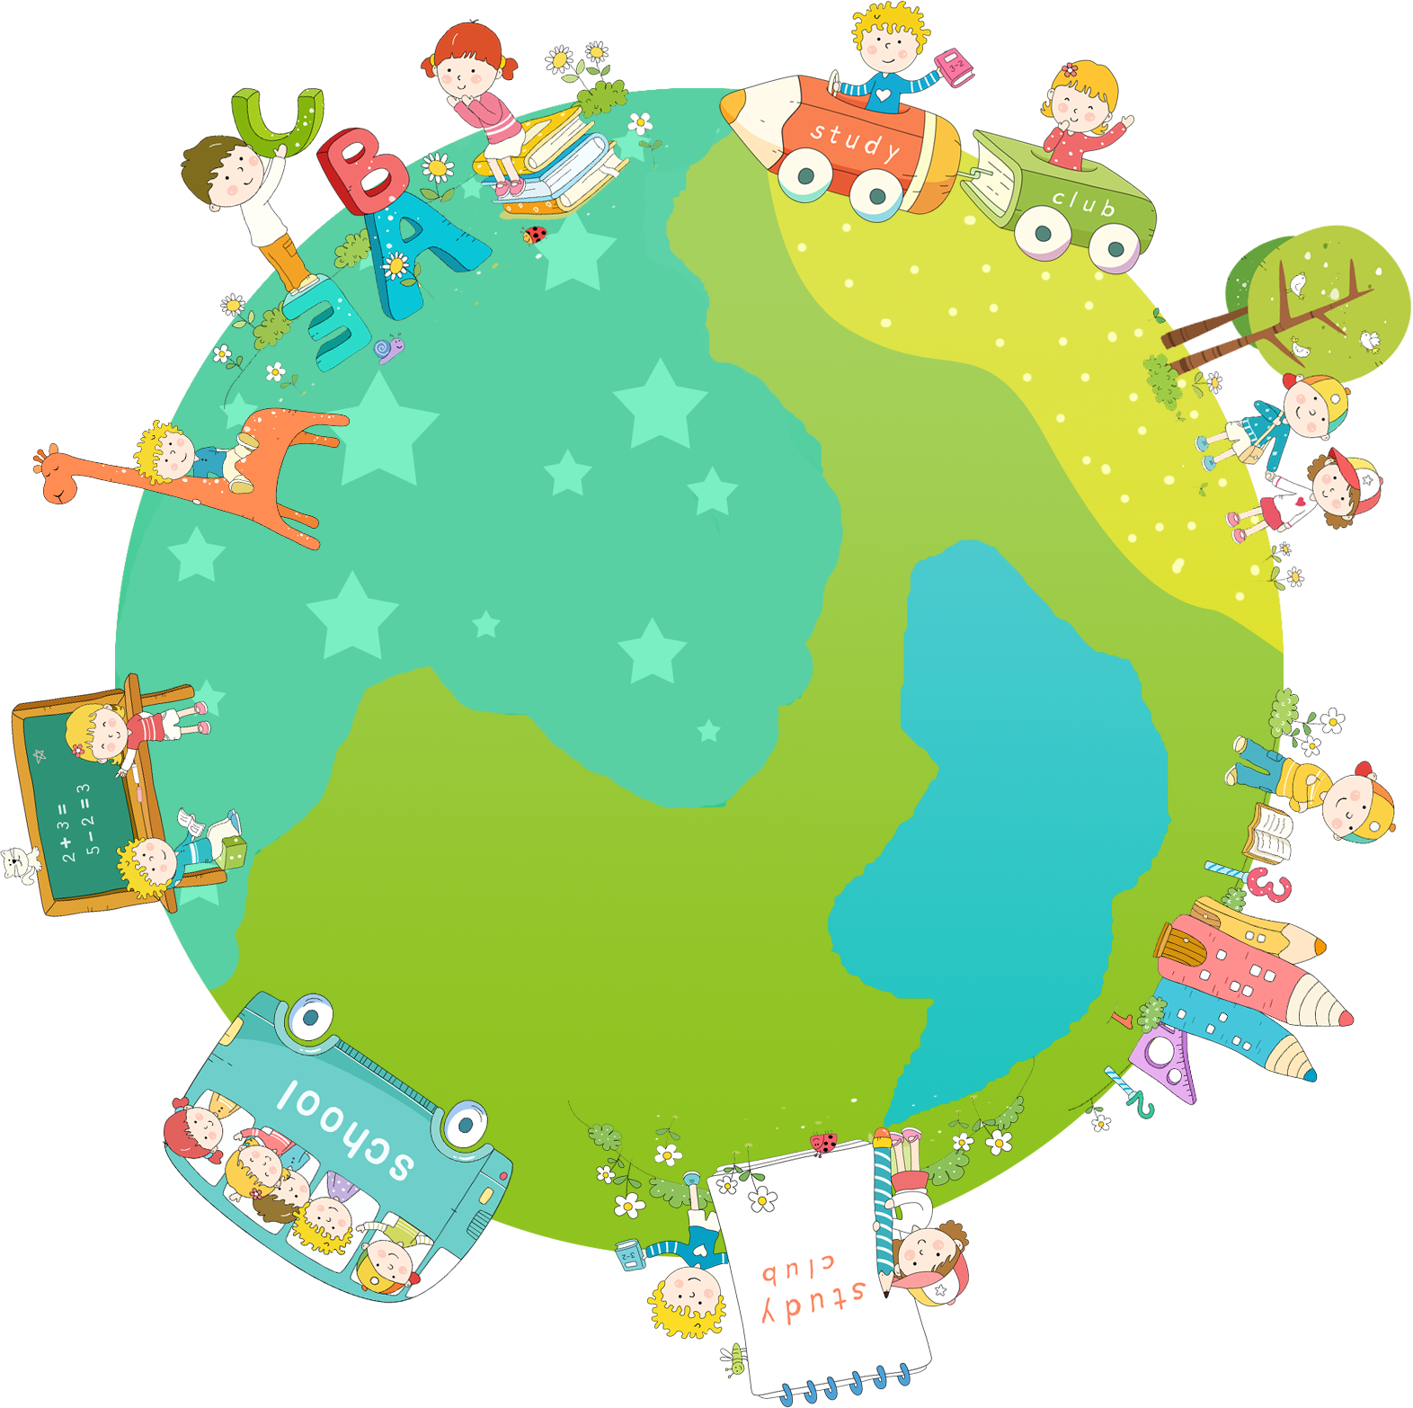

Thank you & goodbye!

