Slide 1


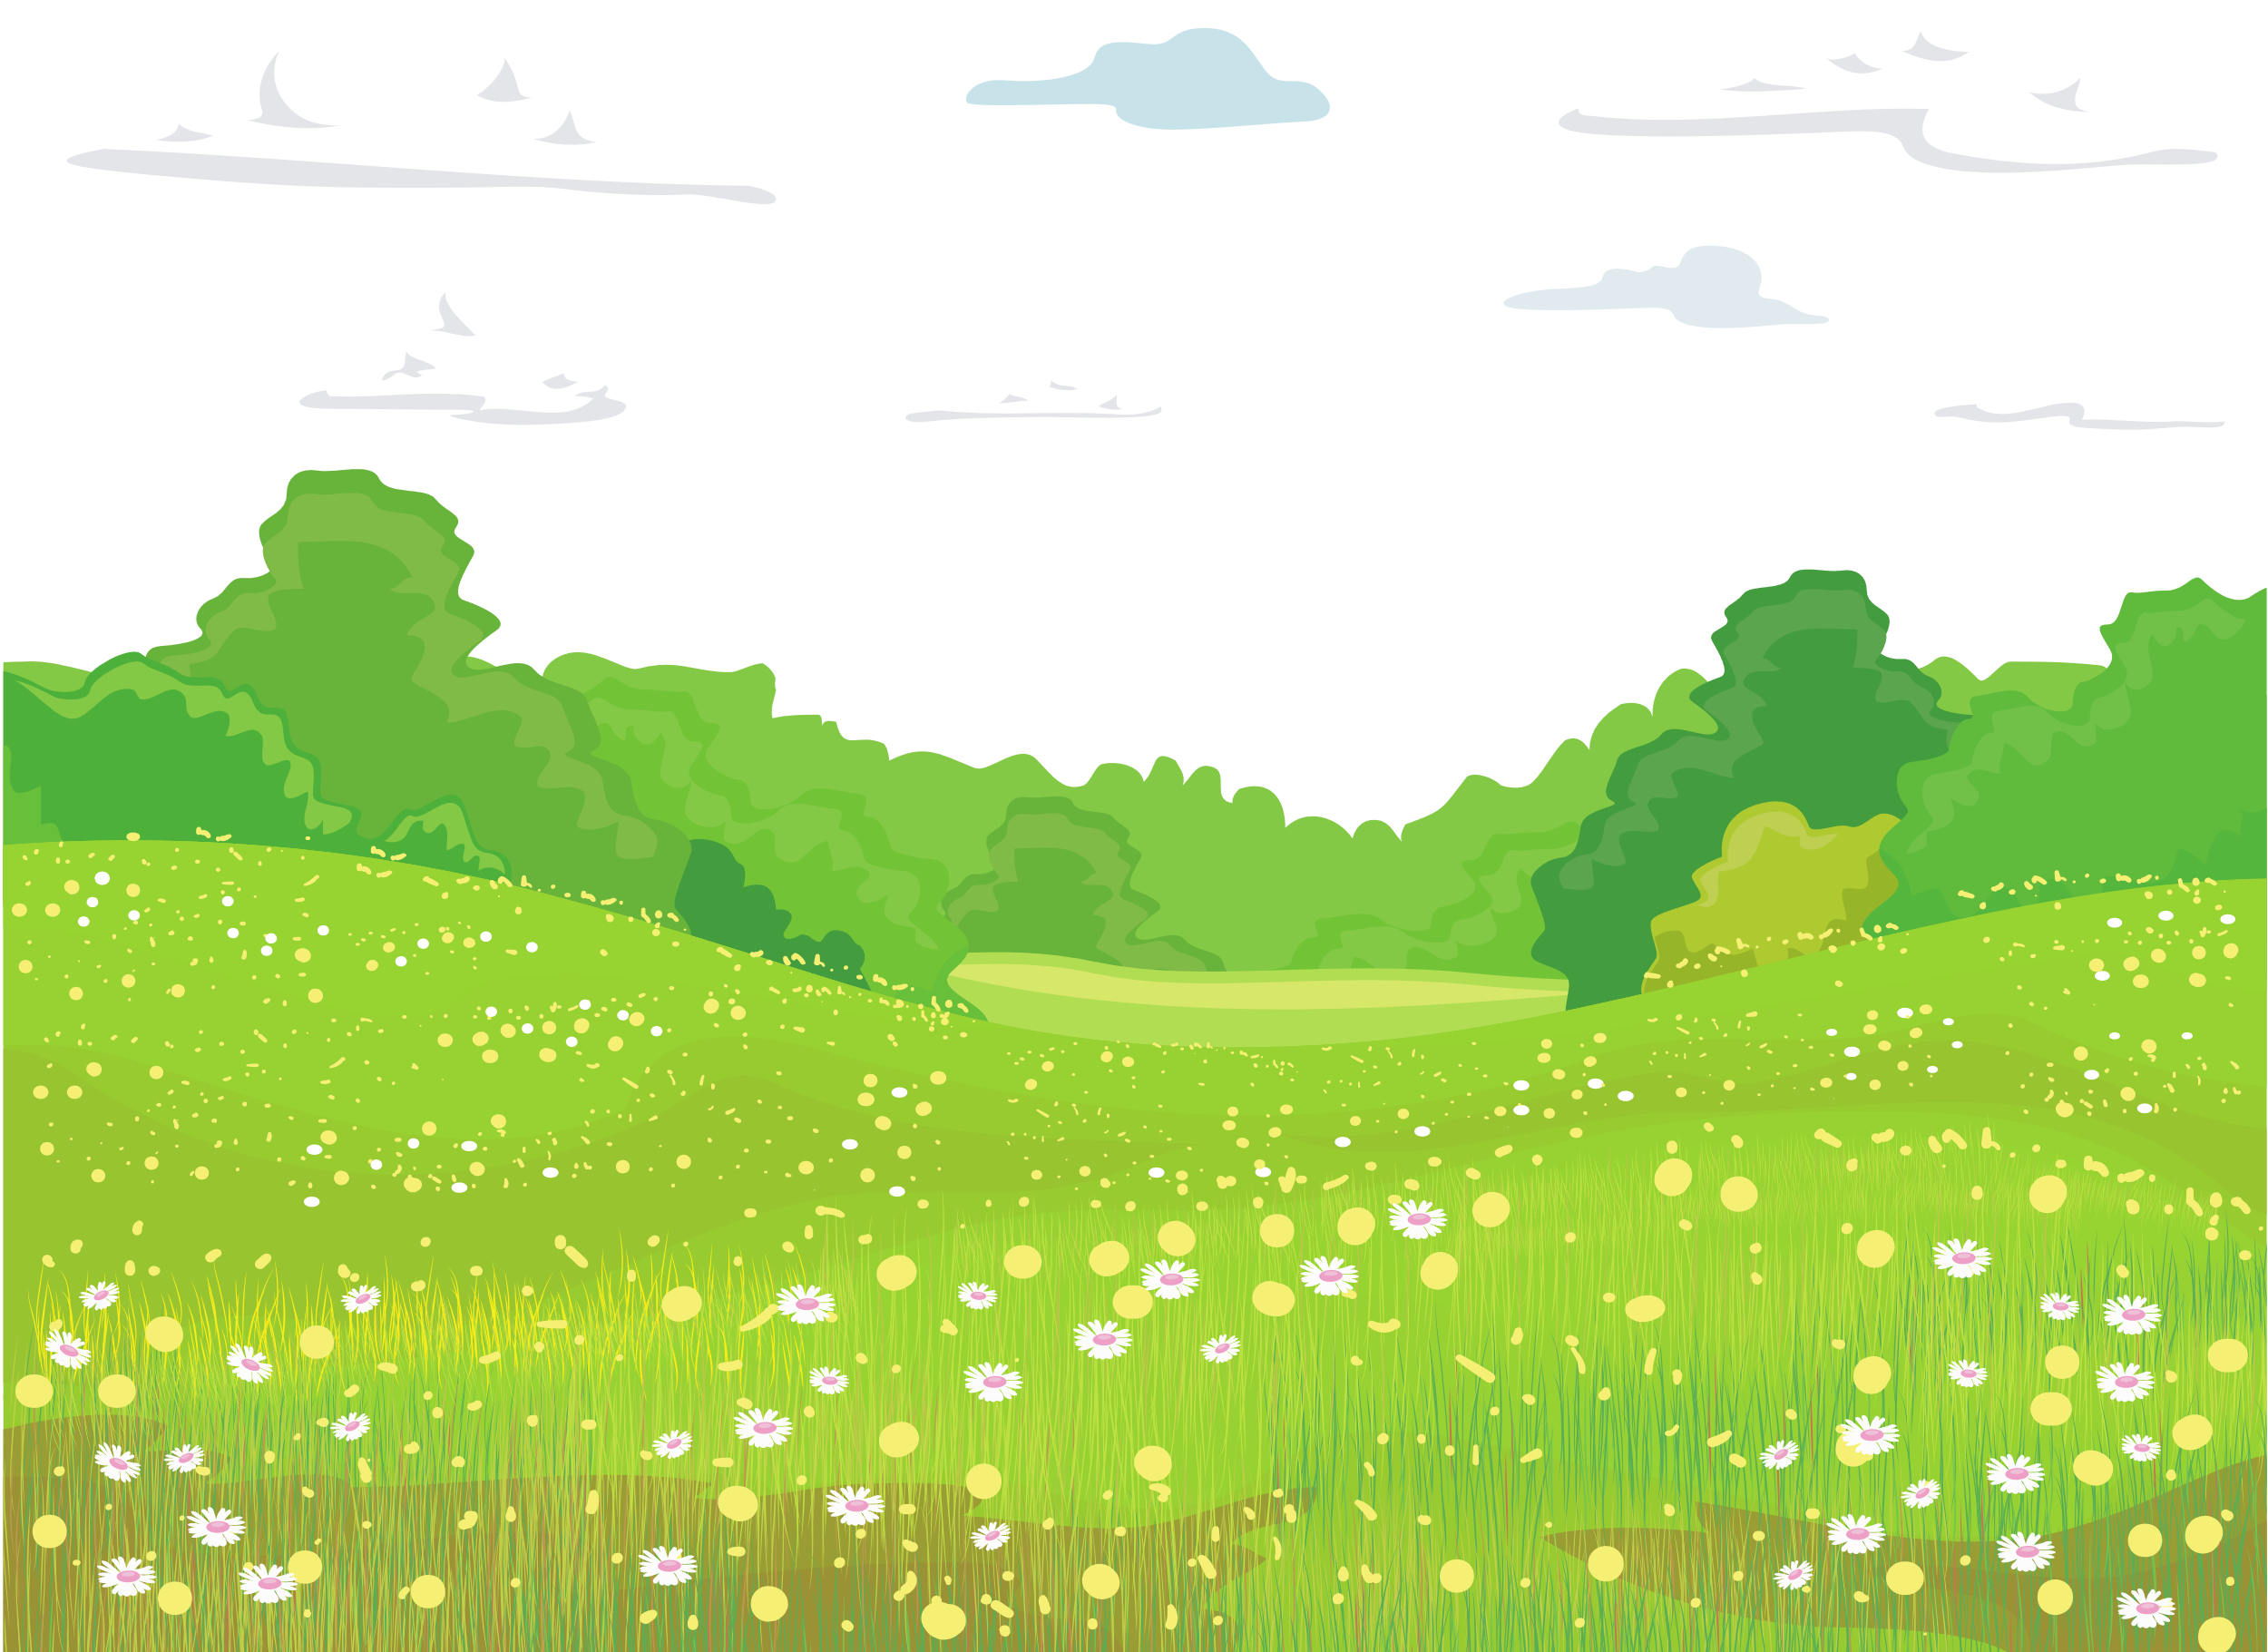
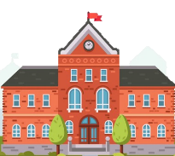



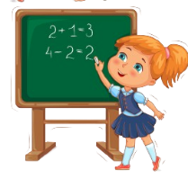



Slide 2

Review 3: Part 4

Slide 3









Table of contents
01
02
03
Warm-up
Presentation
Practice
04
05
Wrap-up &
Assessment
Production

Slide 4
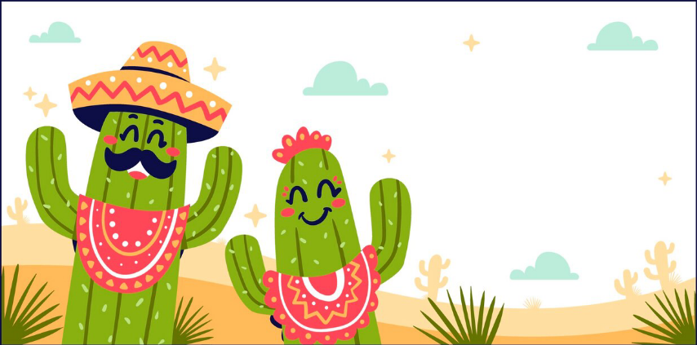
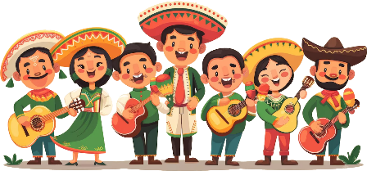
Warm-up
01

Slide 5
Presentation
02

Slide 6






1 Read these descriptions of favourite foods.
Click to start
In Mexico, we’ve got lots of great food. My dad’s got a restaurant, and he makes delicious meals. He also makes a drink with bananas. It’s sweet, and I love it! I like cakes and chocolate. My sister likes them, too. We eat these desserts every week.
Maria, 8, Mexico
We eat a lot of Italian food in my family. It’s great, but my favourite food is eggs and chips. My uncle is from England.
He loves eggs and chips, too. We eat this meal together at my house. My sister doesn’t like eggs, so she usually eats fish or meat.
Benito, 12, Italy
In my family, we eat a lot of fish. My dad buys the fish, and my mum cooks it. I like fish, but it isn’t my favourite food. My favourite meal is chicken and rice. My grandma often makes this meal for me at her house. It’s delicious!
Laura, 10, Australia

Slide 7
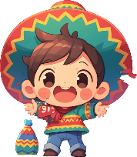
2 Write M (Maria), B (Benito) or L (Laura). Who...
likes a sweet drink?
is crazy about eggs and chips?
eats at his / her grandma’s home?
has a meal at home with his / her uncle?
eats dessert with his / her sister?
M
B
L
B
M

Slide 8



How to talk about your favourite food?
Maria, 8, Mexico
It’s sweet, and I love it! I like cakes and chocolate. My sister likes them, too.
Benito, 12, Italy
My favourite food is eggs and chips. My uncle is from England. He loves eggs and chips, too. My sister doesn’t like eggs, so she usually eats fish or meat.
Laura, 10, Australia
I like fish, but it isn’t my favourite food. My favourite meal is chicken and rice. It’s delicious!

Slide 9
Practice
03

Slide 10
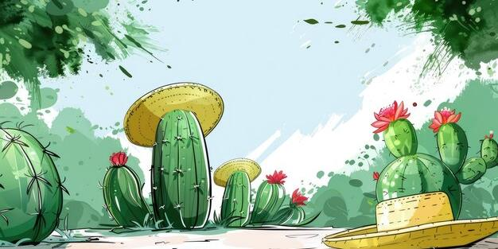
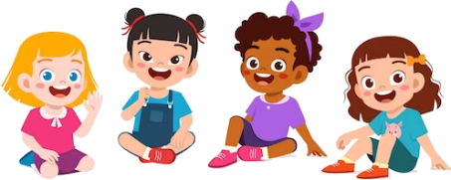
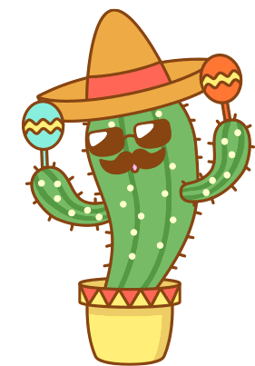
Let’s check.
In Mexico, we’ve got lots of great food. My dad’s got a restaurant, and he makes delicious meals. He also makes a drink with bananas. It’s sweet, and I love it! I like cakes and chocolate. My sister likes them, too. We eat these desserts every week.
Does she like the drink with bananas?
How are Maria’s dad meals?

Slide 11
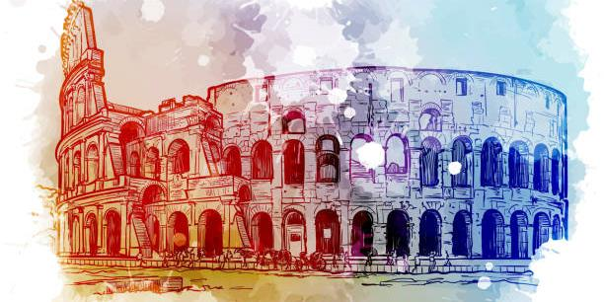

Let’s check.
We eat a lot of Italian food in my family. It’s great, but my favourite food is eggs and chips. My uncle is from England. He loves eggs and chips, too. We eat this meal together at my house. My sister doesn’t like eggs, so she usually eats fish or meat.
Who does he have meal with?
What is Benito’s favourite food?

Slide 12
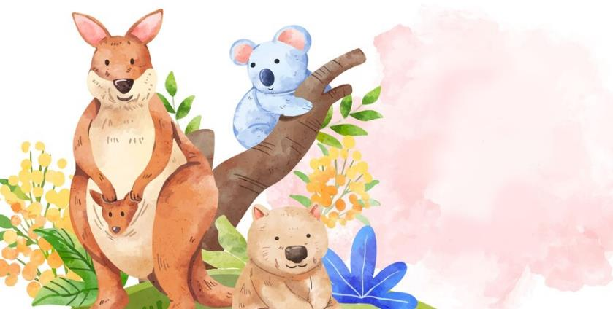
Let’s check.
In my family, we eat a lot of fish. My dad buys the fish, and my mum cooks it. I like fish, but it isn’t my favourite food. My favourite meal is chicken and rice. My grandma often makes this meal for me at her house. It’s delicious!
Is fish her favourite food?
Does Laura like fish?

Slide 13
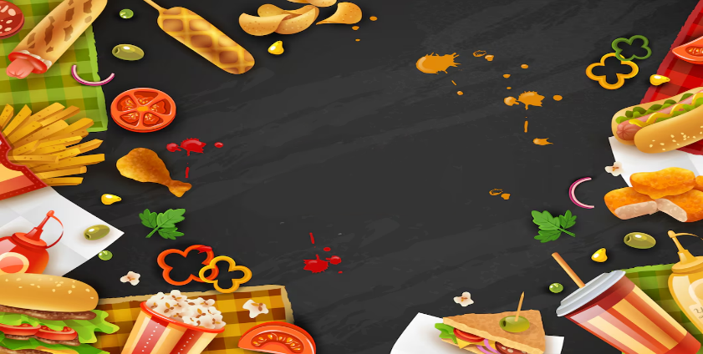
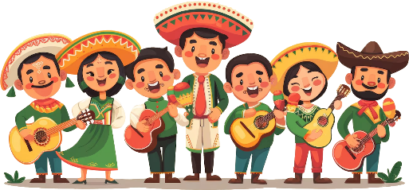


Food riddles
Read the clues and guess the name of these food!!

Slide 14

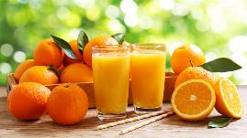



I am orange.
5
I am liquid.
10
I am a drink made from oranges.
15
I am orange juice.

Slide 15
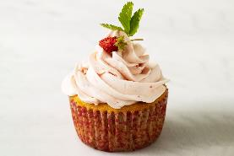
I am a small cake that is like a cup in shape.
5
10
I have icing on top.
I am made of flour, butter, sugar, and egg.
15
I am cupcake.

Slide 16
Production
04

Slide 17
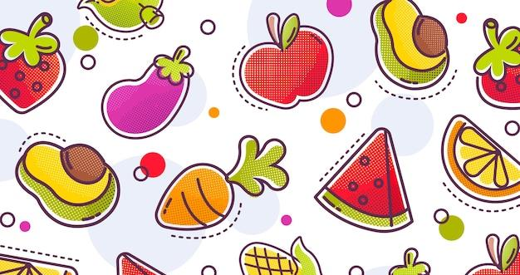
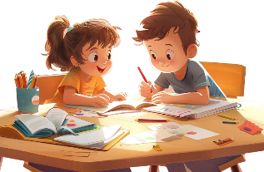
3 Write and say.
Write about your favourite dessert. Then share with your friend.
Let’s answer some questions below.
1. What is your favourite dessert?
2. Why do you like it?
3. Who makes it for you?
4. What are your favourite flavours?
5. How often do you eat it?
6. Who do you eat it with?

Slide 18
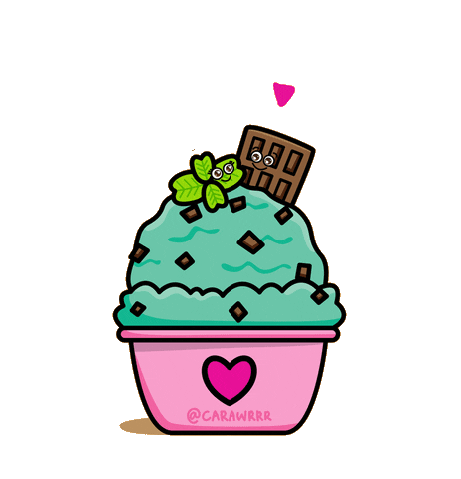

3 Write and say.
Ice cream is my favourite dessert because it’s delicious, sweet and cold. I often eat it with a spoon or in a cone. I eat ice cream a lot in summer. There are many flavours like strawberry, lemon, chocolate and vanilla, and they all taste really good.

Slide 19
Wrap-up &
Assessment
05

Slide 20
Listen and fill in the blanks.
In Mexico, we’ve got lots of great food. My dad’s got a restaurant, and he makes ________ meals. He also makes a drink with bananas. It’s sweet, and I love it! I ____ cakes and chocolate. My sister likes them, too. We eat these desserts every week.
delicious
like
favourite
We eat a lot of Italian food in my family. It’s great, but my _________ food is _____________. My uncle is from England.
He ______ eggs and chips, too. We eat this meal together at my house. My sister doesn’t like eggs, so she usually eats fish or meat.
egg and chips
loves
In my family, we eat a lot of fish. My dad buys the fish, and my mum cooks it. I _____ fish, but it isn’t my favourite food. My _________ meal is chicken and rice. My grandma often makes this meal for me at her house. It’s ___________!
like
favourite
delicious

Slide 21


Review 3
What have we learnt today?
My favourite food
- My favourite food is ___.
- It’s ____.
- I often eat it with ___.
- I often eat it in ___.

