Slide 1



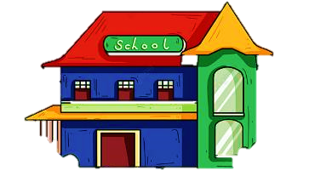
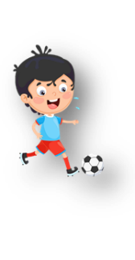


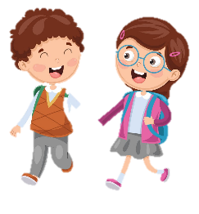



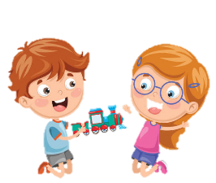





Notes:
Để nguyên trang bìa như này, chỉ thay đổi tên bài trong quá trình làm. Logo của sách Wonderful World

Slide 2
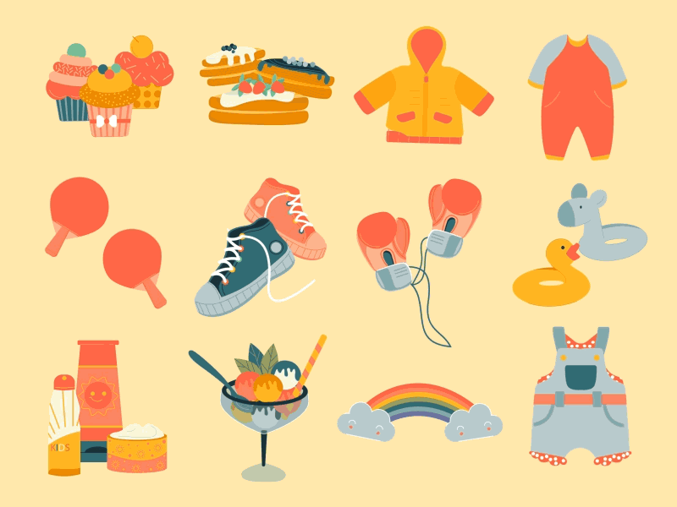



Unit 5
My clothes
Lesson 1 – Task 4,5,6

Slide 3



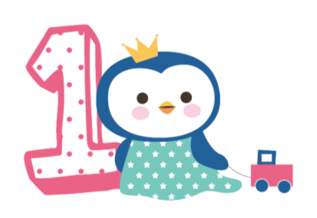



Warm up
Song: Hello song

Slide 4

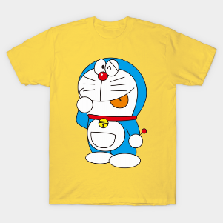
My name starts with ‘T’.
You wear me in summer.
Nothing here ☹
Nothing here ☹
T-shirt
Notes:
Bấm vào các note chữ màu vàng sẽ hiện ra clue để hs đoán từ vựng
T-Shirt

Slide 5
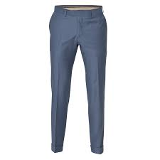
I’m always in plural form.
I am often blue.
I am your uniform.
My name has 8 letters.
trousers
Notes:
Bấm vào các note chữ màu vàng sẽ hiện ra clue để hs đoán từ vựng
Trousers

Slide 6
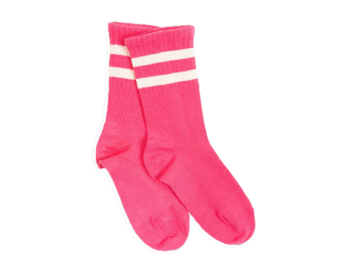
I keep you warm.
Nothing here 😐
My name starts with ‘s’.
I always come in pair.
socks
Notes:
Bấm vào các note chữ màu vàng sẽ hiện ra clue để hs đoán từ vựng
Socks

Slide 7
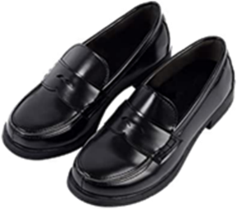
Nothing here😐
I come in pair.
I am a footwear.
I love your feet.
shoes
Notes:
Bấm vào các note chữ màu vàng sẽ hiện ra clue để hs đoán từ vựng
Shoes

Slide 8
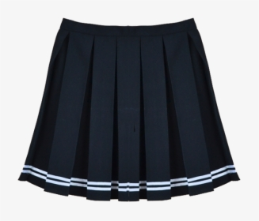
My name ends with ‘t’.
Nothing here😐
I can be long or short.
Only girls wear me.
skirt
Notes:
Bấm vào các note chữ màu vàng sẽ hiện ra clue để hs đoán từ vựng
Skirt

Slide 9


Presentation
Task 4: Listen and repeat.

Slide 10

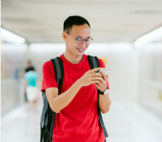
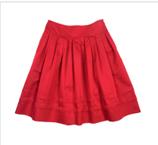
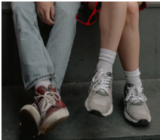

Listen and repeat.
‘ve got = have got
1. I’ve got a Tshirt.
My T-shirt is red.
2. You’ve got a skirt. Your skirt is nice.
3. They’ve got shoes. Their shoes are old.

Slide 11
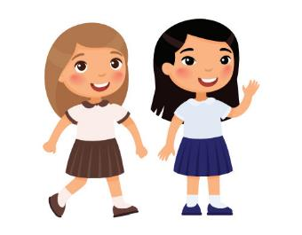
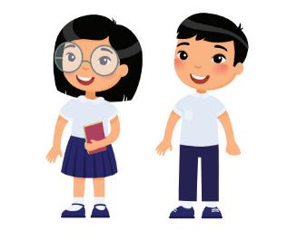
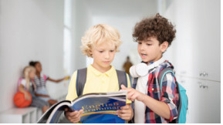
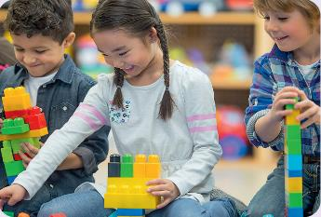
Who’s faster?
They have got skirts. Their skirts are brown and blue.
They have got T-shirts. Their T-shirts are white.
They have got books. Their books are blue.
They have got toys. Their toys are yellow and blue.

Slide 12

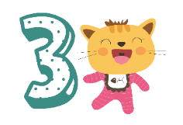
Practice
Task 5: Look and say

Slide 13
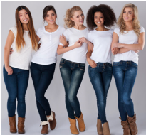
A. They’ve got T-shirts.
Their T-shirts are white
B.They has got T-shirts. Their T-shirt are white.
1 They / T-shirts / white
Notes:
TƯƠNG TÁC:
They/ T-shirts/ white.
They’ve got T-shirts. Their T-shirts are white.
They has got T-shirts. Their T-shirts are white.

Slide 14
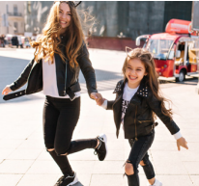
a. My sisters are trousers. Their trousers are black
b. My sisters have got trousers.
Their trousers are black.
2 My sisters / trousers / black
Notes:
TƯƠNG TÁC:
2 My sisters / trousers / black
a. My sisters are trousers. Their trousers are black.
b. My sisters have got trousers. Their trousers are black.

Slide 15
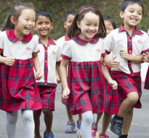
They skirt are red.
They have got skirts. Their skirts are red.
3 They / skirts / red
Notes:
TƯƠNG TÁC:
3. They / skirts / red
They skirts are red.
They have got skirts. Their skirts are red.

Slide 16
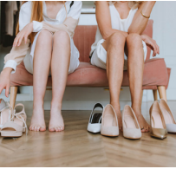
Lan and Hoa have got shoes. Their shoes is nice
Lan and Hoa have got shoes. Their shoes are nice.
4 Lan and Hoa / shoes / nice
Notes:
TƯƠNG TÁC:
4. Lan and Hoa / shoes / nice
a. Lan and Hoa have got shoes. Their shoes is nice.
b. Lan and Hoa have got shoes. Their shoes are nice.

Slide 17
Write and say
        1 I’ve got _____ . My _____ is _____ .
        2 My father and mother have got_____ .
        Their____ are____ .
        3 My brother and sister have got_____ .
        Their____ are____ .
        4 My friends have got_____ .
        Their____ are______ .
a pencil
pencil
green

Slide 18
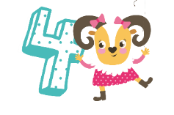
Production

Slide 19
The longest sentence
 | trousers/ blue/… | T-shirt | skirts/….
I have got
My friends have got
…..

Slide 20
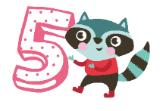
Assessment
Choose the correct answer!

Slide 21


Choose the correct answer
1. I’ve got new shoes. _____ shoes are cool. A. They B. My
2. Lan and Lisa’ve got lots of toys. They love _____ toys.
A. their B. you
3. Your T-shirt is black and ____ shoes are black, too.
A. your B. you
Notes:
THIẾT KẾ HOẠT ĐỘNG TƯƠNG TÁC CHO 3 CÂU NÀY

Slide 22




Good bye.
See you again!

