Slide 1
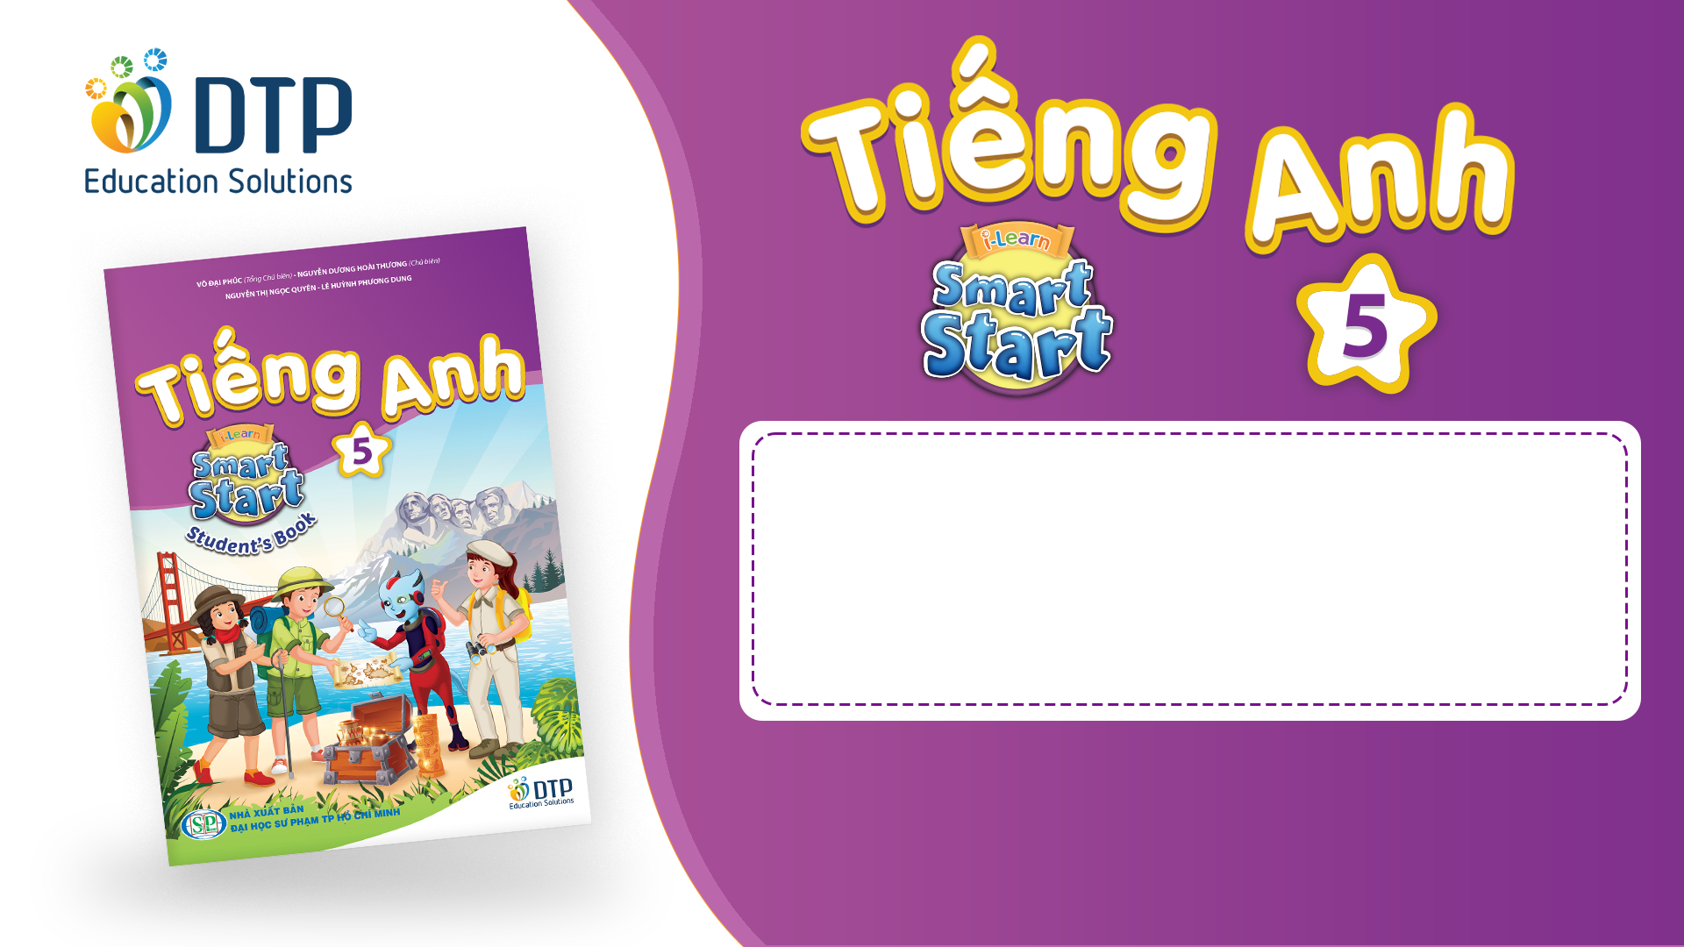
Unit 7: JOBS
Lesson 2.2
Page 96

Slide 2
Objectives
By the end of this lesson, students will be able to practice intonation, the target language and the conversations about future jobs.
Pronunciation: word stress for 2-syllable nouns ending in ‘-er’
Structure: Tom likes sports. I think he’ll be a soccer player.

Slide 3

WARM-UP

Slide 4
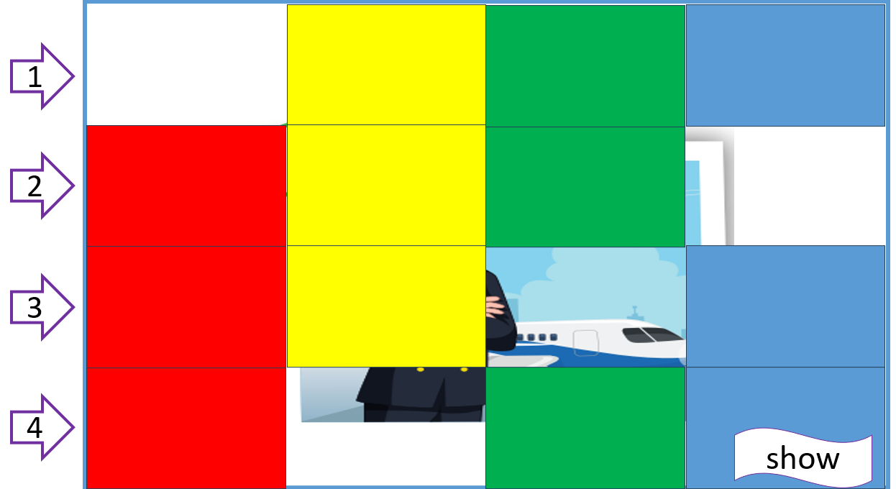
Let’s play!
What’s hidden?

Slide 5
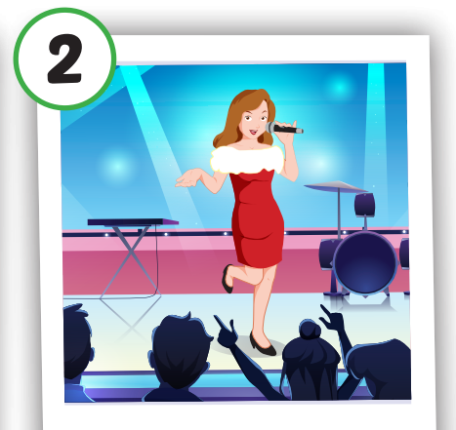
singer
1
2
3
4
show
1

Slide 6
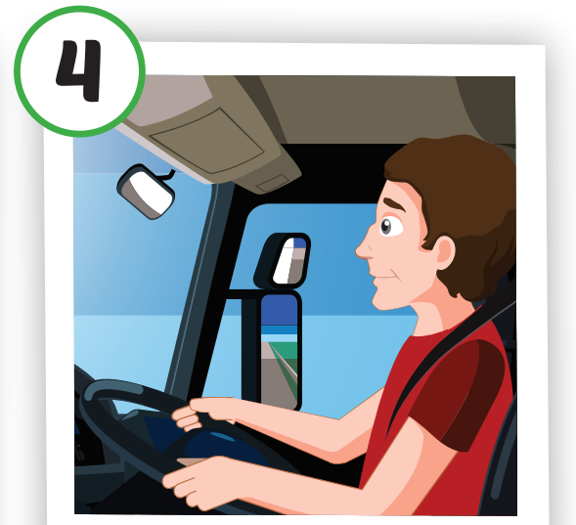
driver
1
2
3
4
show
2

Slide 7
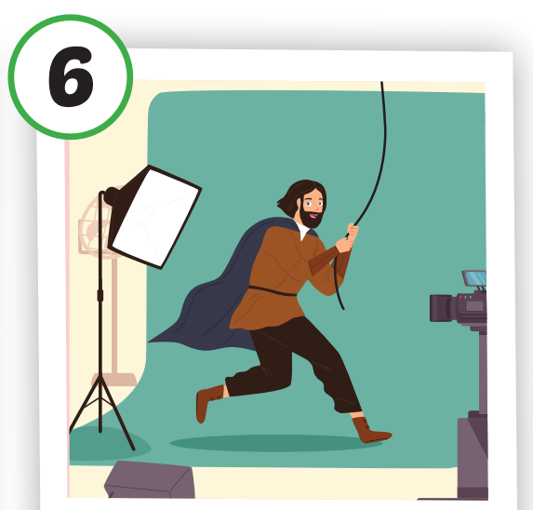
actor
1
2
3
4
show
3

Slide 8
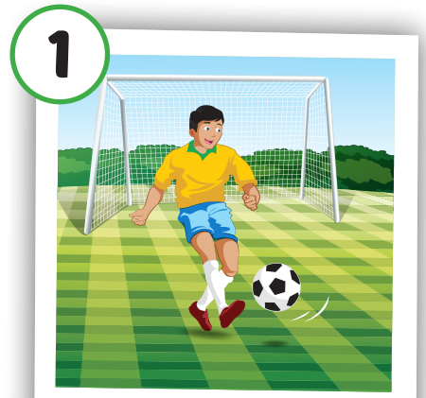
soccer player
1
2
3
4
show
4

Slide 9
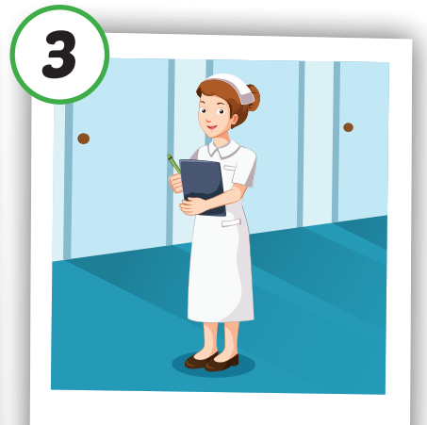
nurse
1
2
3
4
show
5

Slide 10
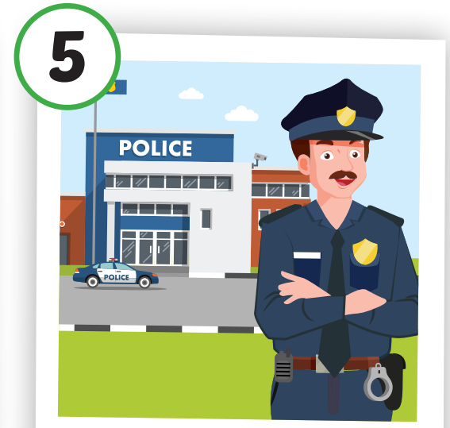
police officer
1
2
3
4
show
6

Slide 11
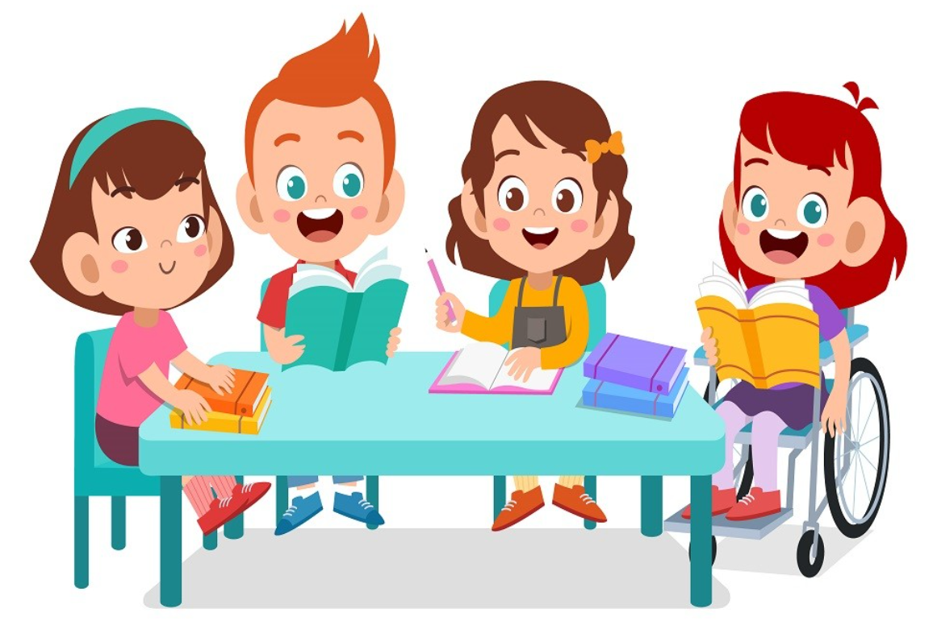
It’s time to learn …

Slide 12

Pronunciation
intonation for verb-er

Slide 13

Presentation

Slide 14
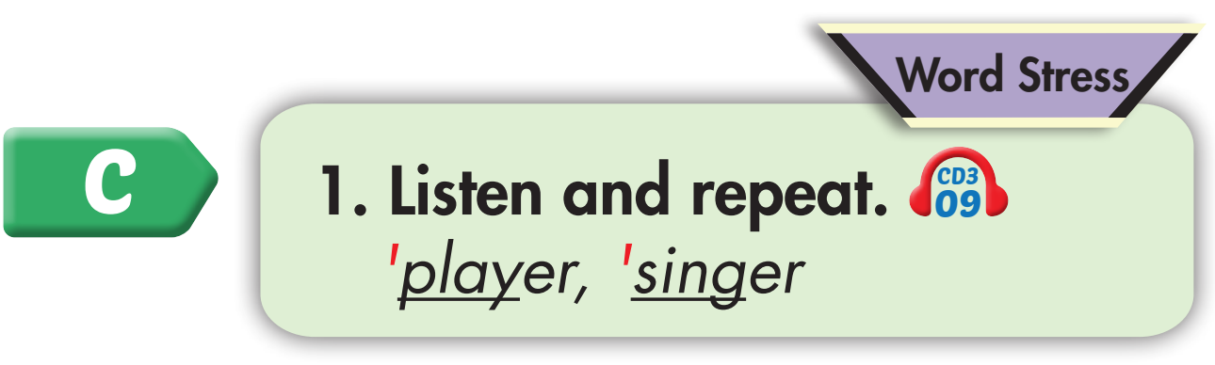
Click on the picture to hear the sound.

Slide 15
Practice

Slide 16
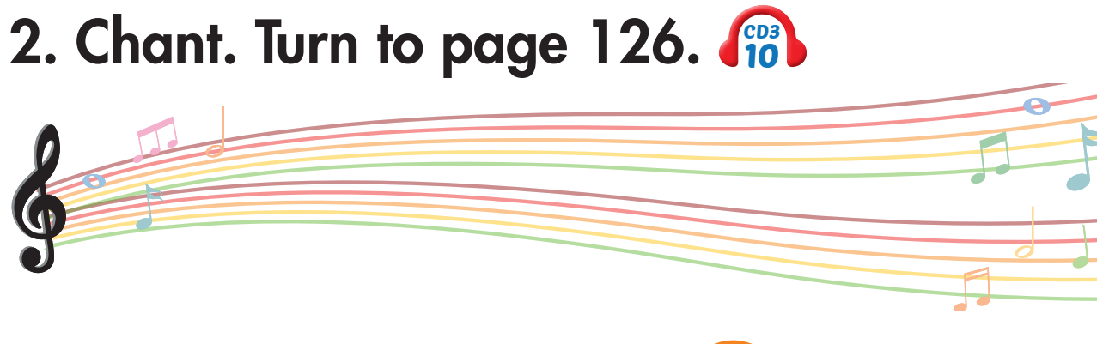


Slide 17
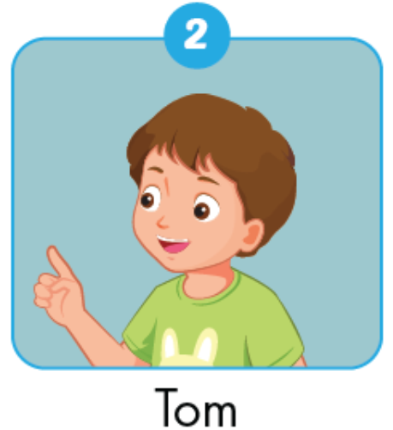
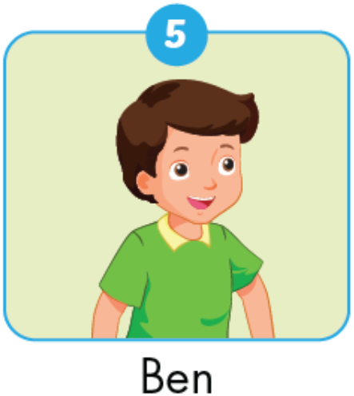
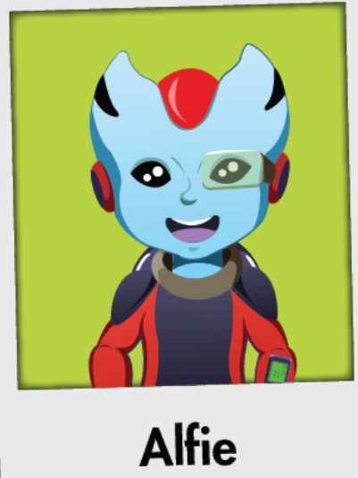
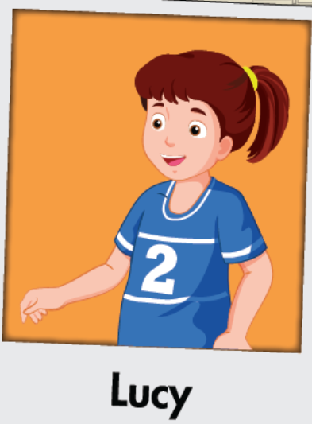
← Click on the picture to hear the sound.
Lucy likes movies.
Ben likes cars.
Tom likes sports.
Alfie likes music.
I think he’ll be a driver.
I think he’ll be a soccer player.
I think he’ll be a singer.
I think she’ll be an actor.

Slide 18
Structure
Tom likes sports. I think he’ll
be a soccer player

Slide 19
Pre-listening

Slide 20
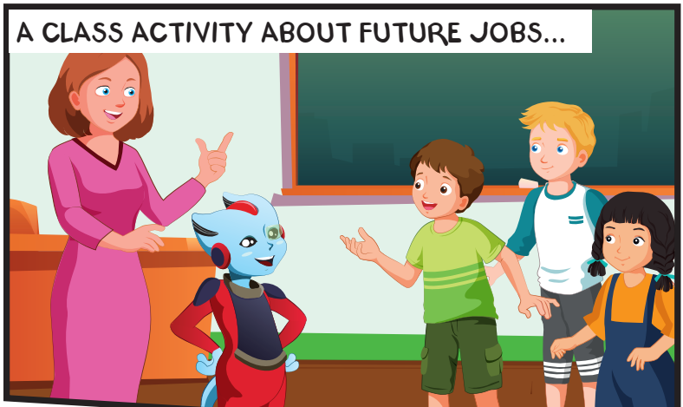
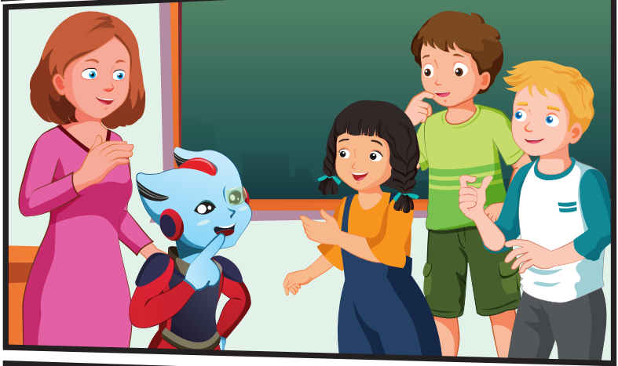
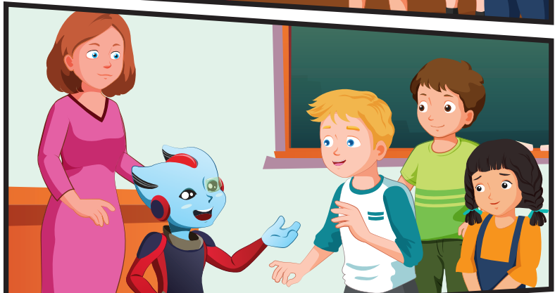
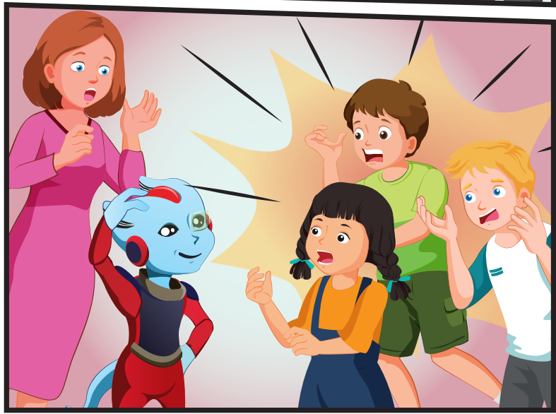
What is the activity about?

Slide 21
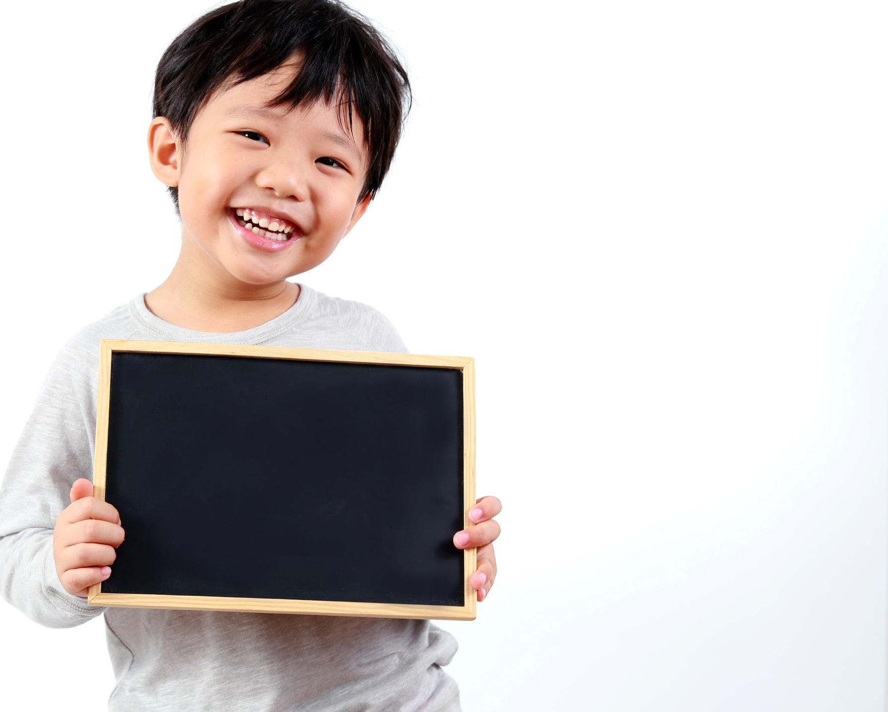
While - listening

Slide 22

← Click on the title to hear the sound.

Slide 23
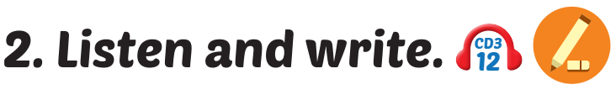
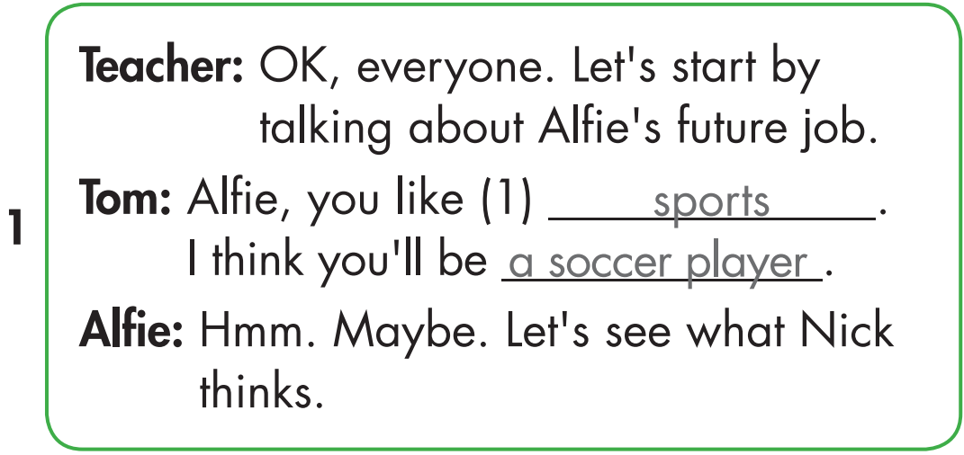
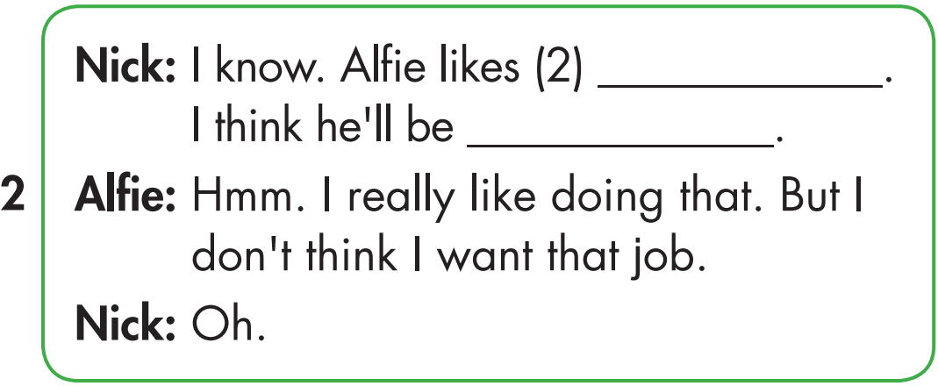
movies
an actor

Slide 24
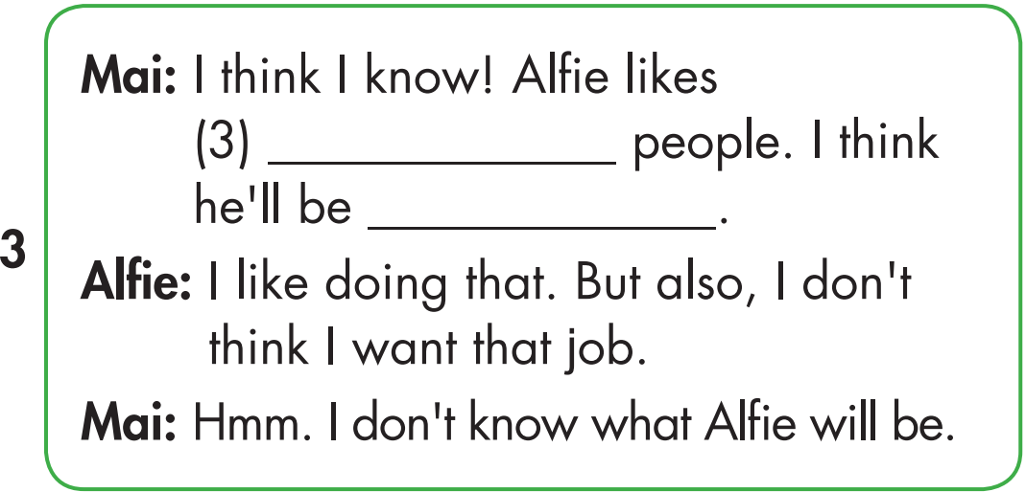
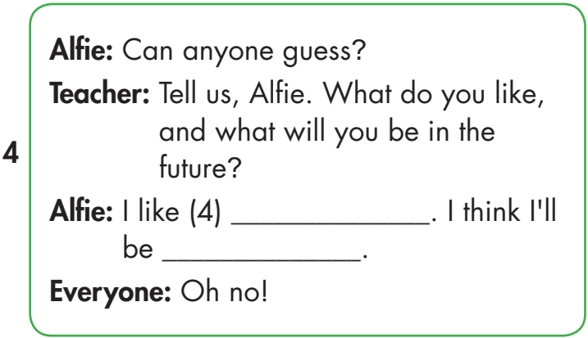
← Click on the title to hear the sound.
helping
a police officer
singing
a singer

Slide 25

Post-listening

Slide 26
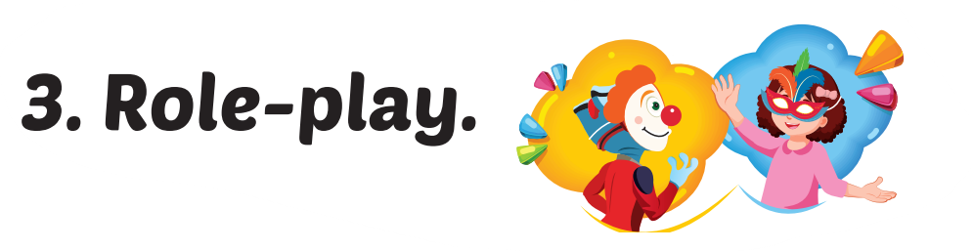

Slide 27
movies
an actor

Slide 28
helping
a police officer

Slide 29
singing
a singer

Slide 30
Production

Slide 31
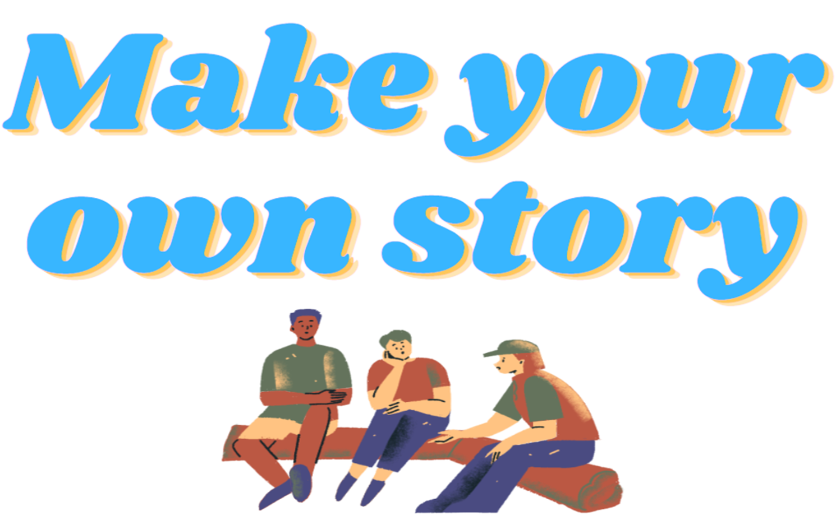

Slide 32
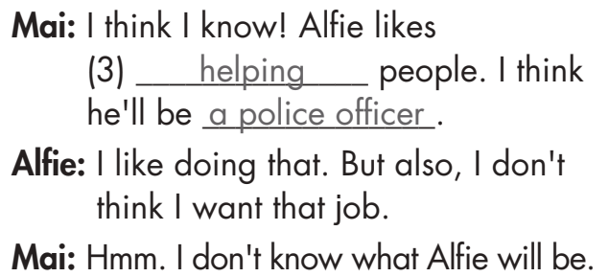
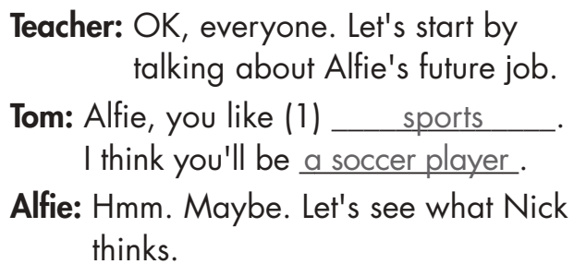

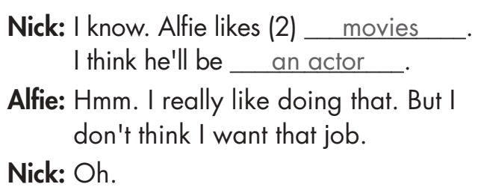
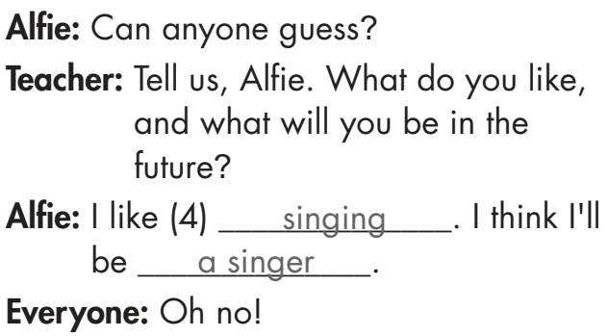
Nam
An
An
Hoa
An
An
An
Lan
Nam
An
Lan
An
An
An
An
An
Lan

Slide 33

CONSOLIDATION

Slide 34

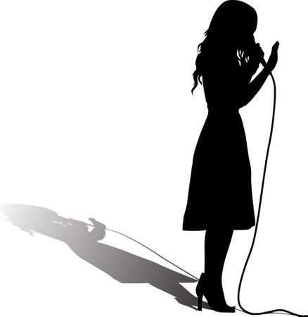


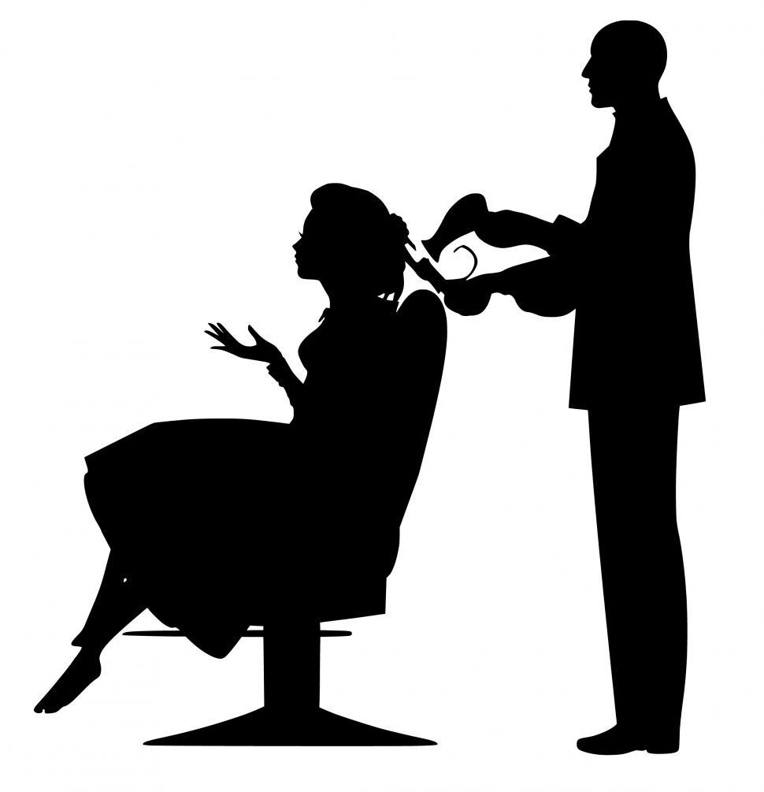
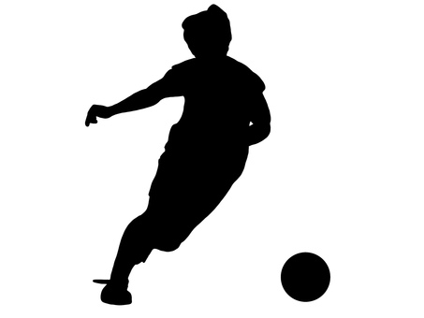
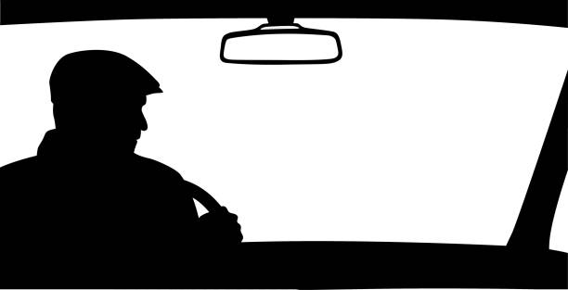
Look and guess my future job!
I think you’ll be ________.

Slide 35
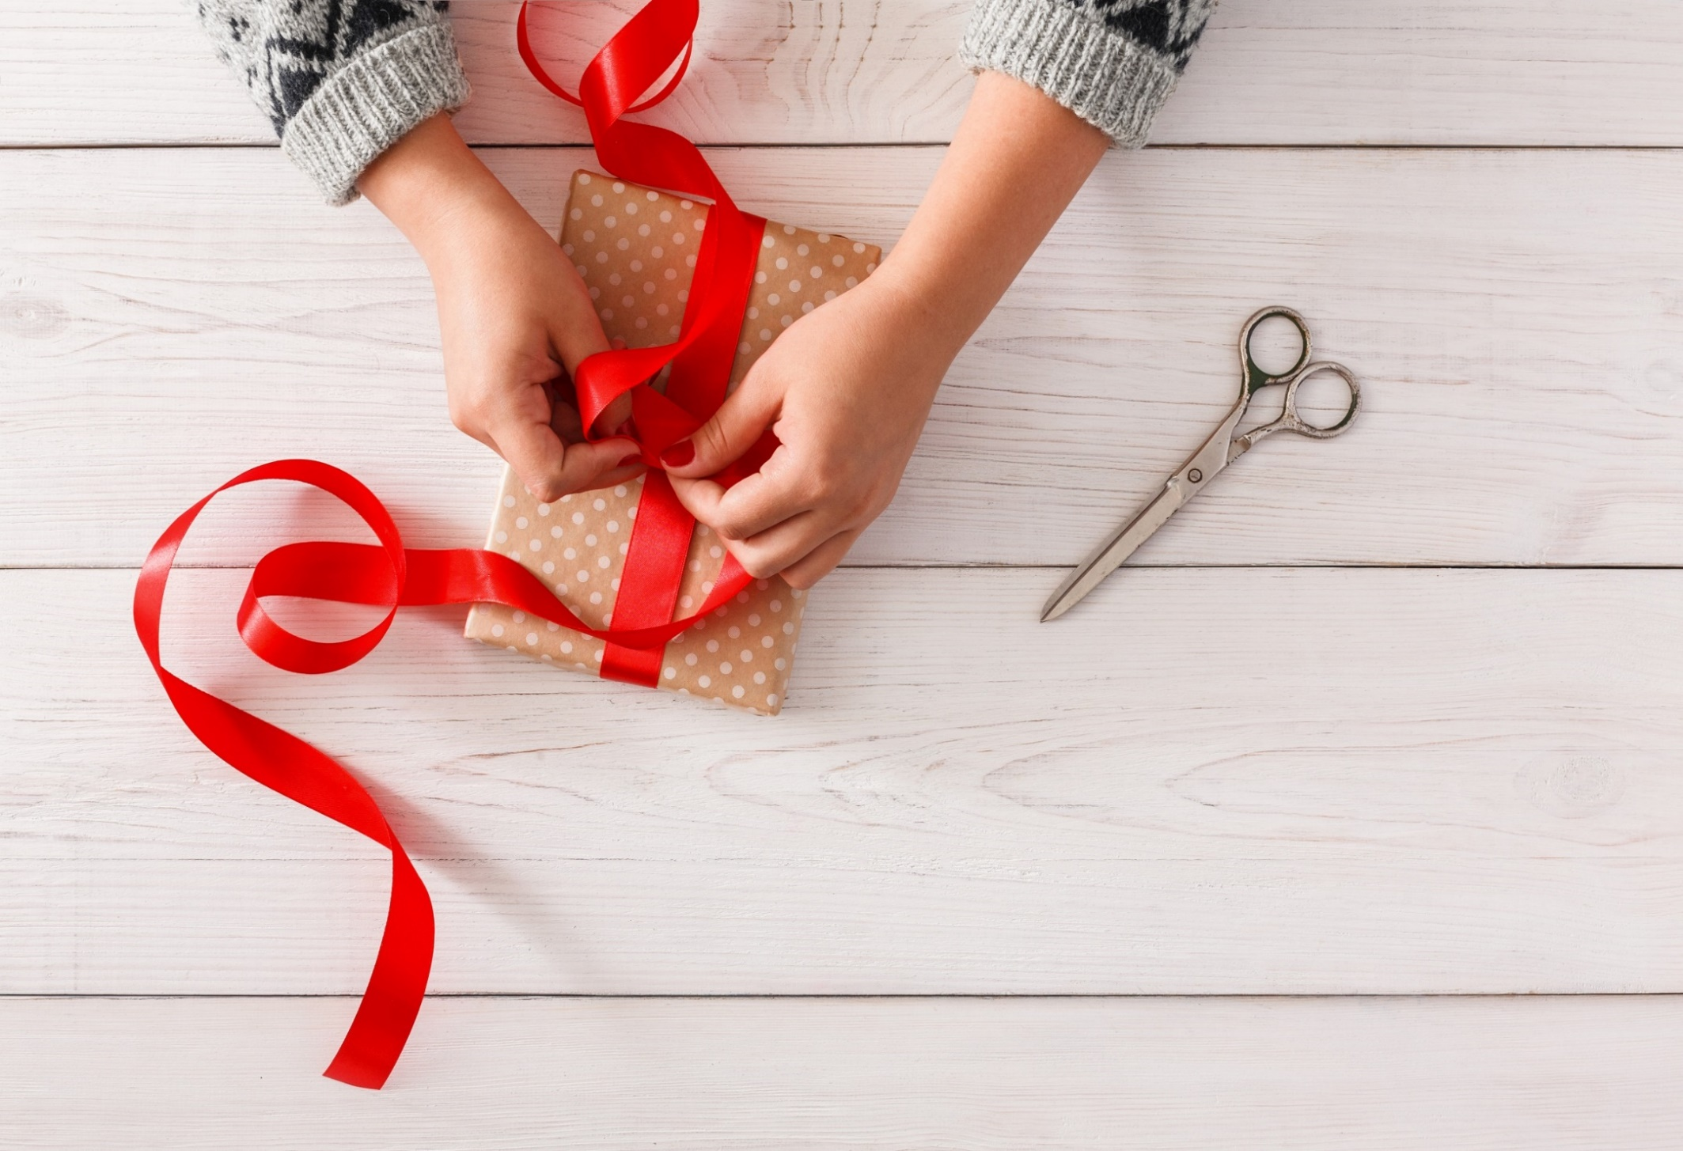
WRAP-UP

Slide 36
Today’s lesson
Pronunciation
Word stress for 2-syllable nouns ending in ‘-er’
Structures/ Sentence patterns
Tom likes sports. I think he’ll be a soccer player.

Slide 37
Homework
Practice the vocabulary and structure, and make sentences using them.
Prepare the next lesson (page 97 SB).

Slide 38

Enjoy your day!

Slide 39
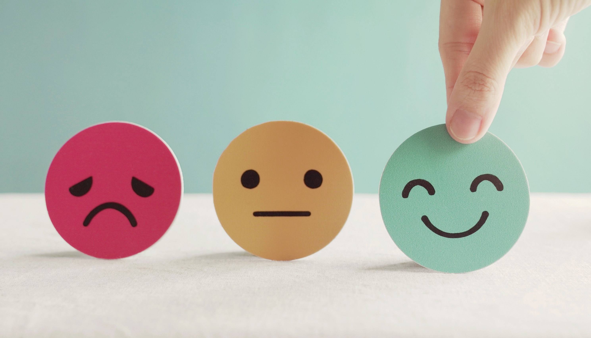
Lesson 3
Stay positive and have a nice day!

