Slide 1
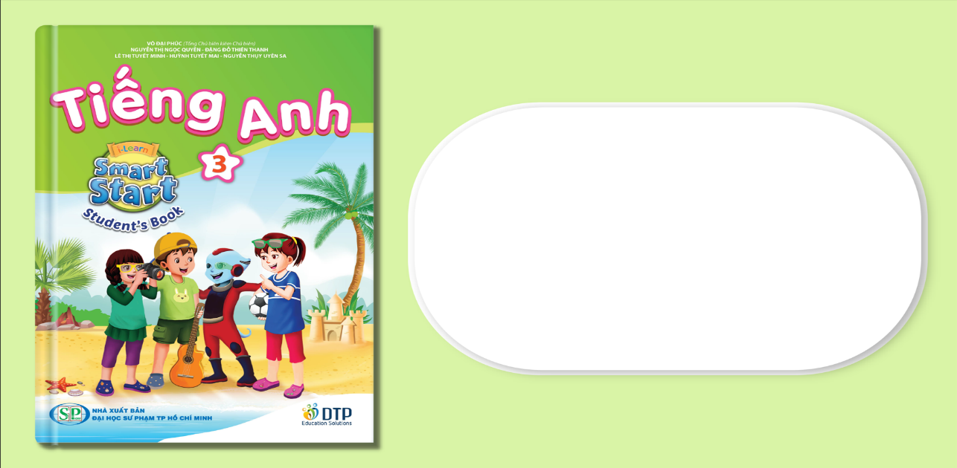
Unit 7: Toys
Lesson 2.3
Page 101

Slide 2
Objectives
By the end of this lesson, students will be able to…
Vocabulary: Practice vocabulary learnt earlier in the lesson.
Model sentences: Practice structures:
How many ...... do you have?
I have ........

Slide 3

WARM UP

Slide 4
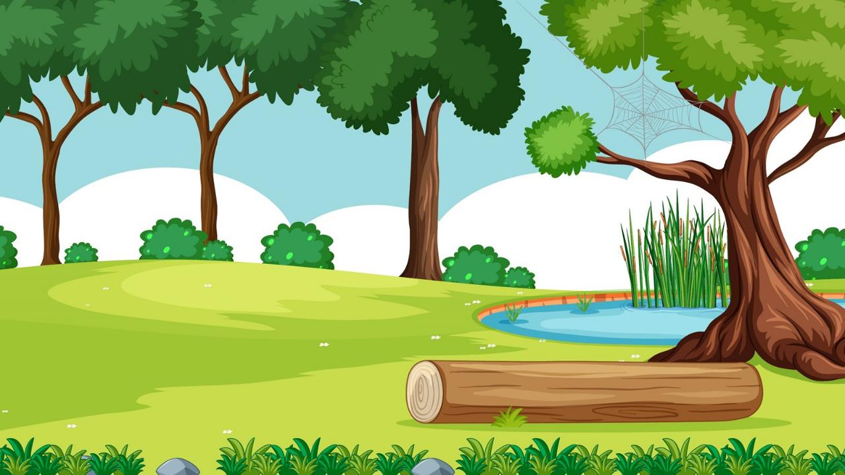

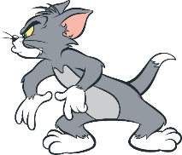
JERRY’S
QUESTIONS
Start
Divide class into 2 teams: TOM and JERRY
TOM has to choose the right opition.
If Tom’s answer is correct, the BOMB WILL MOVE TO JERRY AND EXPLODE.
If Tom’s answer is incorrect, THE BOMB WILL MOVE TO TOM AND EXPLODE.

Slide 5





next
marble
dice

Slide 6
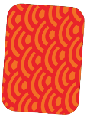
next
dice
card

Slide 7
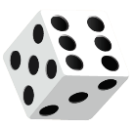
next
marble
dice

Slide 8

next
block
card

Slide 9

Goodbye!!!

Slide 10
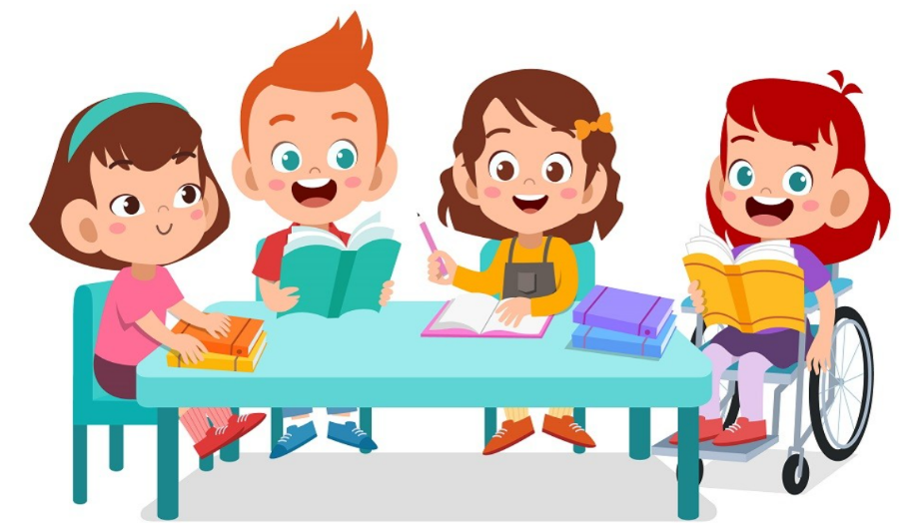
It’s time to learn …

Slide 11

Pre-Speaking
Look and write
How many marbles
______ _______ _______ do you have?
seven marbles
I have _____ ________.
Notes:
Click textbox: pre-speaking to hear the sound

Slide 12
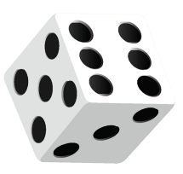
Pre-Speaking
Look and write
How many dice
______ _______ _______ do you have?
five dice
I have _____ ________.
Notes:
Click textbox: pre-speaking to hear the sound

Slide 13
Pre-Speaking
Look and write
_____ _____ _____ _____ ____ _____?
How many dice do you have
_ ____ ___ _______.
I have five dice
Notes:
Click textbox: pre-speaking to hear the sound

Slide 14

Structures
How many marbles do you have?
- I have five marbles.

Slide 15
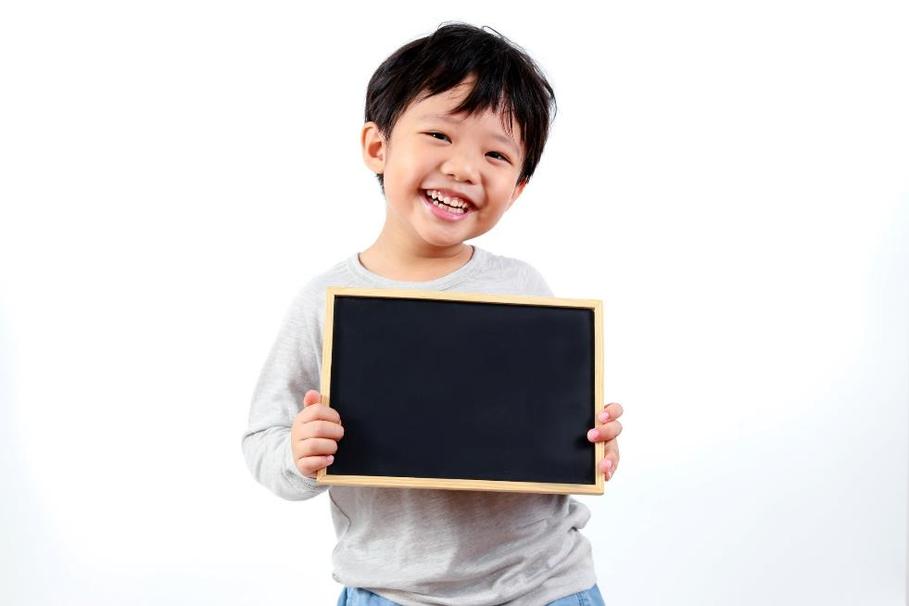
Practice

Slide 16


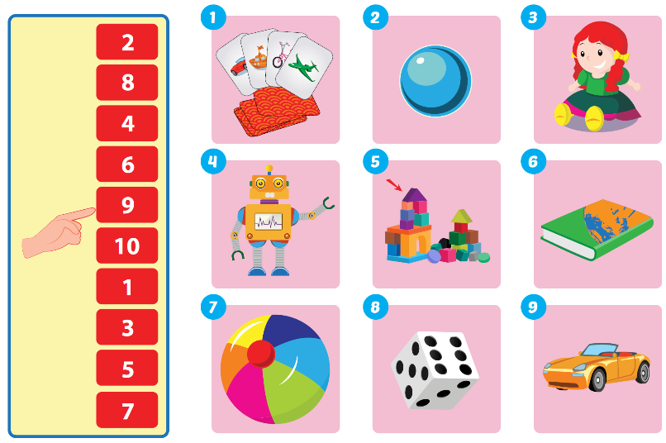

Slide 17
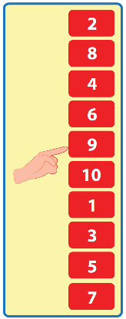


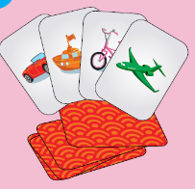
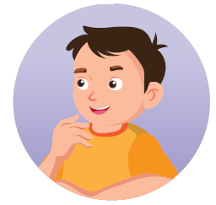

1
I have nine cards.
How many cards do you have?

Slide 18
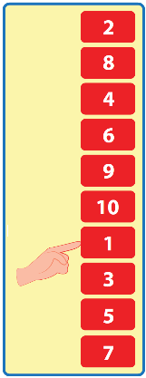
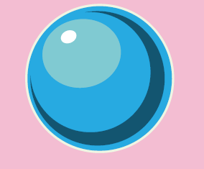
2
I have one marble.
How many marbles do you have?

Slide 19
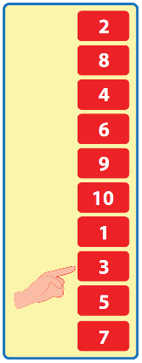
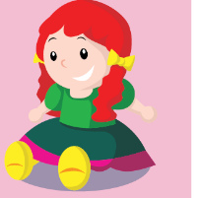
3
I have three dolls.
How many dolls do you have?

Slide 20
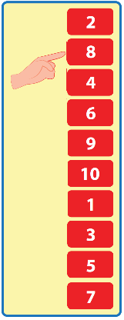
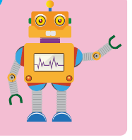
4
I have eight robots.
How many robots do you have?

Slide 21
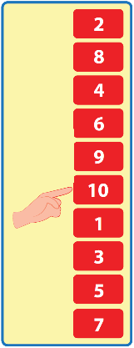
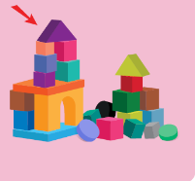
5
I have ten bolcks.
How many blocks do you have?

Slide 22
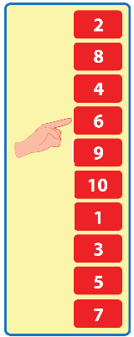

6
I have six books.
How many books do you have?

Slide 23
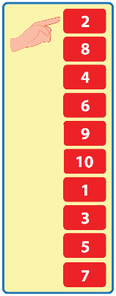
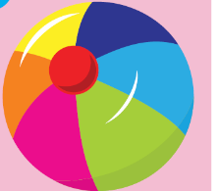
7
I have two balls.
How many balls do you have?

Slide 24
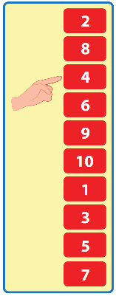
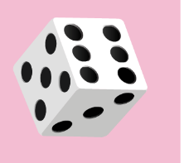
8
I have four dice.
How many dice do you have?

Slide 25
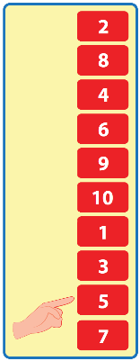
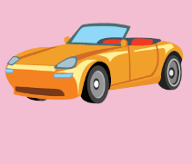
9
I have five cars.
How many cars do you have?

Slide 26

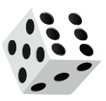
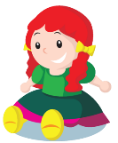



Post speaking
Guess the toys by asking questions.
One student will stand in front of the class. The teacher gives the student a picture of toys. The other students will ask the questions to guess the toys in the picture.

Slide 27

CONSOLIDATION

Slide 28

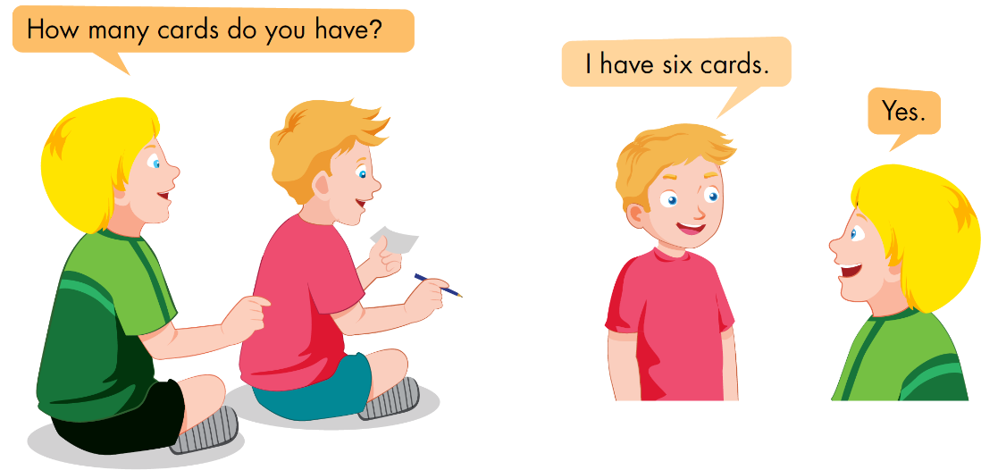

Slide 29
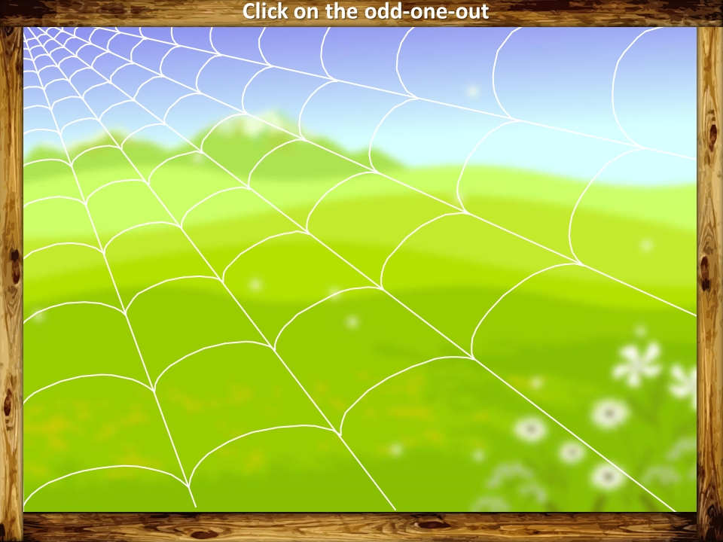
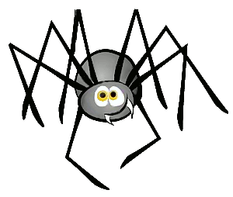

VOCABULARY REVIEW
PLAY

Slide 30

sit down
listen
car
Why?
CHECK
Because it is a kind of toy.
NEXT

Slide 31
doll
robot
father
Why?
CHECK
Because it is not a toy.
NEXT

Slide 32
father
mother
dice
Why?
CHECK
NEXT
Because it is not a family member.

Slide 33
block
card
goodbye
Why?
CHECK
NEXT
Because it is not a toy

Slide 34
car
sister
marble
Why?
CHECK
NEXT
Because it is a family member.

Slide 35

WRAP-UP

Slide 36
Today’s lesson
Vocabulary:
Review: robot, car, doll, marble, dice, block, card
Model sentences
How many ...... do you have?
I have ........

Slide 37
Homework
Practice the vocabulary and structure; and make sentences using them.
Prepare the next lesson (page 102 SB)

Slide 38
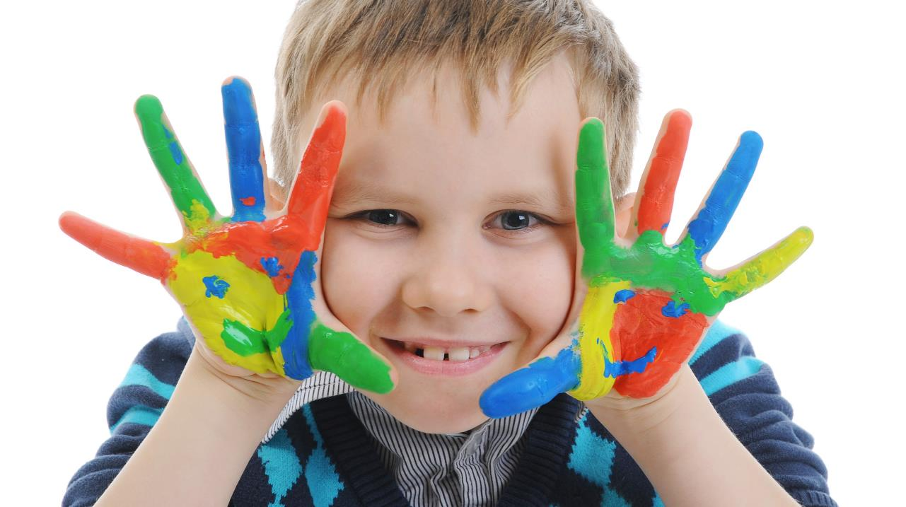
Enjoy your day!

