Slide 1

Unit 7: JOBS
Lesson 1.1
Page 92

Slide 2
Objectives
By the end of this lesson, students will be able to point out and name different jobs.
Vocabulary: scientist, pilot, tour guide, business person, hairdresser, designer.
Structure: What would you like to be when you grow up?
- I’d like to be a scientist.

Slide 3

WARM-UP

Slide 4

It’s time to learn …

Slide 5

New words
scientist,
pilot,
tour guide,
business person,
hairdresser
designer

Slide 6

Presentation

Slide 7

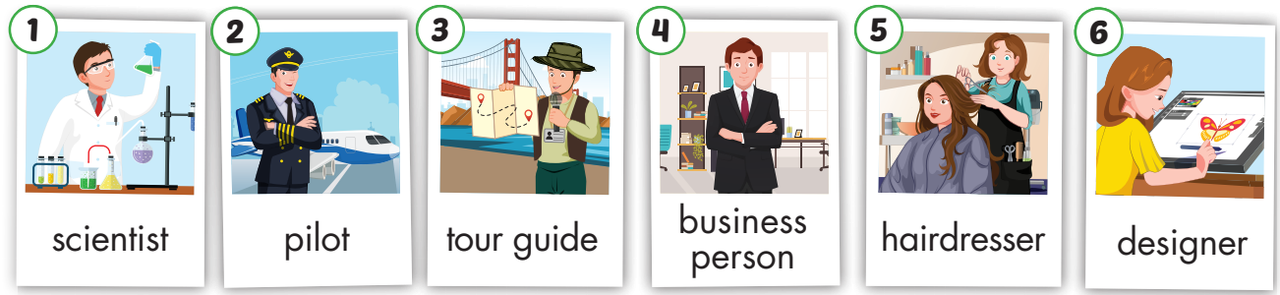
Click on the picture below to hear the sound.
/ˈpaɪlət/
phi công
/ ˈbɪznəs pɜːrsən /
doanh nhân
/dɪˈzaɪ.nɚ/
nhà thiết kế
/ˈsaɪəntɪst/
nhà khoa học
/tʊr ɡaɪd/
hướng dẫn viên du lich
/ˈherˌdres.ɚ/
thợ cắt tóc
Notes:
Click vào hình A. 1. Listen and point. Repeat để cho cả audio full chạy

Slide 8
Practice

Slide 9
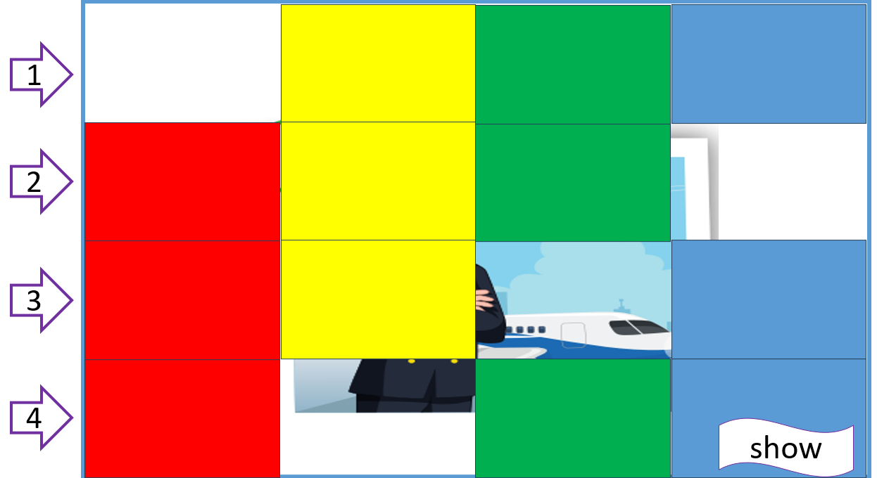
Let’s play!
What’s hidden?

Slide 10
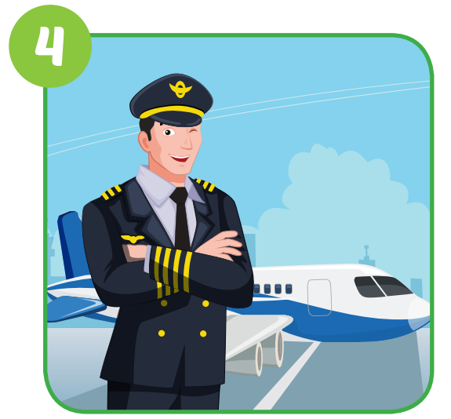
pilot
1
2
3
4
show
1

Slide 11
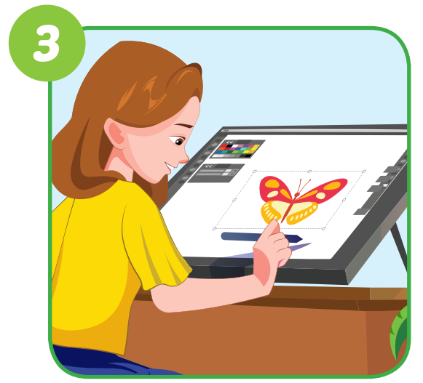
designer
1
2
3
4
show
2

Slide 12
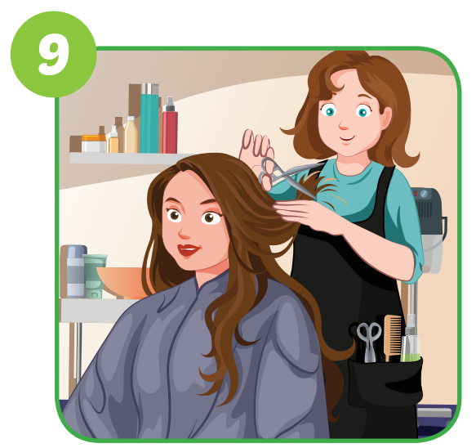
hairdresser
1
2
3
4
show
3

Slide 13
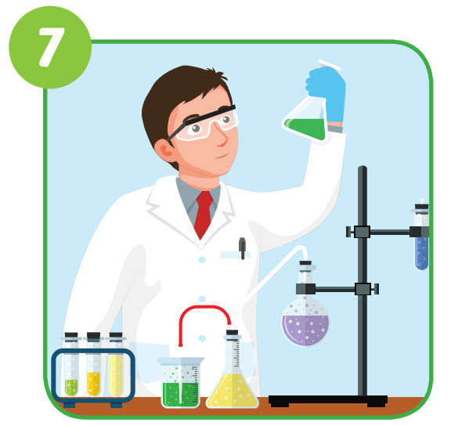
scientist
1
2
3
4
show
4

Slide 14
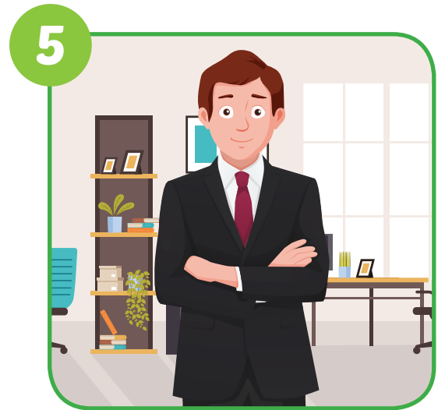
business person
1
2
3
4
show
5

Slide 15
pilot
1
2
3
4
show
6

Slide 16
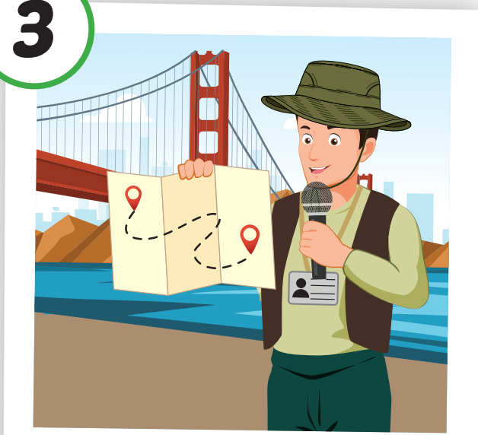

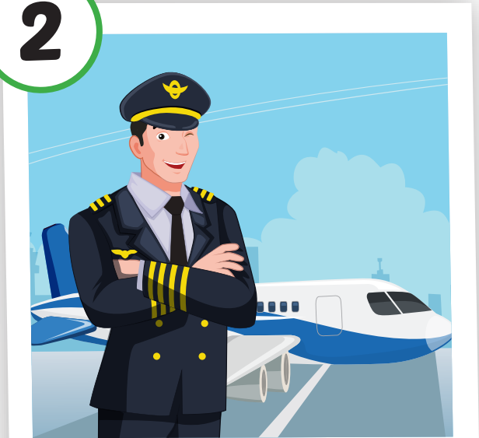
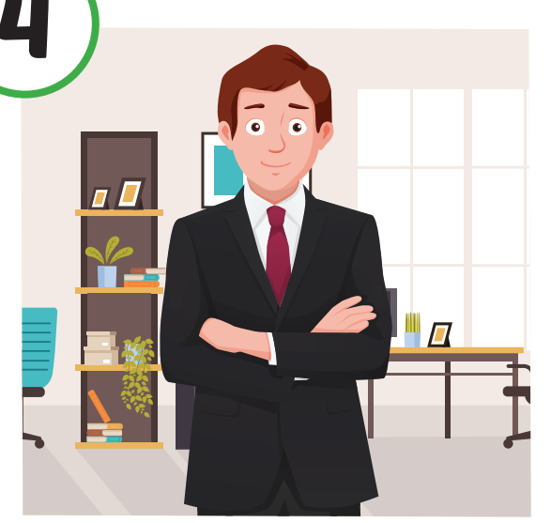
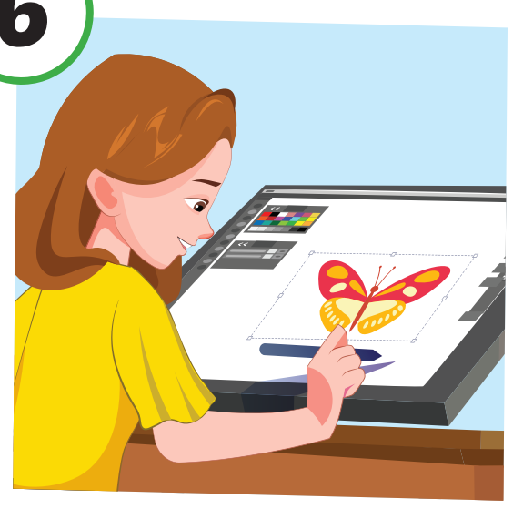
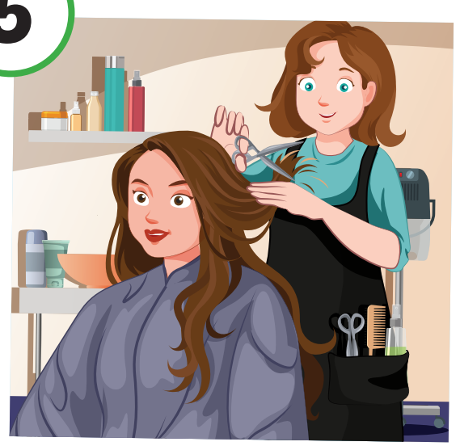
Let’s play – “Slow motion” game.

Slide 17
Structure
What would you like to be
when you grow up?
- I’d like to be a scientist.

Slide 18
Presentation

Slide 19
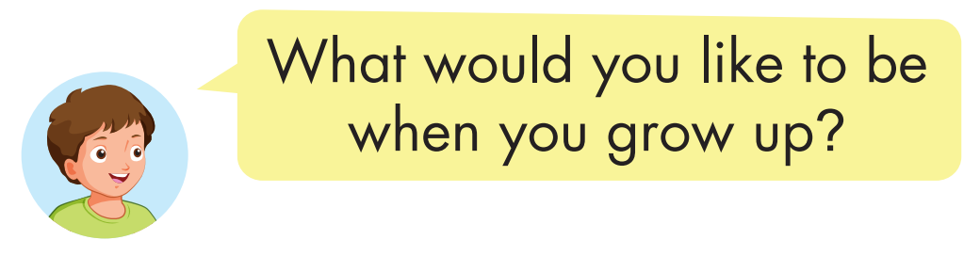


Structure
Click on the picture to hear the sound.

Slide 20

Practice

Slide 21

Click on the picture to hear the sound.

Slide 22
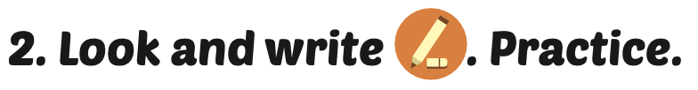
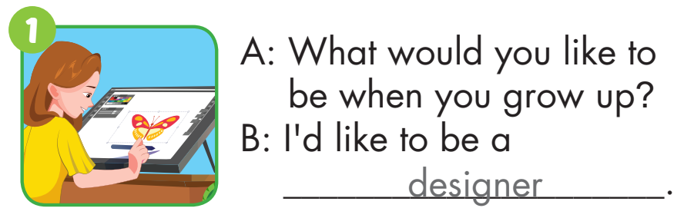
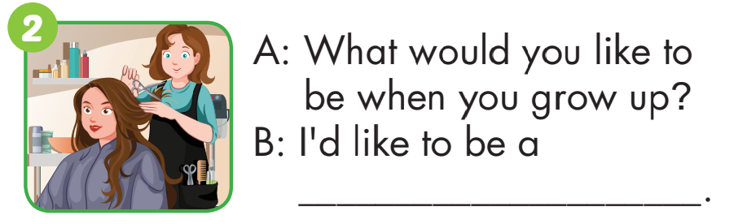
hairdresser

Slide 23
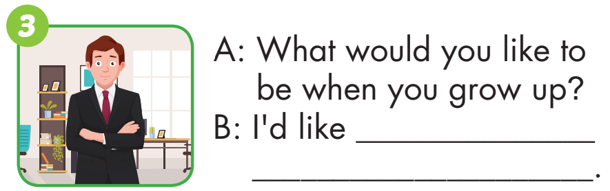
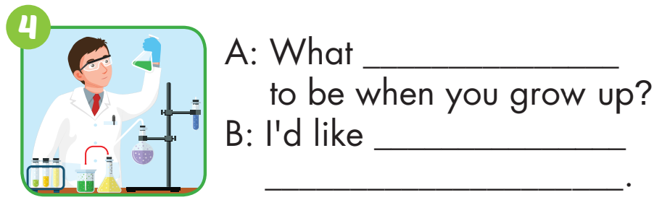
to be
a business person
would you like
to be
a scientist

Slide 24
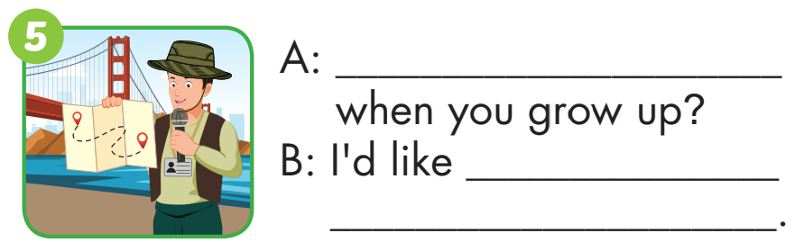
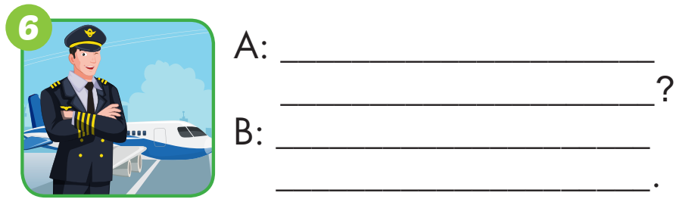
What would you like to be
to be
a tour guide
What would you like to be
when you grow up
I’d like to be a pilot.

Slide 25

Production

Slide 26
Make a survey
Name | What would you like to be when you grow up?
1,
2,
3,

Slide 27

CONSOLIDATION

Slide 28
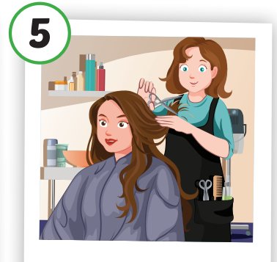
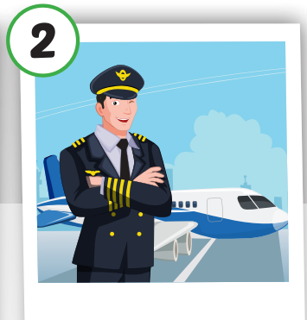
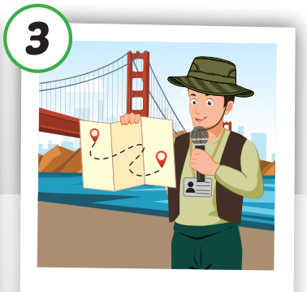
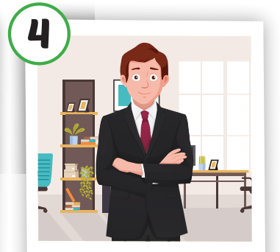
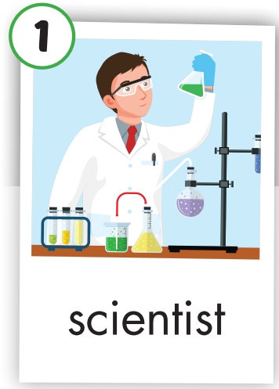
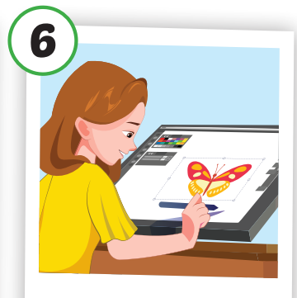

Ask and answer.
What would you like to be when you grow up?
I’d like to be a ……………

Slide 29

WRAP-UP

Slide 30
Today’s lesson
Vocabulary
scientist, pilot,
tour guide, business person, hairdresser, designer.
Structures/ Sentence patterns
What would you like to do when you grow up?
- I’d like to be a scientist.

Slide 31
Homework
Practice the vocabulary and structure, and make sentences using them.
Prepare for the next lesson (page 93 SB).

Slide 32

Enjoy your day!

Slide 33

Lesson 3
Stay positive and have a nice day!

