Slide 1

Unit 7: MY FAMILY
Lesson 2.1
Page 95

Slide 2
Objectives
By the end of this lesson, students will be able to talk about where their family members work.
Vocabulary: store, hospital, restaurant, office, farm, bank.
Model sentences: Where does your father work?
My father works at a bank. He's a cashier.

Slide 3

WARM UP

Slide 4
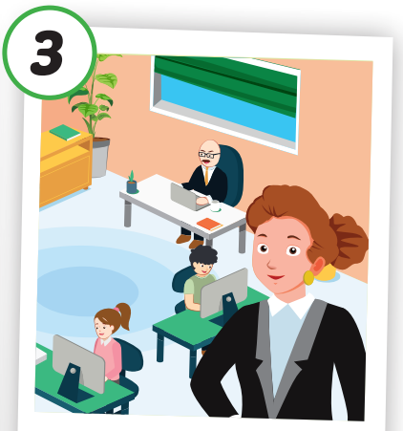
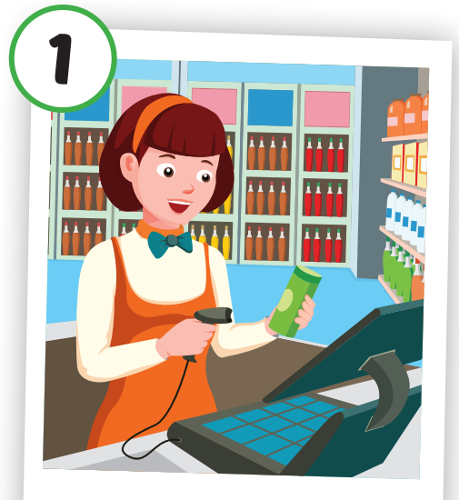
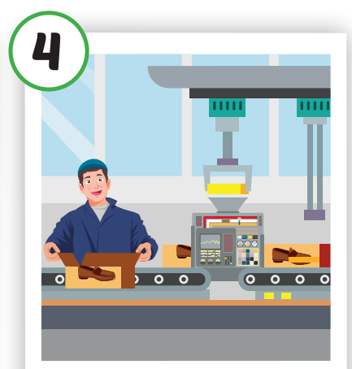
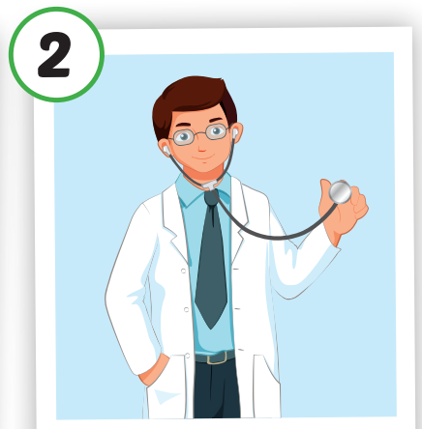
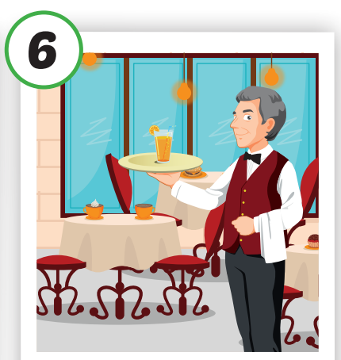

4
1
SPIN
3
2
2
5

Slide 5

It’s time to learn …

Slide 6

New words
store,
hospital,
restaurant,
office,
farm,
bank.

Slide 7

Presentation

Slide 8



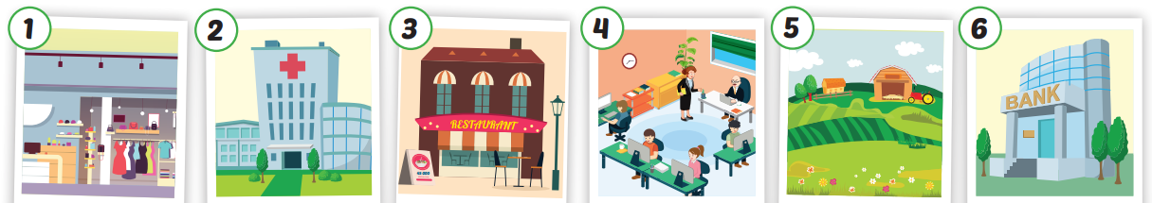
Click each English word to hear the sound.
store
hospital
restaurant
office
farm
bank
/stɔːr/
Cửa hàng
/ˈhɑːspɪtəl
Bệnh viện
/ˈrestərɑːnt/
Nhà hàng
/ˈɑːfɪs/
Văn phòng
/fɑːrm/
Nông trại
/bæŋk/
Ngân hàng

Slide 9
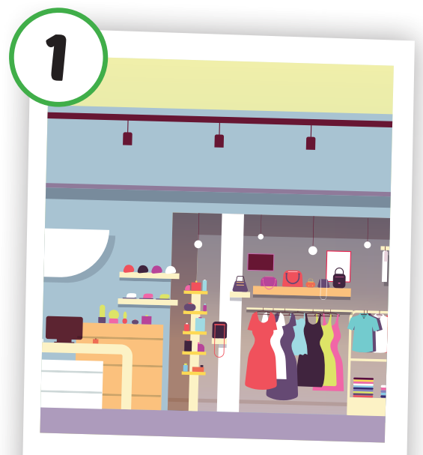
Click each English word to hear the sound.
store
/stɔːr/
Cửa hàng

Slide 10
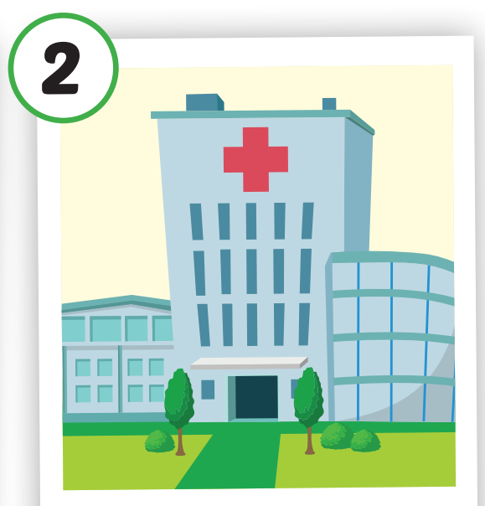
Click each English word to hear the sound.
hospital
/ˈhɑːspɪtəl/
Bệnh viện

Slide 11
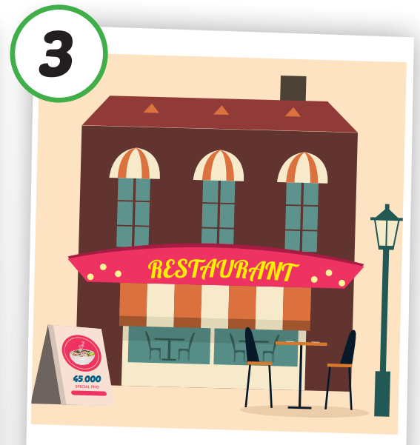
Click each English word to hear the sound.
restaurant
/ˈrestərɑːnt/
Nhà hàng

Slide 12
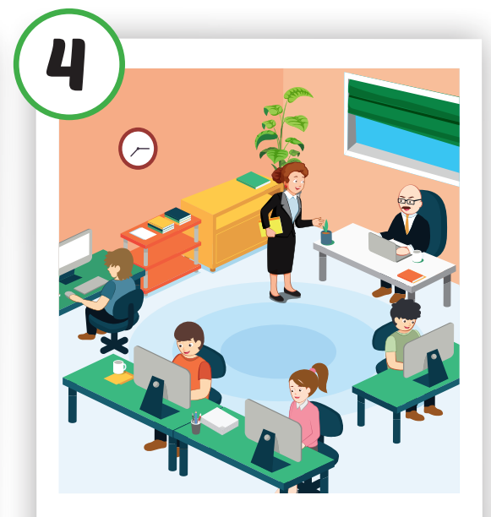
Click each English word to hear the sound.
office
/ˈɑːfɪs/
Văn phòng

Slide 13

Click each English word to hear the sound.
farm
/fɑːrm/
Nông trại

Slide 14
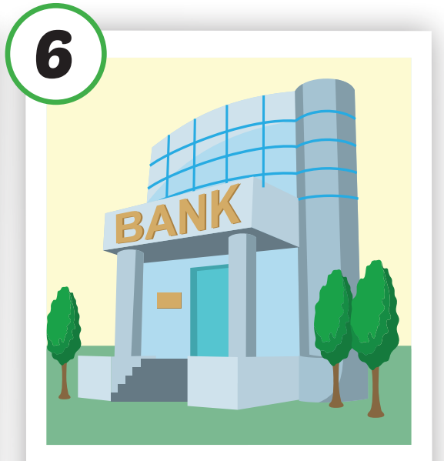
Click each English word to hear the sound.
bank
/bæŋk/
Ngân hàng

Slide 15

Practice

Slide 16

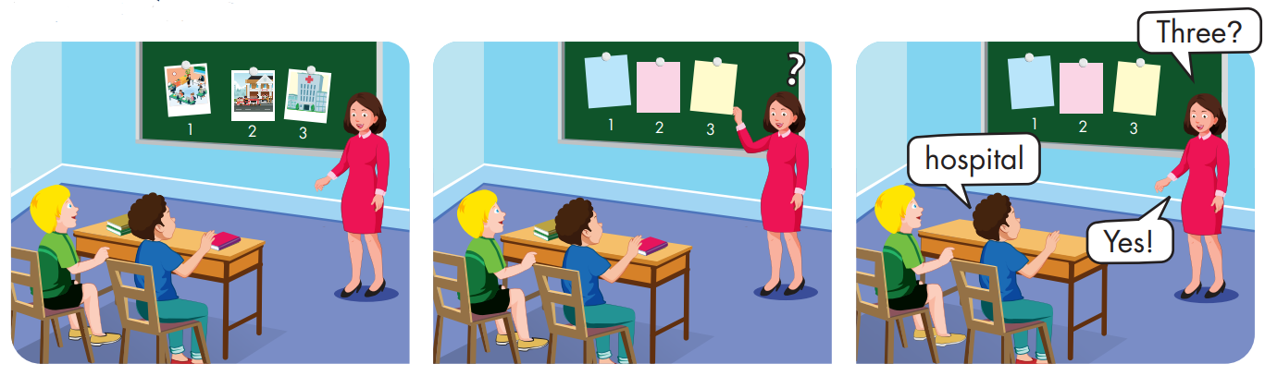

Slide 17
Structures:
Where does your father work?
My father works at a bank.
He's a cashier.

Slide 18
Presentation

Slide 19

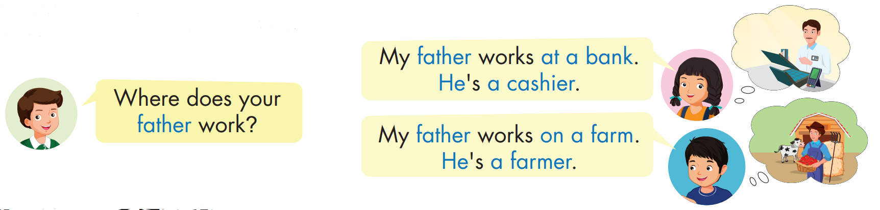


Slide 20
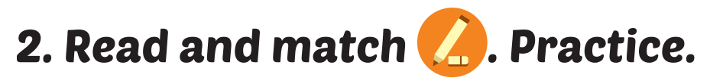
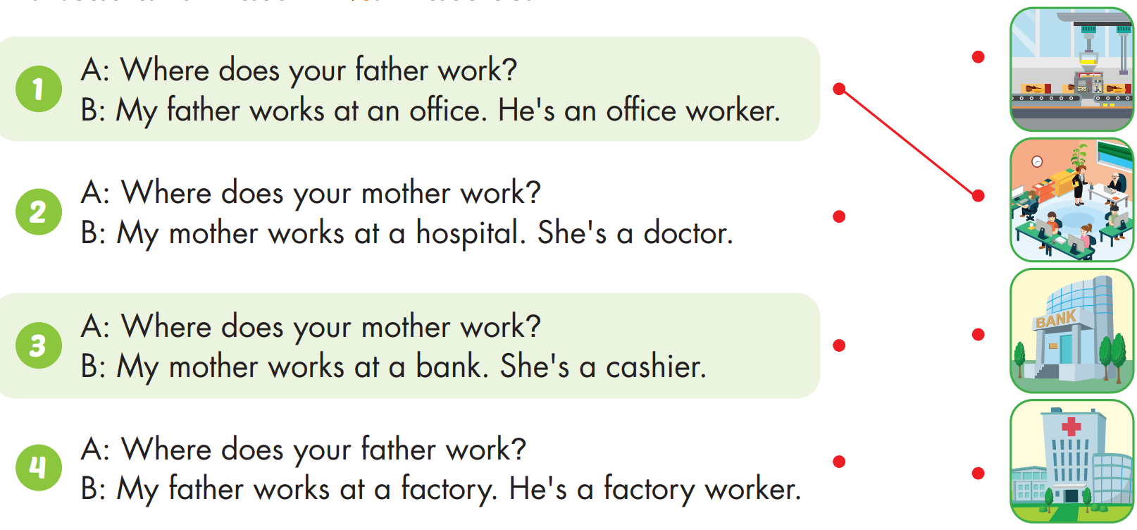

Slide 21
Practice

Slide 22

CONSOLIDATION

Slide 23
Lesson 3
Today’s lesson
Vocabulary
store, hospital, restaurant, office, farm, bank.
Model sentences
Where does your father work?
My father works at a bank. He's a cashier.

Slide 24
Lesson 3
Homework
Practice the vocabulary and structure, and make sentences using them.
Prepare the next lesson (page 96 SB)

Slide 25

Have a nice day!

