Slide 1

Unit 6: FOOD AND DRINKS
Lesson 2.3
Page 83

Slide 2
Objectives
By the end of this lesson, students will be able to ask and answer with confidence about what drink they want to make and what they will bring to make it.
Vocabulary: soda, smoothie, tea, lemonade, juice, hot chocolate.
Structure: Let's make smoothies.
OK. I'll bring milk.

Slide 3

WARM-UP

Slide 4

Move to the next slide

Slide 5

New words
soda, smoothie, tea, lemonade, juice, hot chocolate.

Slide 6
Structure
How do you feel?
- I feel weak.
- That's too bad.

Slide 7


WHERE IS THE COOKIE ?

Slide 8
Choose a cookie jar and read the word.
Click on the jar to find out if the cookie is hidden in it.

Slide 9


I’ll bring apples.
I’ll bring oranges.
I’ll bring soda.
I’ll bring sugar.
I’ll bring milk.

Slide 10
I’ll bring tea.
I’ll bring chocolate chips.
I’ll bring water.
I’ll bring soda.
I’ll bring oranges.

Slide 11
I’ll bring cookies.
I’ll bring milk.
I’ll bring water.
I’ll bring tea.
I’ll bring apples.

Slide 12
I’ll bring tea.
I’ll bring apples.
I’ll bring soda.
I’ll bring chocolate chips.
I’ll bring sugar .

Slide 13
I’ll bring soda.
I’ll bring apples.
I’ll bring tea.
I’ bring water.
I’ll bring milk.

Slide 14

Practice

Slide 15

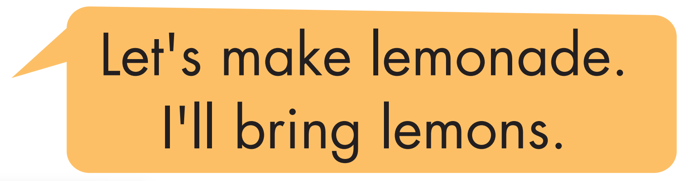


Slide 16
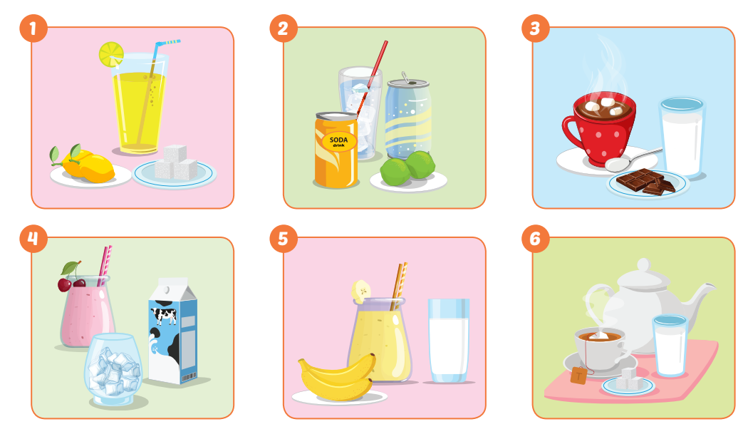

Slide 17

Speaking

Slide 18

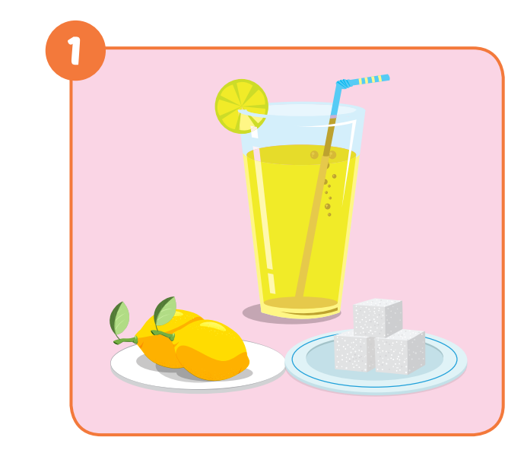

Slide 19
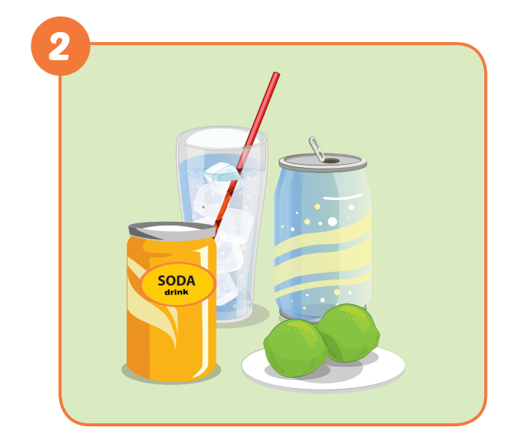
lemon soda
Let’s make __________.
I’ll bring ___________.
soda
Ok. I’ll bring _________.
lemons

Slide 20
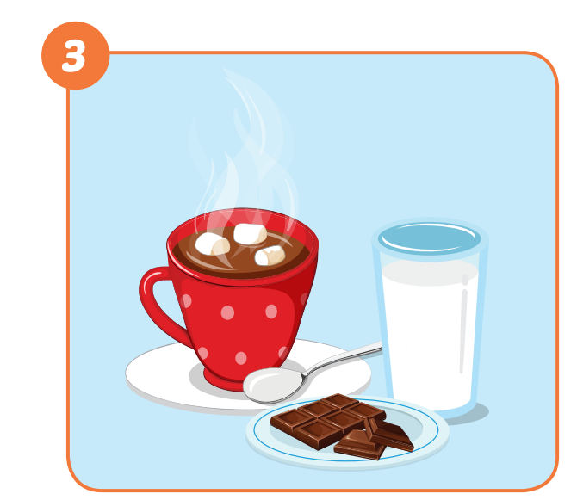
Let’s make _____________.
I’ll bring ___________.
hot chocolate
milk
Ok. I’ll bring ___________.
chocolate chips

Slide 21
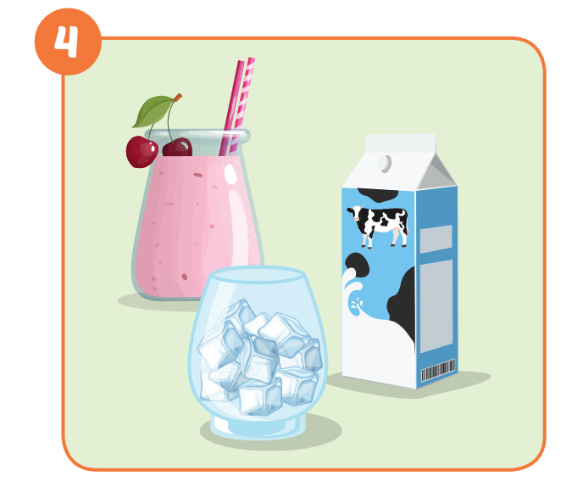
Let’s make _____________.
I’ll bring ___________.
smoothies
milk
Ok. I’ll bring ________.
ice

Slide 22
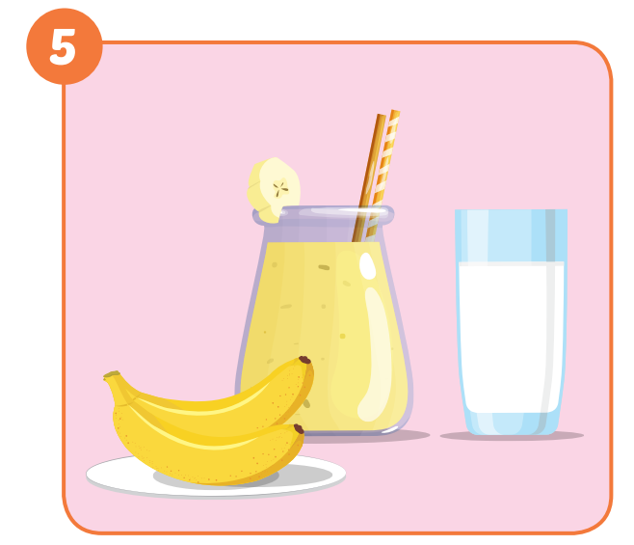
Let’s make _______________.
I’ll bring ___________.
banana smoothies
milk
Ok. I’ll bring ________.
bananas

Slide 23
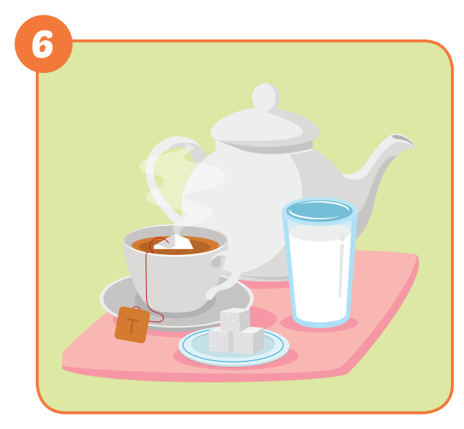
milktea
Let’s make _____________.
I’ll bring ___________.
milk
I’ll bring ___________.
sugar

Slide 24

Production

Slide 25


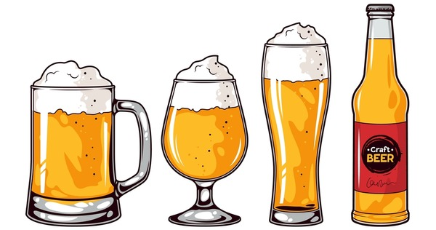
beer
coffee latte
milkshake

Slide 26
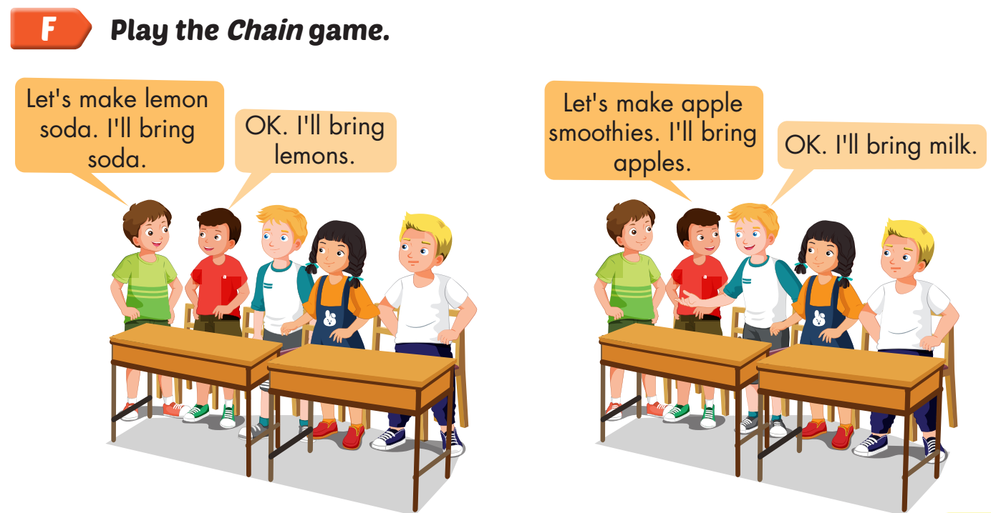

Slide 27

CONSOLIDATION

Slide 28



Slide 29
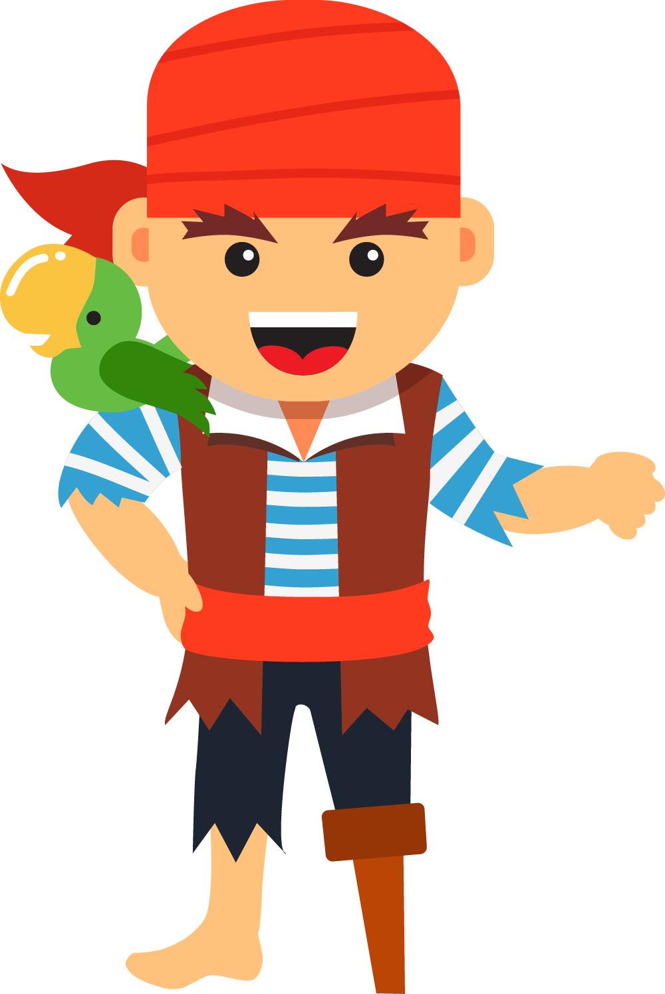
NEXT
Help me please!

Slide 30


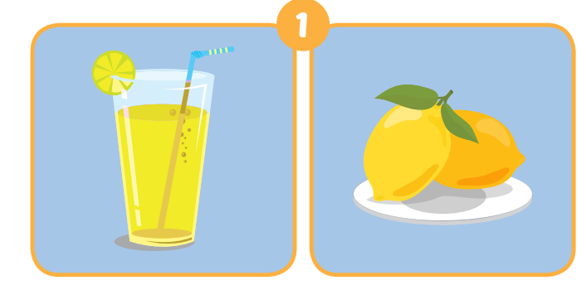
1
NEXT
Let’s make lemonade.
- …….................
Ok. I’ll bring lemons.
ANSWER

Slide 31
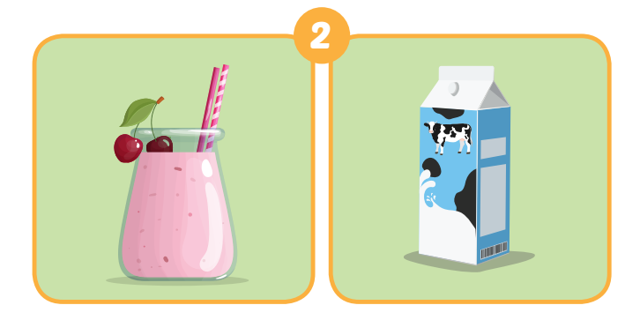
1
NEXT
2
Let’s make smoothies.
- …….................
I’ll bring milk.
ANSWER

Slide 32
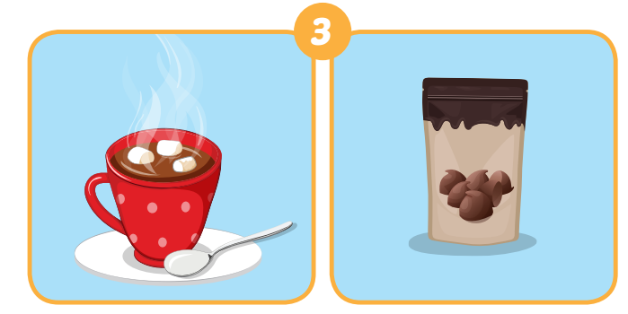
1
NEXT
2
3
Let’s make hot chocolate.
- …….................
I’ll bring chocolate chips.
ANSWER

Slide 33
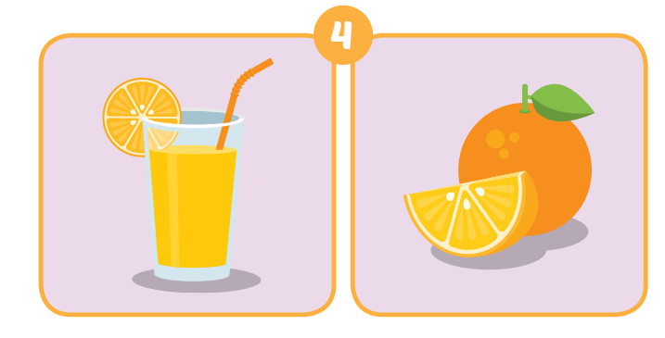
1
NEXT
2
3
4
…….................
I’ll bring oranges
ANSWER
Let’s make orange juice.

Slide 34
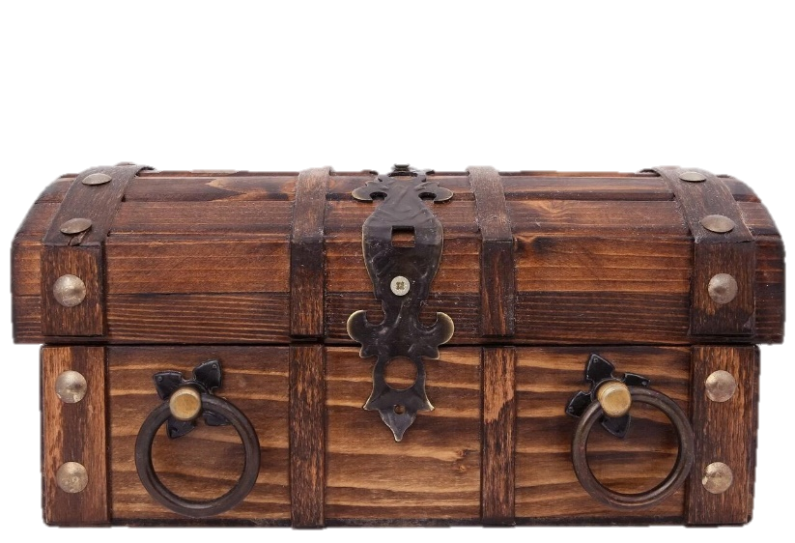
1
END
2
Hurray!
We found the treasure! THANK YOU!
3
4
ANSWER

Slide 35

WRAP-UP

Slide 36
Today’s lesson
Vocabulary
soda, smoothie, tea, lemonade, juice, hot chocolate.
Structures/ Sentence patterns
Let's make smoothies.
OK. I'll bring milk.

Slide 37
Homework
Practice the vocabularies and structure, and make sentences using them.
Prepare the next lesson (page 84 SB).

Slide 38

Enjoy your day!

Slide 39

Lesson 3
Stay positive and have a nice day!

