Slide 1

Unit 6: FOOD AND DRINKS
Lesson 2.1
Page 81

Slide 2
Objectives
By the end of this lesson, students will be able to recognize the vocabulary to say what drink they want to make and
what they will bring to make it.
Vocabulary: soda, smoothie, tea, lemonade, juice, hot chocolate
Structure: Let's make smoothies.
OK.
I'll bring milk.

Slide 3

WARM-UP

Slide 4

Guess the Food and Drinks

Slide 5

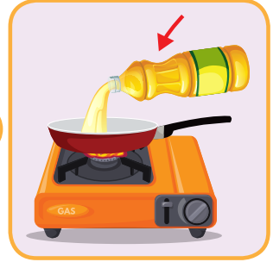
a smooth thick liquid produced from plants or animals that is used in cooking.
OIL

Slide 6
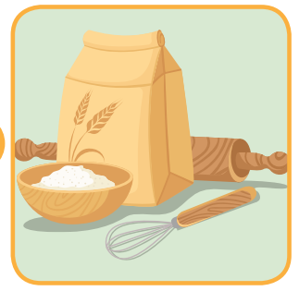
powder made from grain, esp. wheat, used for making bread, cakes, pasta, pastry,….
FLOUR

Slide 7
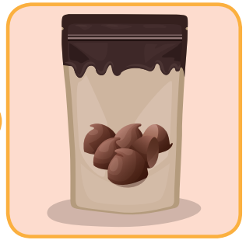
a small piece of solid chocolate.
CHOCOLATE CHIPS

Slide 8
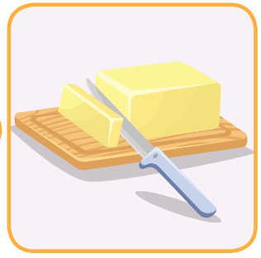
a pale yellow, fatty solid made from cream that is spread on bread or used in cooking.
BUTTER

Slide 9
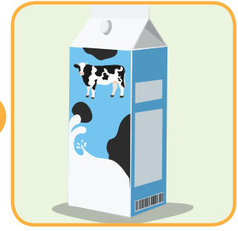
the white liquid produced by cows, goats, and sheep and used by humans as a drink or for making butter, cheese,….
MILK

Slide 10
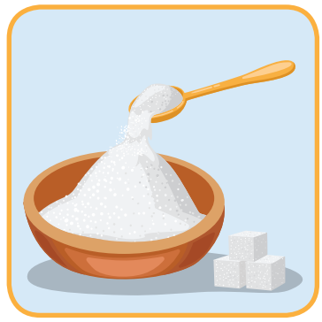
a sweet substance especially from the plants sugar cane and sugar beet, used to make food and drinks sweet
SUGAR

Slide 11

It’s time to learn …

Slide 12

New words
soda, smoothie, tea, lemonade, juice, hot chocolate.

Slide 13

Presentation

Slide 14

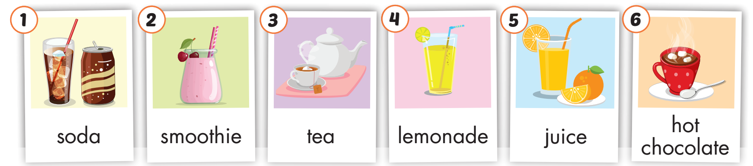
Click on A to hear the sound.
Notes:
Click vào hình A. 1. Listen and point. Repeat để cho cả audio full chạy

Slide 15
Practice

Slide 16
Listen and choose. Then say.

Slide 17





Listen and choose
A
B
C
lemonade

Slide 18
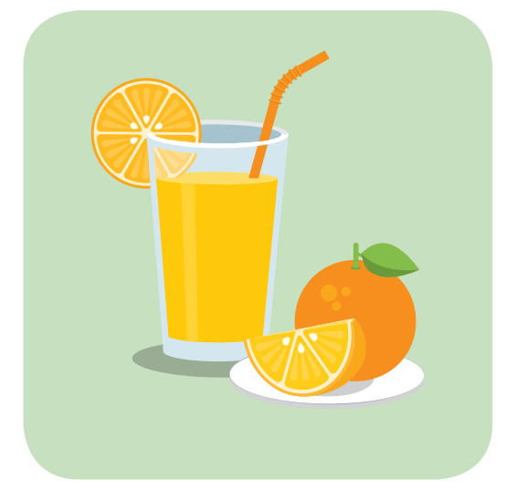
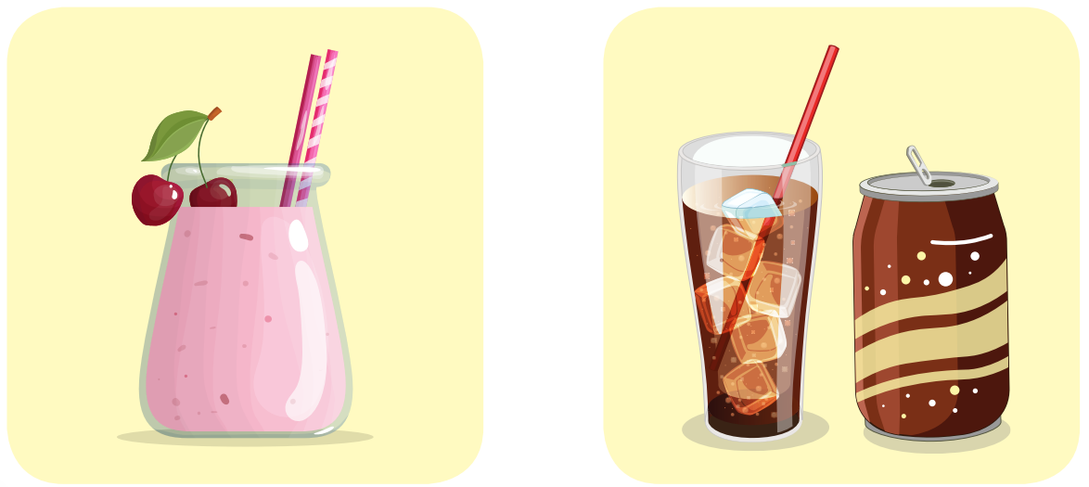
Listen and choose
A
B
C
soda

Slide 19

Listen and choose
A
B
C
Hot chocolate

Slide 20
Listen and choose
A
B
C
tea

Slide 21
Listen and choose
A
B
C
juice

Slide 22

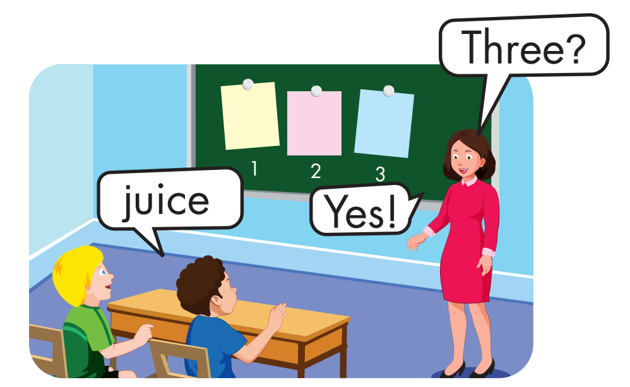
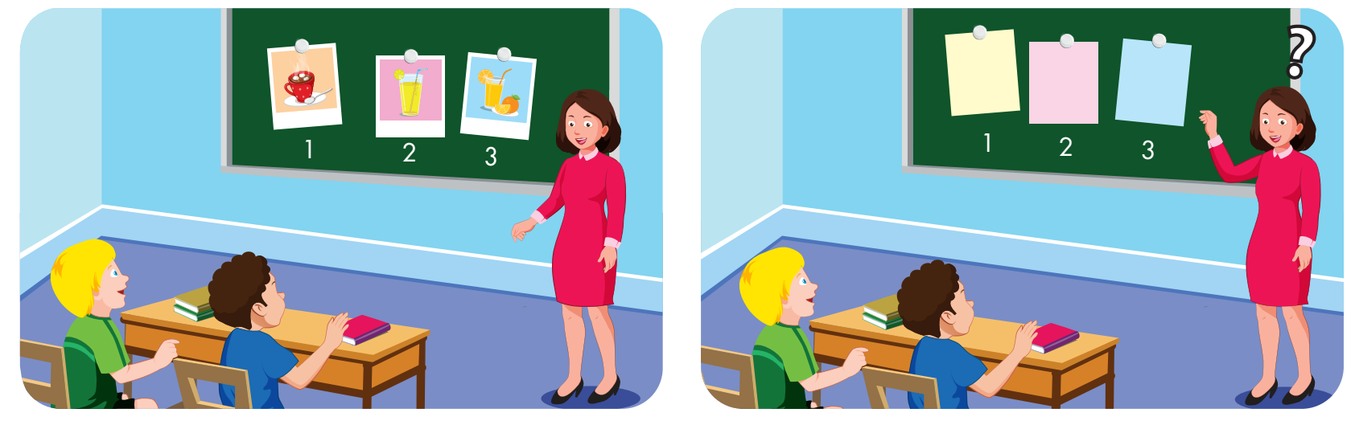

Slide 23
Structure
Let's make smoothies.
OK.
I'll bring milk.

Slide 24
Presentation

Slide 25
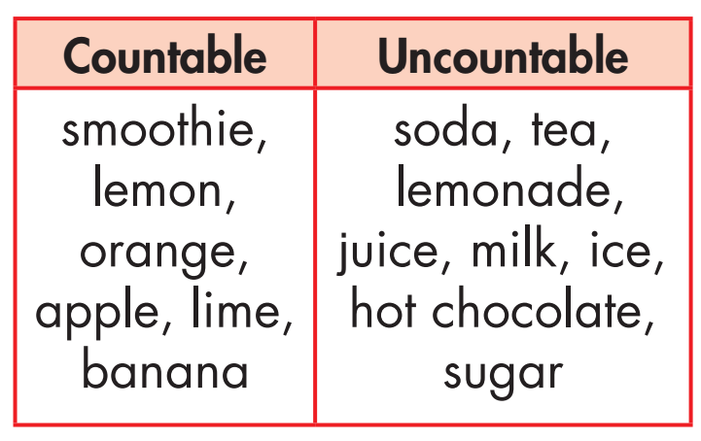
Grammar

Slide 26
Grammar
Singular | Plural
a smoothie a lemon an orange an apple a lime a banana | smoothies lemons oranges apples limes bananas

Slide 27

Grammar
milks
juices
sugars
sodas
teas
ices
hot chocolates

Slide 28
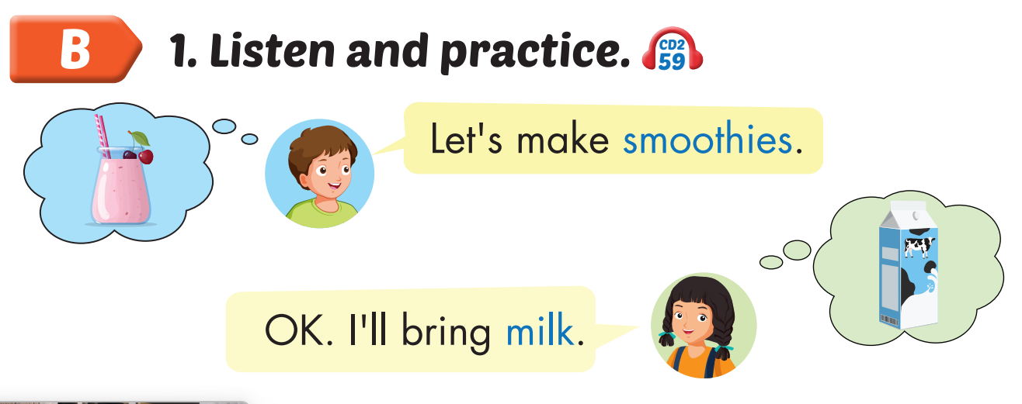
Click on B to hear the sound.

Slide 29
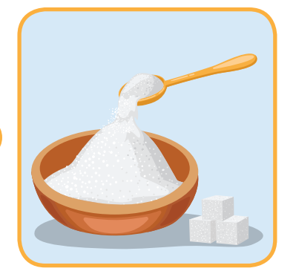
Let’s make __________.
Ok. I will bring ________.
smoothies
sugar

Slide 30

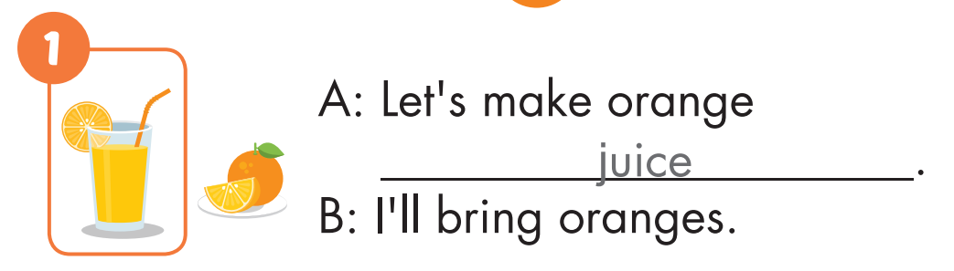

Slide 31
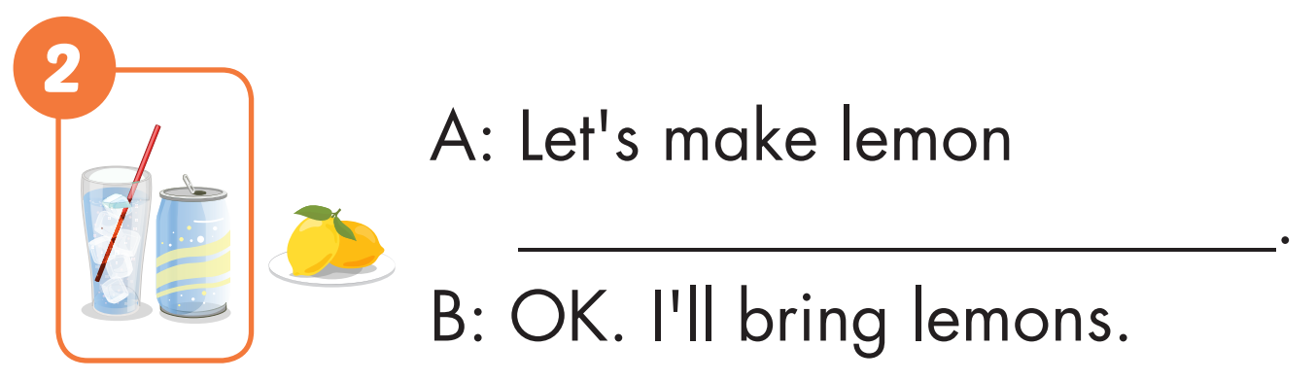
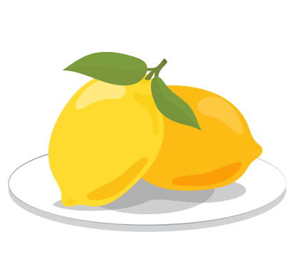
soda

Slide 32
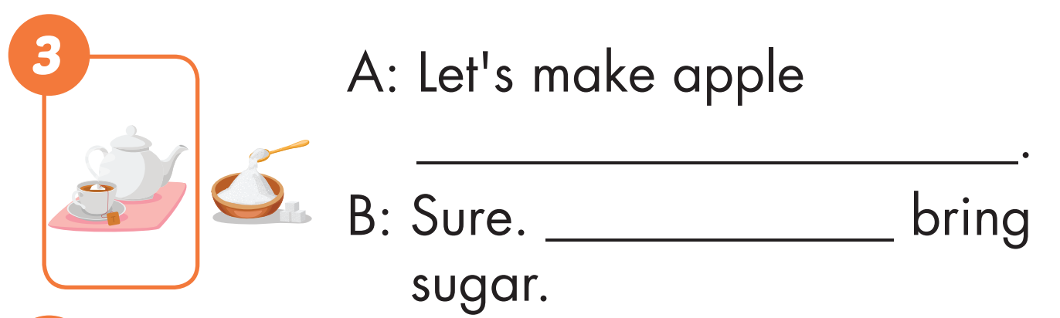
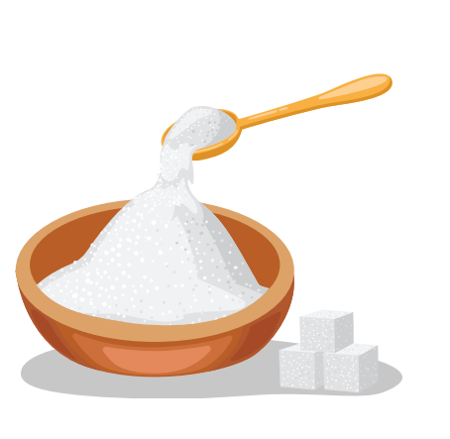
tea
I’ll

Slide 33
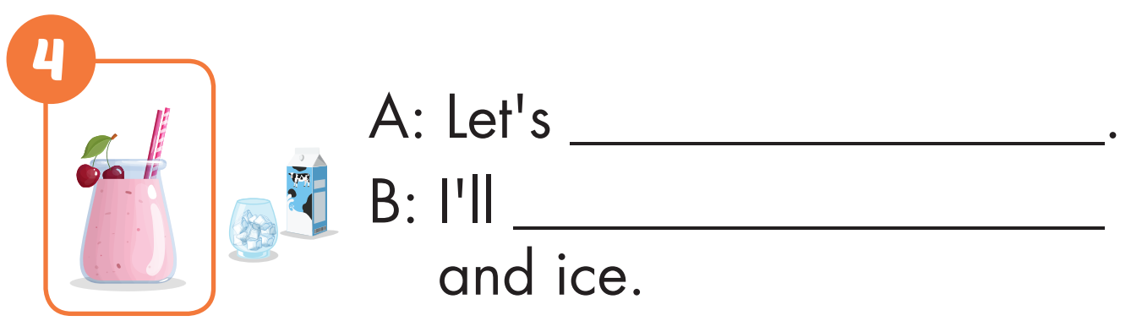
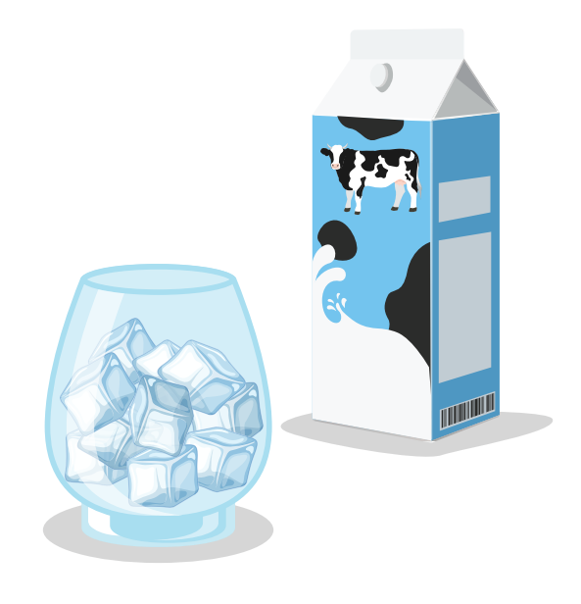
make smoothies
bring milk

Slide 34
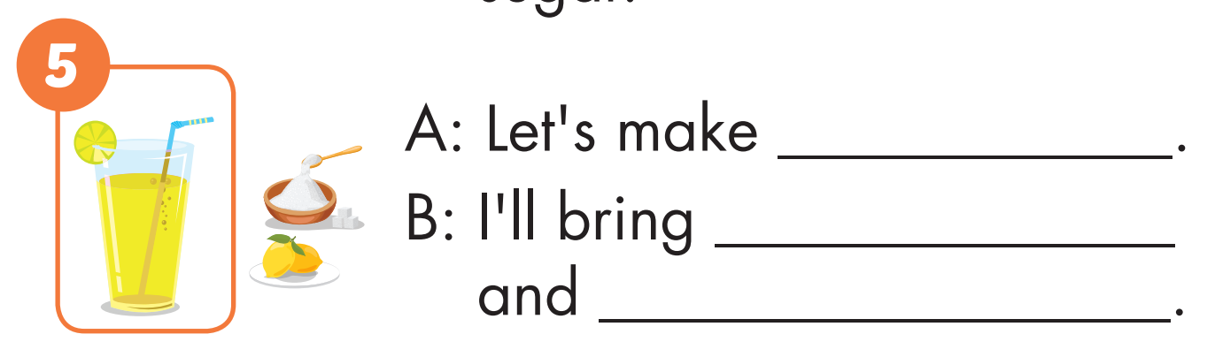
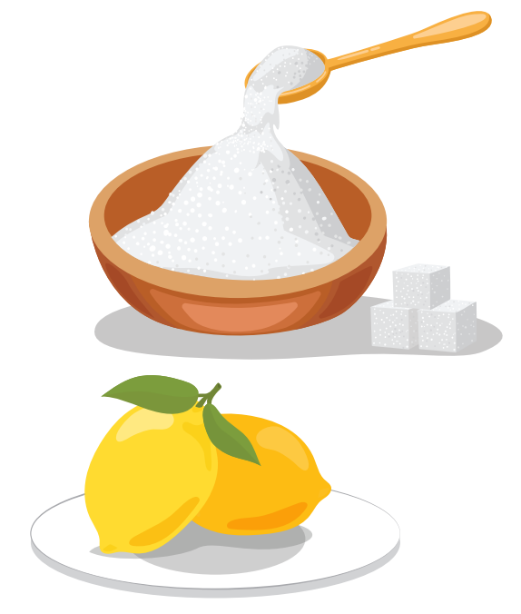
lemonade
lemons
sugar

Slide 35
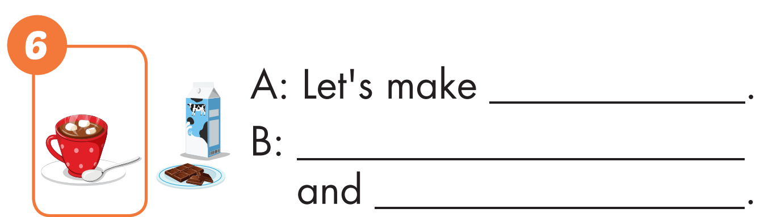
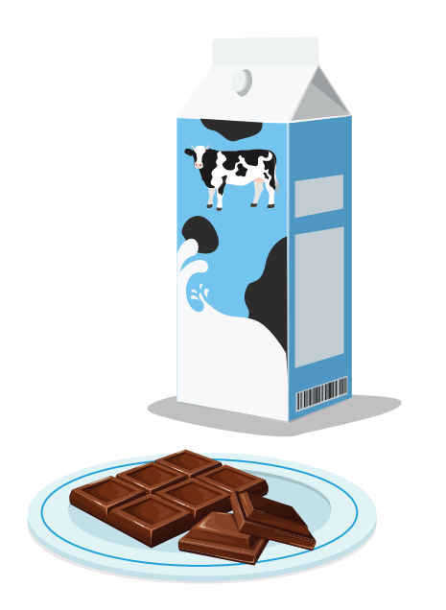
hot chocolate
Ok. I’ll bring milk
chocolate chips

Slide 36

Production

Slide 37

CONSOLIDATION

Slide 38

WRAP-UP

Slide 39
Today’s lesson
Vocabulary
soda, smoothie, tea, lemonade, juice, hot chocolate.
Structures/ Sentence patterns
Let's make smoothies.
OK.
I'll bring milk.

Slide 40
Homework
Practice the vocabularies and structure, and make sentences using them.
Prepare the next lesson (page 82 SB).

Slide 41

Enjoy your day!

Slide 42

Lesson 3
Stay positive and have a nice day!

