Slide 1

Unit 6
DESCRIBING PEOPLE
LESSON 1. 1 - PAGE 78

Slide 2
Objectives
By the end of this lesson, students will be able to identify family members
Vocabulary: tall, short, big, slim, strong, weak.
Structure: Is your father big or slim? / He's slim. / Is your sister tall or short? / She's tall.

Slide 3

WARM UP

Slide 4

Pass the Ball Game
Pass the ball.
When the music stops – whoever has the ball must answer the question.

Slide 5

Pass the BALL!

Slide 6

What does this sign mean?

Slide 7
Pass the BALL!

Slide 8


Where's the school?

Slide 9
Pass the BALL!

Slide 10
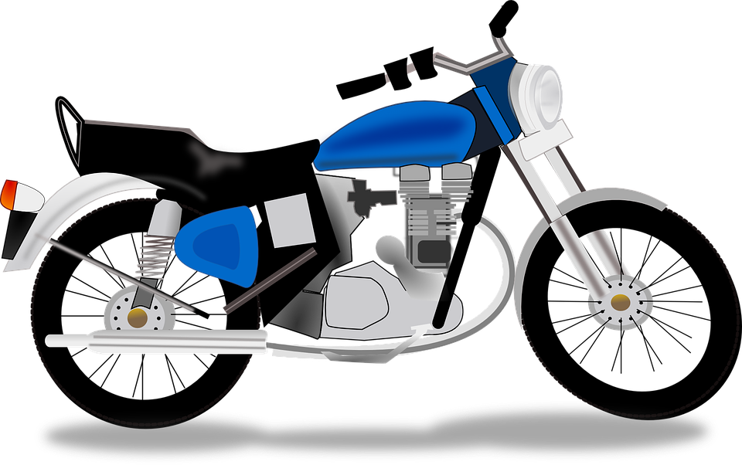
How do you go to school?

Slide 11
Pass the BALL!

Slide 12

How do you go to the library?

Slide 13

It’s time to learn …

Slide 14

New words
tall,
short,
big,
slim,
strong,
weak.

Slide 15

Presentation

Slide 16

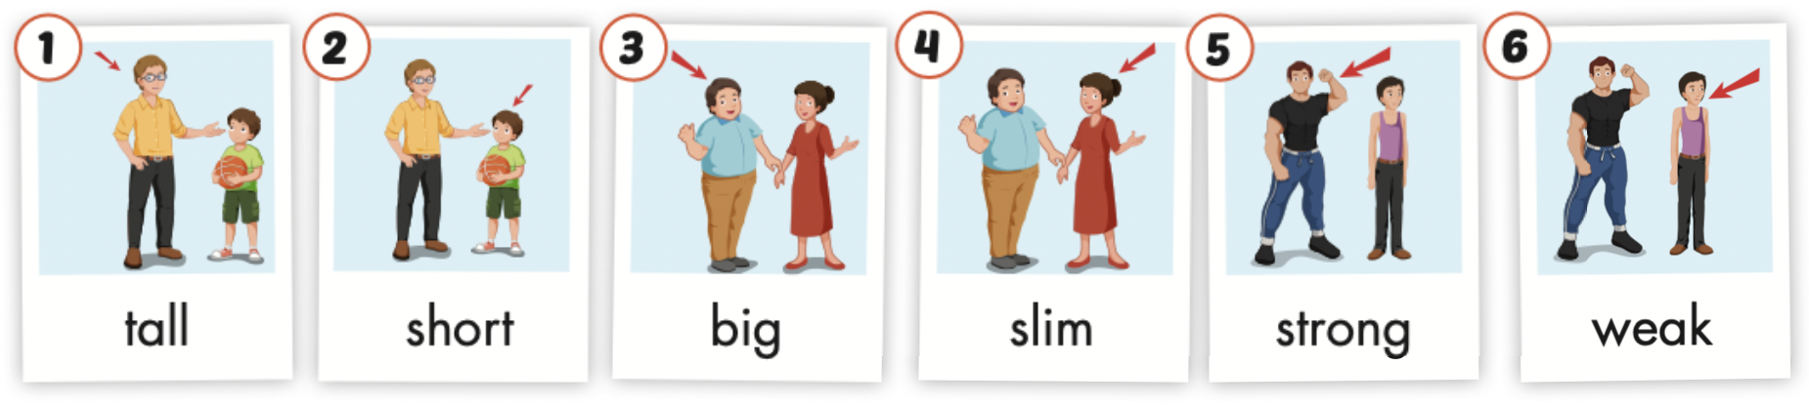
Click the icon to hear the sound.

Slide 17

Practice

Slide 18
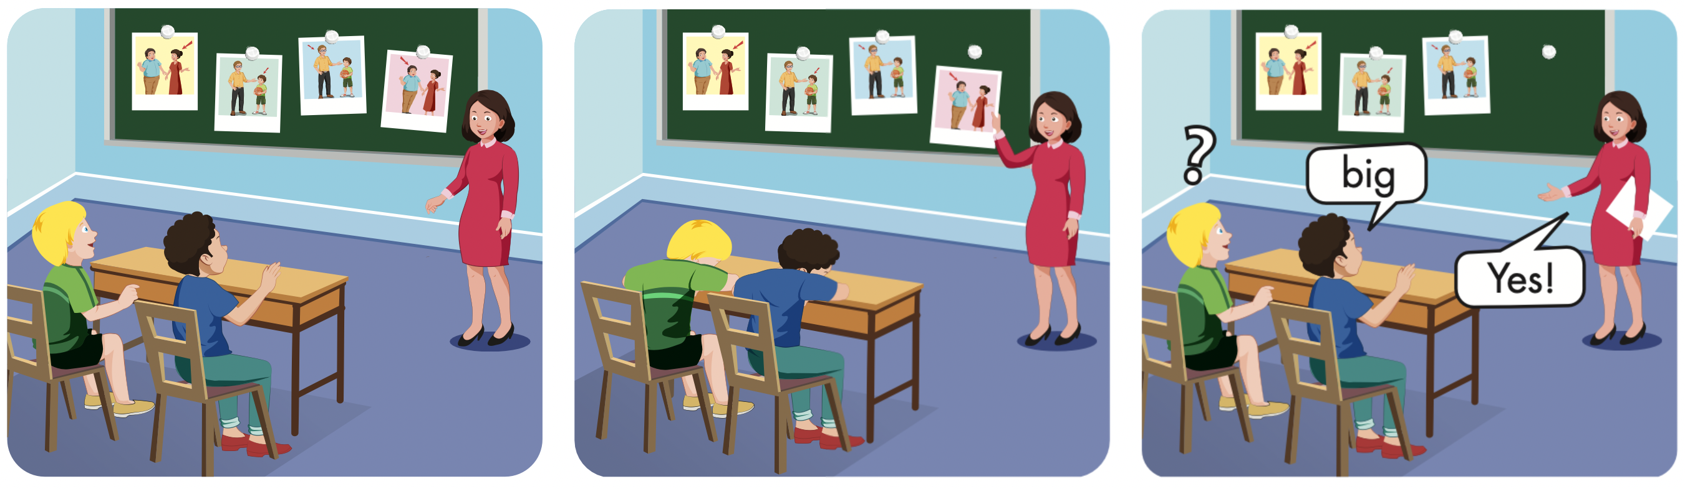

Slide 19
Lucky Numer
A
B
1
2
3
1
2
3
4
5
1
2
3
4
5
4
5
6
END!
7
8
9

Slide 20
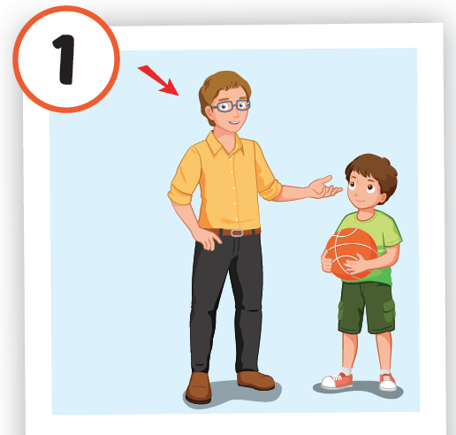

Slide 21
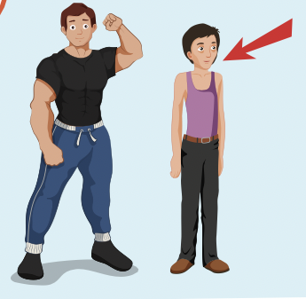

Slide 22
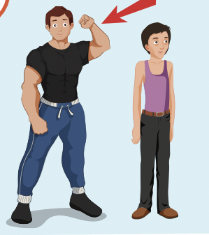

Slide 23
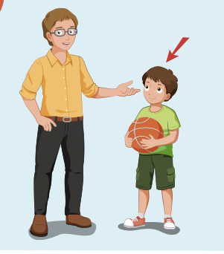

Slide 24
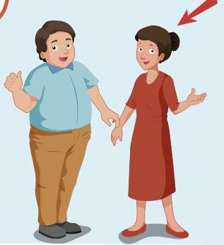

Slide 25
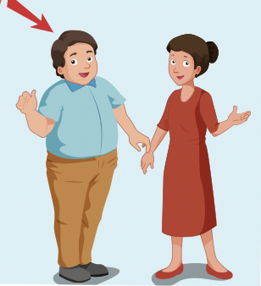

Slide 26
Lucky Number

Slide 27
Structures
Is your father big or slim?
He's slim.
Is your sister tall or short?
She's tall.

Slide 28
Presentation

Slide 29

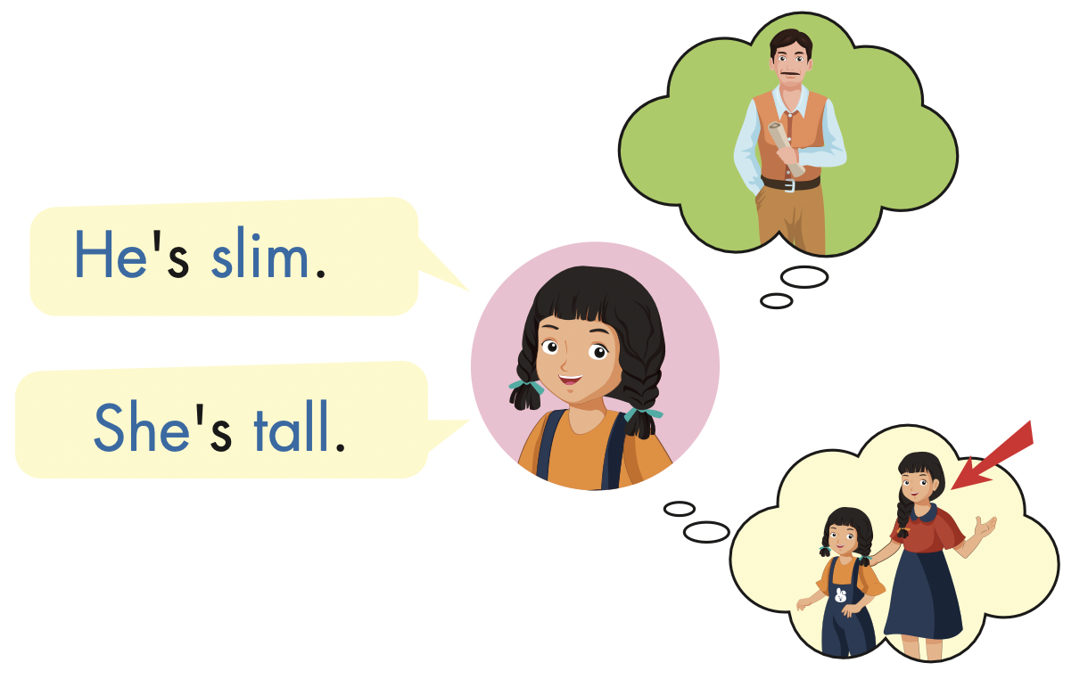
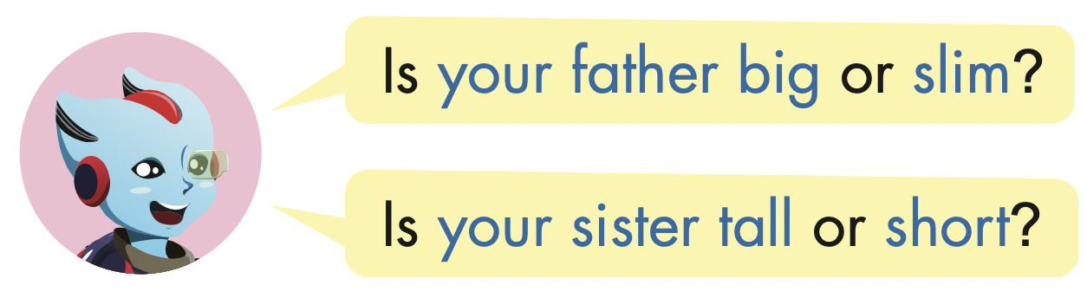

Slide 30
Practice

Slide 31

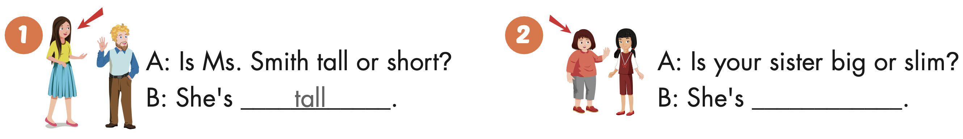

Slide 32
big

Slide 33
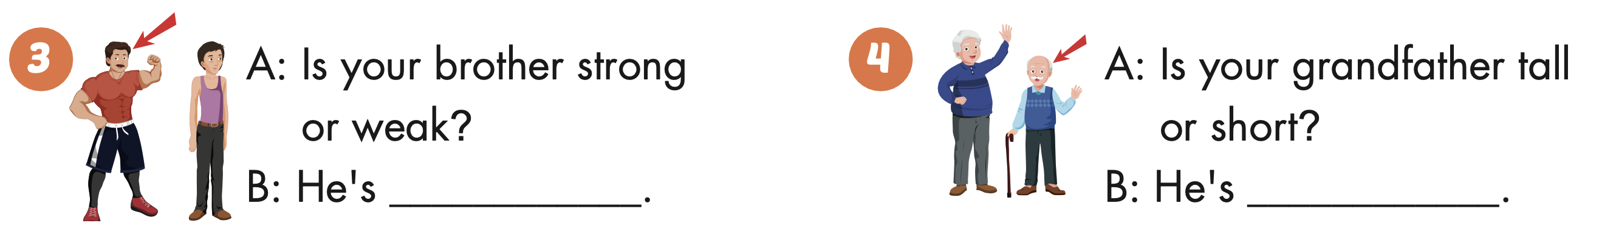
strong

Slide 34
short

Slide 35

Production

Slide 36

CONSOLIDATION

Slide 37

WRAP-UP

Slide 38
Today’s lesson
Vocabulary
tall, short, big, slim, strong, weak.
Structures/ Sentence patterns
Is your father big or slim? / He's slim. / Is your sister tall or short? / She's tall.

Slide 39
Homework
Practice the vocabularies and structure, and make sentences using them.
Prepare the next lesson (page 79 SB).

Slide 40

Enjoy your day!

