Slide 1

Unit 5: HEALTH
Lesson 3.1
Page 70

Slide 2
Objectives
By the end of this lesson, students will be able to give advice about health problems.
Vocabulary: see a dentist, take some medicine, get some rest, stay up late, take a bath, skip breakfast.
Structure: You should see a dentist.
You shouldn't stay up late

Slide 3

WARM UP

Slide 4




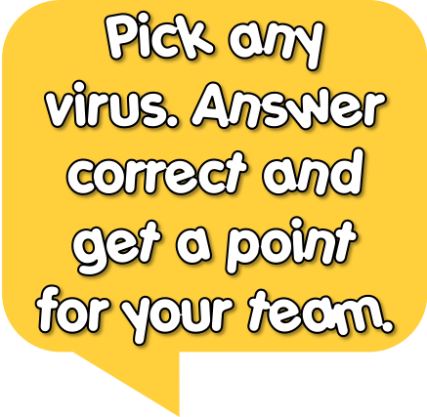





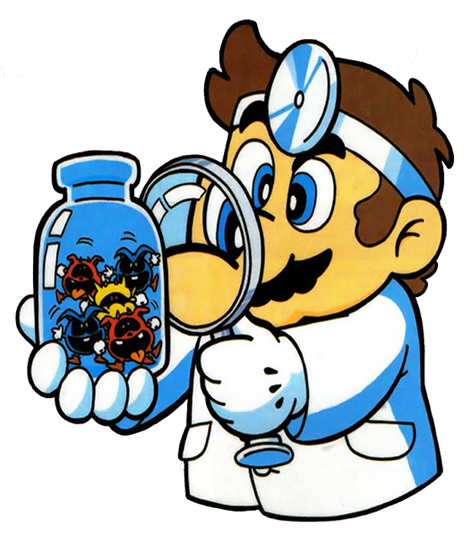
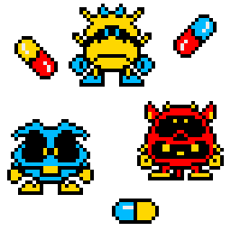





1
2
3
4
Welcome to my clinic!
5
8
7
6

Slide 5
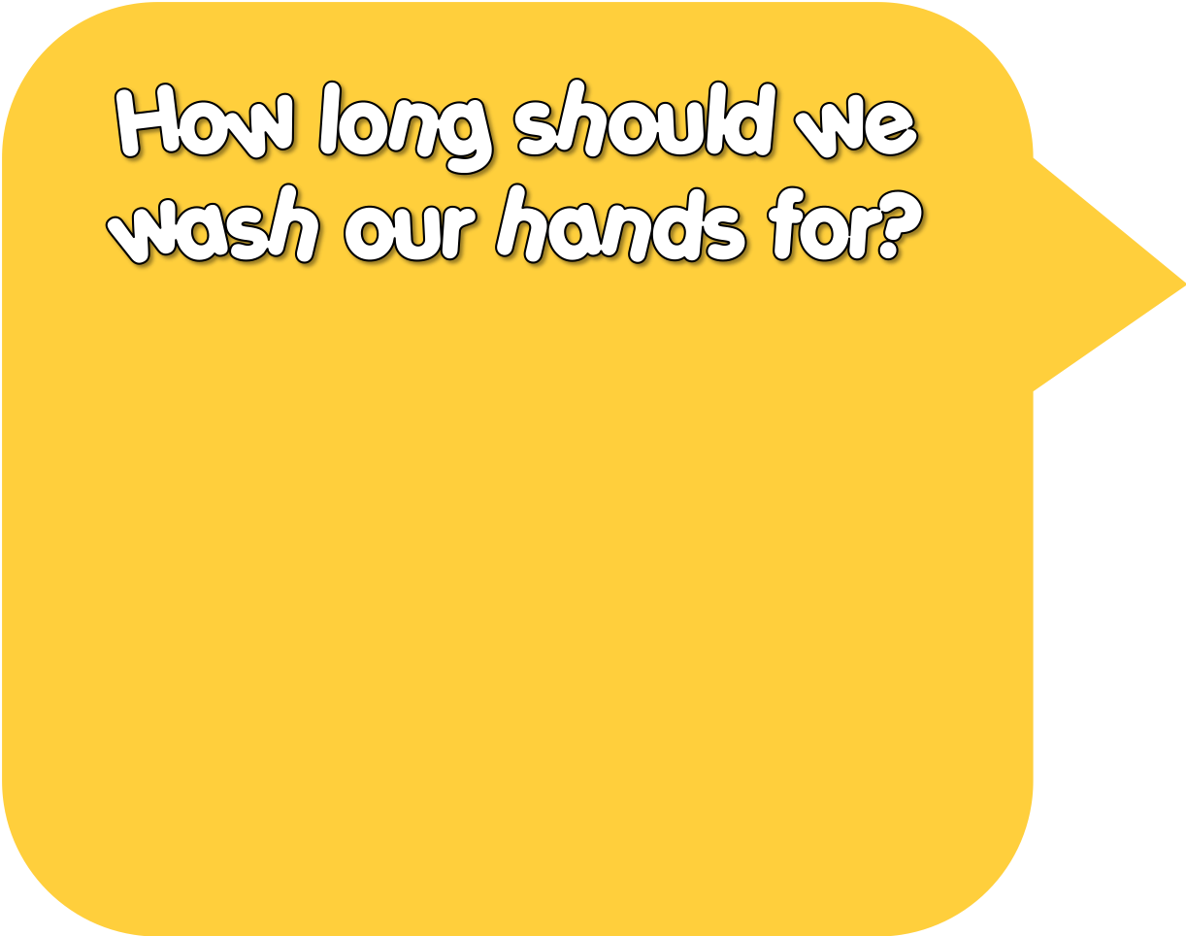

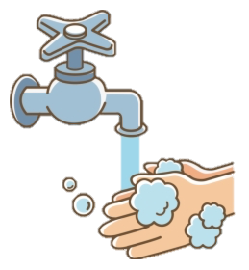



1-2 sec
3-10 sec
20-30 sec

Slide 6
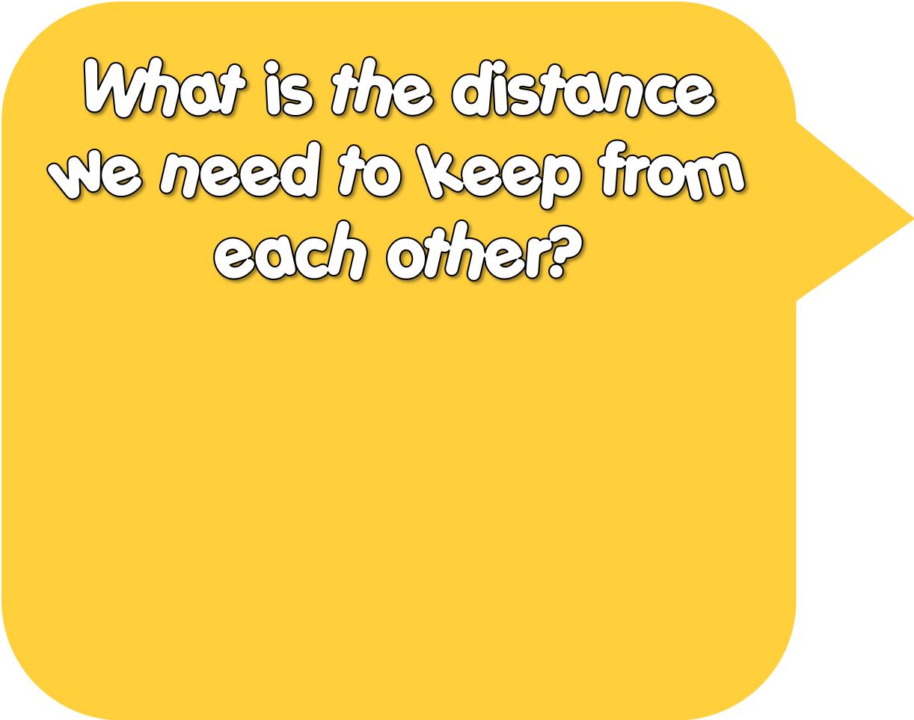
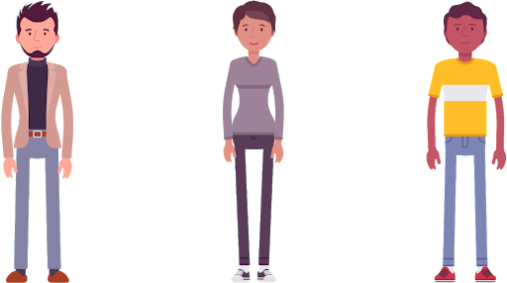
2 m
3 m
100 m

Slide 7
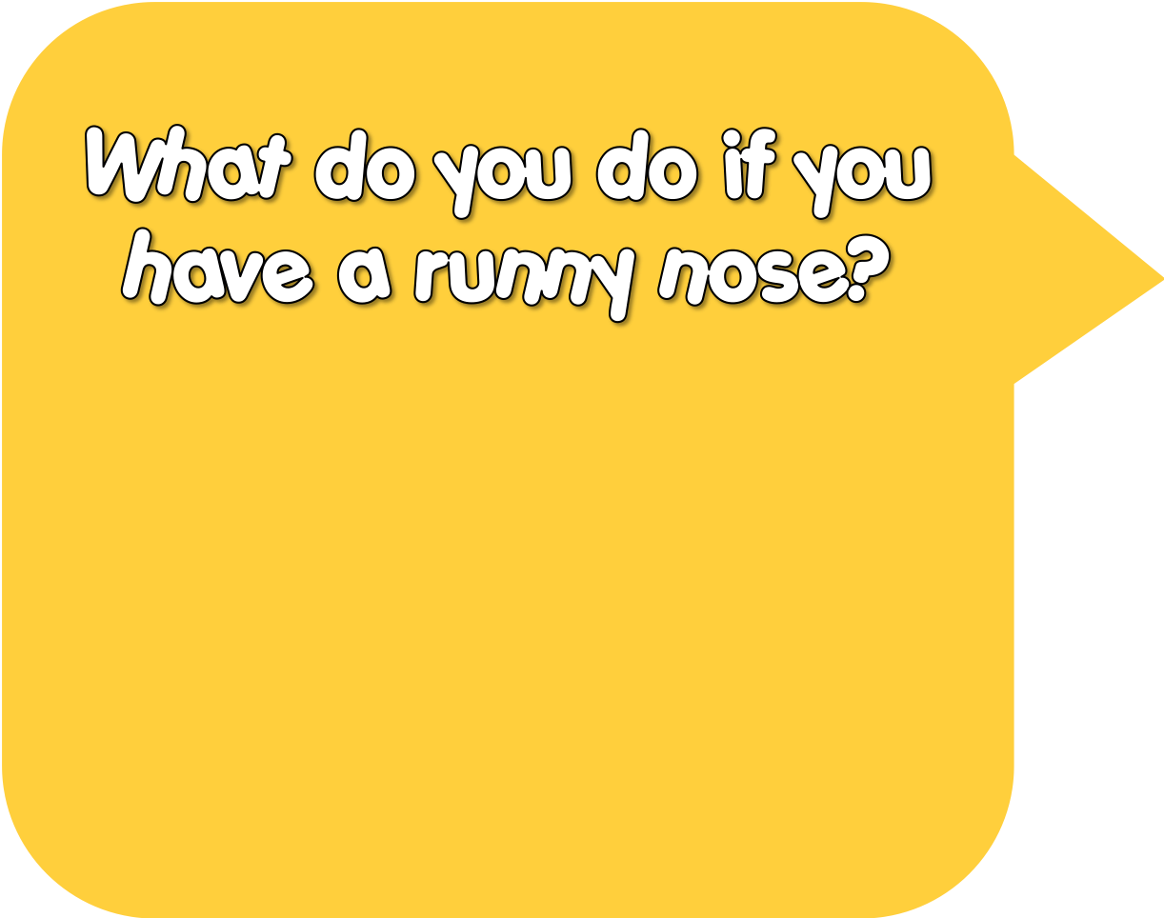

Lick it
Use a tissue
Nothing

Slide 8
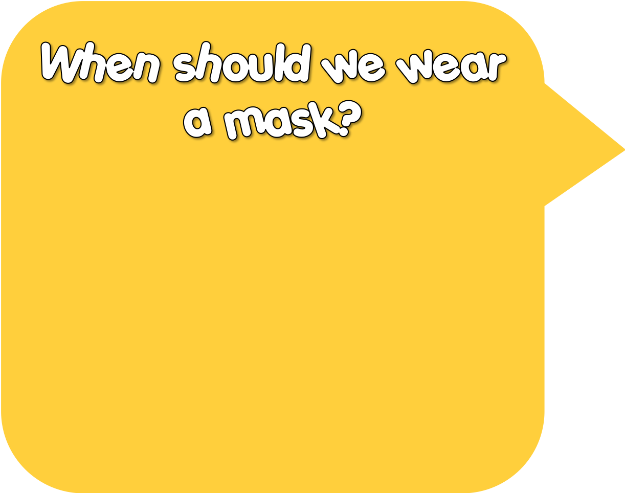
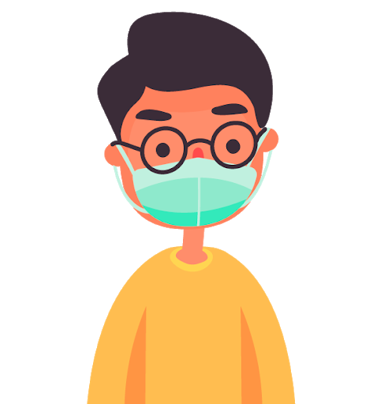
Outside
Eating
Swimming

Slide 9

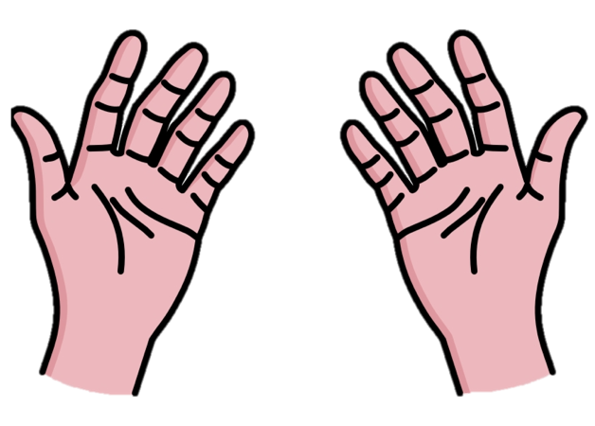
Soap
Coffee
Butter

Slide 10

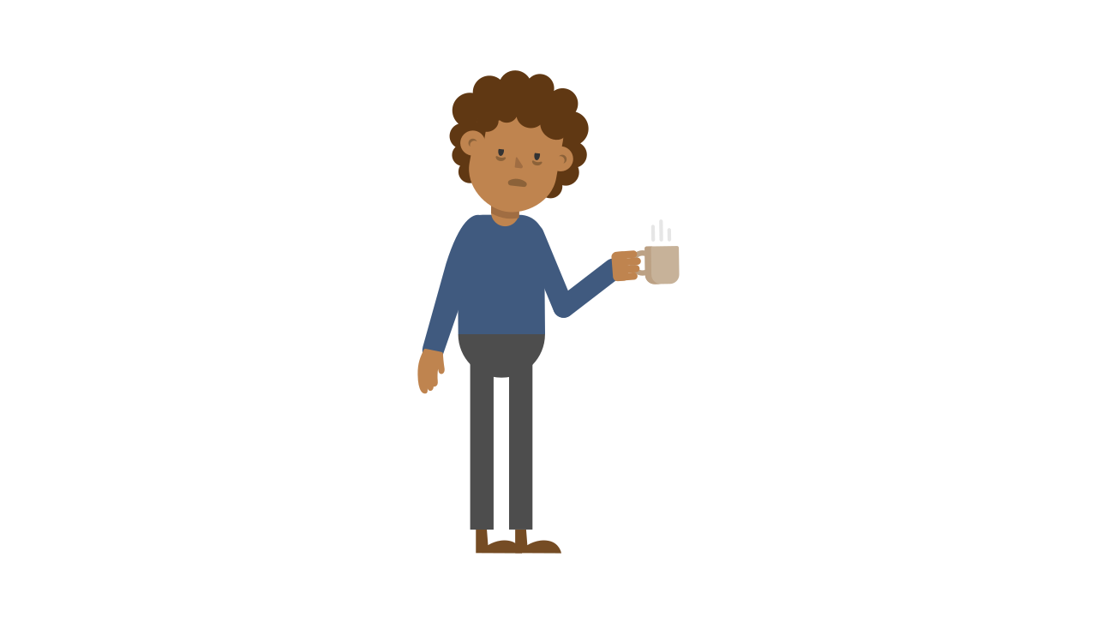
Yes
No
Maybe

Slide 11
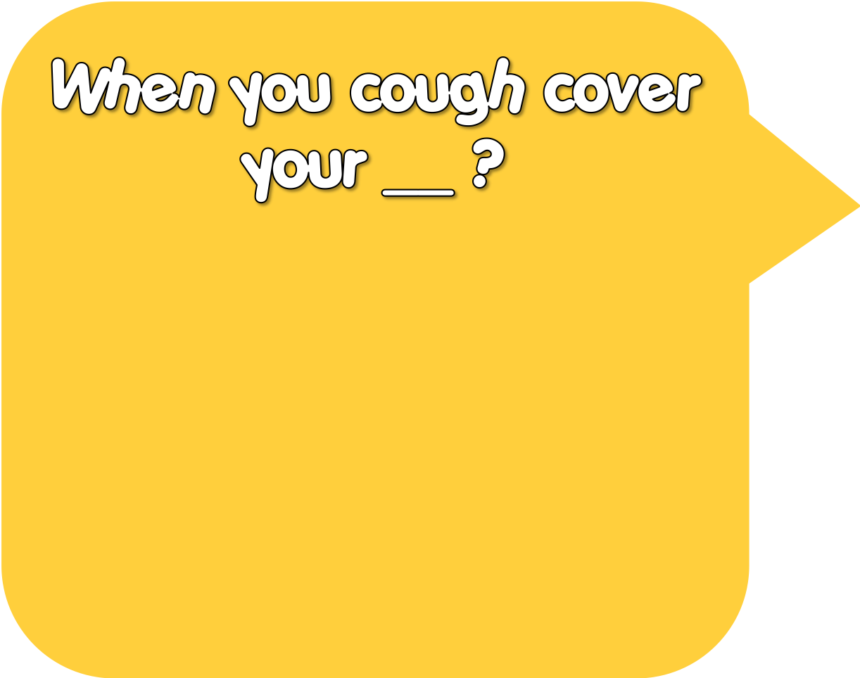
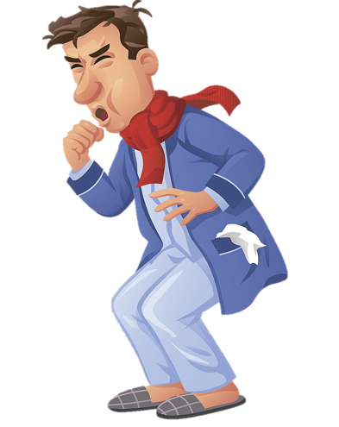
Eyes
Nose
Mouth

Slide 12

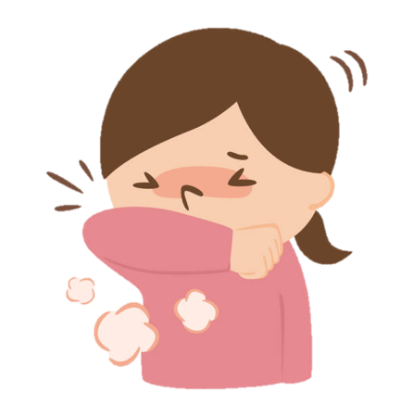
Cover your eyes
Use the toilet
Use your elbow

Slide 13

It’s time to learn …

Slide 14

New words
see a dentist, take some medicine, get some rest, stay up late, take a bath, skip breakfast

Slide 15

Presentation

Slide 16


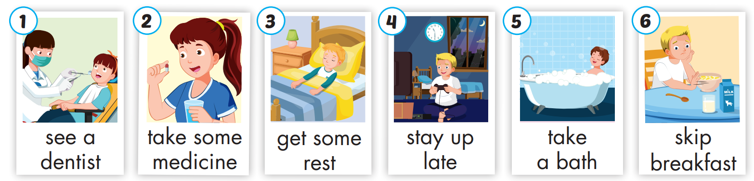
Click on A to hear the sound.
/siː/ /eɪ/ /ˈden.t̬ɪst/
đi khám nha sĩ
/teɪk/ /sʌm/ /ˈmed.ɪ.sən/
uống thuốc
/ɡet/ /sʌm/ /rest/
nghỉ ngơi
/steɪ/ /ʌp/ /leɪt/
thức khuya
/teɪk/ /eɪ/ /bæθ/
đi tắm
/skɪp/ /ˈbrek.fəst/
bỏ bữa sáng
Notes:
Click vào hình A. 1. Listen and point. Repeat để cho cả audio full chạy

Slide 17
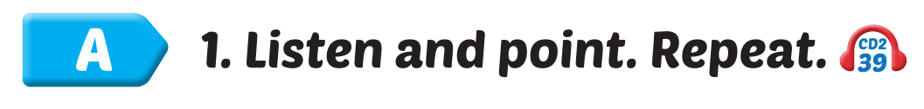
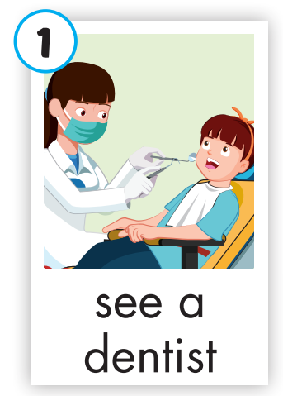
Click on the picture to hear the sound.
see a dentist
/siː/ /eɪ/ /ˈden.t̬ɪst/
đi khám nha sĩ

Slide 18
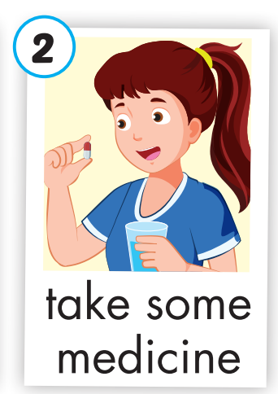
Click on the picture to hear the sound.
take some medicine
/teɪk/ /sʌm/ /ˈmed.ɪ.sən/
uống thuốc

Slide 19
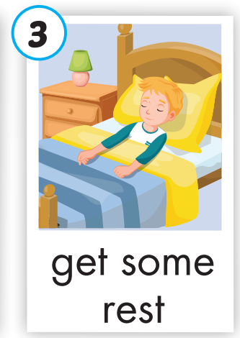
Click on the picture to hear the sound.
get some rest
/ɡet/ /sʌm/ /rest/
nghỉ ngơi

Slide 20
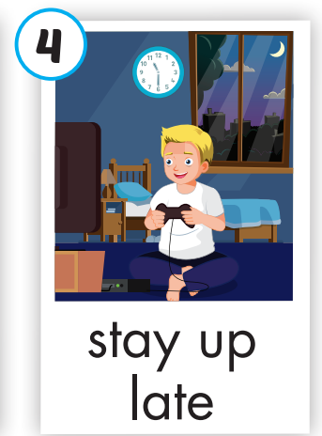
Click on the picture to hear the sound.
stay up late
/steɪ/ /ʌp/ /leɪt/
thức khuya

Slide 21
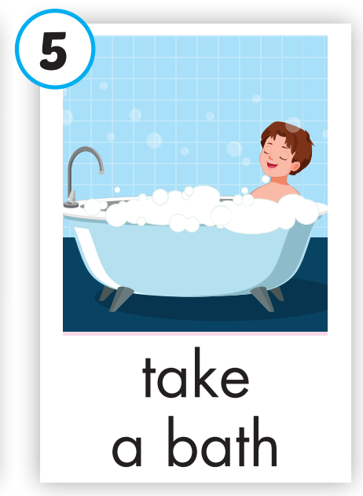
Click on the picture to hear the sound.
take a bath
/teɪk/ /eɪ/ /bæθ/
đi tắm

Slide 22
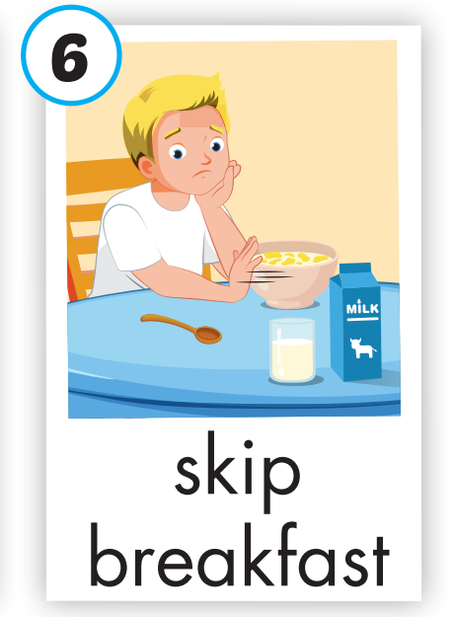
Click on the picture to hear the sound.
skip breakfast
/skɪp/ /ˈbrek.fəst/
bỏ bữa sáng

Slide 23
Practice

Slide 24
Look, read and choose

Slide 25
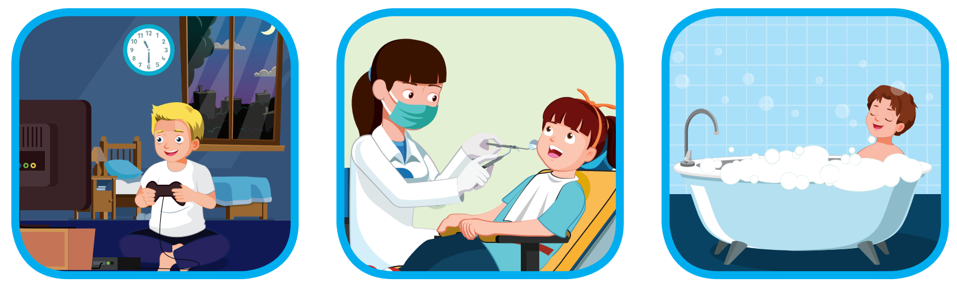
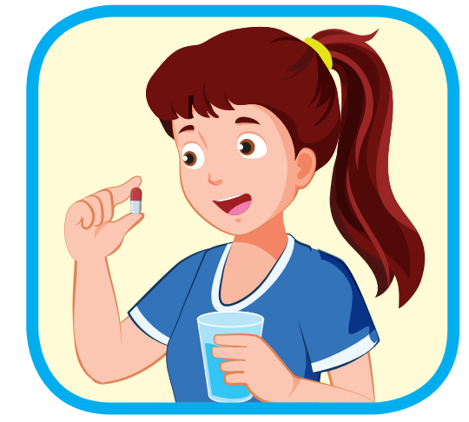

Look, read and choose
A
B
C
stay up late

Slide 26
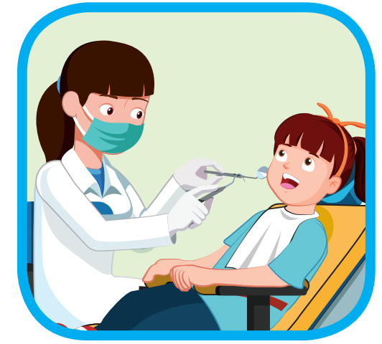
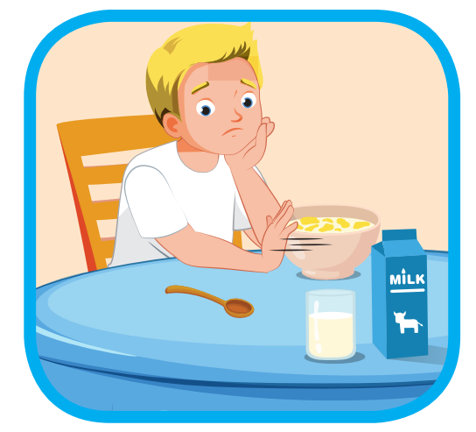
Look, read and choose
A
B
C
skip breakfast

Slide 27
Look, read and choose
A
B
C
take a bath

Slide 28
Look, read and choose
A
B
C
see a dentist

Slide 29
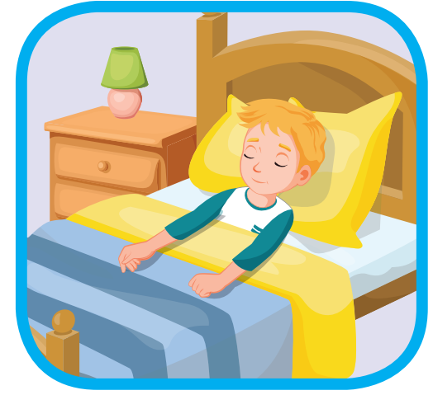
Look, read and choose
A
B
C
get some rest

Slide 30

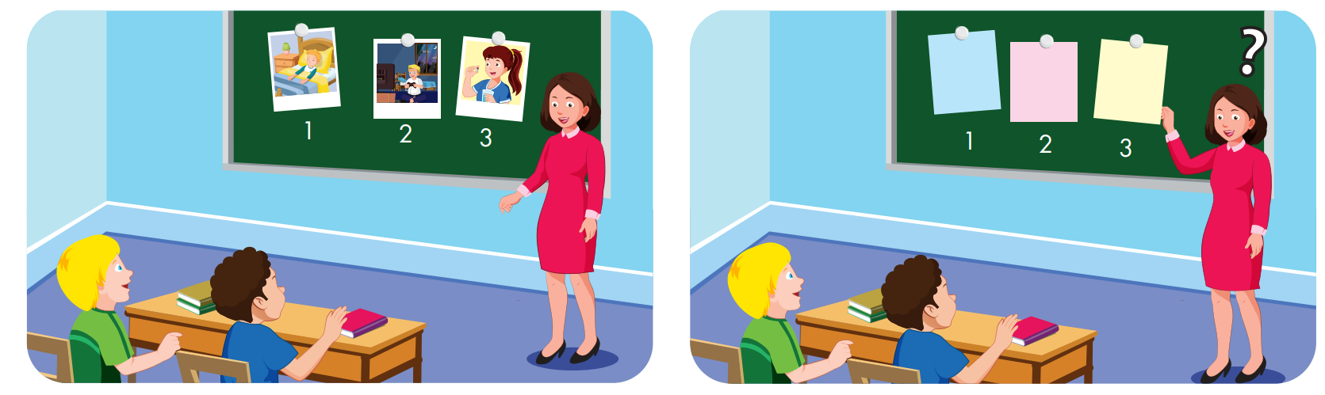
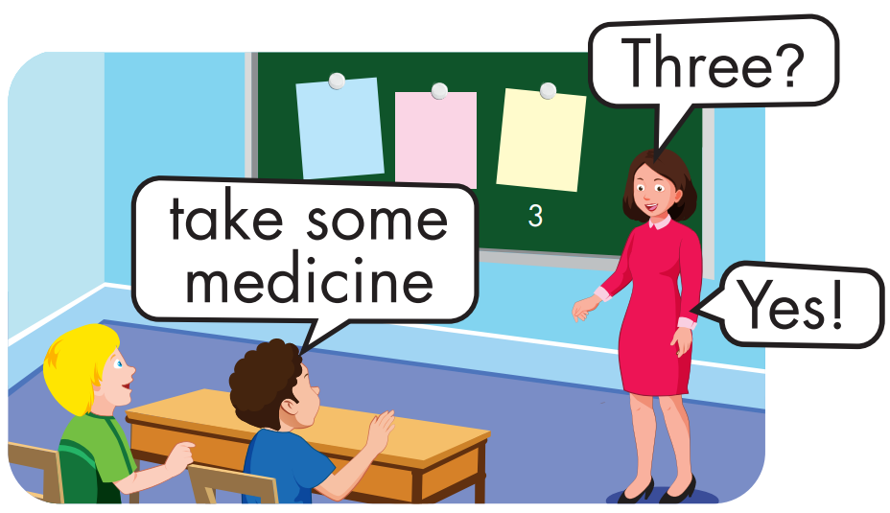

Slide 31
Structure
You should see a dentist.
You shouldn't stay up late.

Slide 32
Presentation

Slide 33
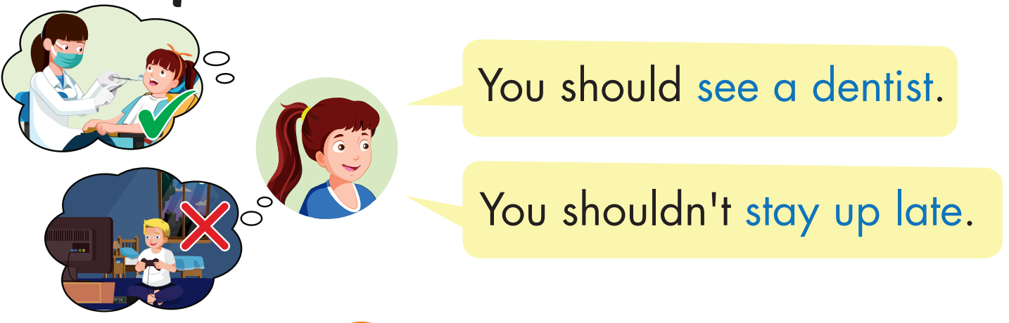
Structure

Slide 34

Practice

Slide 35
Click on B to hear the sound.

Slide 36
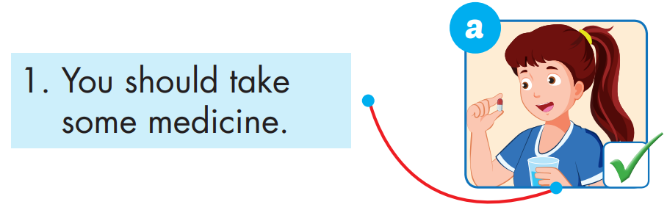

Slide 37
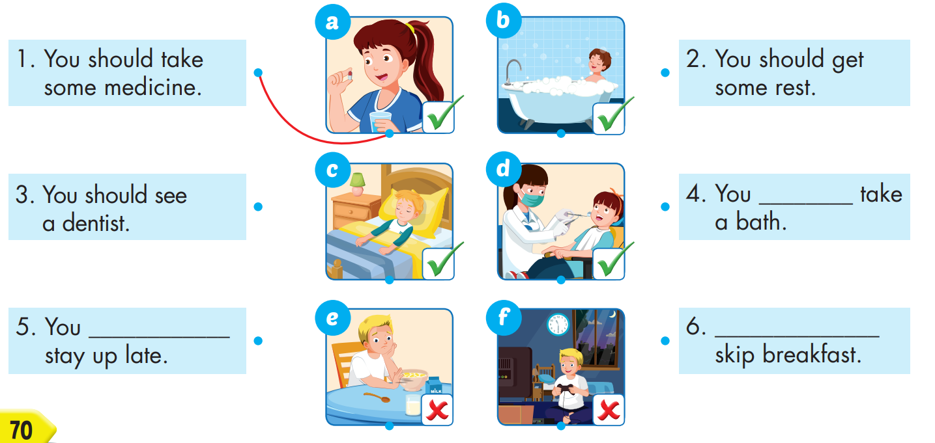
should
shouldn’t
You shouldn’t

Slide 38

Production

Slide 39

CONSOLIDATION

Slide 40

WRAP-UP

Slide 41
Today’s lesson
Vocabulary
see a dentist, take some medicine, get some rest, stay up late, take a bath, skip breakfast.
Structures/ Sentence patterns
You should see a dentist.
You shouldn't stay up late.

Slide 42
Homework
Practice the vocabularies and structure, and make sentences using them.
Do the exercises in Tiếng Anh 5 i-Learn Smart Start WB (page 47).
Do the exercises in Tiếng Anh 5 i-Learn Smart Start Notebook.
Prepare the next lesson (page 71 SB).

Slide 43

Enjoy your day!

Slide 44

Lesson 3
Stay positive and have a nice day!

