Slide 1

Unit 5: Getting Around
Lesson 1.2
Page 65

Slide 2
Objectives
By the end of this lesson, students will be able to…
Vocabulary: Pronounce and use the words related to the topic properly: stop, do not enter, turn left, turn right, no parking.
Structure: What does that sign mean? - It means "Stop".
Phonics: Identify the /g/ sound and practice the conversations.

Slide 3

WARM UP

Slide 4

It’s time to learn …

Slide 5

Phonics
/g/

Slide 6
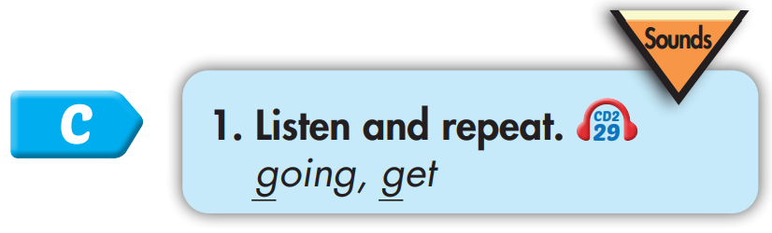
Click CD1 track 04 to hear the sound.
g g going
g g get

Slide 7
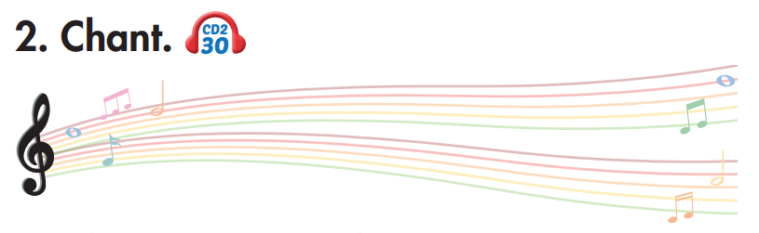
Track 30
Where are we going?
Where are we going?
We're going around town.
We're going around town.
Can we get some ice cream?
Can we get some ice cream?
Yes, we can!
Yes, we can!
Click on the music note to hear the sound.

Slide 8

game
guide
List the words with the same sound /g/. Practice saying them with a partner.
good
great
guest
greet
grape
give

Slide 9

Listening

Slide 10
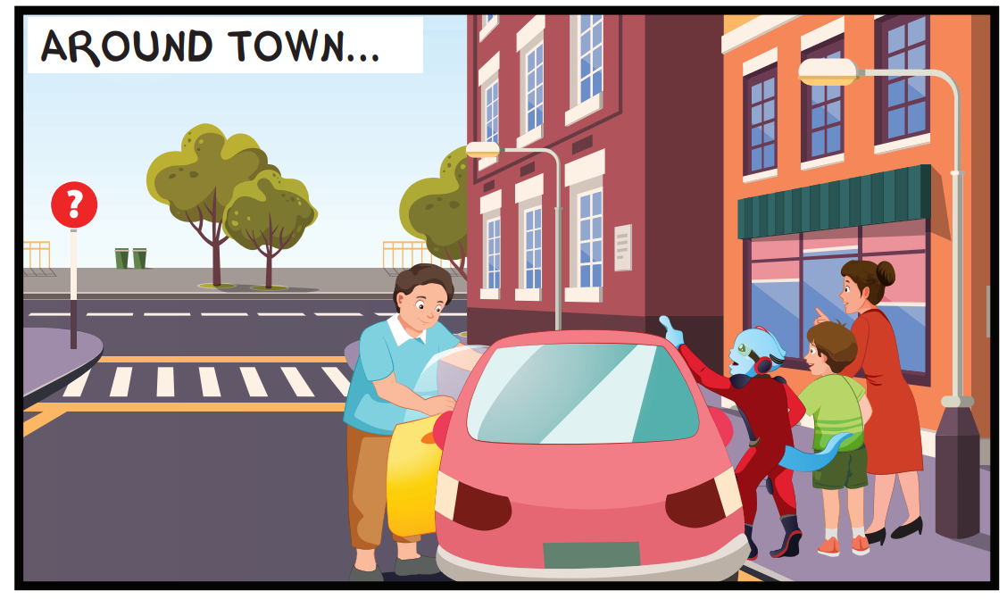
Look at the picture and answer.
Pre-Listening
Who can you see?
Alfie, Tom, Mr. Brown and Mrs. Brown

Slide 11
Look at the picture and answer.
Pre-Listening
What are they doing?
They are going around
/driving around.

Slide 12
Look at the picture and answer.
Pre-Listening
What things can you see?
I can see streets, an ice cream shop, cars

Slide 13

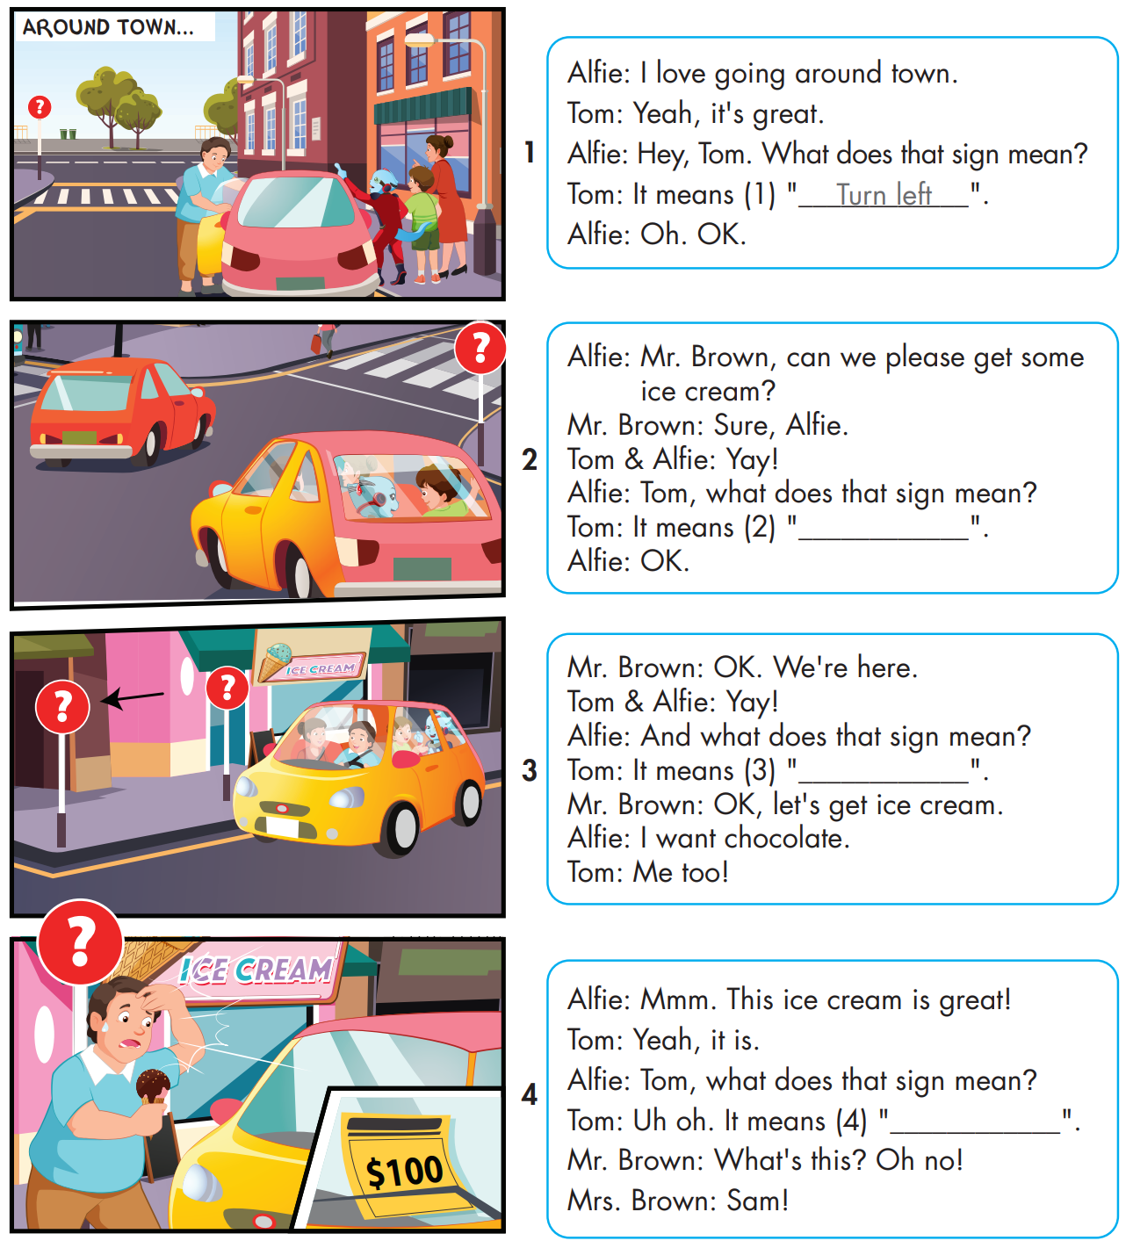
While-Listening

Slide 14
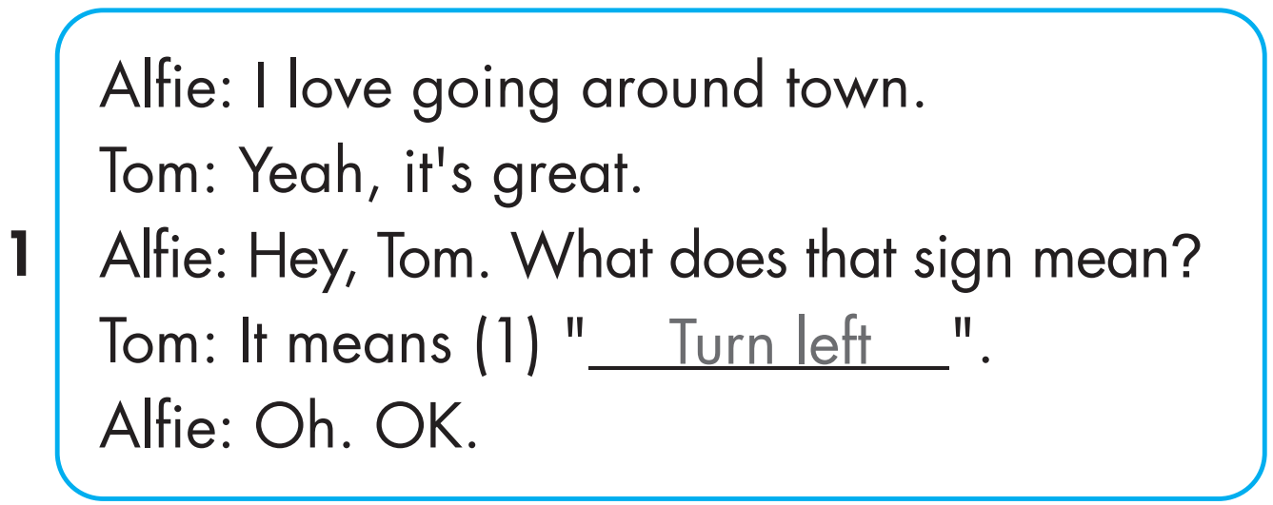
While-Listening

Slide 15
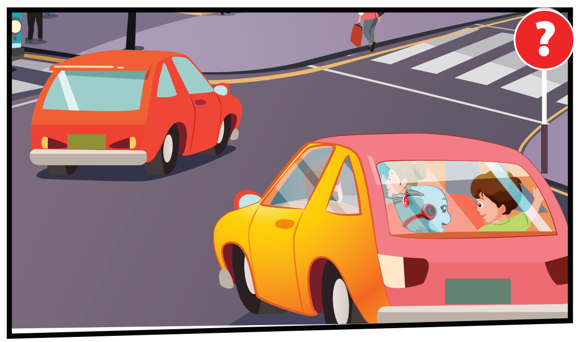
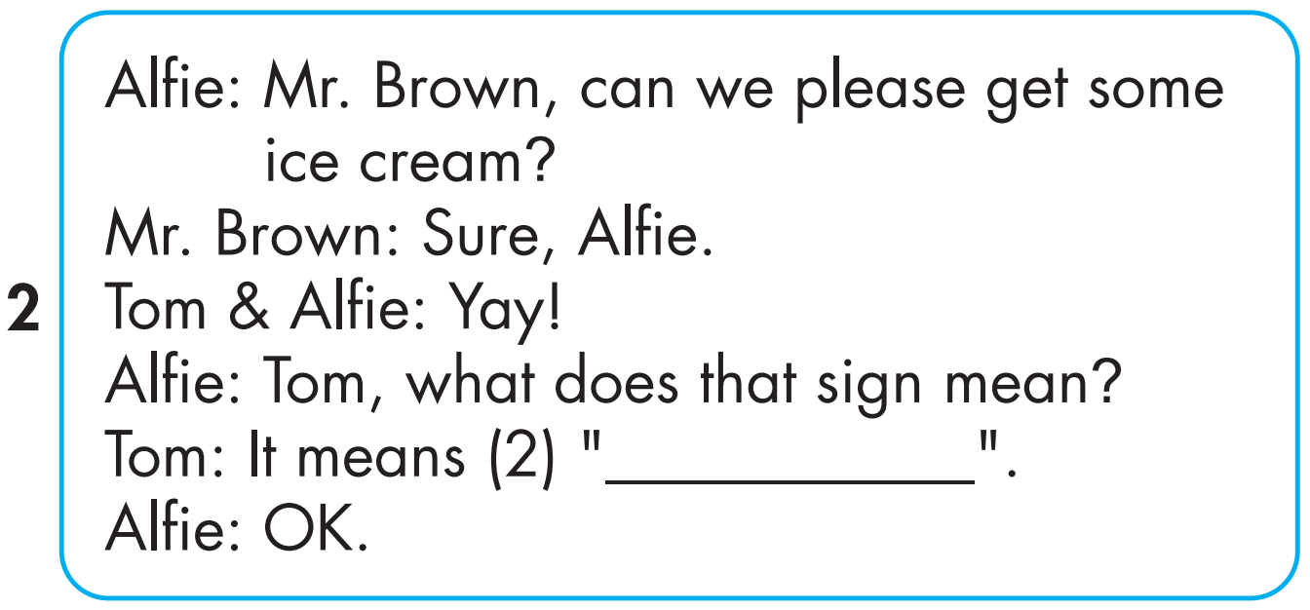
While-Listening

Slide 16
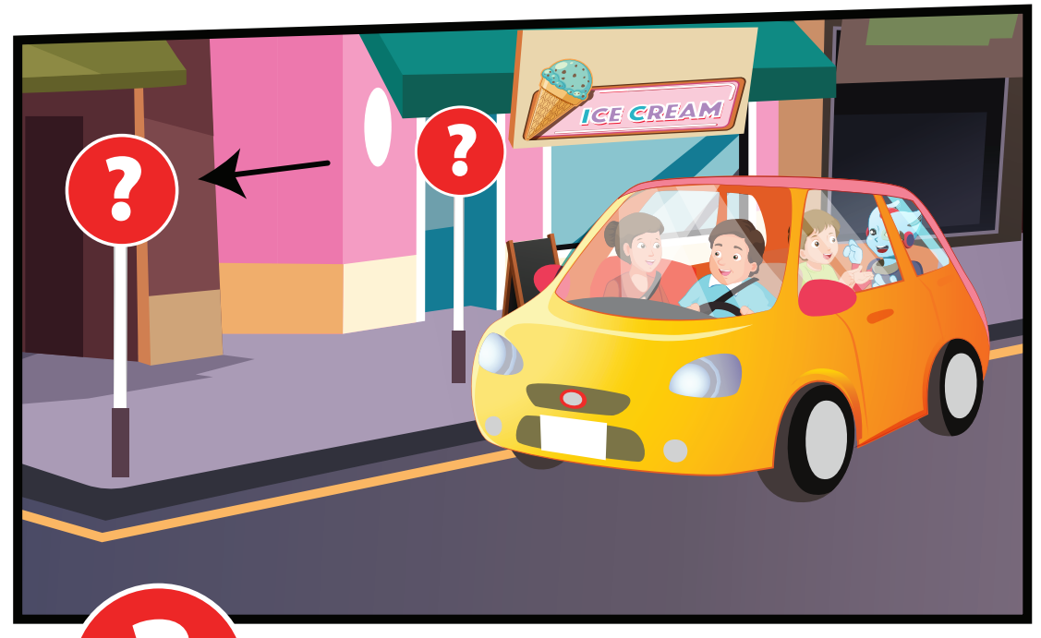
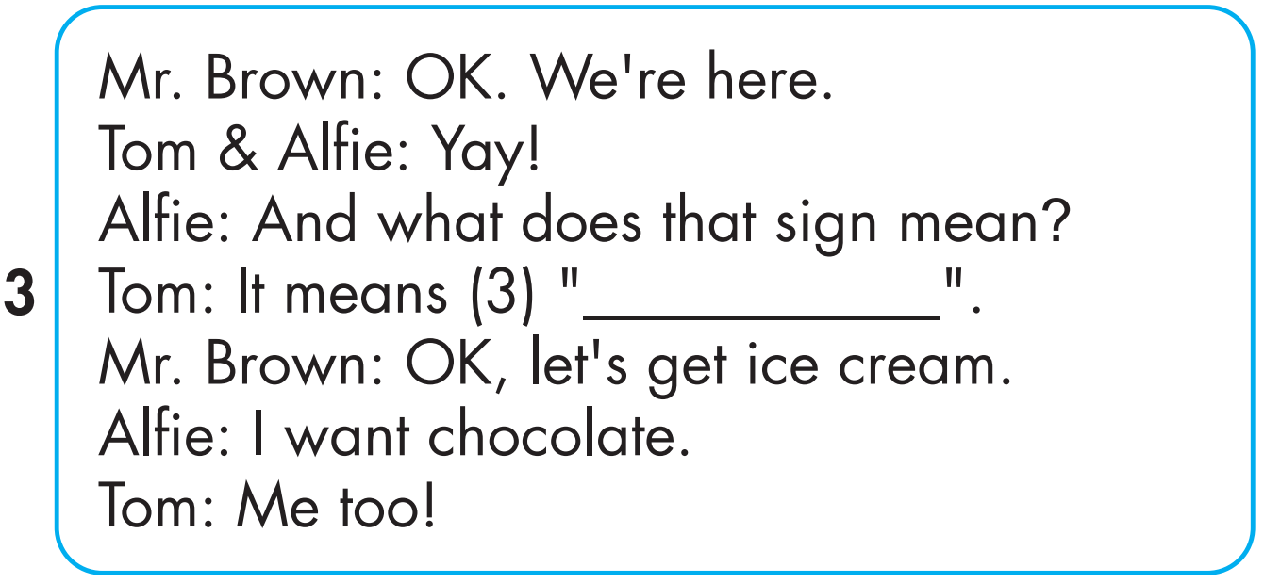
While-Listening
Notes:
Bấm vô chữ listen audio sẽ bật, muốn tắt bấm vô audio lần nữa

Slide 17
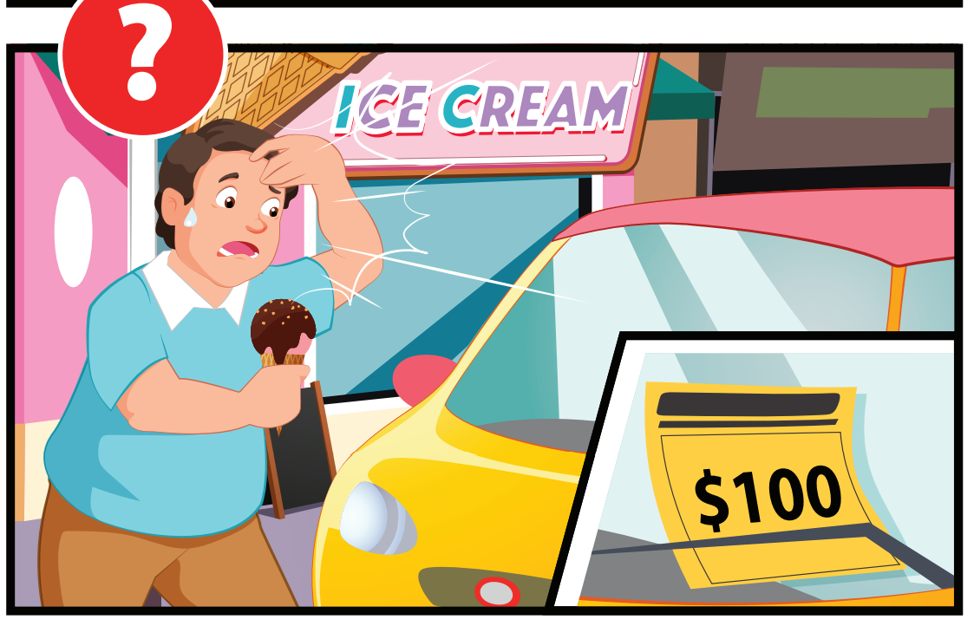
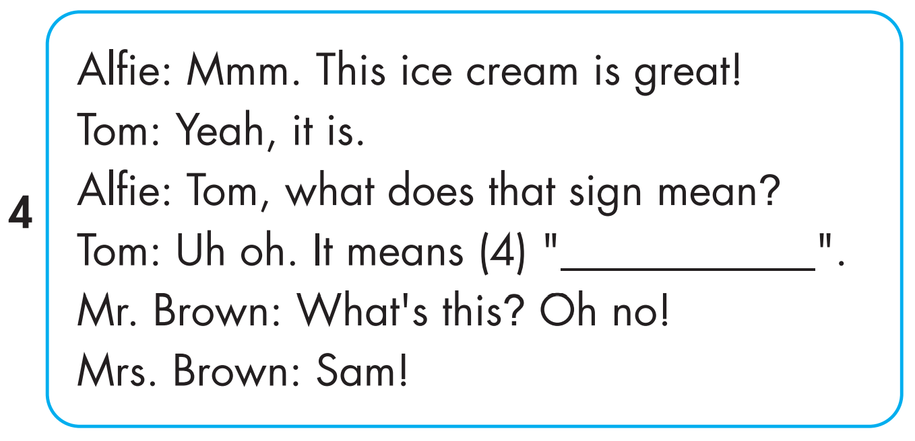
While-Listening

Slide 18

Post-Listening

Slide 19

WRAP-UP

Slide 20
Today’s lesson
Vocabulary
stop, do not enter, turn left, turn right, no parking.
Structures/ Sentence patterns
What does that sign mean?
It means "Stop".
Phonics
Identify the /g/ sound and practice the conversations.

Slide 21
Homework
Practice the vocabularies and structure, and make sentences using them.
Do the exercises in Tiếng Anh 4 i-Learn Smart Start WB (page 43).
Do the exercises in Tiếng Anh 4 i-Learn Smart Start Notebook (page 28).
Prepare the next lesson (page 66 SB).

Slide 22

Enjoy your day!

