Slide 1

Unit 5: Getting Around
Lesson 1.1
Page 64

Slide 2
Objectives
By the end of this lesson, students will be able to…
Vocabulary: Pronounce and use the words related to the topic properly: stop, do not enter, turn left, turn right, no parking.
Structure: What does that sign mean? - It means "Stop".

Slide 3

WARM UP

Slide 4

It’s time to learn …

Slide 5

New words
stop, do not enter, turn left,
turn right, no parking.

Slide 6

Presentation

Slide 7


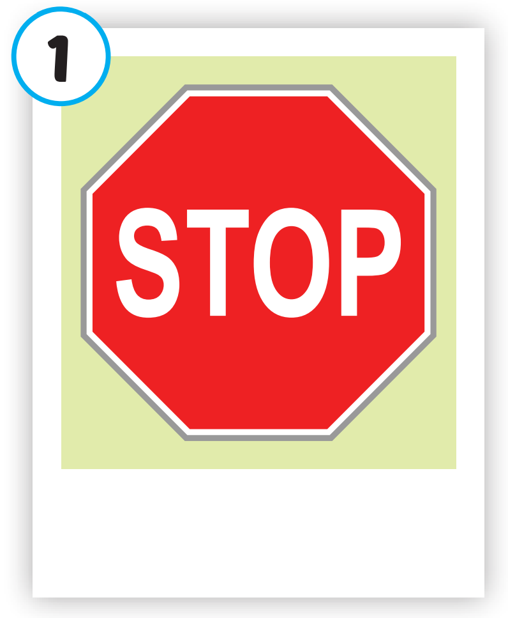
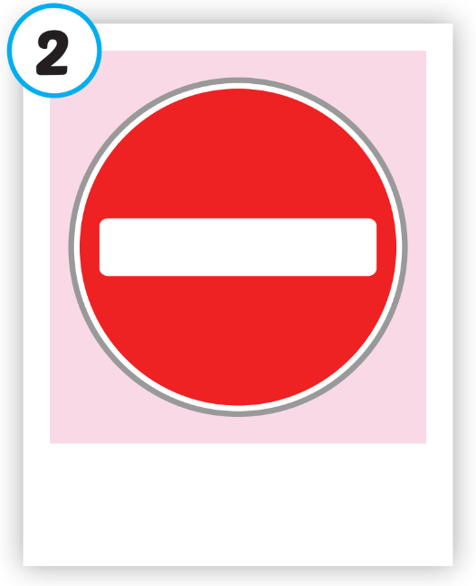
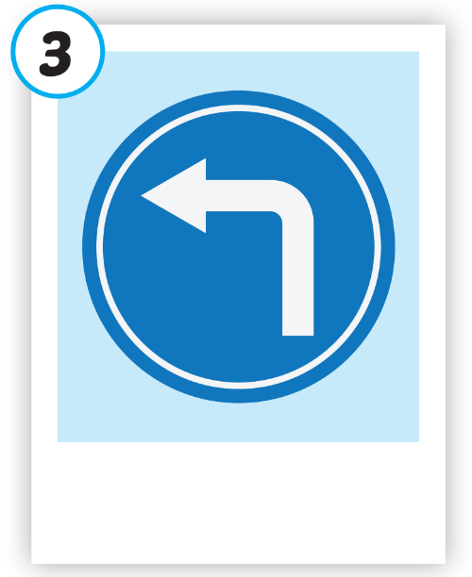
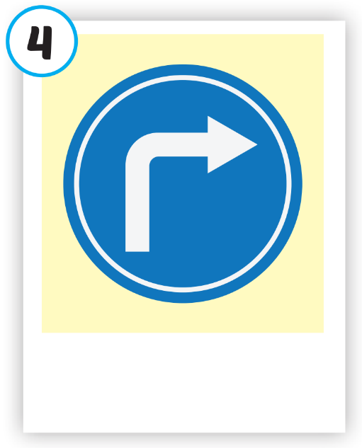
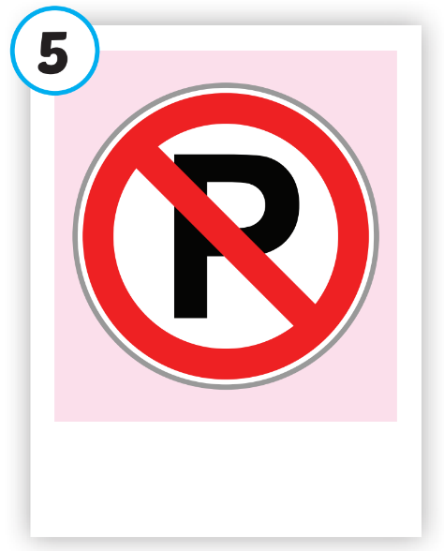





Click on each picture to hear the sound.
/stɑːp/
ngừng lại, dừng lại
/duː nɑːt ˈentər/
cấm vào
/tɜːrn left/
rẽ trái
/tɜːrn raɪt/
rẽ phải
/noʊ ˈpɑːrkɪŋ/
cấm đỗ xe

Slide 8

Click on each picture to hear the sound.
/stɑːp/
ngừng lại, dừng lại

Slide 9

Click on each picture to hear the sound.
/duː nɑːt ˈentər/
cấm vào

Slide 10

Click on each picture to hear the sound.
/tɜːrn left/
rẽ trái

Slide 11

Click on each picture to hear the sound.
/tɜːrn raɪt/
rẽ phải

Slide 12
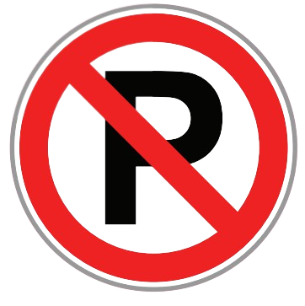
Click on each picture to hear the sound.
/noʊ ˈpɑːrkɪŋ/
cấm đỗ xe

Slide 13
Practice

Slide 14
Check your memory

Slide 15

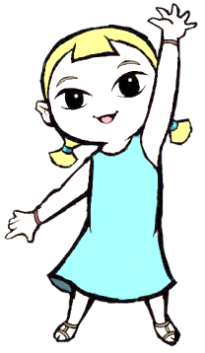

Look at the the line and say what disappears with the wind within the time limit (5 seconds)

Slide 16

What disappears?
TIME’S UP
stop

Slide 17



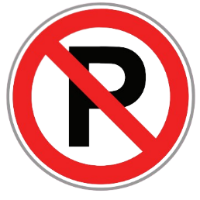
What disappears?
TIME’S UP
no parking

Slide 18




What disappears?
do not enter
TIME’S UP

Slide 19

What disappears?
turn left
TIME’S UP

Slide 20
What disappears?
turn right
TIME’S UP

Slide 21

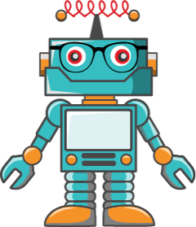

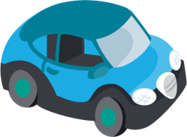

What disappears?
a teddy bear
TIME’S UP

Slide 22
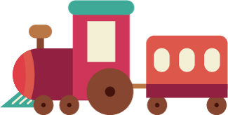
What disappears?
a train
TIME’S UP

Slide 23

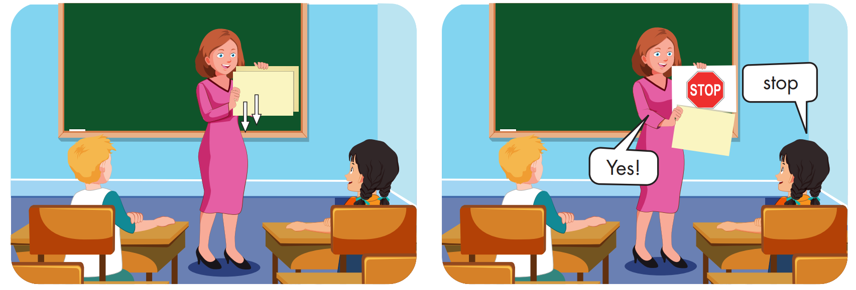

Slide 24
Structure
What does that sign mean?
It means "Stop".

Slide 25
Presentation

Slide 26


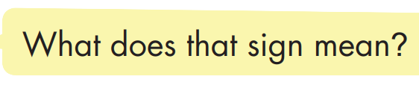
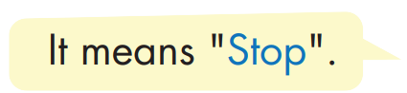

Structure

Slide 27

Practice

Slide 28


Slide 29

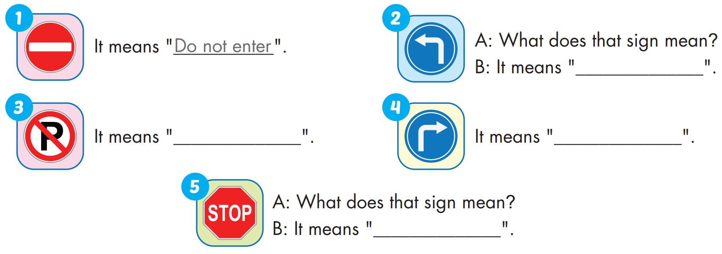
turn left
no parking
turn right
stop

Slide 30

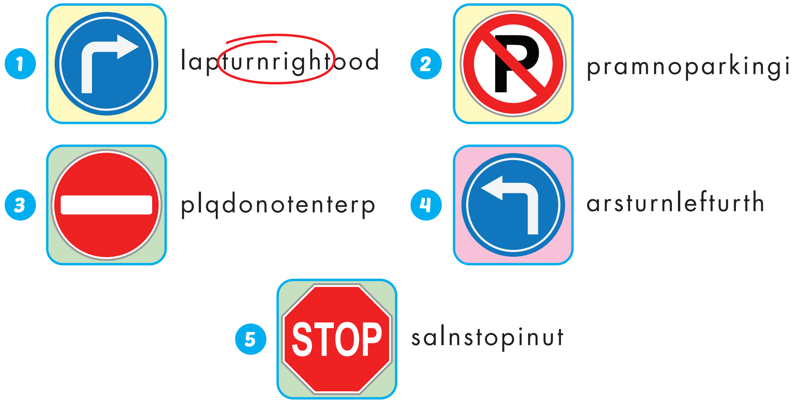
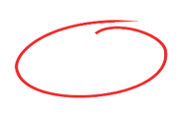
Extra Practice
WB, page 42

Slide 31

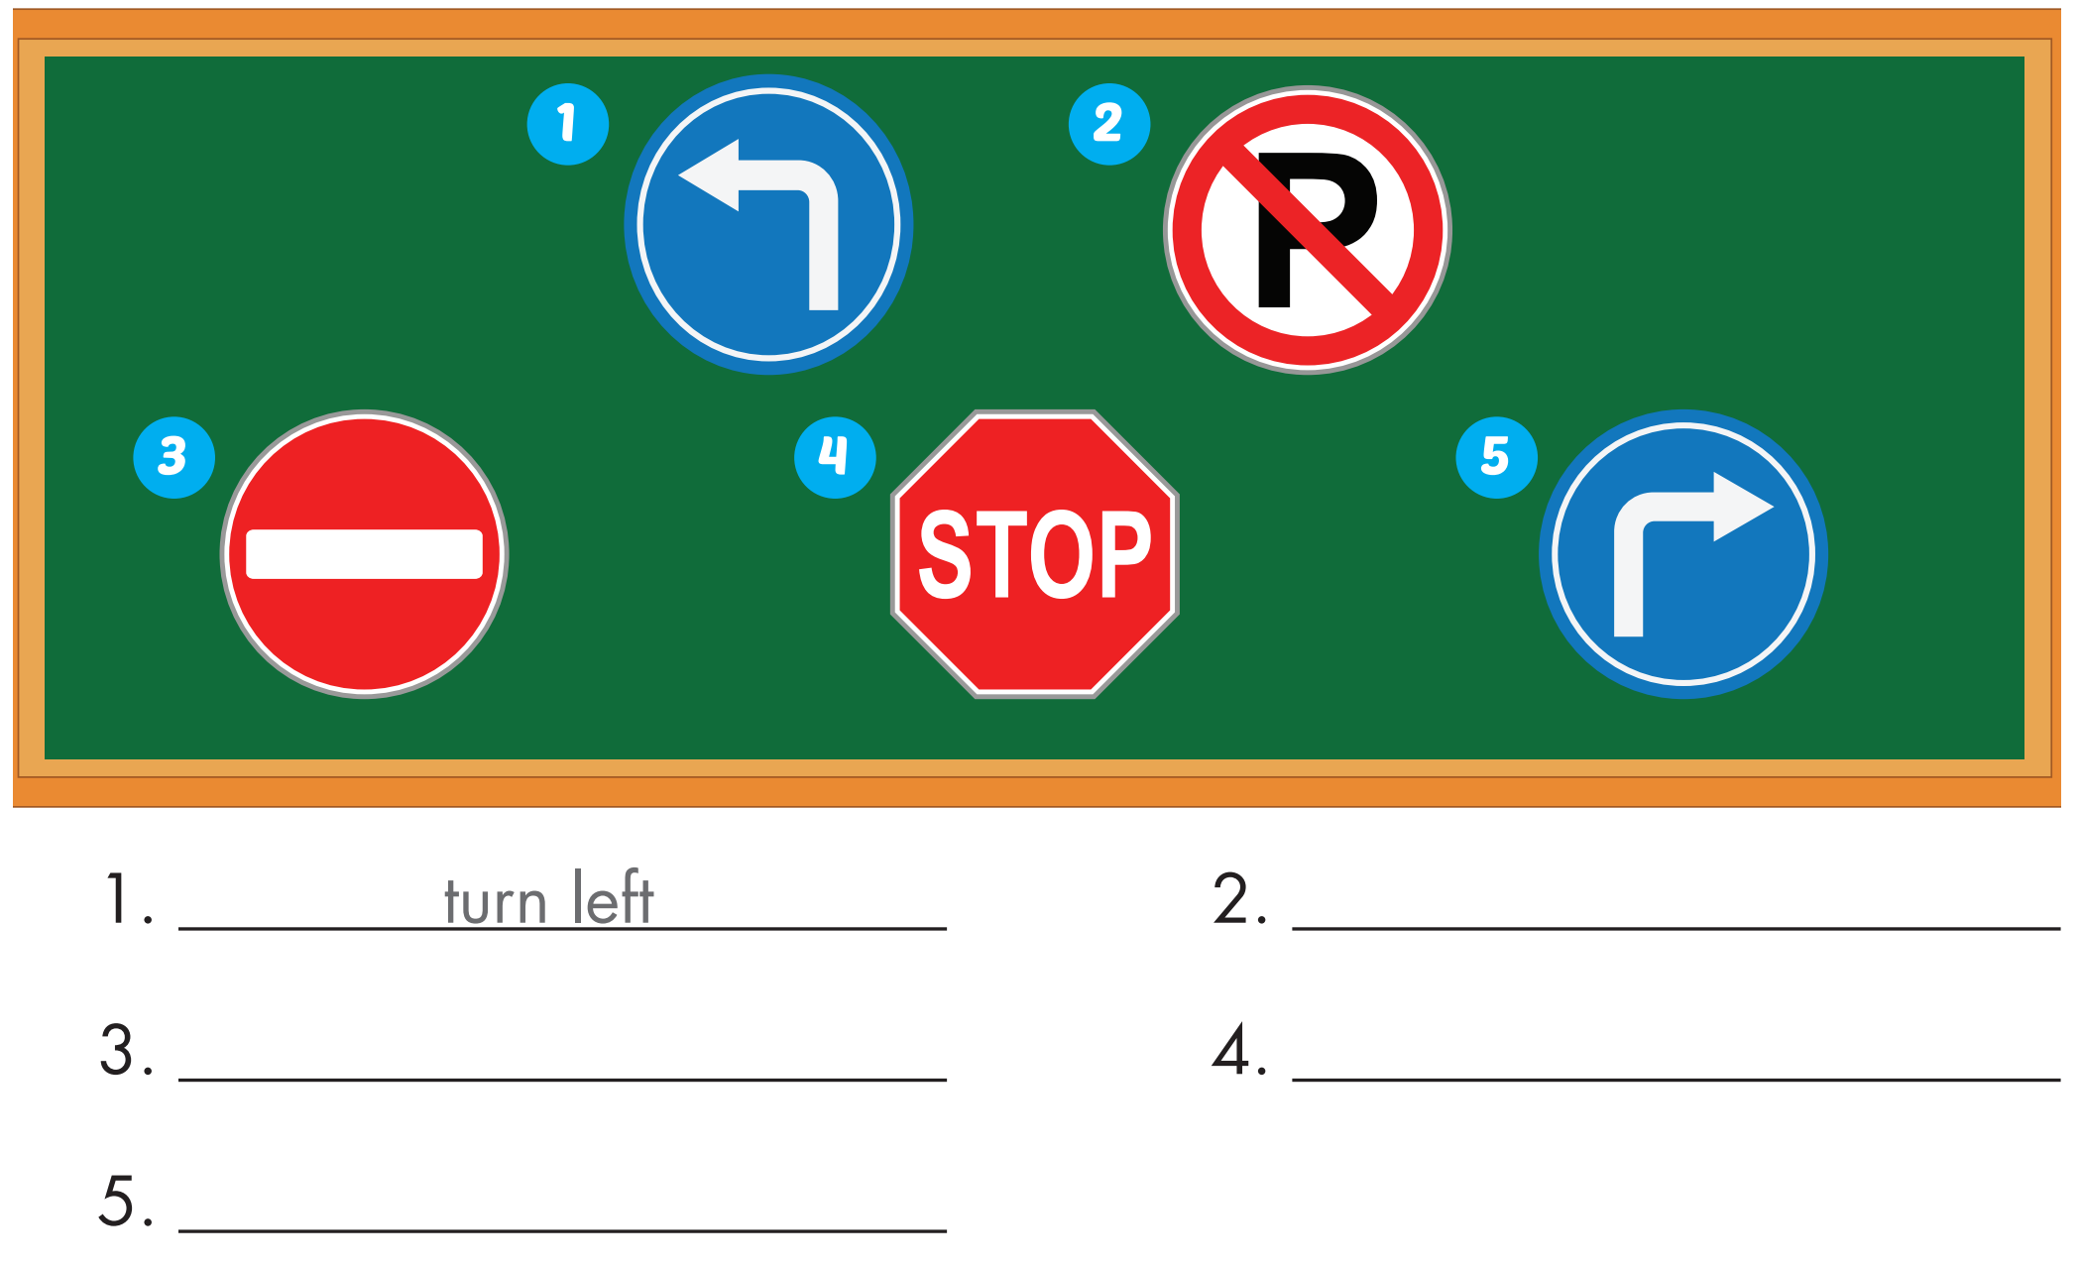
Extra Practice
WB, page 42
no parking
do not enter
stop
turn right

Slide 32

Production

Slide 33

CONSOLIDATION

Slide 34

WRAP-UP

Slide 35
Today’s lesson
Vocabulary
stop, do not enter, turn left, turn right, no parking.
Structures/ Sentence patterns
What does that sign mean?
- It means "Stop".

Slide 36
Homework
Practice the vocabularies and structure; and make sentences using them.
Do the exercises in Tiếng Anh 4 i-Learn Smart Start WB (page 42).
Do the exercises in Tiếng Anh 4 i-Learn Smart Start Notebook (page 28).
Prepare the next lesson (page 65 SB).

Slide 37

Enjoy your day!

