Slide 1

Unit 5: Sports and hobbies
Lesson 3.1
Page 74

Slide 2
Objectives
By the end of this lesson, students will be able to ask for permission, using ……….
Vocabulary: watch TV, go skateboarding, go out, go swimming
Structure: May I watch TV?
- Yes, you may./ No, you may not.

Slide 3

WARM UP

Slide 4
CROSSWORD
1
H | I | T | T | I | N | G
2
V | O | L | L | E | Y | B | A | L | L
3
B | A | D | M | I | N | T | O | N
4
B | A | S | K | E | T | B | A | L | L
5
K | I | C | K | I | N | G
6
T | E | N | N | I | S
7
S | O | C | C | E | R
KEYWORD
Click on the crossword to show the answer.
END

Slide 5
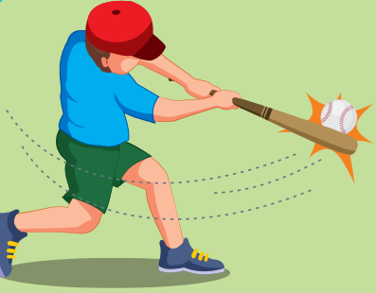
Back

Slide 6

Back

Slide 7
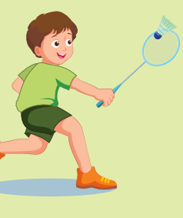
Back

Slide 8

Back

Slide 9
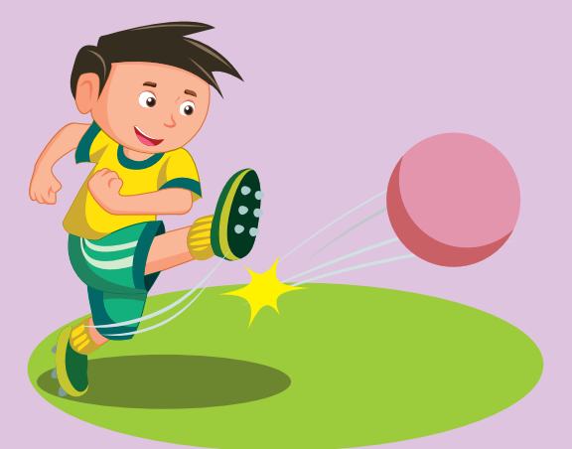
Back

Slide 10
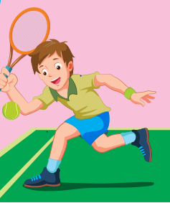
Back

Slide 11
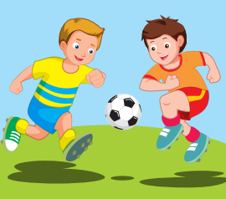
Back

Slide 12

It’s time to learn …

Slide 13
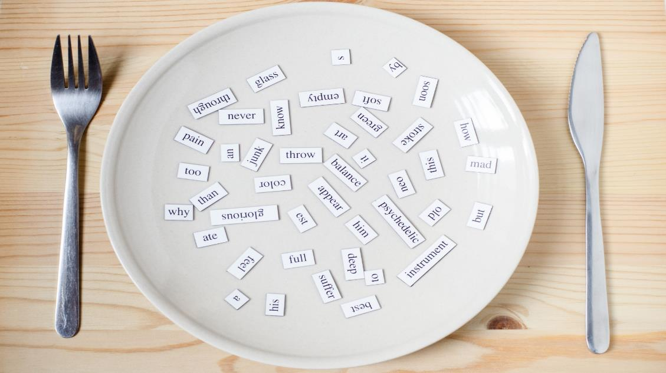
New words
watch TV
go skateboarding
go out
go swimming

Slide 14

Presentation

Slide 15

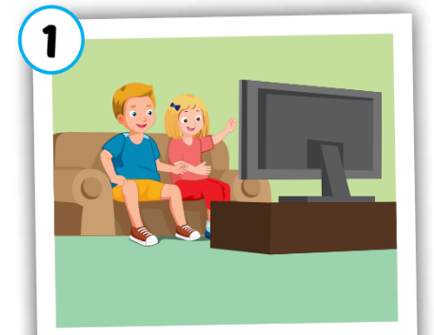

watch TV
/wɑːtʃ ˌtiː ˈviː/
Xem ti-vi
Click on each word to hear the sound.

Slide 16
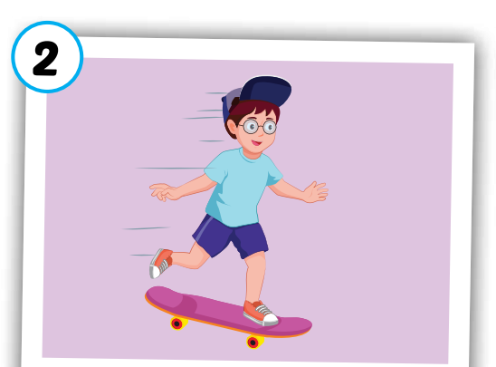
go skateboarding
/ɡəʊ ˈskeɪtˌbɔːrdɪŋ/
đi trượt ván
Click on each word to hear the sound.

Slide 17
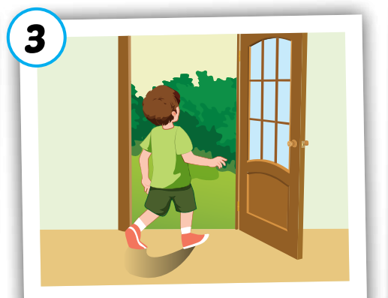
go out
/ɡəʊ aʊt/
đi ra ngoài
Click on each word to hear the sound.

Slide 18
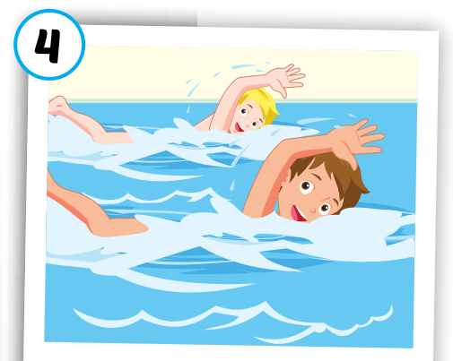
go swimming
/ɡəʊ ˈswɪmɪŋ/
đi bơi
Click on each word to hear the sound.

Slide 19




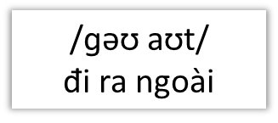
Click on each word to hear the sound.
watch TV
go swimming
go skateboarding
go out
/ɡəʊ ˈswɪmɪŋ/
đi bơi
/wɑːtʃ ˌtiː ˈviː/
Xem ti-vi
/ɡəʊ ˈskeɪtˌbɔːrdɪŋ/
đi trượt ván

Slide 20

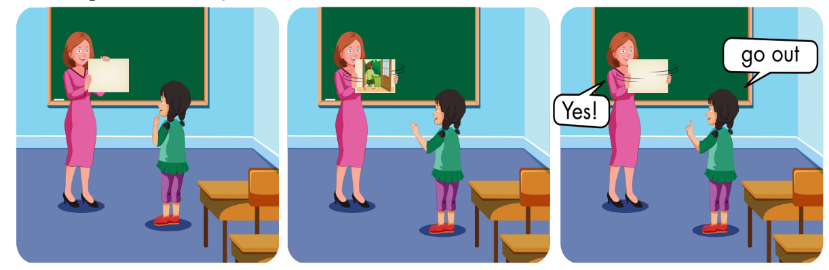

Slide 21

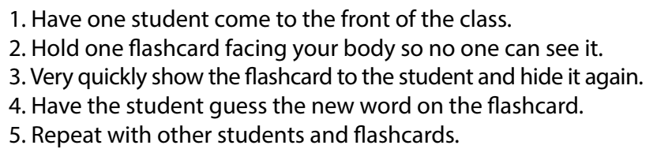

Slide 22

Practice

Slide 23



Answer 1 question correctly, you will open 1 puzzle piece.
1
2
3
4
Click here to open the task.
1
2
3
4
END

Slide 24
go o_t
U
BACK

Slide 25
go s_im_ing
W m
BACK

Slide 26
W_tc_ TV
a h
BACK

Slide 27
__ s_ate_oarding
go k b
BACK

Slide 28
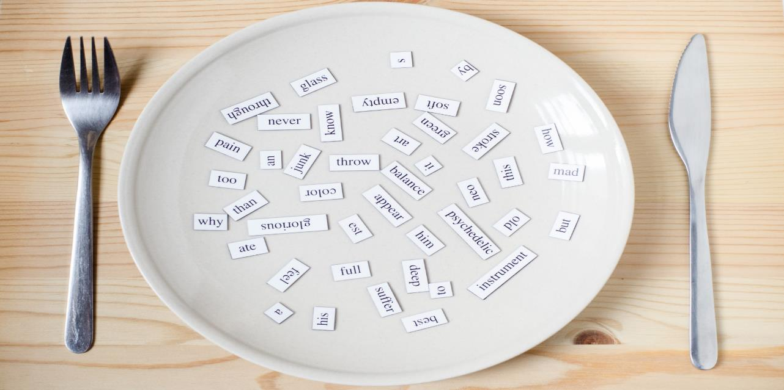
Structures
May I watch TV?
- Yes, you may./No, you may not.

Slide 29
Presentation

Slide 30



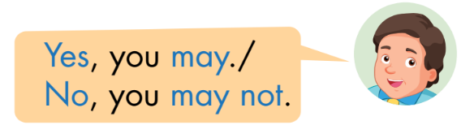

Slide 31
Practice

Slide 32

CONSOLIDATION

Slide 33
Early Production

Slide 34

WRAP-UP

Slide 35
Today’s lesson
Vocabulary
watch TV
go skateboarding
go out
go swimming
Structures/ Sentence patterns
May I watch TV?
- Yes, you may./No, you may not.

Slide 36
Homework
Practice vocabularies and structure. Make sentences using them.
Do the exercises in Tiếng Anh 3 i-Learn Smart Start Workbook (page 52)
Do the exercises in Tiếng Anh 3 i-Learn Smart Start Notebook (page 36)

Slide 37
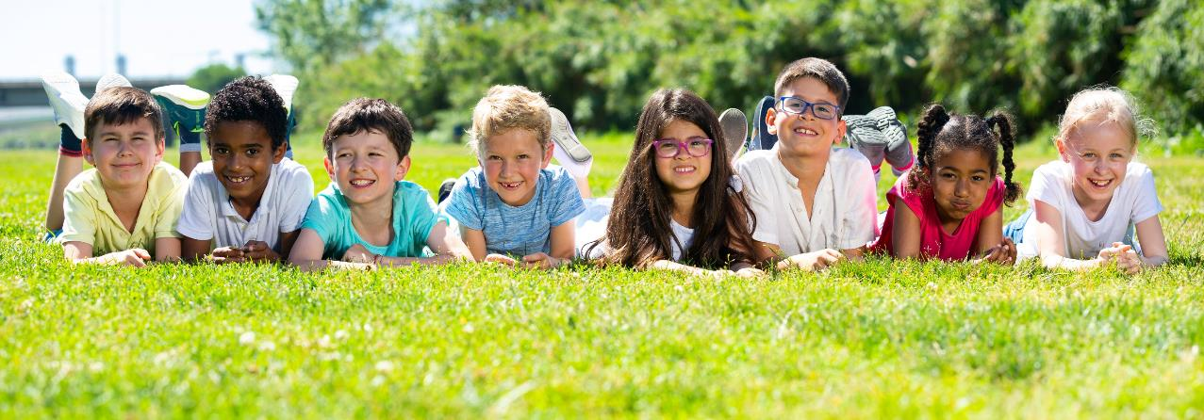
Have a nice day!

