Slide 1









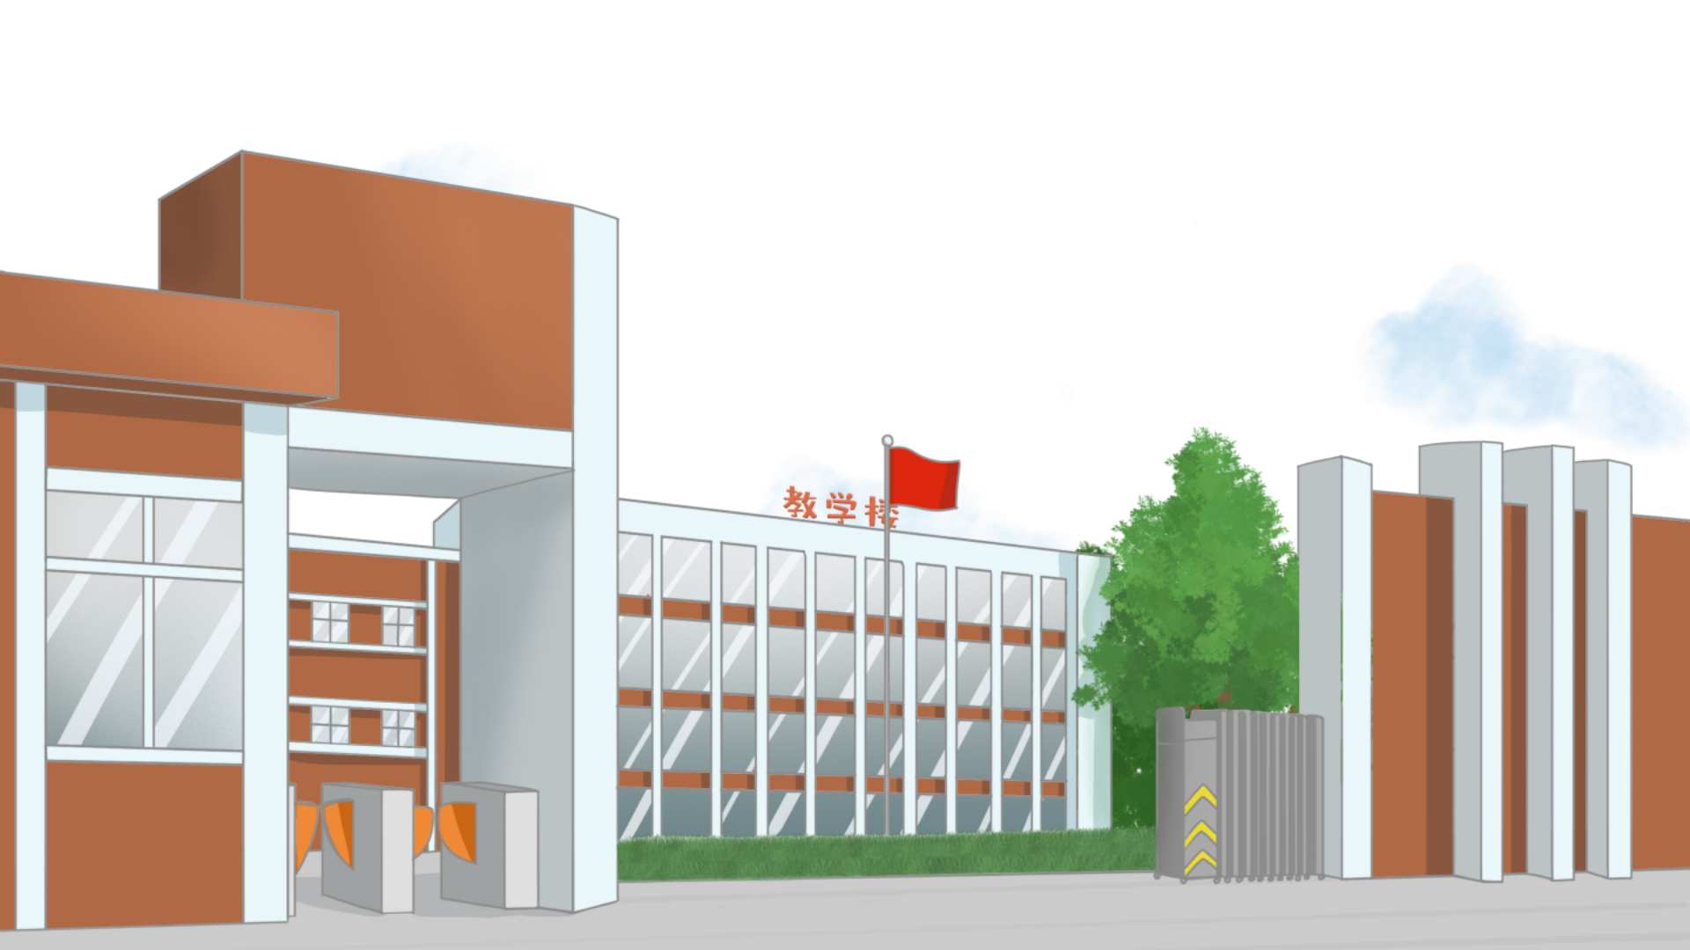





(Trang 56)

Slide 2


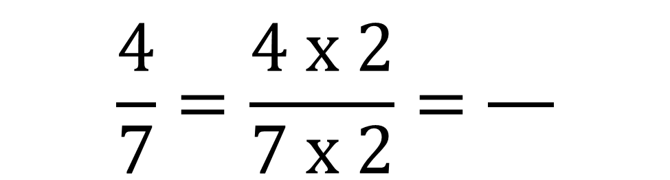

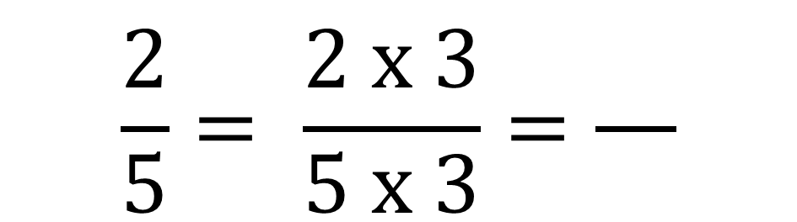

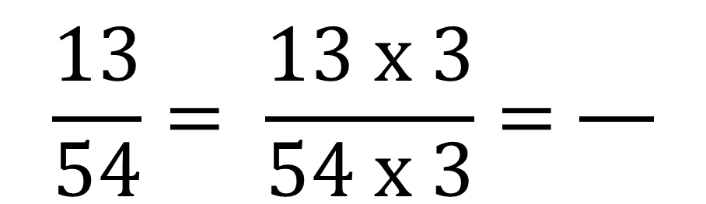
Bài 1: Số?
$$\frac{2}{5}= \frac{2 x 3}{5 x 3}=\frac{}{}$$
$$\frac{4}{7}=\frac{4 x 2}{7 x 2}=\frac{}{}$$
$$\frac{6}{15}$$
$$\frac{8}{14}$$
a)
$$\frac{13}{54}= \frac{13 x 3}{54 x 3}=\frac{}{}$$
$$\frac{39}{162}$$

Slide 3


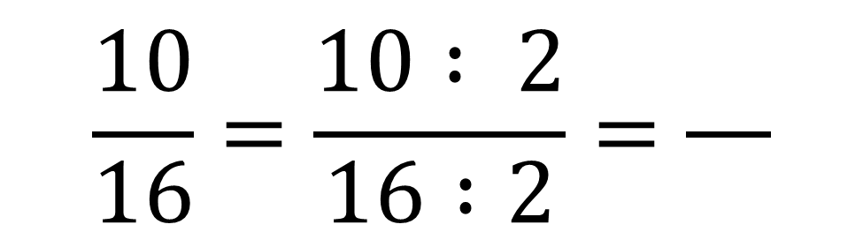

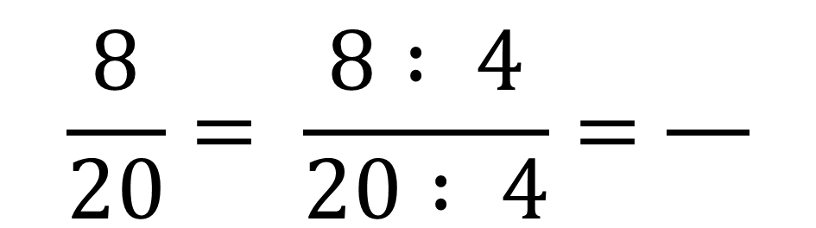

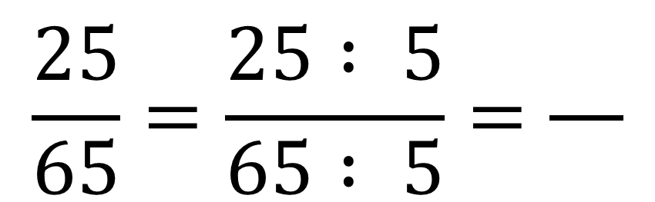
Bài 1: Số?
$$\frac{8}{20}= \frac{8 : 4}{20 : 4}=\frac{}{}$$
$$\frac{10}{16}=\frac{10 : 2}{16 :2}=\frac{}{}$$
$$\frac{2}{5}$$
$$\frac{5}{8}$$
b)
$$\frac{25}{65}=\frac{25 : 5}{65 : 5}=\frac{}{}$$
$$\frac{5}{13}$$

