Slide 1

Unit 8: WEATHER
Lesson 1.1
Page 106

Slide 2
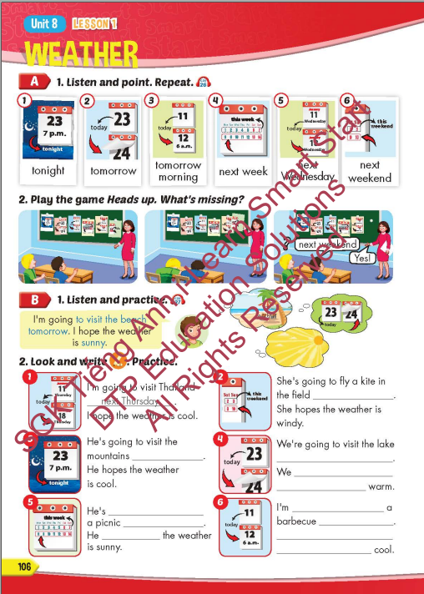
Lesson Outline
Warm-up
Vocabulary
Structure
Consolidation
Wrap-up

Slide 3
Objectives
By the end of this lesson, students will be able to talk about their plans and what they hope the weather is like.
Vocabulary: tonight, tomorrow, tomorrow morning,
next week, next Wednesday, next weekend.
Sentence pattern:
I'm going to visit the beach tomorrow.
I hope the weather is sunny.

Slide 4

WARM-UP

Slide 5

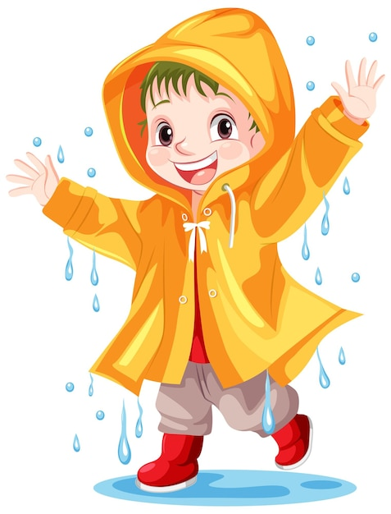

Catch the word
rain
a raincoat
a coat

Slide 6

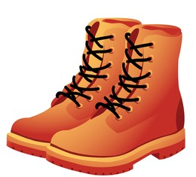
Catch the word
rain
boots
rain boots

Slide 7



Catch the word
a sun
glasses
sunglasses

Slide 8


Catch the word
a sun
a sunflower
a flower

Slide 9


Catch the word
rain
boots
rain boots

Slide 10
Catch the word
a sun
glasses
sunglasses

Slide 11
Catch the word
a sun
a sunflower
a flower

Slide 12
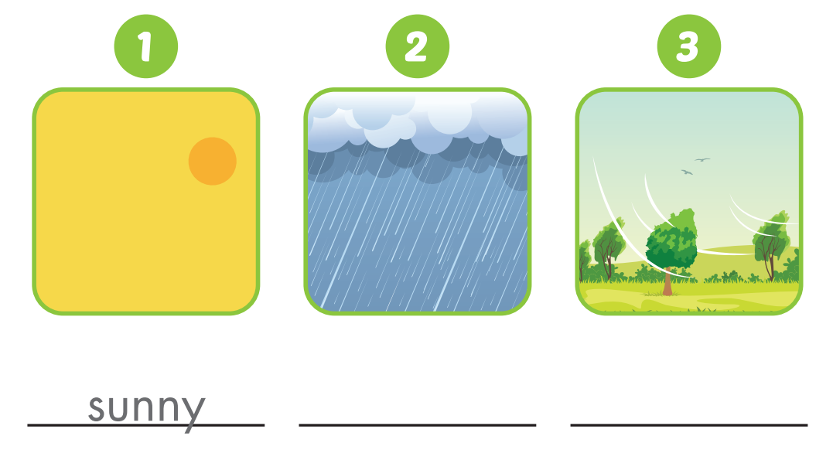
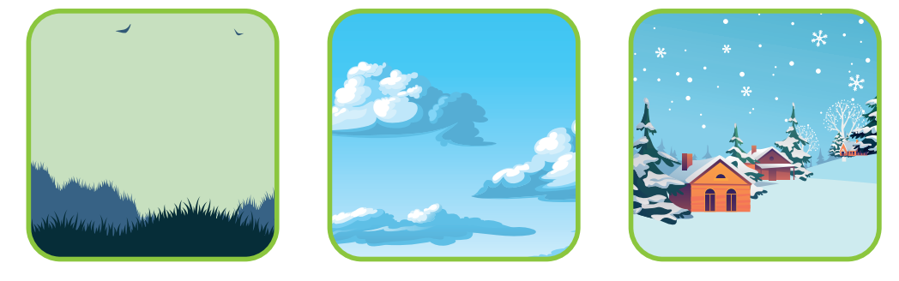
WEATHER

Slide 13

Enjoy your day!

