Slide 1

Unit 8: WEATHER
Lesson 1.1
Page 106

Slide 2
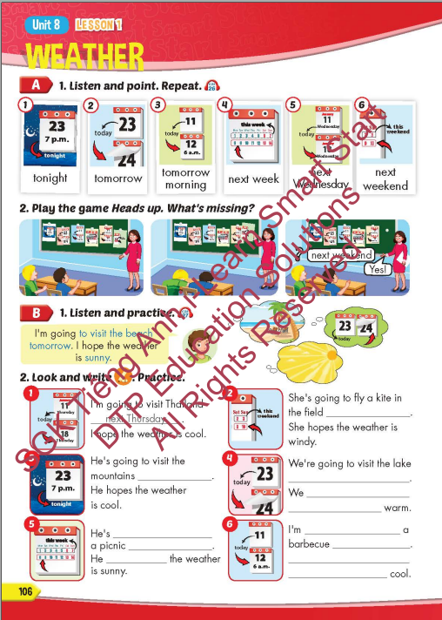
Lesson Outline
Warm-up
Vocabulary
Structure
Consolidation
Wrap-up

Slide 3
Objectives
By the end of this lesson, students will be able to talk about their plans and what they hope the weather is like.
Vocabulary: tonight, tomorrow, tomorrow morning,
next week, next Wednesday, next weekend.
Sentence pattern:
I'm going to visit the beach tomorrow.
I hope the weather is sunny.

Slide 4

It’s time to learn …

Slide 5

New words
tonight, tomorrow, tomorrow morning,
next week, next Wednesday, next weekend.

Slide 6

Presentation

Slide 7


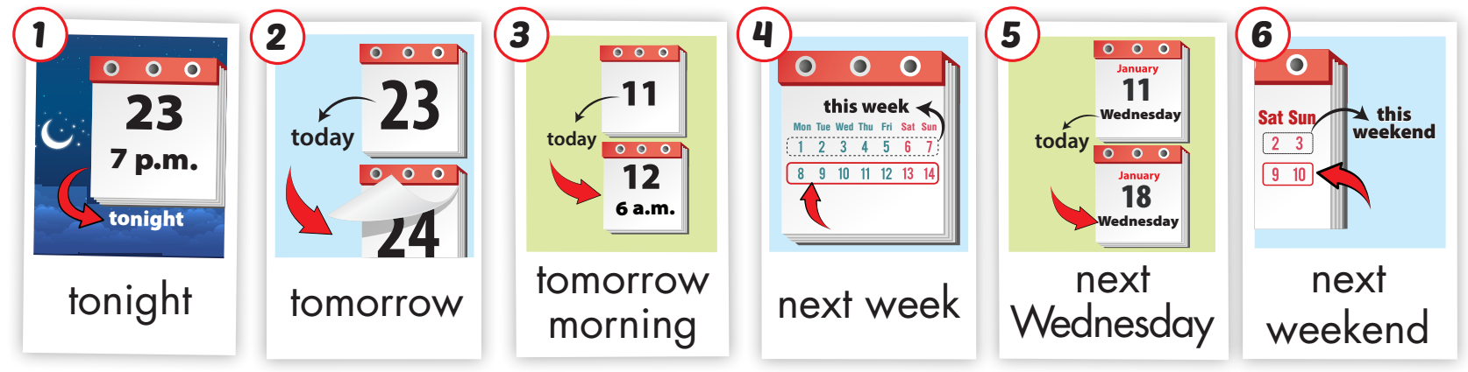
Click on A to hear the sound.
/təˈnaɪt/
tối nay
/təˈmɔːroʊ ˈmɔːrnɪŋ/
sáng mai
/nekst wiːk/
tuần kế tiếp
/nekst ˈwenzdeɪ/ thứ tư kế tiếp
/nekst ˈwiːkend/ cuối tuần
/təˈmɔːroʊ/
ngày mai
Notes:
Click vào hình A. 1. Listen and point. Repeat để cho cả audio full chạy

Slide 8
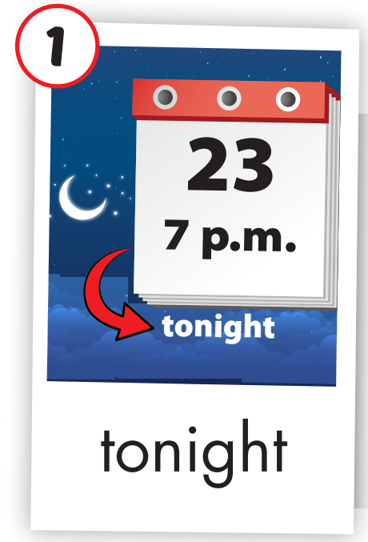
Click on the picture to hear the sound.
tonight (adv)
/təˈnaɪt/
tối nay

Slide 9
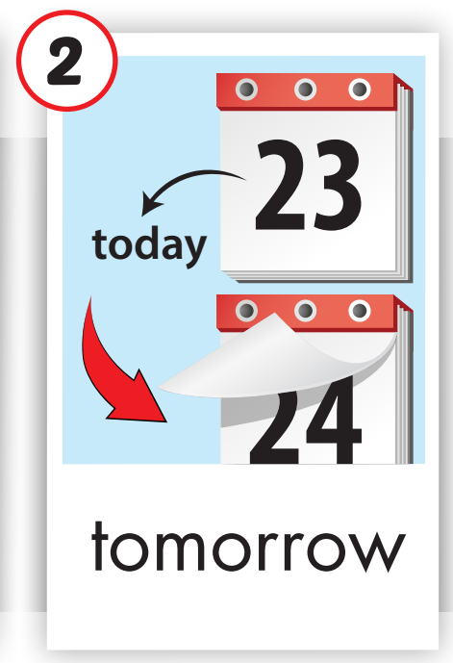
Click on the picture to hear the sound.
tomorrow (adv)
/təˈmɔːroʊ/
ngày mai

Slide 10
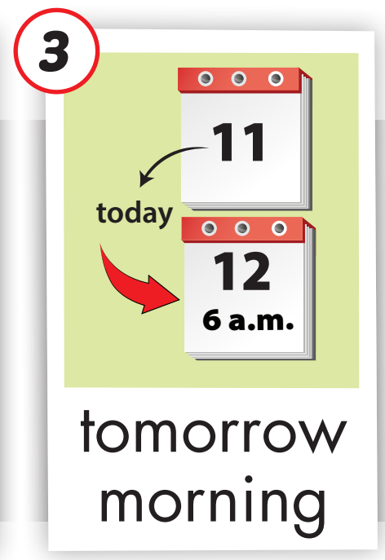
Click on the picture to hear the sound.
tomorrow morning (adv)
/təˈmɔːroʊ ˈmɔːrnɪŋ/
sáng mai

Slide 11
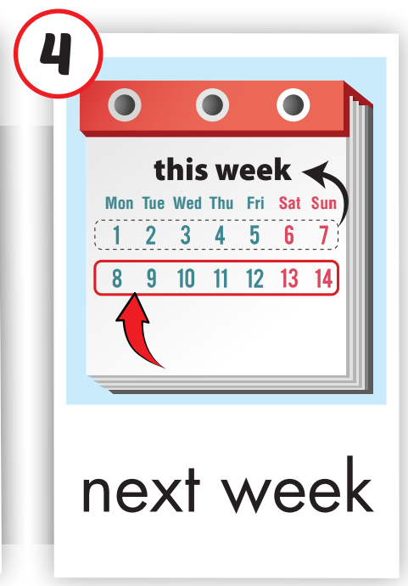
Click on the picture to hear the sound.
next week (adv)
/nekst wiːk/
tuần kế tiếp

Slide 12
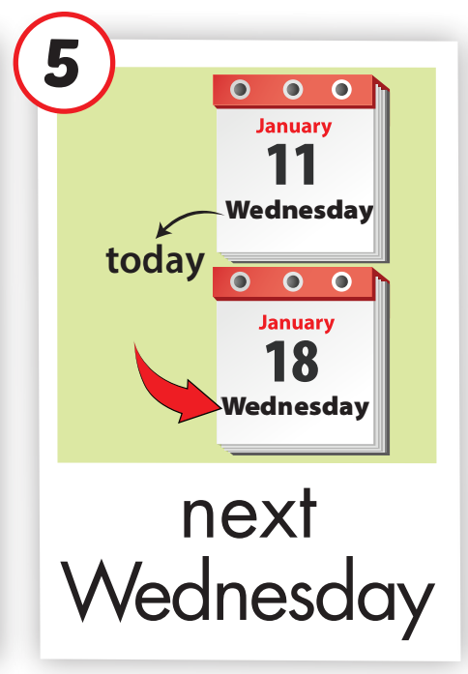
Click on the picture to hear the sound.
next Wednesday (adv)
/nekst ˈwenzdeɪ/ thứ tư kế tiếp

Slide 13
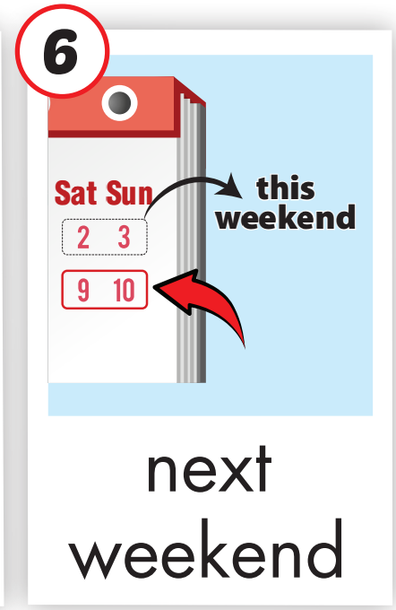
Click on the picture to hear the sound.
next weekend (adv)
/nekst ˈwiːkend/ cuối tuần tới

Slide 14

Lesson 3
Stay positive and have a nice day!

