Slide 1

Unit 5: Getting Around
Review and Practice 1
Page 76

Slide 2

WARM UP

Slide 3



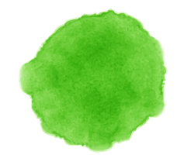


VOCAB QUIZ

Slide 4






stop
A
B

Slide 5


turn right
A
B

Slide 6

turn left
A
B

Slide 7

no parking
A
B

Slide 8
do not enter
A
B

Slide 9
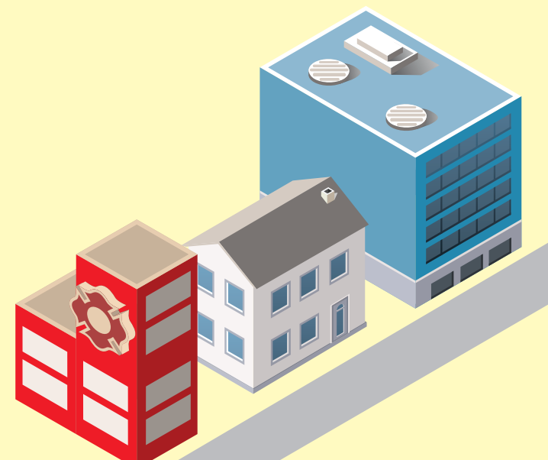

near
A
B

Slide 10
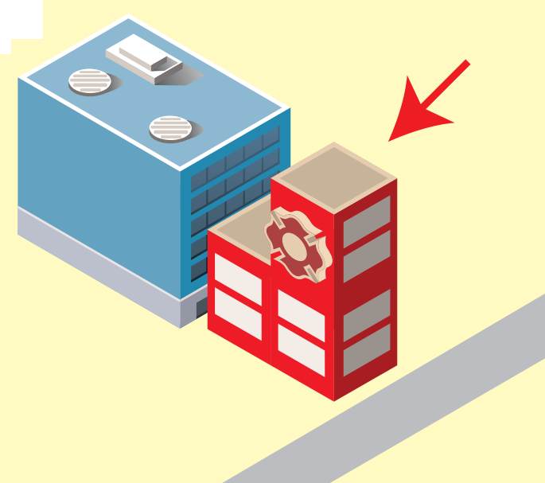
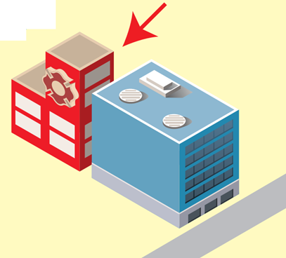
behind
A
B

Slide 11

Enjoy your day!

