Slide 1

Unit 5: HEALTH
Lesson 3.3
Page 72

Slide 2

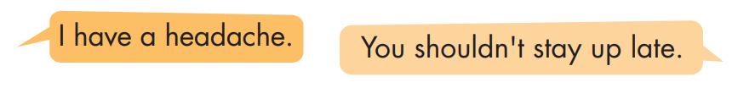
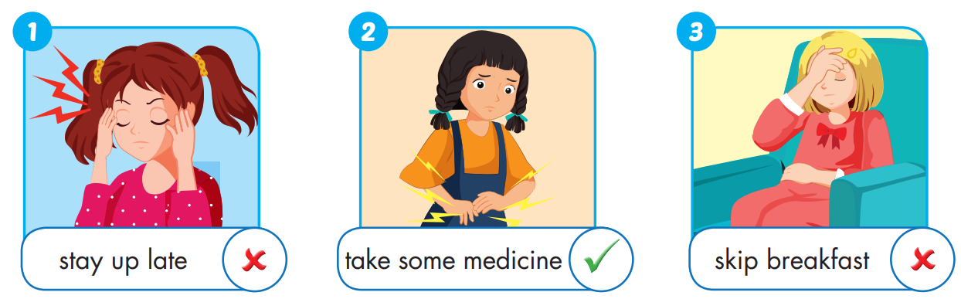

Slide 3
I have a stomachache.
You should take some medicine.

Slide 4
I feel terrible.
You shouldn’t skip breakfast.

Slide 5
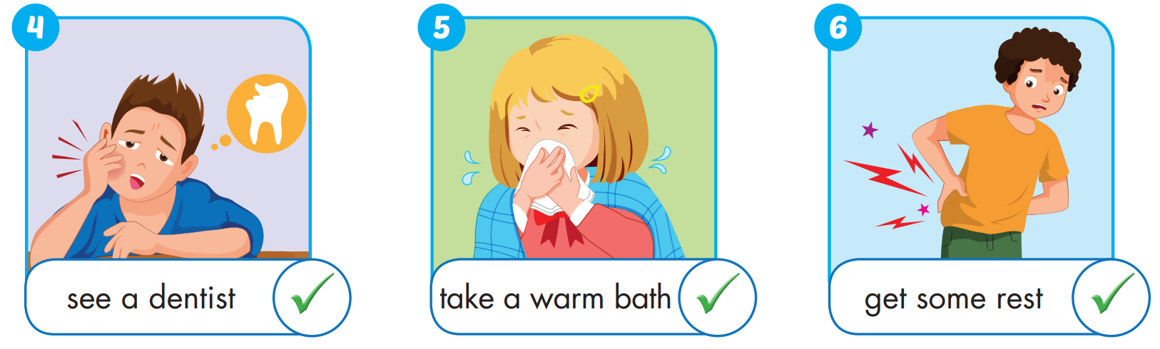
I have a toothache.
You should see a dentist.

Slide 6
I feel stuffed up.
You should take a warm bath.

Slide 7
I feel sore.
You should get some rest.

Slide 8

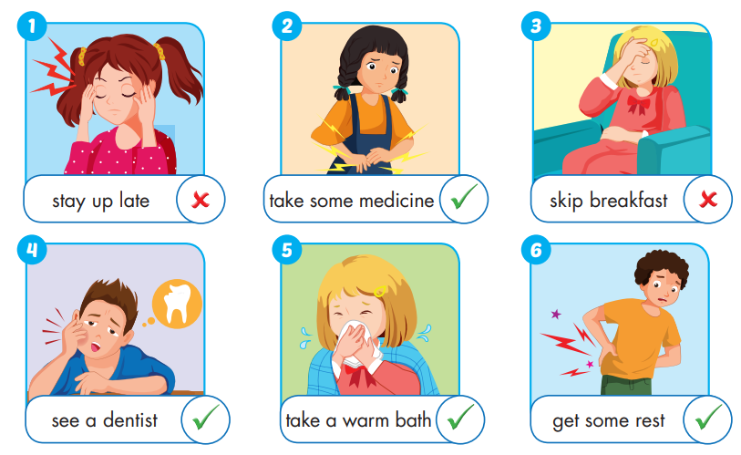

Slide 9

Enjoy your day!

