Slide 1

Unit 7: JOBS
Lesson 1.1
Page 92

Slide 2
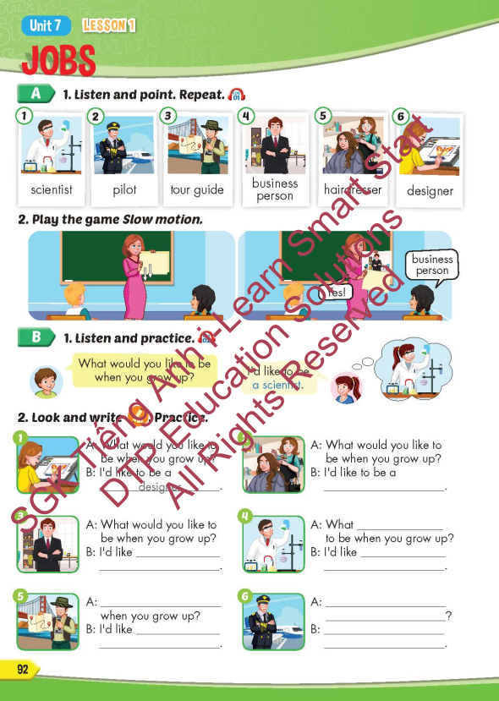
Lesson Outline
Warm-up
Vocabulary
Structure
Consolidation
Wrap-up

Slide 3
Objectives
By the end of this lesson, students will be able to point out and name different jobs.
Vocabulary: scientist, pilot, tour guide, business person, hairdresser, designer.
Structure: What would you like to be when you grow up?
- I’d like to be a scientist.

Slide 4

Structure
What would you like to be
when you grow up?
- I’d like to be a scientist.

Slide 5

Presentation

Slide 6
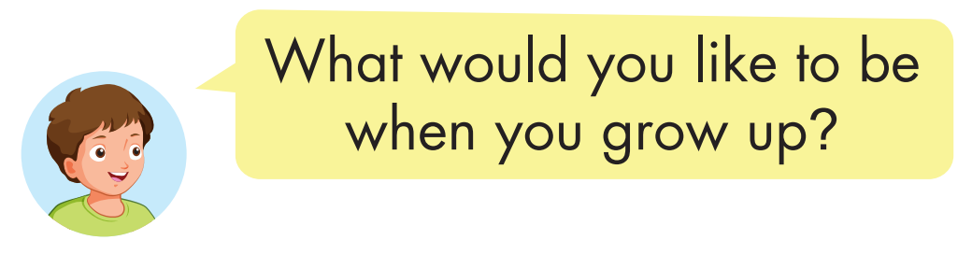

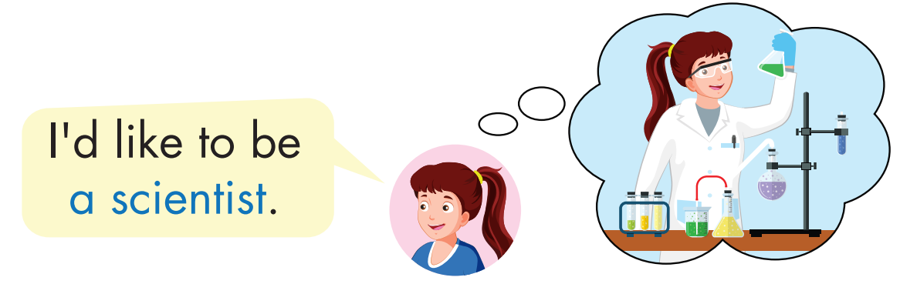
Structure
Click on the picture to hear the sound.

Slide 7

Lesson 3
Stay positive and have a nice day!

