Slide 1

Unit 7: JOBS
Lesson 1.1
Page 92

Slide 2
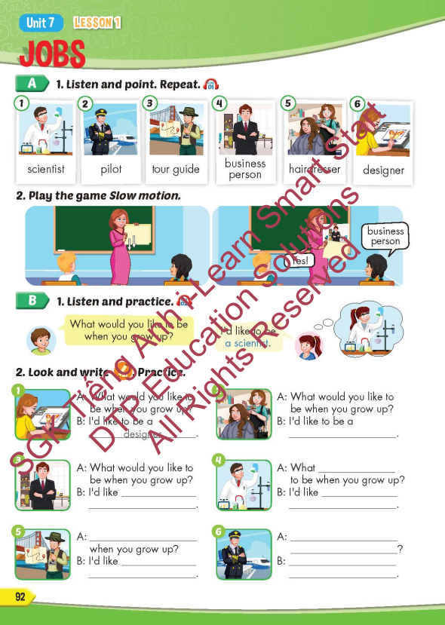
Lesson Outline
Warm-up
Vocabulary
Structure
Consolidation
Wrap-up

Slide 3
Objectives
By the end of this lesson, students will be able to point out and name different jobs.
Vocabulary: scientist, pilot, tour guide, business person, hairdresser, designer.
Structure: What would you like to be when you grow up?
- I’d like to be a scientist.

Slide 4

It’s time to learn …

Slide 5

New words
scientist,
pilot,
tour guide,
business person,
hairdresser
designer

Slide 6

Presentation

Slide 7


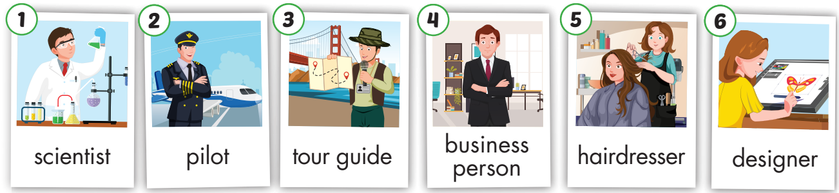
Click on the picture below to hear the sound.
/ˈpaɪlət/
phi công
/ ˈbɪznəs pɜːrsən /
doanh nhân
/dɪˈzaɪ.nɚ/
nhà thiết kế
/ˈsaɪəntɪst/
nhà khoa học
/tʊr ɡaɪd/
hướng dẫn viên du lich
/ˈherˌdres.ɚ/
thợ cắt tóc
Notes:
Click vào hình A. 1. Listen and point. Repeat để cho cả audio full chạy

Slide 8
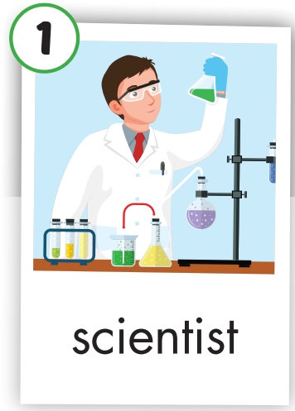
Click on the picture to hear the sound.
scientist
/ˈsaɪəntɪst/
nhà khoa học

Slide 9
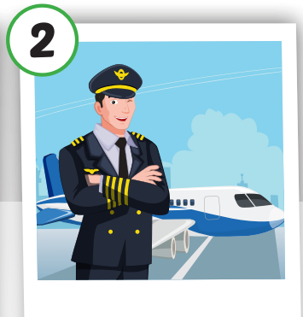
Click on the picture to hear the sound.
pilot
/ˈpaɪlət/
phi công

Slide 10
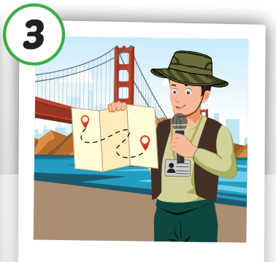
Click on the picture to hear the sound.
tour guide
/ˈtʊr ɡaɪd/
hướng dẫn viên du lich

Slide 11

Click on the picture to hear the sound.
business person
/ ˈbɪznəs pɜːrsən/
doanh nhân

Slide 12
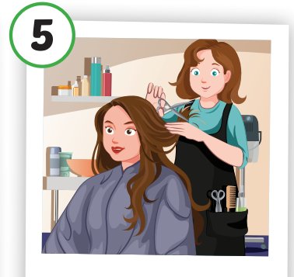
Click on the picture to hear the sound.
hairdresser
/ˈherˌdres.ɚ/
thợ cắt tóc

Slide 13
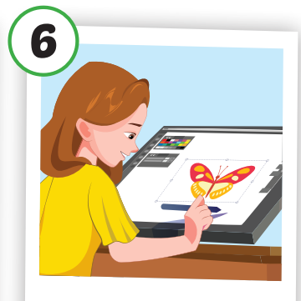
Click on the picture to hear the sound.
designer
/dɪˈzaɪ.nɚ/
nhà thiết kế

Slide 14

Lesson 3
Stay positive and have a nice day!

