Slide 1

Unit 7: MY FAMILY
Lesson 2.2
Page 96

Slide 2
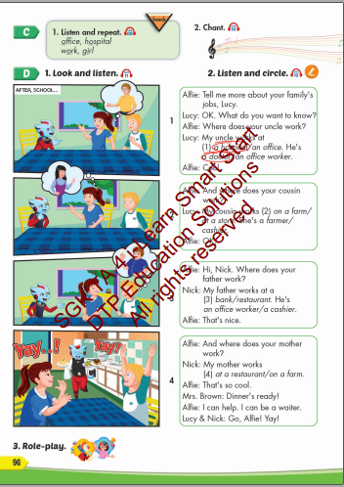
Lesson Outline
Warm-up
Listening
Consolidation
Wrap-up

Slide 3
Objectives
By the end of this lesson, students will be able to talk about where their family members work.
Vocabulary: office, hospital, work, girl
Structure: Where does your father work?
My father works at a bank. He's a cashier.

Slide 4

WARM UP

Slide 5
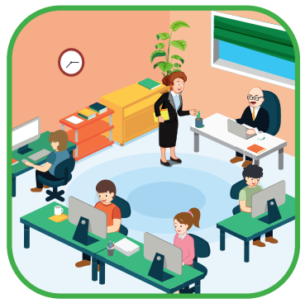


Slide 6
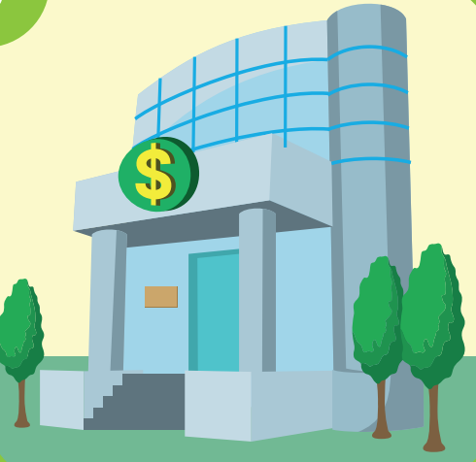

Slide 7


Slide 8


Slide 9
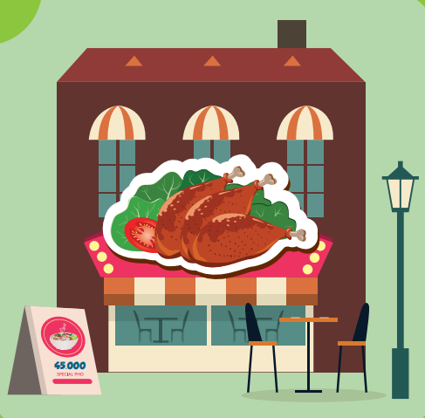

Slide 10

Have a nice day!

