Slide 1

Unit 7: MY FAMILY
Lesson 2.2
Page 96

Slide 2
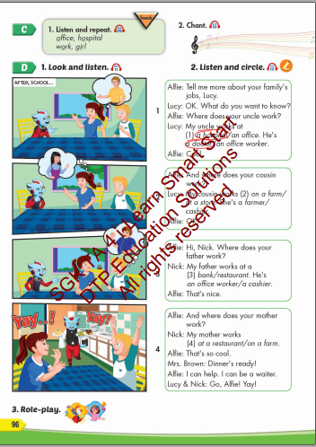
Lesson Outline
Warm-up
Listening
Consolidation
Wrap-up

Slide 3
Objectives
By the end of this lesson, students will be able to talk about where their family members work.
Vocabulary: office, hospital, work, girl
Structure: Where does your father work?
My father works at a bank. He's a cashier.

Slide 4

Listening

Slide 5


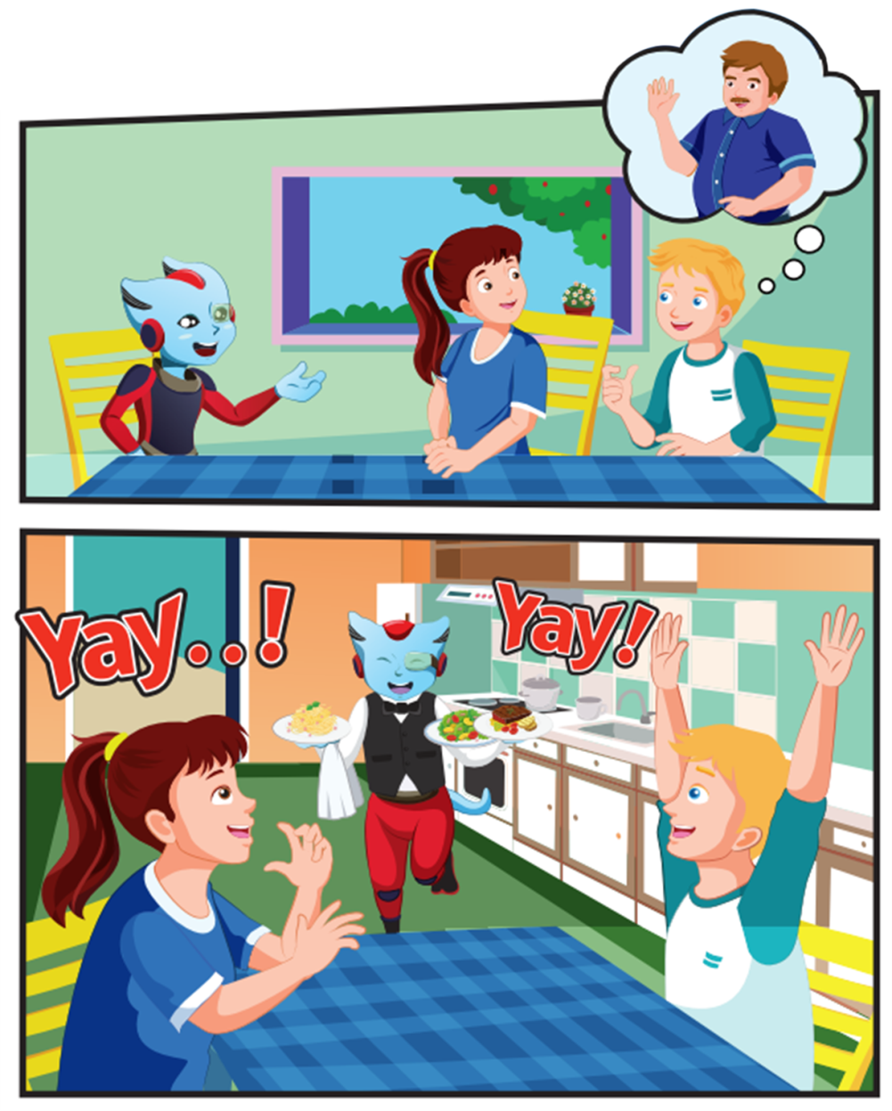
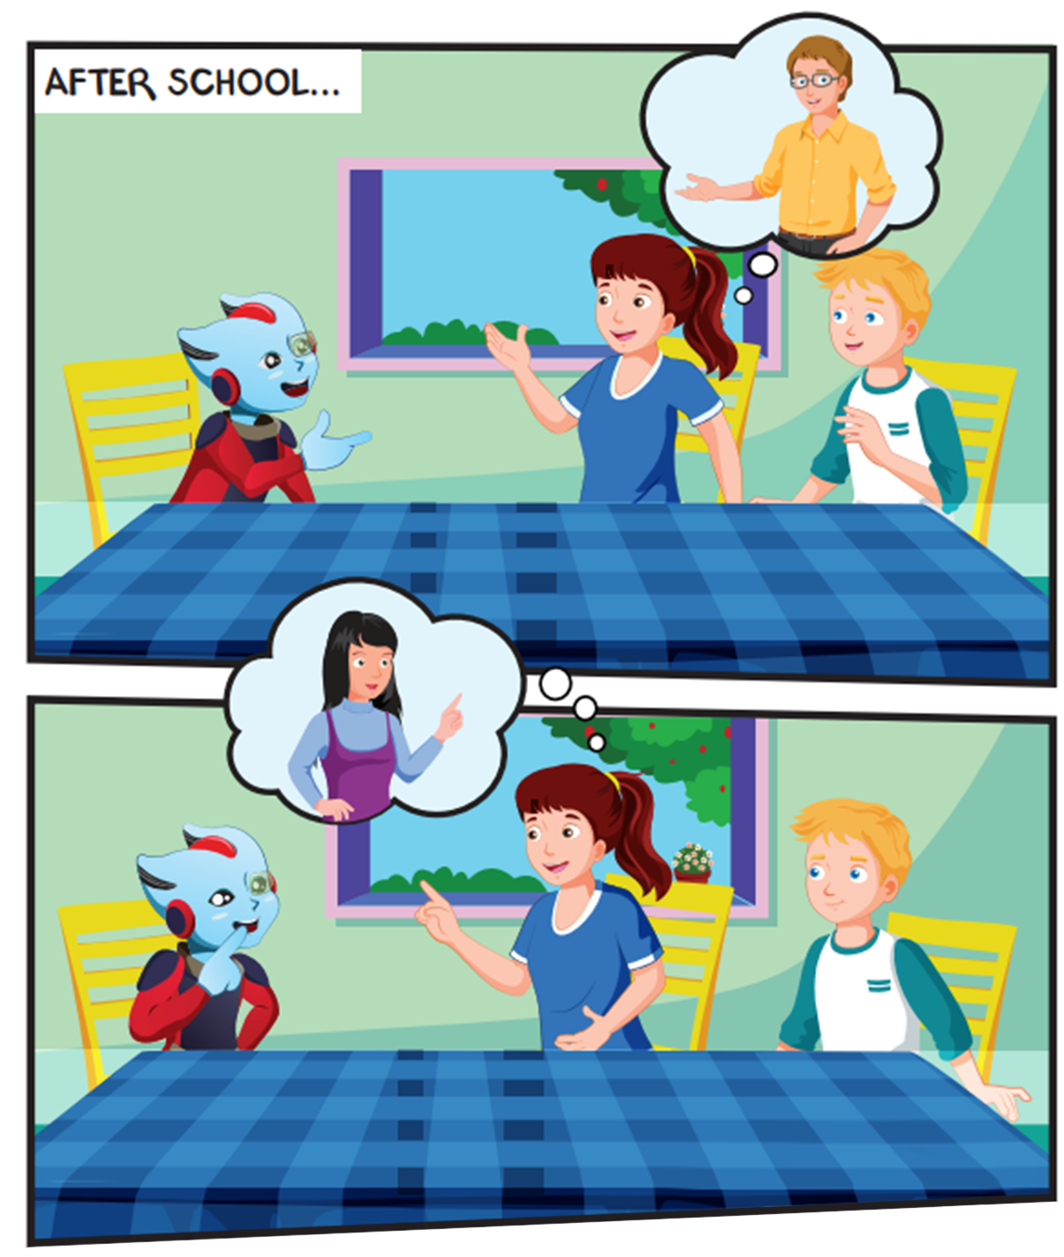
Click the loud speaker to hear the sound.

Slide 6
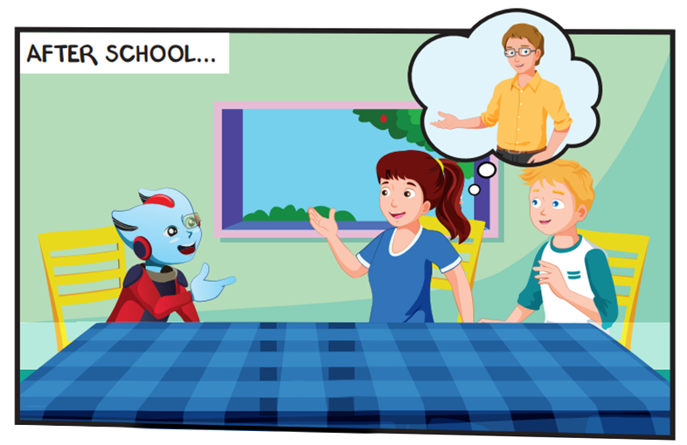
Where are they?
Who are they talking about?

Slide 7
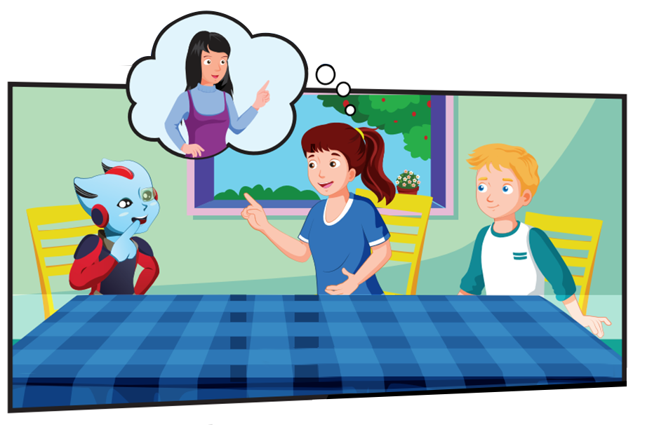
Who are they talking about?
What color is the table?

Slide 8
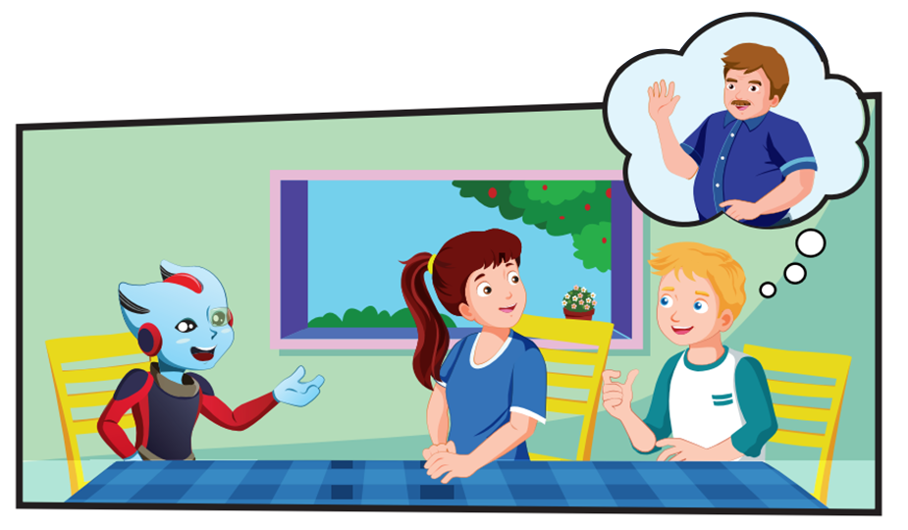
Who are they talking about?

Slide 9
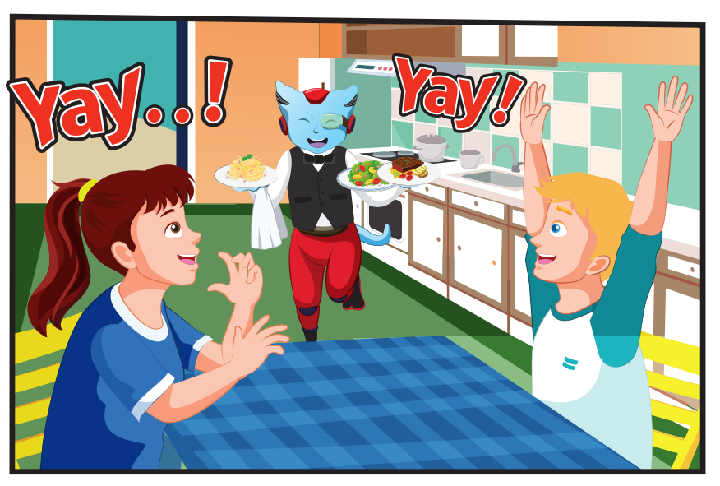
Where are they?
How are they feeling?

Slide 10

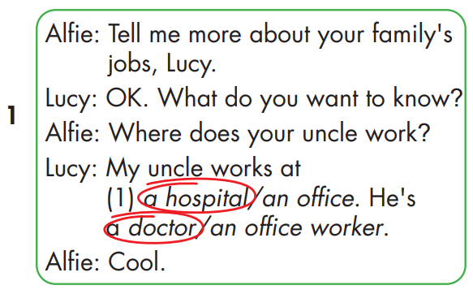
Click the loud speaker to hear the sound.

Slide 11

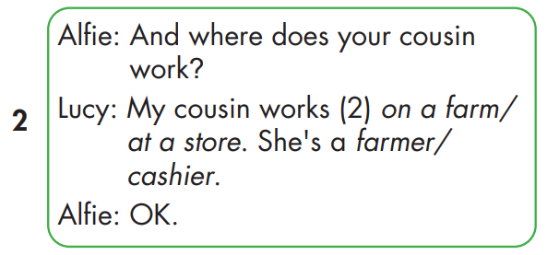
Click the loud speaker to hear the sound.

Slide 12
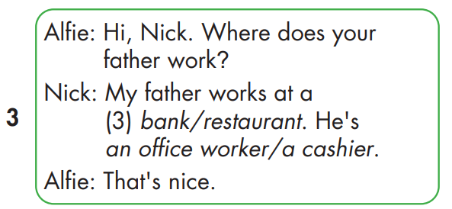
Click the loud speaker to hear the sound.

Slide 13
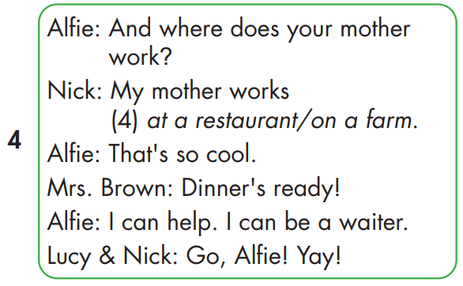
Click the loud speaker to hear the sound.

Slide 14

Have a nice day!

