Slide 1

Unit 5: HEALTH
Lesson 2.1
Page 67

Slide 2
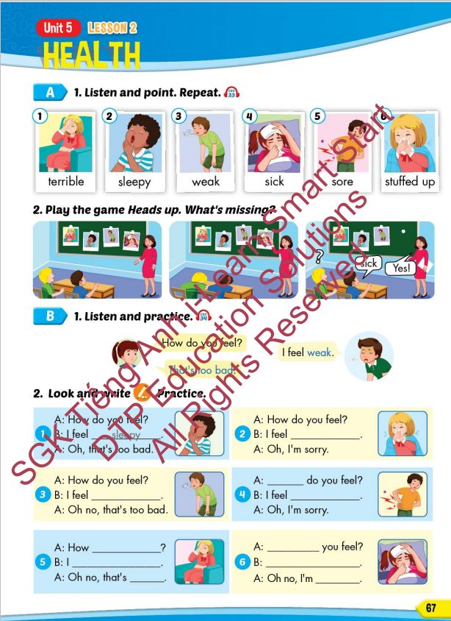
Lesson Outline
Warm-up
Vocabulary
Structure
Consolidation
Wrap-up

Slide 3
Objectives
By the end of this lesson, students will be able to recognize the vocabulary and get to know the structure asking and answering about how they feel.
Vocabulary: terrible, sleepy, weak, sick, sore, stuffed up
Structure: How do you feel?
- I feel weak.
- That's too bad.

Slide 4

WARM UP

Slide 5

Guess the HEALTH PROBLEMS

Slide 6

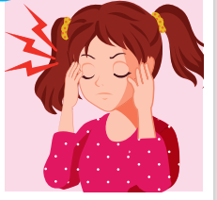
a pain you feel inside your head.
HEADACHE

Slide 7
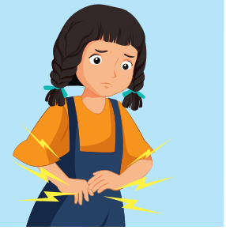
I ate too much and I had a terrible _____________.
STOMACHACHE

Slide 8
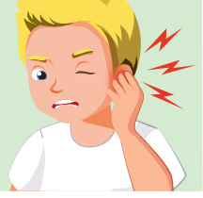
The pain inside part of your ear.
EARACHE

Slide 9
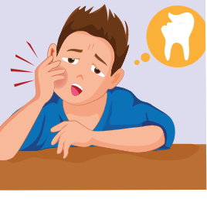
the pain caused by something being wrong with one of your teeth.
TOOTHACHE

Slide 10
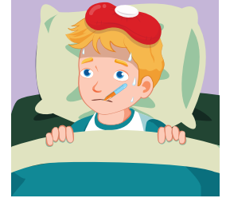
She's very hot and shivery, so I think she must have ______.
THE FLU

Slide 11
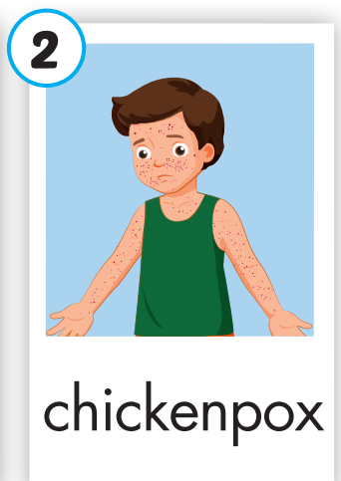
an infectious disease that causes a slight fever and red spots on the skin.
CHICKENPOX

Slide 12

Lesson 3
Stay positive and have a nice day!

