Slide 1

Unit 5: HEALTH
Lesson 2.1
Page 67

Slide 2
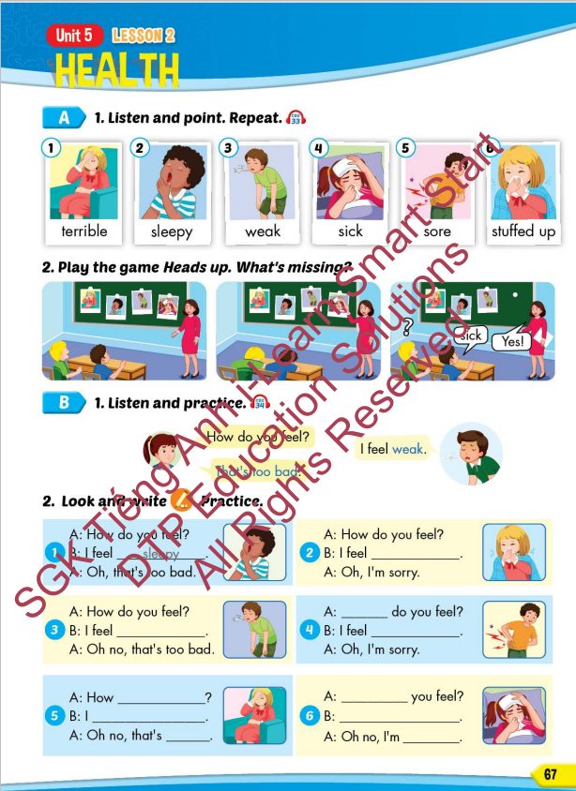
Lesson Outline
Warm-up
Vocabulary
Structure
Consolidation
Wrap-up

Slide 3
Objectives
By the end of this lesson, students will be able to recognize the vocabulary and get to know the structure asking and answering about how they feel.
Vocabulary: terrible, sleepy, weak, sick, sore, stuffed up
Structure: How do you feel?
- I feel weak.
- That's too bad.

Slide 4

Thursday January 23rd 2025
Unit 5. Health - Lesson 2.1 (P.67)
New words. 2. Model sentences.
terrible [A: How do you feel?
sleepy B: I feel weak.
weak A: That’s too bad.]
sick
sore
stuffed up

Slide 5

WARM UP

Slide 6

Guess the HEALTH PROBLEMS

Slide 7

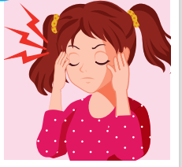
a pain you feel inside your head.
HEADACHE

Slide 8
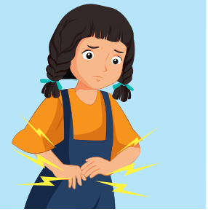
I ate too much and I had a terrible _____________.
STOMACHACHE

Slide 9
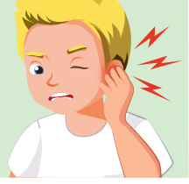
The pain inside part of your ear.
EARACHE

Slide 10
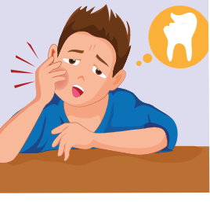
the pain caused by something being wrong with one of your teeth.
TOOTHACHE

Slide 11
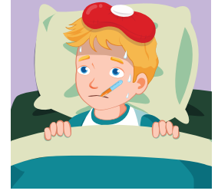
She's very hot and shivery, so I think she must have ______.
THE FLU

Slide 12
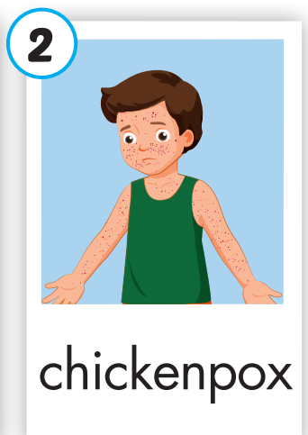
an infectious disease that causes a slight fever and red spots on the skin.
CHICKENPOX

Slide 13

It’s time to learn …

Slide 14

New words
terrible, sleepy, weak, sick, sore, stuffed up

Slide 15

Presentation

Slide 16
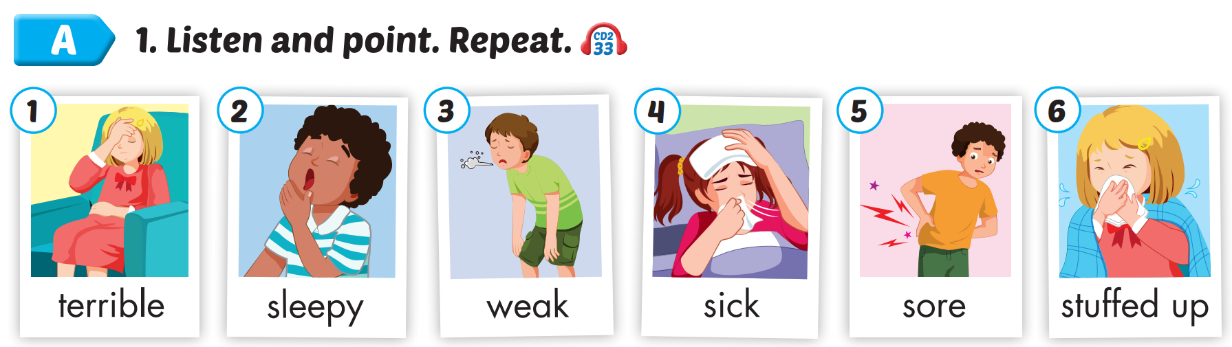

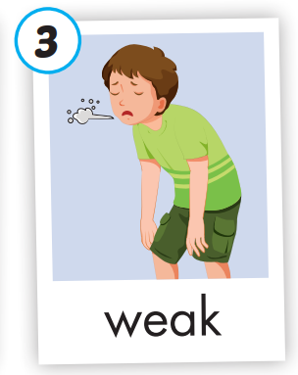
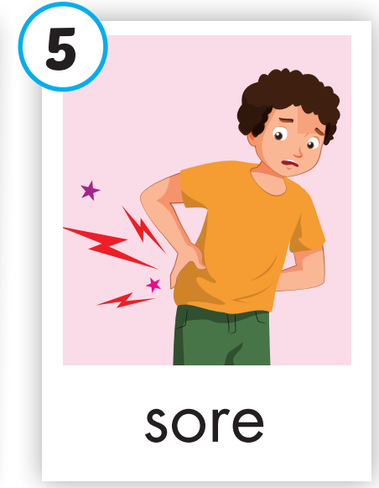
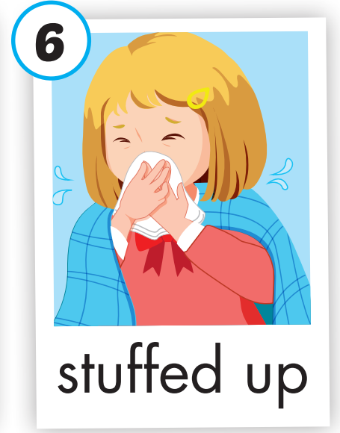
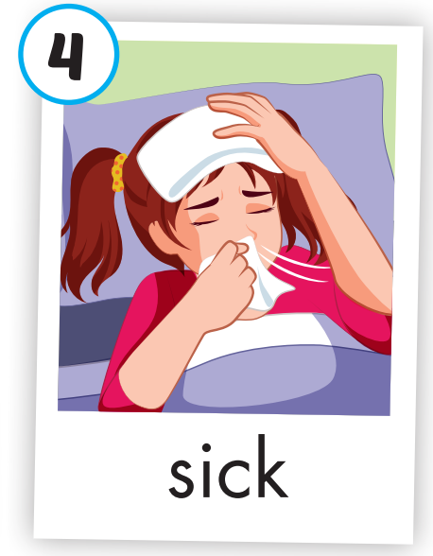
Click on A to hear the sound.
/ˈterəbl/
(adj)
tồi tệ
/ˈsliːpi/
(adj)
buồn ngủ
/wiːk/
(adj)
yếu
/sɪk/
(adj)
bệnh
/sɔːr/
(adj)
đau
/ˌstʌft ˈʌp/
(adj)
nghẹt mũi
Notes:
Click vào hình A. 1. Listen and point. Repeat để cho cả audio full chạy

Slide 17
Click on the picture to hear the sound.
terrible
/ˈterəbl/
(adj)
tồi tệ

Slide 18
Click on the picture to hear the sound.
sleepy
/ˈsliːpi/
(adj)
buồn ngủ

Slide 19
Click on the picture to hear the sound.
weak
/wiːk/
(adj)
yếu

Slide 20
Click on the picture to hear the sound.
sick
/sɪk/
(adj)
bệnh

Slide 21
Click on the picture to hear the sound.
sore
/sɔːr/
(adj)
đau

Slide 22
Click on the picture to hear the sound.
stuffed up
/ˌstʌft ˈʌp/
(adj)
nghẹt mũi

Slide 23
Practice

Slide 24
Read and choose. Then say.

Slide 25

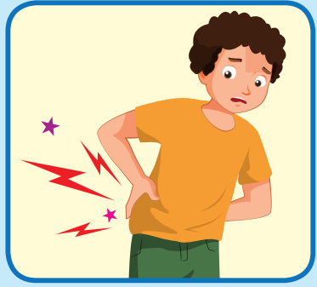
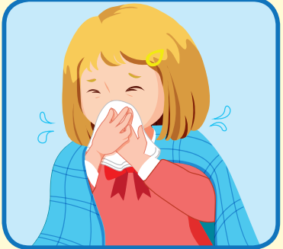

Read and choose
A
B
C
terrible

Slide 26
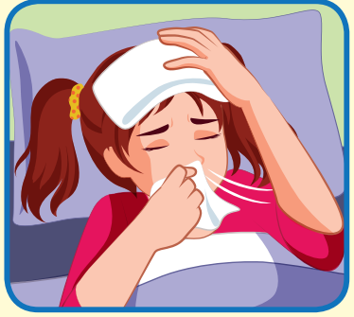
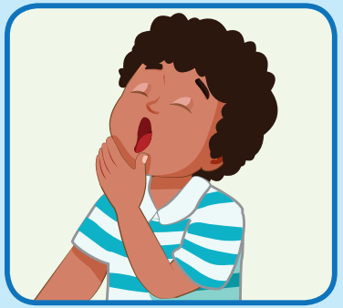
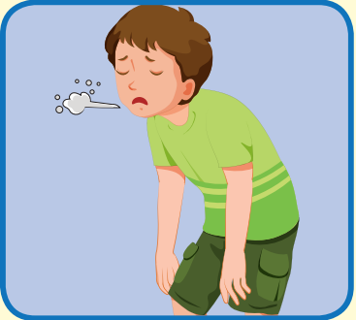
Read and choose
A
B
C
sick

Slide 27
Read and choose
A
B
C
sleepy

Slide 28
Read and choose
A
B
C
sore

Slide 29

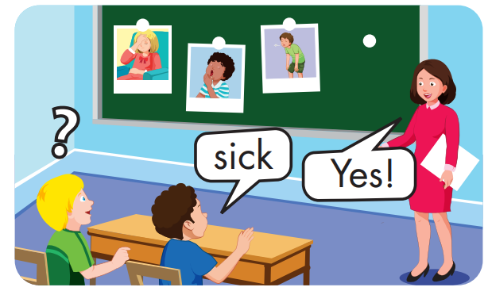

Slide 30
Structure
How do you feel?
- I feel weak.
- That's too bad

Slide 31
Presentation

Slide 32
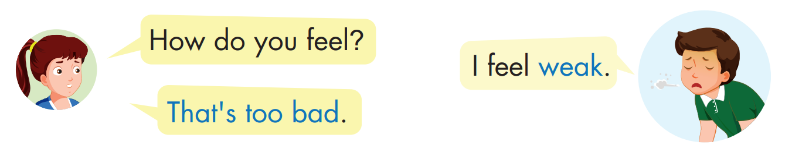
Structure

Slide 33

Practice

Slide 34


Click on B to hear the sound.

Slide 35

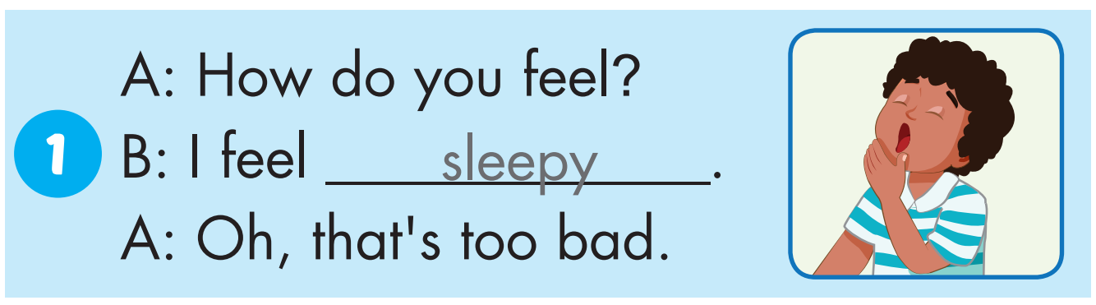

Slide 36
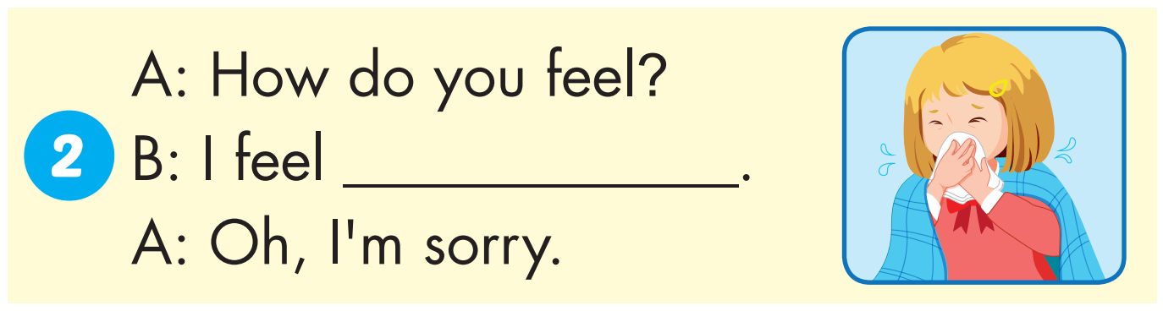
stuffed up

Slide 37
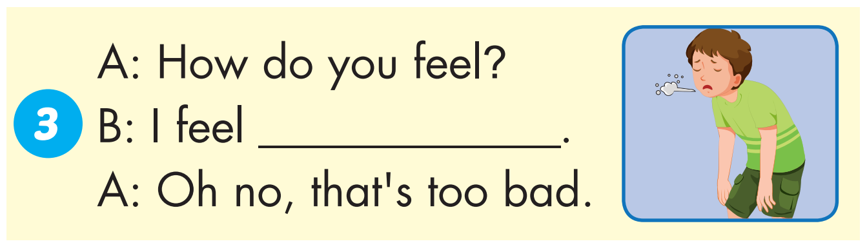
weak

Slide 38
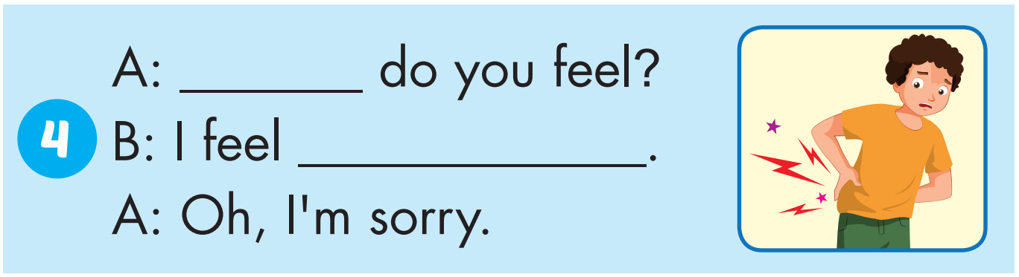
How
sore

Slide 39
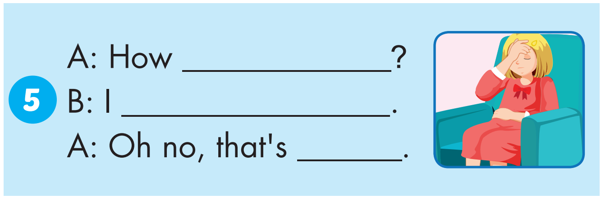
do you feel
feel terrible
too bad

Slide 40
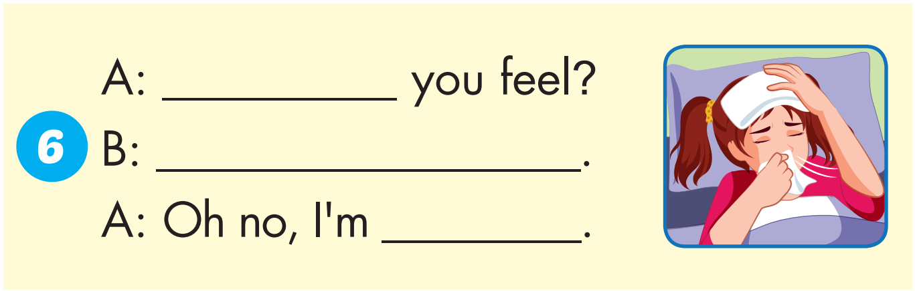
How do
I feel sick
sorry

Slide 41

Production

Slide 42
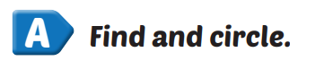
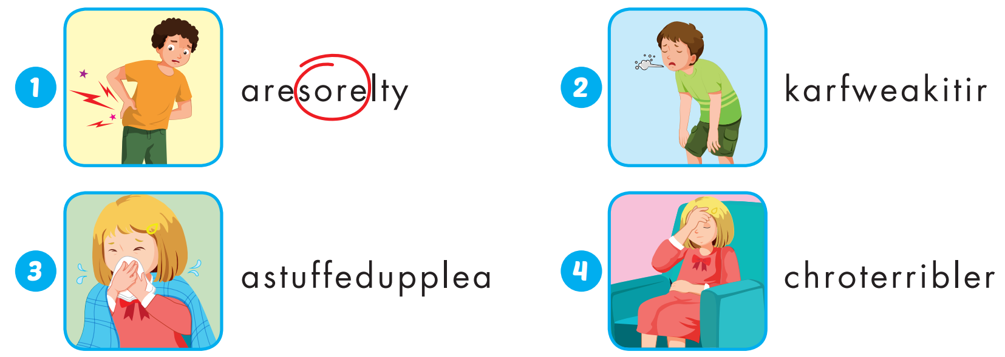
Extra Practice
WB, page 44

Slide 43
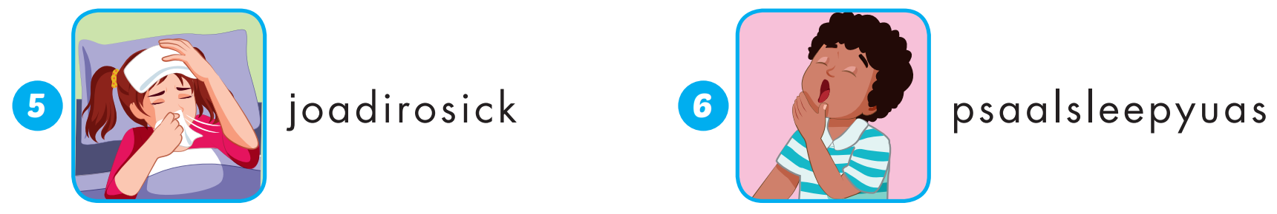
Extra Practice
WB, page 44

Slide 44
sore |  | sick
 | terrible
weak |  | sleepy
 | stuffed up
1
2
3
4
5
6
7
8
9
10
11
12

Slide 45

CONSOLIDATION

Slide 46

WRAP-UP

Slide 47
Today’s lesson
Vocabularies
terrible, sleepy, weak, sick, sore, stuffed up.
Structures/ Sentence patterns
How do you feel?
I feel weak.
That's too bad.

Slide 48
Homework
Practice the vocabularies and structure, and make sentences using them.
Do the exercises in Tiếng Anh 5 i-Learn Smart Start WB (page 44).
Do the exercises in Tiếng Anh 5 i-Learn Smart Start Notebook.
Prepare the next lesson (page 68 SB).
Play the consolidation games in Tiếng Anh 5 i-Learn Smart Start DHA App on www.eduhome.com.vn

Slide 49

Enjoy your day!

Slide 50

Lesson 3
Stay positive and have a nice day!

