Slide 1

Unit 5: Getting Around
Lesson 1.1
Page 64

Slide 2
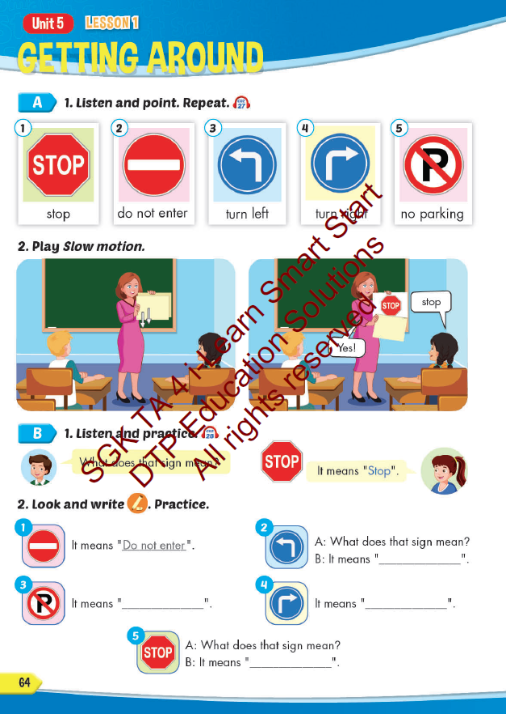
Lesson Outline
Warm-up
Vocabulary
Structure
Consolidation
Wrap-up

Slide 3
Objectives
By the end of this lesson, students will be able to…
Vocabulary: Pronounce and use the words related to the topic properly: stop, do not enter, turn left, turn right, no parking.
Structure: What does that sign mean? - It means "Stop".

Slide 4

It’s time to learn …

Slide 5


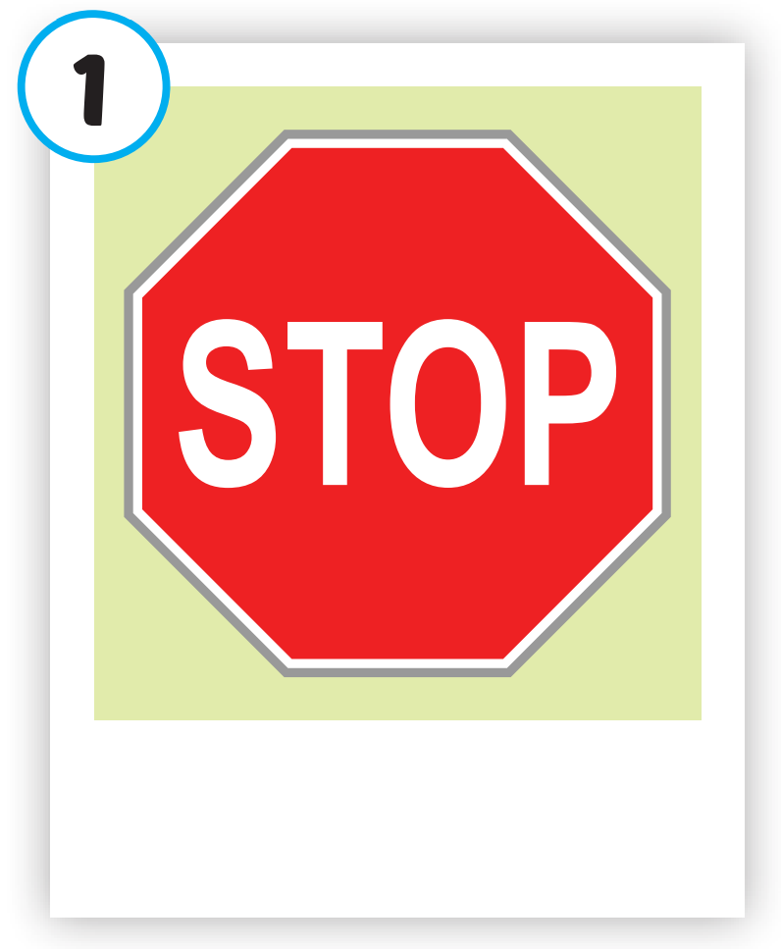
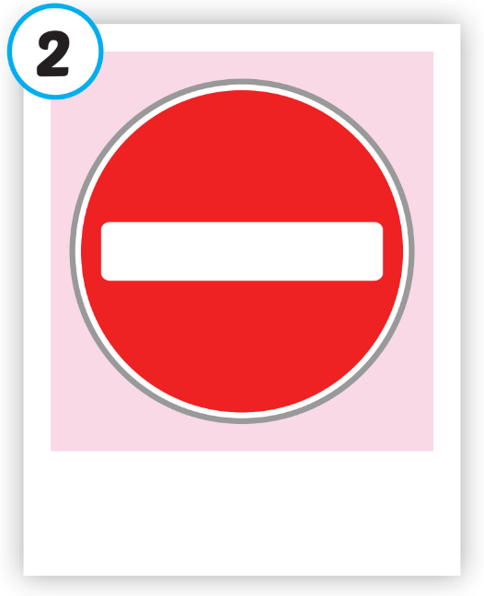
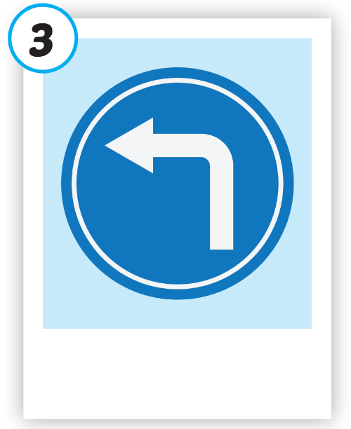
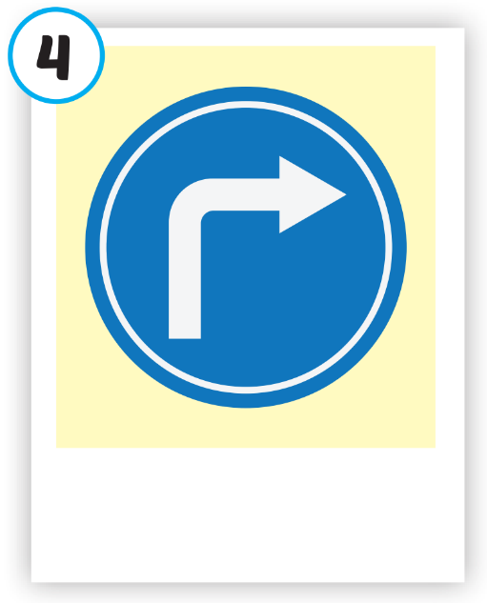
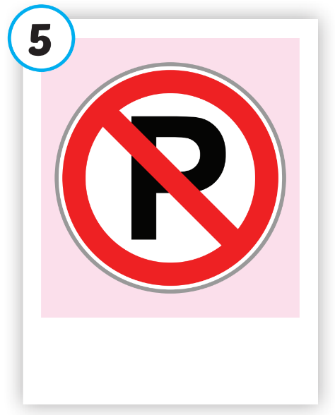





Click on each picture to hear the sound.
/stɑːp/
ngừng lại, dừng lại
/duː nɑːt ˈentər/
cấm vào
/tɜːrn left/
rẽ trái
/tɜːrn raɪt/
rẽ phải
/noʊ ˈpɑːrkɪŋ/
cấm đỗ xe

Slide 6

Click on each picture to hear the sound.
/stɑːp/
ngừng lại, dừng lại

Slide 7

Click on each picture to hear the sound.
/duː nɑːt ˈentər/
cấm vào

Slide 8

Click on each picture to hear the sound.
/tɜːrn left/
rẽ trái

Slide 9

Click on each picture to hear the sound.
/tɜːrn raɪt/
rẽ phải

Slide 10
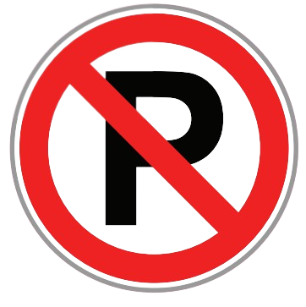
Click on each picture to hear the sound.
/noʊ ˈpɑːrkɪŋ/
cấm đỗ xe

