Slide 1

Unit 5: Getting Around
Lesson 1.1
Page 64

Slide 2
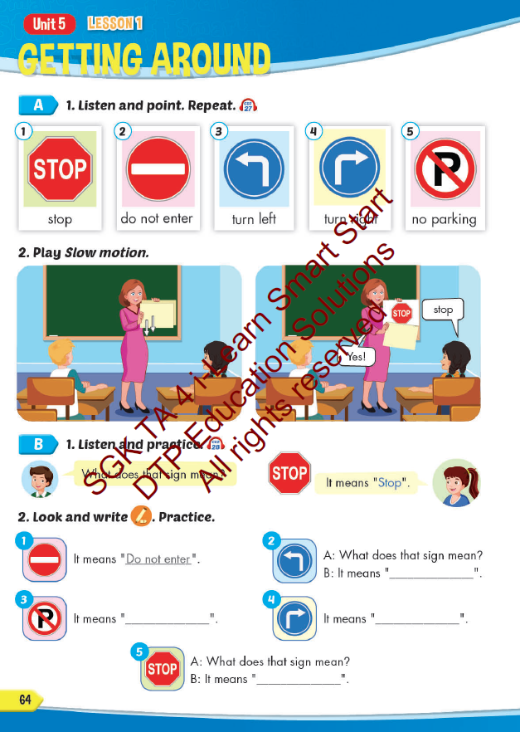
Lesson Outline
Warm-up
Vocabulary
Structure
Consolidation
Wrap-up

Slide 3
Objectives
By the end of this lesson, students will be able to…
Vocabulary: Pronounce and use the words related to the topic properly: stop, do not enter, turn left, turn right, no parking.
Structure: What does that sign mean? - It means "Stop".

Slide 4

Structure
What does that sign mean?
It means "Stop".

Slide 5


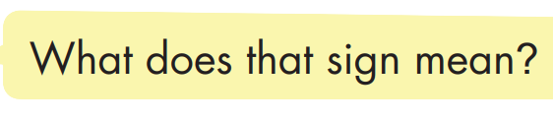
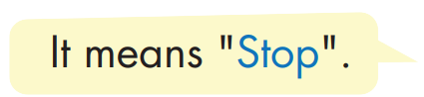
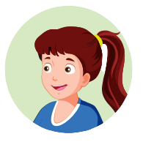
Structure

Slide 6

Practice

Slide 7



Slide 8

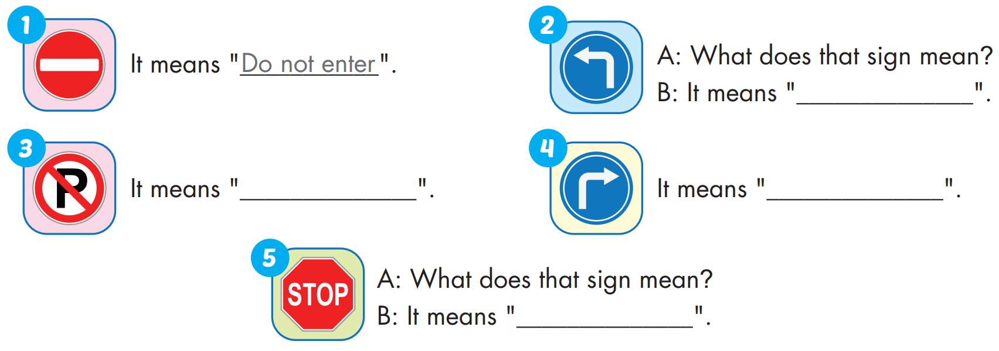
turn left
no parking
turn right
stop

Slide 9

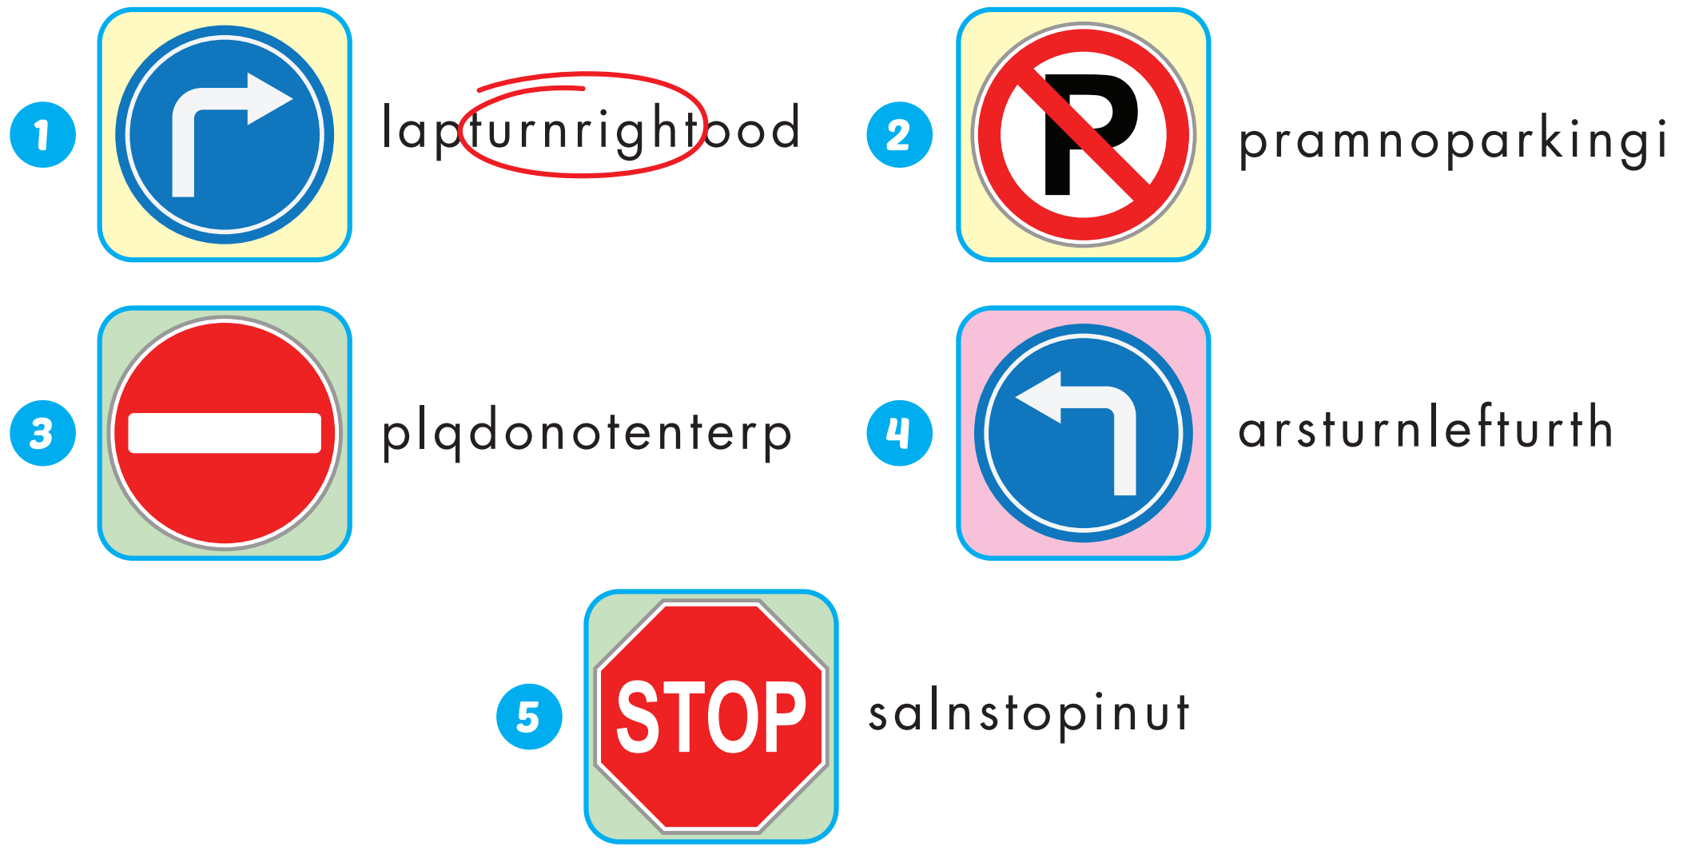
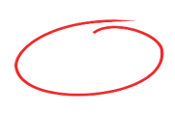
Extra Practice
WB, page 42

Slide 10

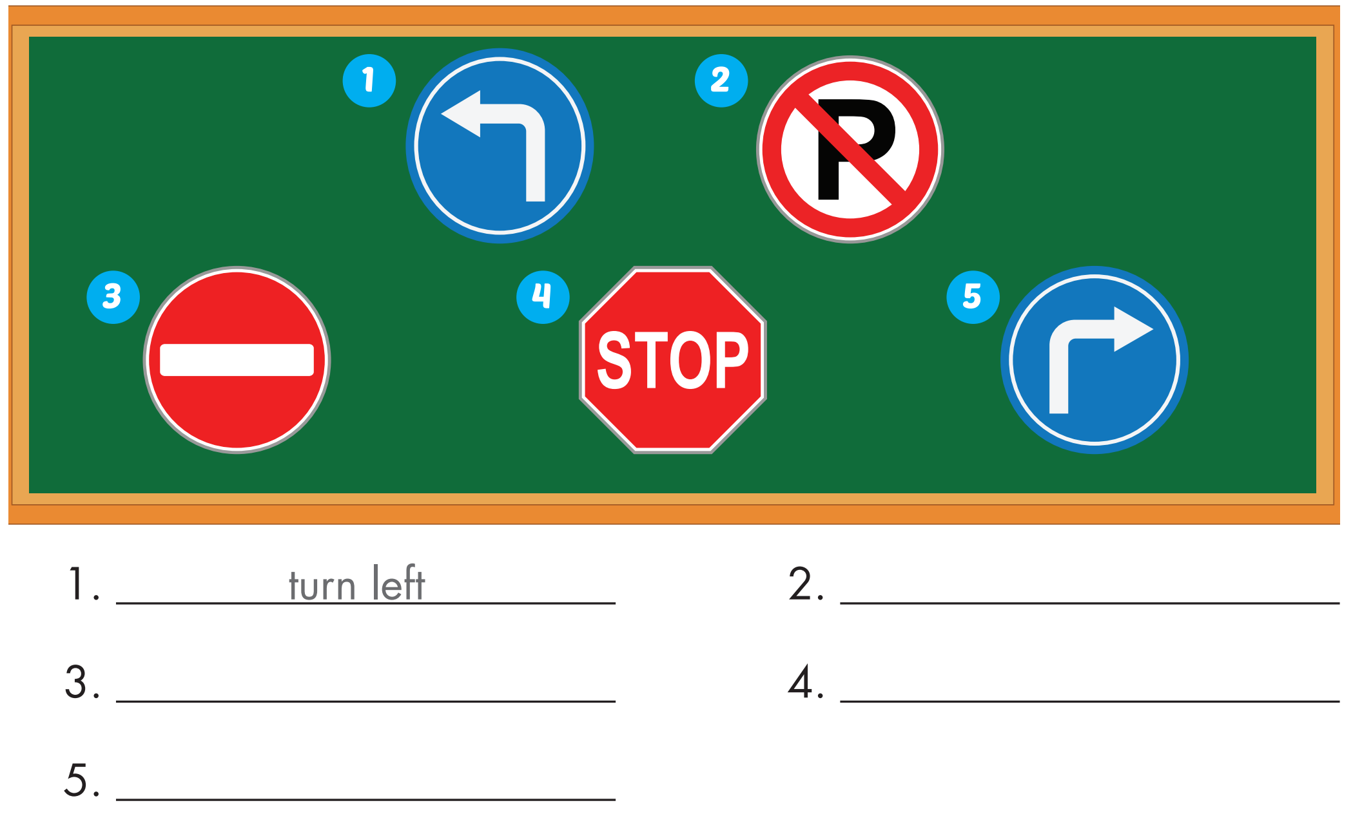
Extra Practice
WB, page 42
no parking
do not enter
stop
turn right

