Slide 1

Unit 8: MY FRIENDS AND I
Lesson 4 - Page.115

Slide 2


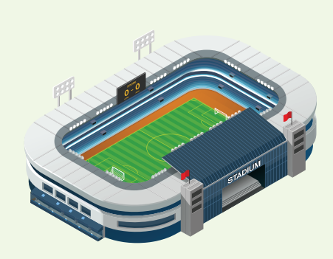


REVIEW
What’s next?
?
?

Slide 3

New words
fun
exciting
relaxing
tiring
boring.

Slide 4
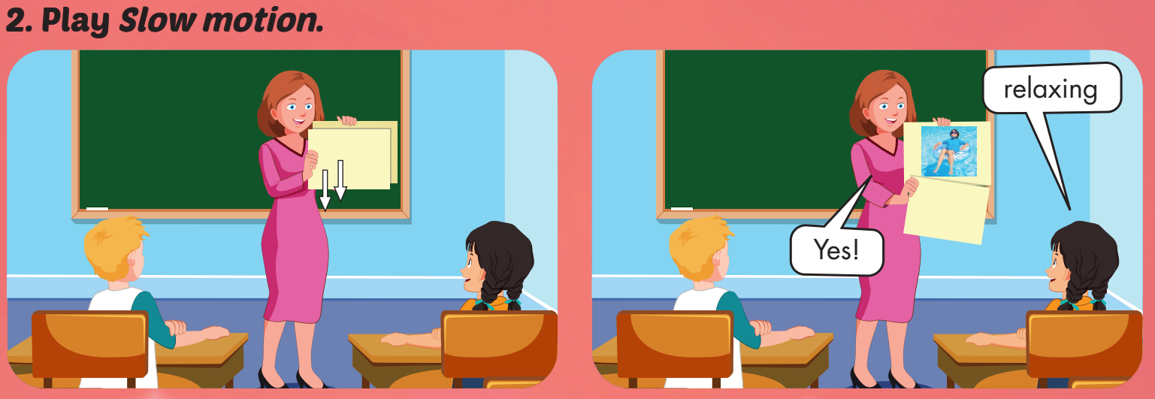

Slide 5

WHAT IS IN THE CLOCK?
HOW TO PLAY
Click on clock to play.
Click CHECK to show the answer.

Slide 6
Structures
- How was your weekend?
- It was relaxing. I was at the beach with my mom and brother.

Slide 7

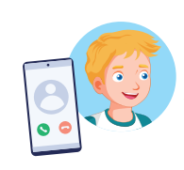

How was your weekend?
It was boring.

Slide 8
