Slide 1
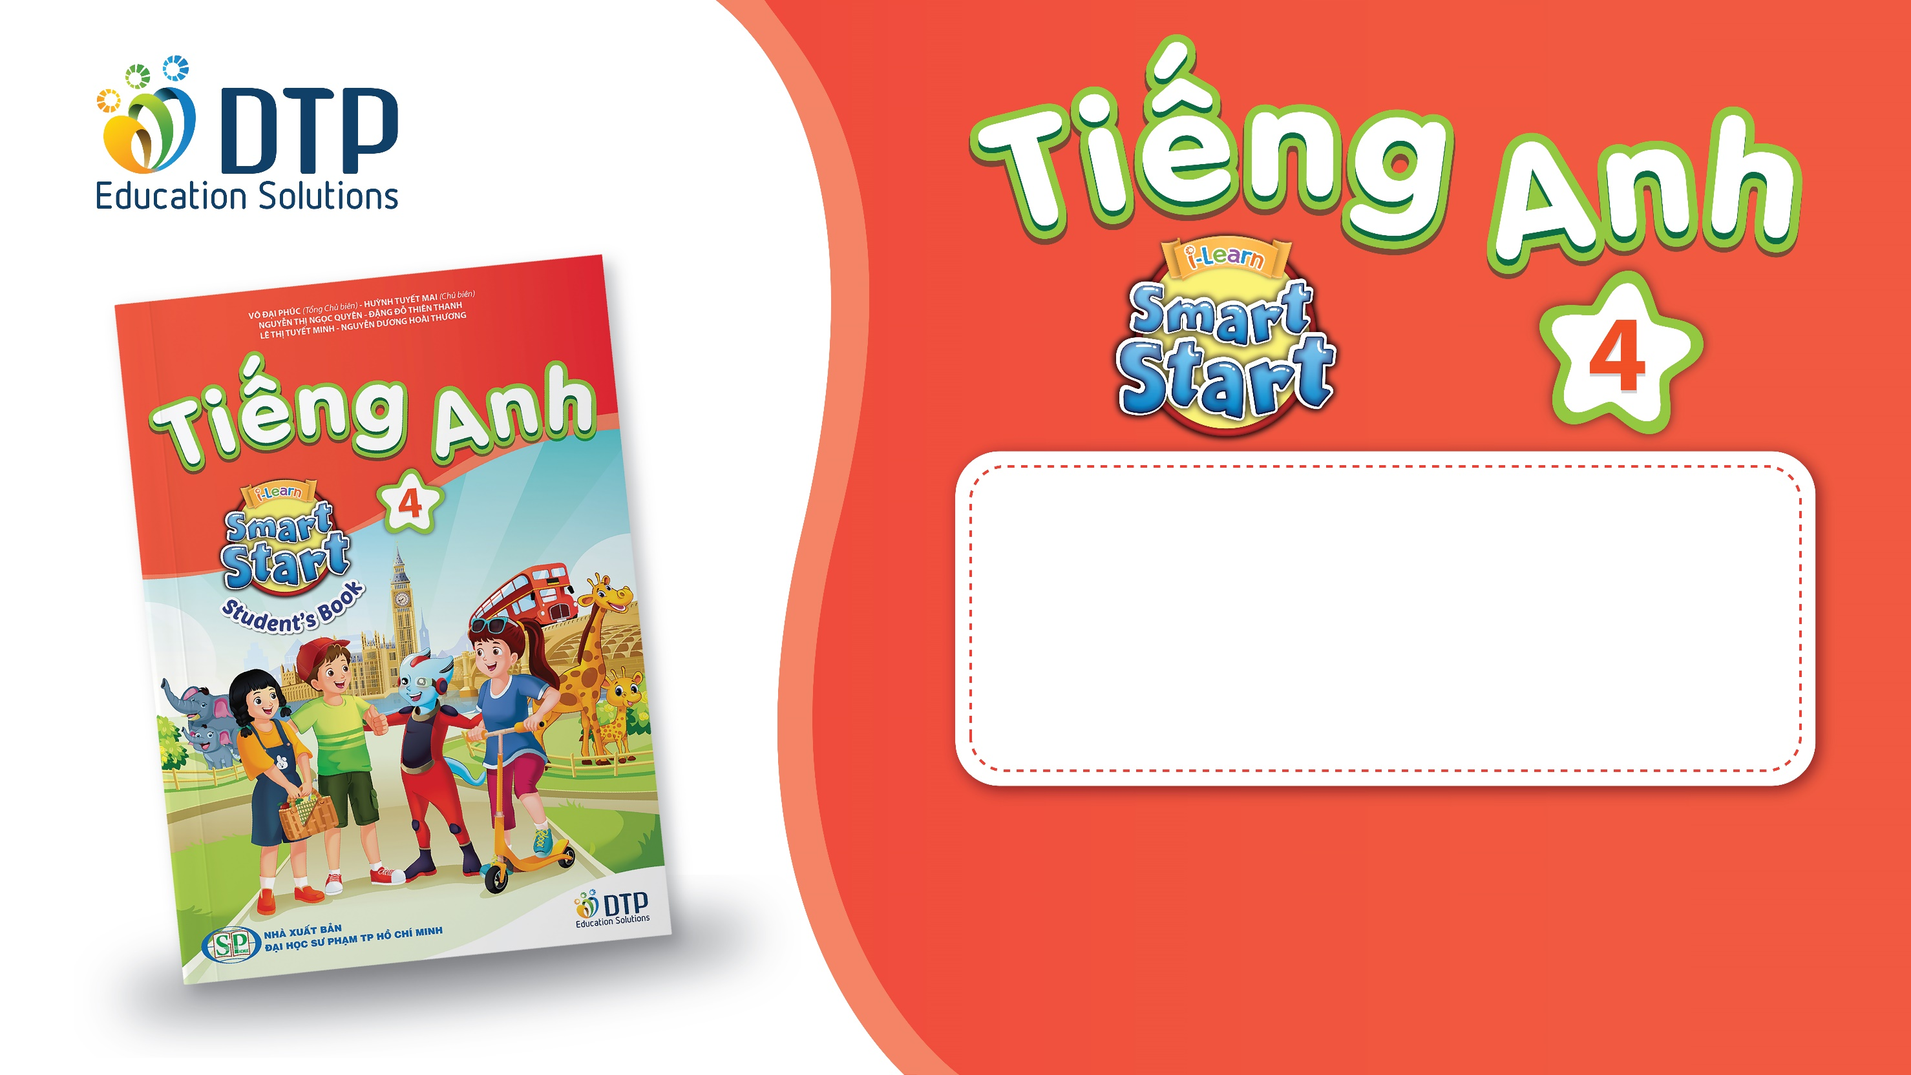
Unit 8: MY FRIENDS AND I
Lesson 3 - Page 112

Slide 2
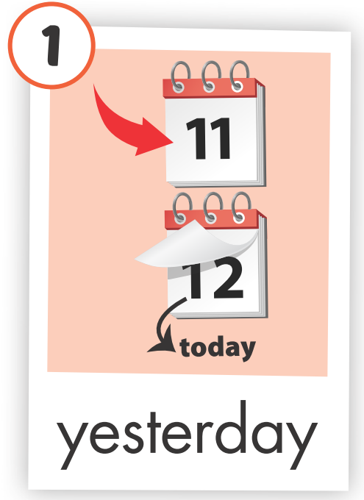
REVIEW 1
WHAT’S MISSING?

Slide 3
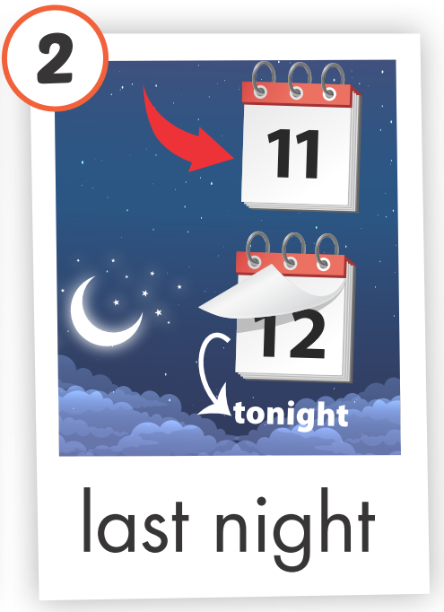
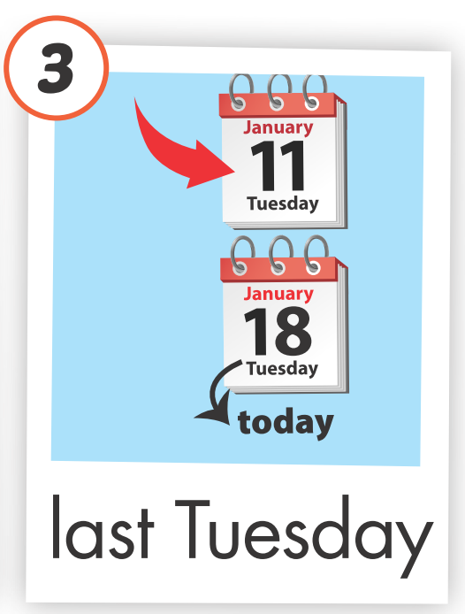
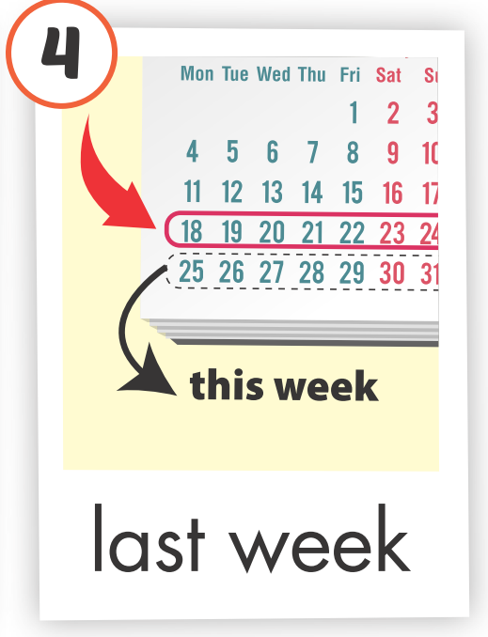
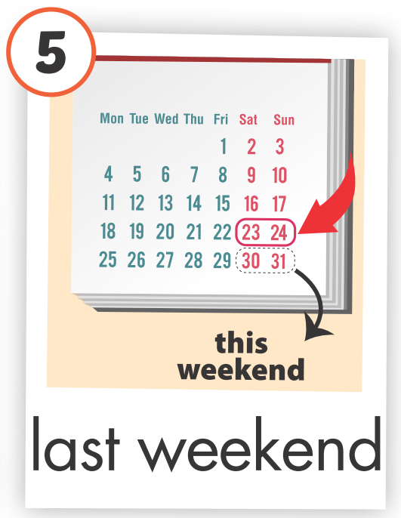
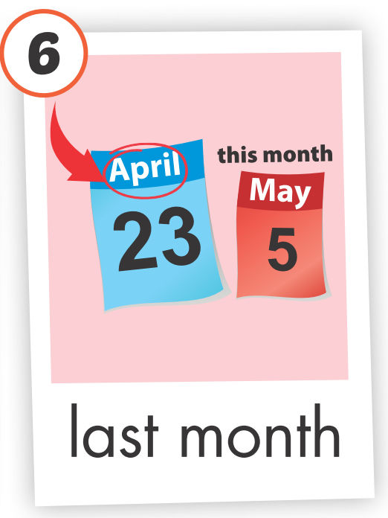

REVIEW 1
Click each picture to hear the sound

Slide 4

New words
movie theater
playground
museum
mall
Supermarket
amusement park

Slide 5
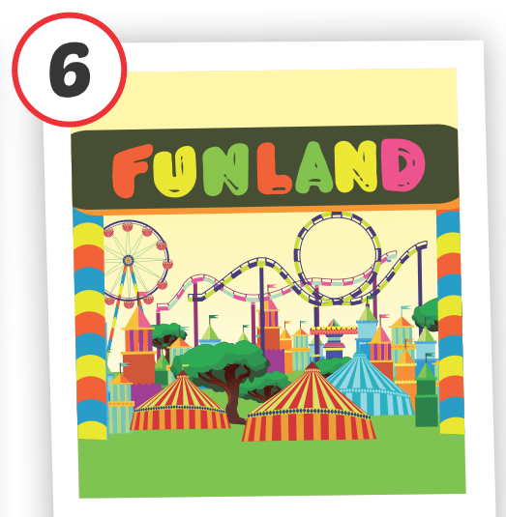
amusement park
/əˈmjuːzmənt ˌpɑːrk/ công viên giải trí
Click on each English word to hear the sound.

Slide 6
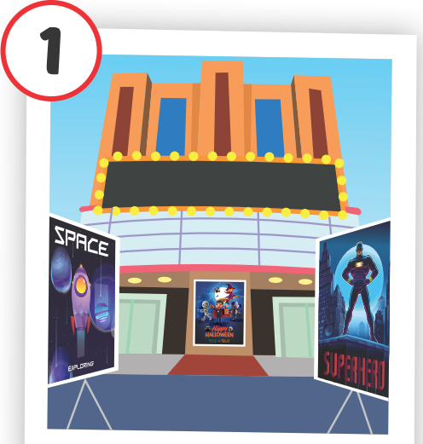
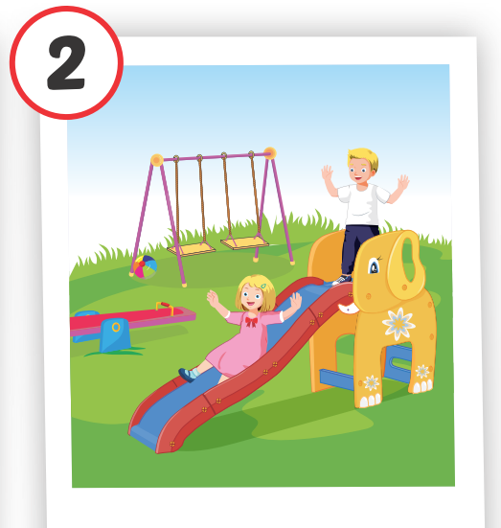
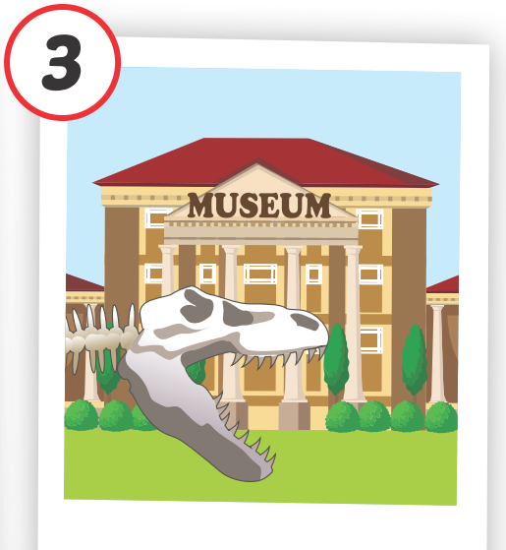

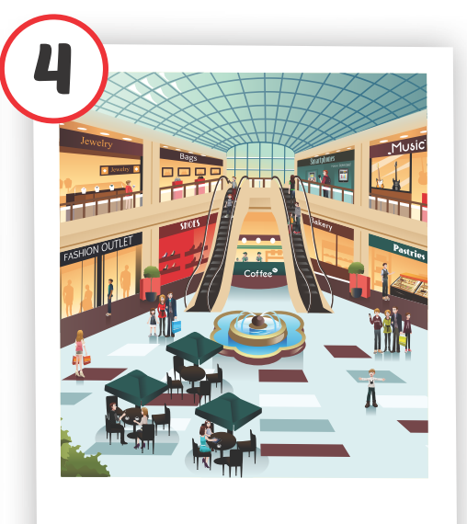

Slide 7
WHAT’S MISSING?
amusement park
museum
supermarket
mall
playground
playground
movie theater
mall
mall
museum
playground
supermarket
supermarket
amusement park
mall
museum
mall
movie theater
museum
playground
playground
amusement park
amusement park
movie theater
supermarket
movie theater
supermarket

Slide 8
Structures
Where were you last night?
I was at the movie theater.
Where was Nick last Saturday?
He was at the mall.
Where were Alfie and Mai yesterday?
They were at the park.

Slide 9
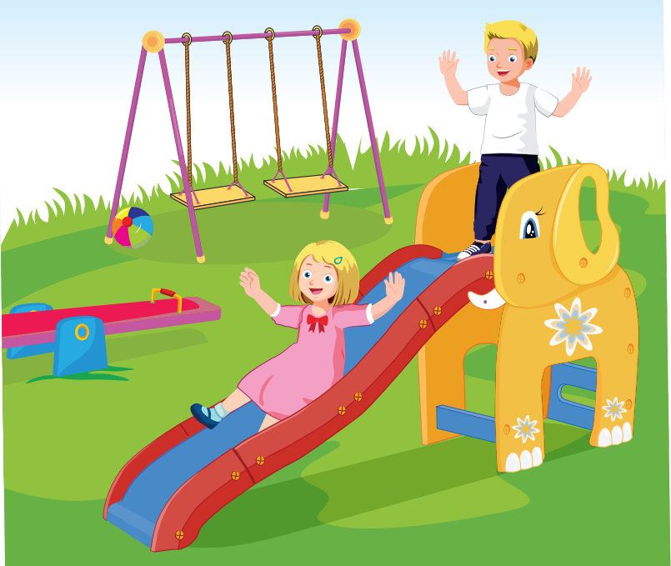
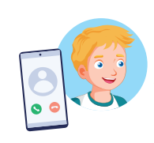

Where were you last week?
I was at the playground.

