Slide 1

Unit 8: MY FRIENDS AND I
Lesson 2 - Page 110

Slide 2
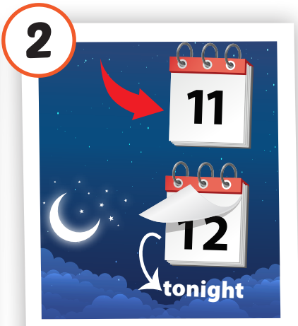
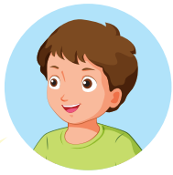

Look and say.
last night
START
CHECK

Slide 3

Phonics
/d/

Slide 4
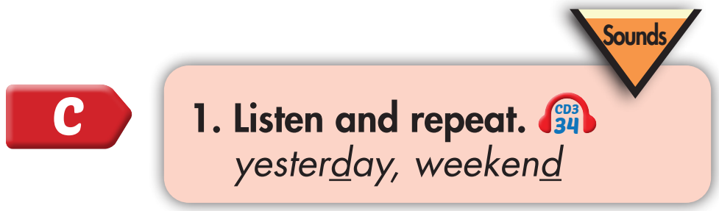

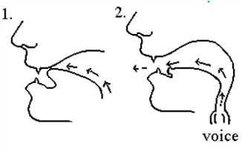
yesterday
weekend
Click on the word to hear the sound

Slide 5
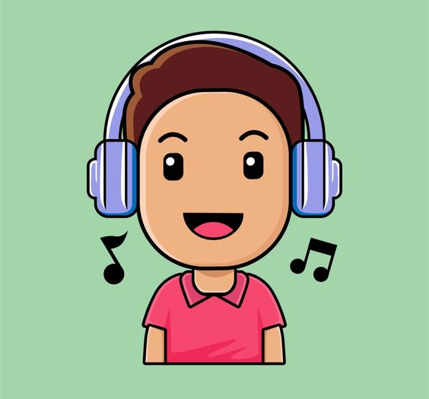
BEFORE YOU LISTEN

Slide 6
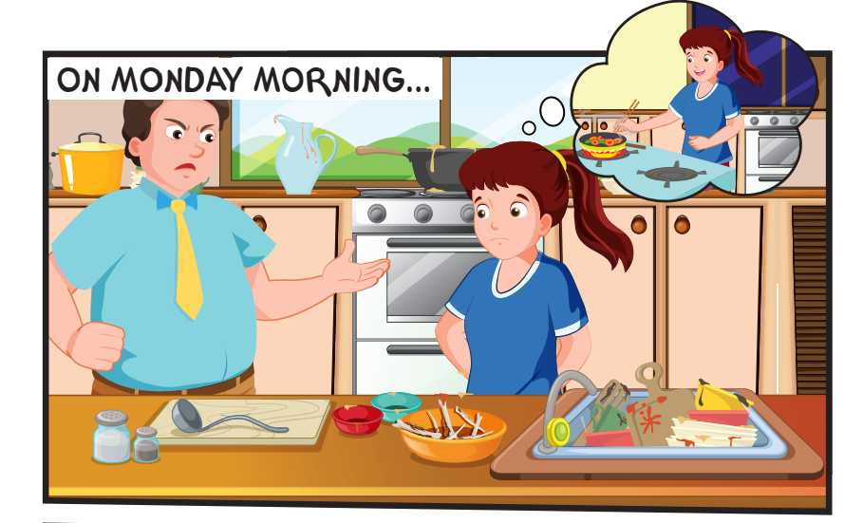
Where are they?
Is Mr Brown happy?

Slide 7

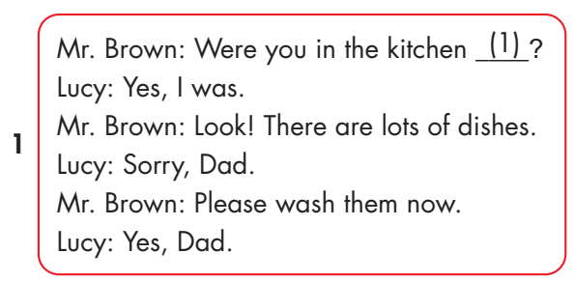
Click on the headphone icon to hear the sound.

Slide 8
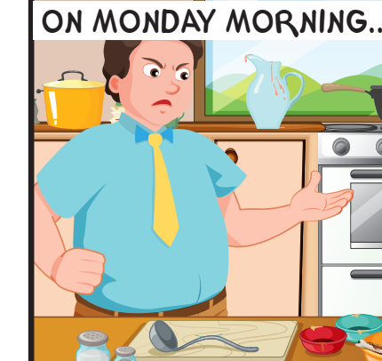
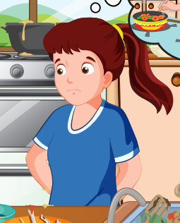
Were you in the kitchen last night?
Yes, I was.
Look. There are lots of dishes.
Sorry, Dad.

