Slide 1

Unit 8: MY FRIENDS AND I
Lesson 1 - Page 108

Slide 2
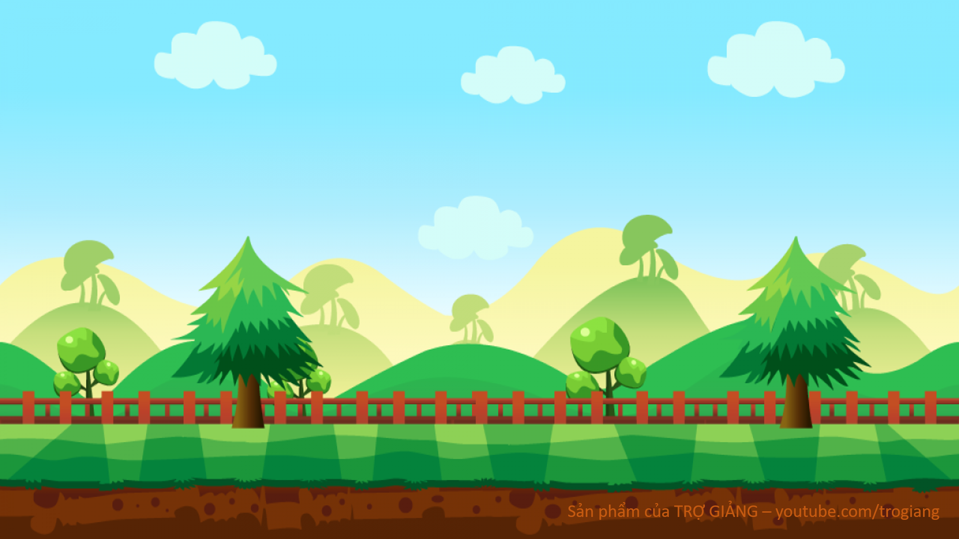


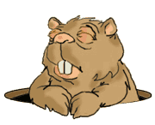

Game
Gold Miner
START

Slide 3
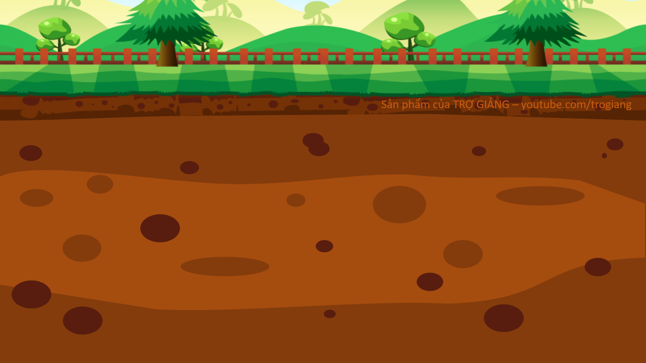






100$
150
50$
20$
100$
10$
150$
50$
20$

Slide 4


She was
Notes:
Click on the man to come back slide 6

Slide 5
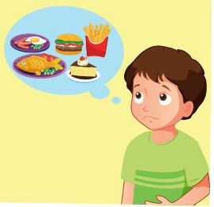
Choose the correct answer
Click on the picture to check the correct answer.
A. They were hungry.
B. He was hungry.

Slide 6

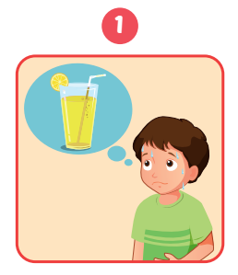
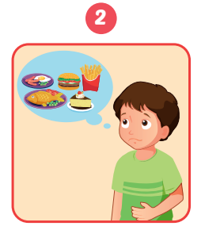



Click on the picture to check the correct answer.

Slide 7

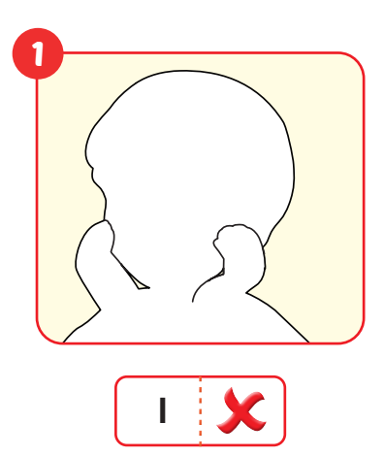
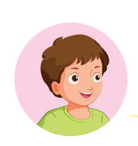


Slide 8
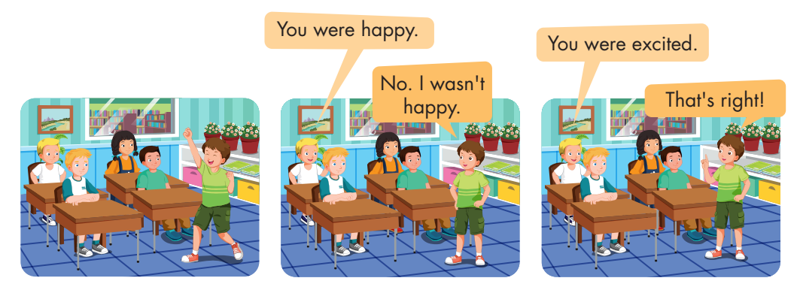

Slide 9


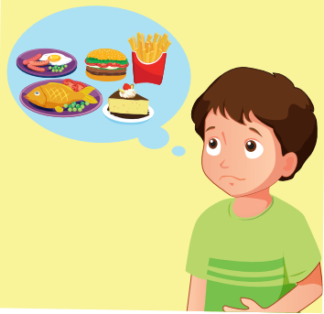
____________
Yes, ______.
A
You was hungry./ I was.
B
You were hungry./ I was.
C
You were hungry./ I were.

