Slide 1

Unit 7: MY FAMILY
Ethics Lesson 4.1
Page 101

Slide 2
Lesson objectives
By the end of this lesson, students will be able to learn and practice ….
Vocabulary: put away groceries, carry bags, clear the table, sweep the floor, take out the trash, wash the dishes.
Structure:
Who puts away groceries?
I put away groceries./I do.

Slide 3
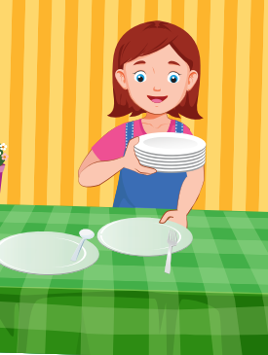
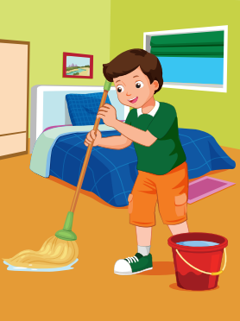
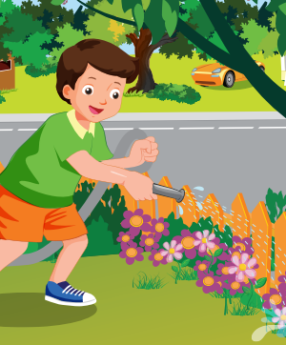
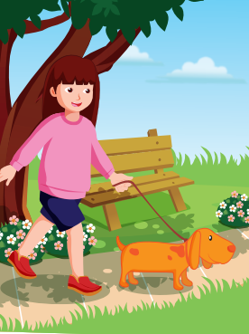
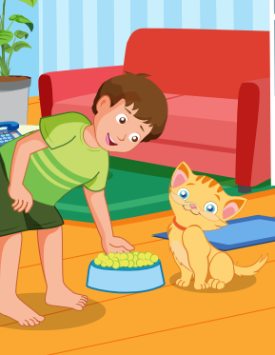
1
4
4
1
SPIN
5
2
2
4
3
3
5

Slide 4
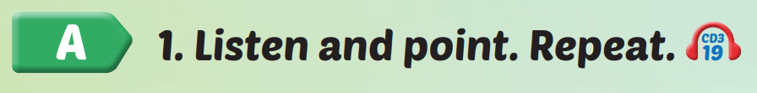

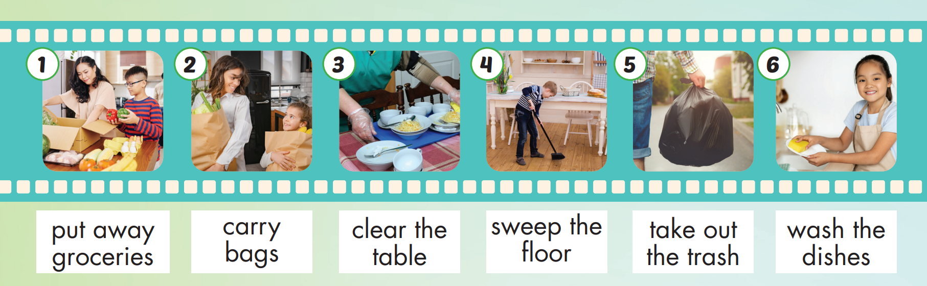
/pʊt
əˈweɪ
ˈɡrəʊsəriz/
/ˈkæri bæɡz/
/klɪr ðəˈteɪbl/
/swiːp ðə flɔːr/
/teɪk aʊt ðə træʃ/
/wɑːʃ ðəˈdɪʃɪz/

Slide 5

Practice

Slide 6
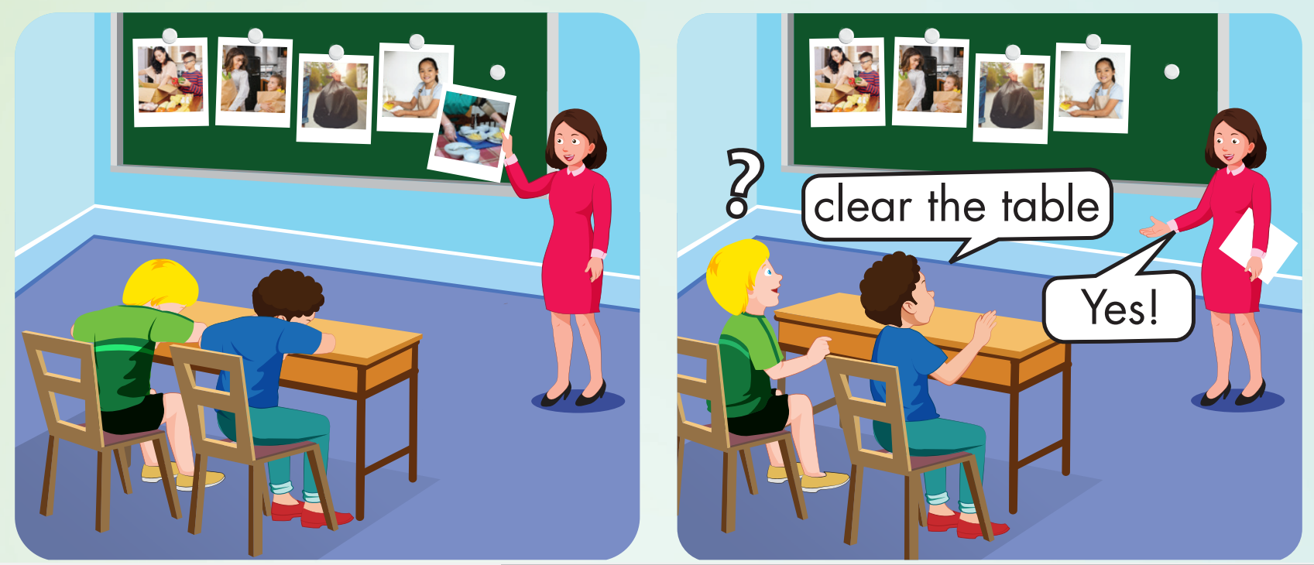

Slide 7
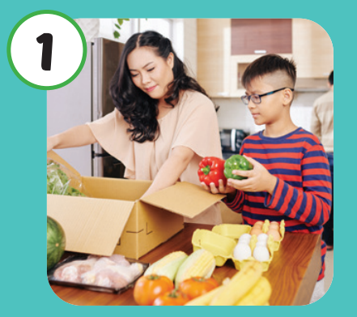
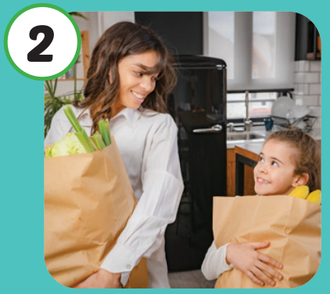
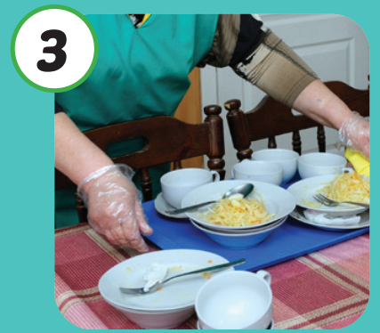
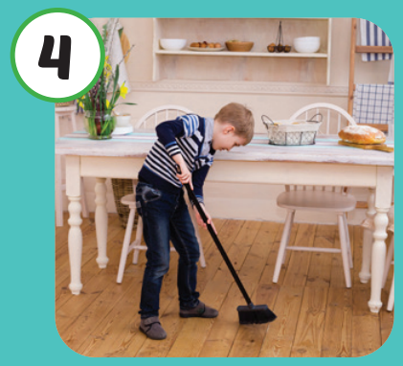
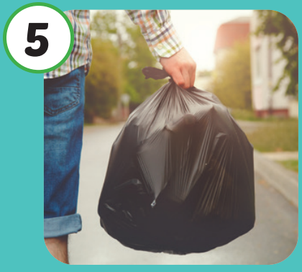

What’s missing?
carry bags

Slide 8
What’s missing?
sweep the floor

Slide 9
What’s missing?
clear the table

Slide 10

Structures
Who puts away groceries?
I put away groceries./ I do.

Slide 11
Presentation

Slide 12



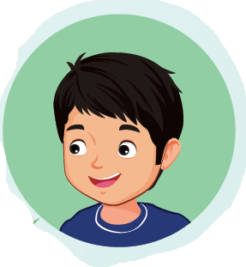

Slide 13
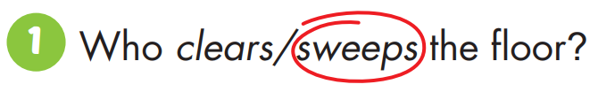
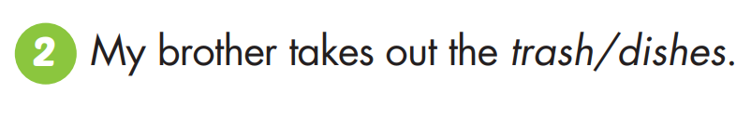

Slide 14
Today’s lesson
Vocabulary: put away groceries, carry bags, clear the table, sweep the floor, take out the trash, wash the dishes.
Structure:
Who puts away groceries?
I put away groceries./I do.

