Slide 1

Unit 7: MY FAMILY
Lesson 3.3
Page 100

Slide 2
Lesson 3
Today’s lesson
Vocabularies
Set the table
Water the plants
Walk the dog
Feed the cat
Mop the floor
Do the laundry
Structures/ Sentence patterns
How do you help at home?
I set the table.
How does your brother help at home?
He mops the floor.

Slide 3

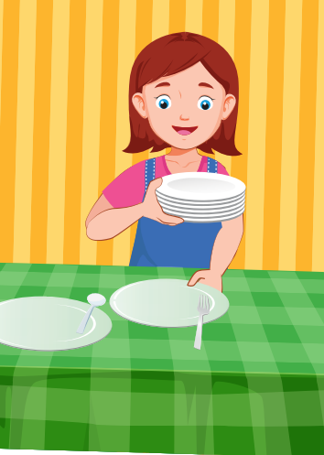

sit
cut
set
_ | _ | _ |  | t | h | e |  | t | a | b | l | e

Slide 4
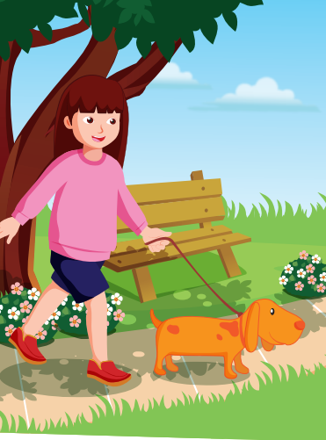
walk
feed
open
_ | _ | _ | _ |  | t | h | e |  | d | o | g

Slide 5

Structures
How do you have at home?
I set the table.

Slide 6


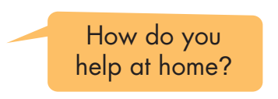


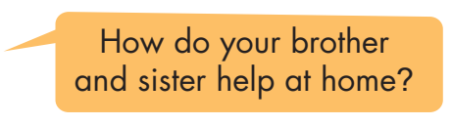
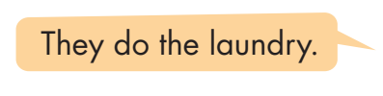

Slide 7
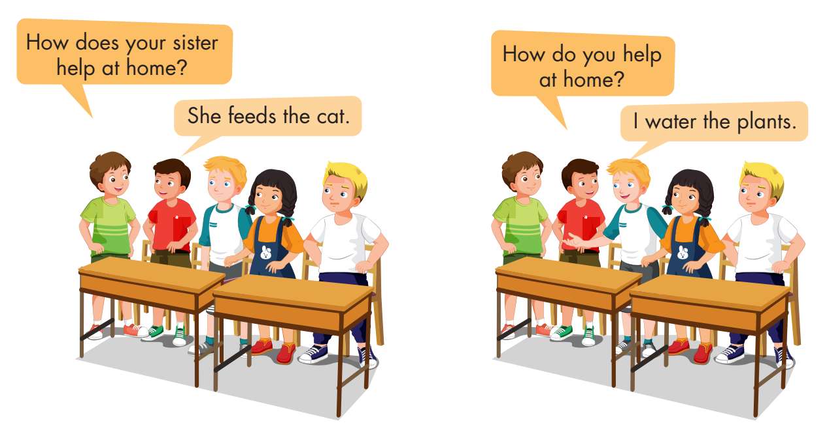
Work in pairs.
Ask each other using the form below.

Slide 8

Let’s play!
Let’s Dance Game

Slide 9
How To Play
Students must take turns reading the words in order.
Each time a student can choose to say the words in 1 square, 2 squares or a maximum of 3 squares.
The student who says the last word must dance!

Slide 10

set
walk
table
mop
water
floor
plant
laundry
feed
do
dog
cat
DANCE!!
store
hospital
office
farm
bank
mop
set
water
floor
laundry
plant
floor
walk
feed
store
farm
dog
table

