Slide 1

Unit 7: MY FAMILY
Lesson 3.2
Page 99

Slide 2
By the end of this lesson, students will be able to talk about chores they do.
Vocabularies
sets, mops
floor, laundry
Structures/ Sentence patterns
How do you help at home?
I set the table.
How does your brother help at home?
He mops the floor.

Slide 3

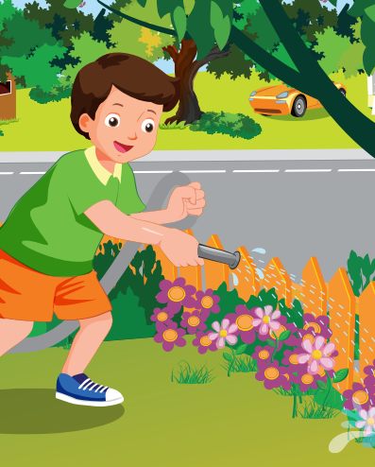
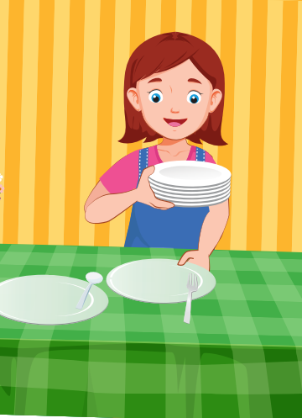
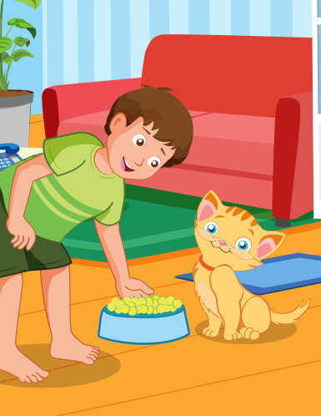
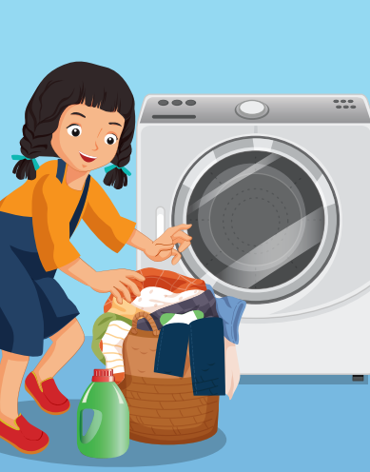
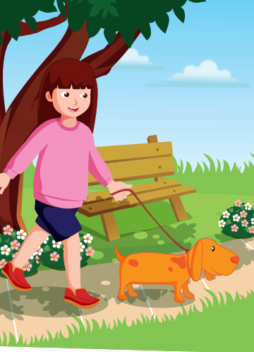
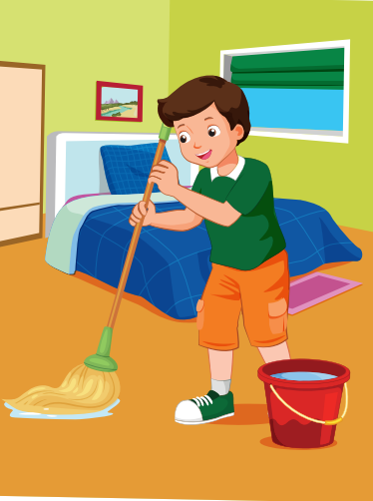
CLICK HERE TO LISTEN ️🎧
LISTEN AND CHOOSE THE PICTURE
WRONG
CORRECT
WRONG
WRONG
WRONG
NEXT
WRONG

Slide 4

Listening

Slide 5
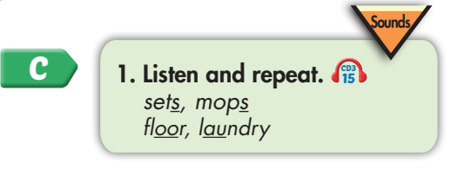
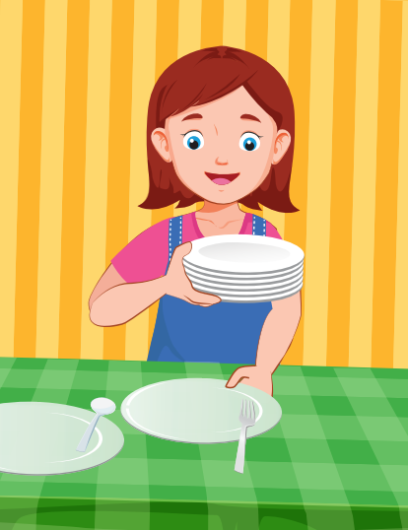
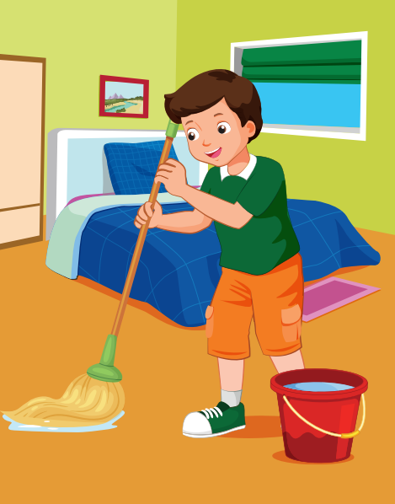
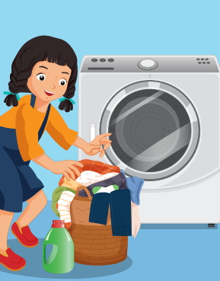
Click each English word to hear the sound.
sets
mops
floor
laundry
/set/
Chuẩn bị
/mɑːp/
Lau, chùi
/flɔːr/
Sàn nhà
/ˈlɑːndri/
Giặt

Slide 6


Click the earphone to hear the sound.
Who mops the floor?
Elfie mops the floor.
Who sets the table?
Elfie sets the table.
Who does the laundry?
Elfie does the laundry.

Slide 7
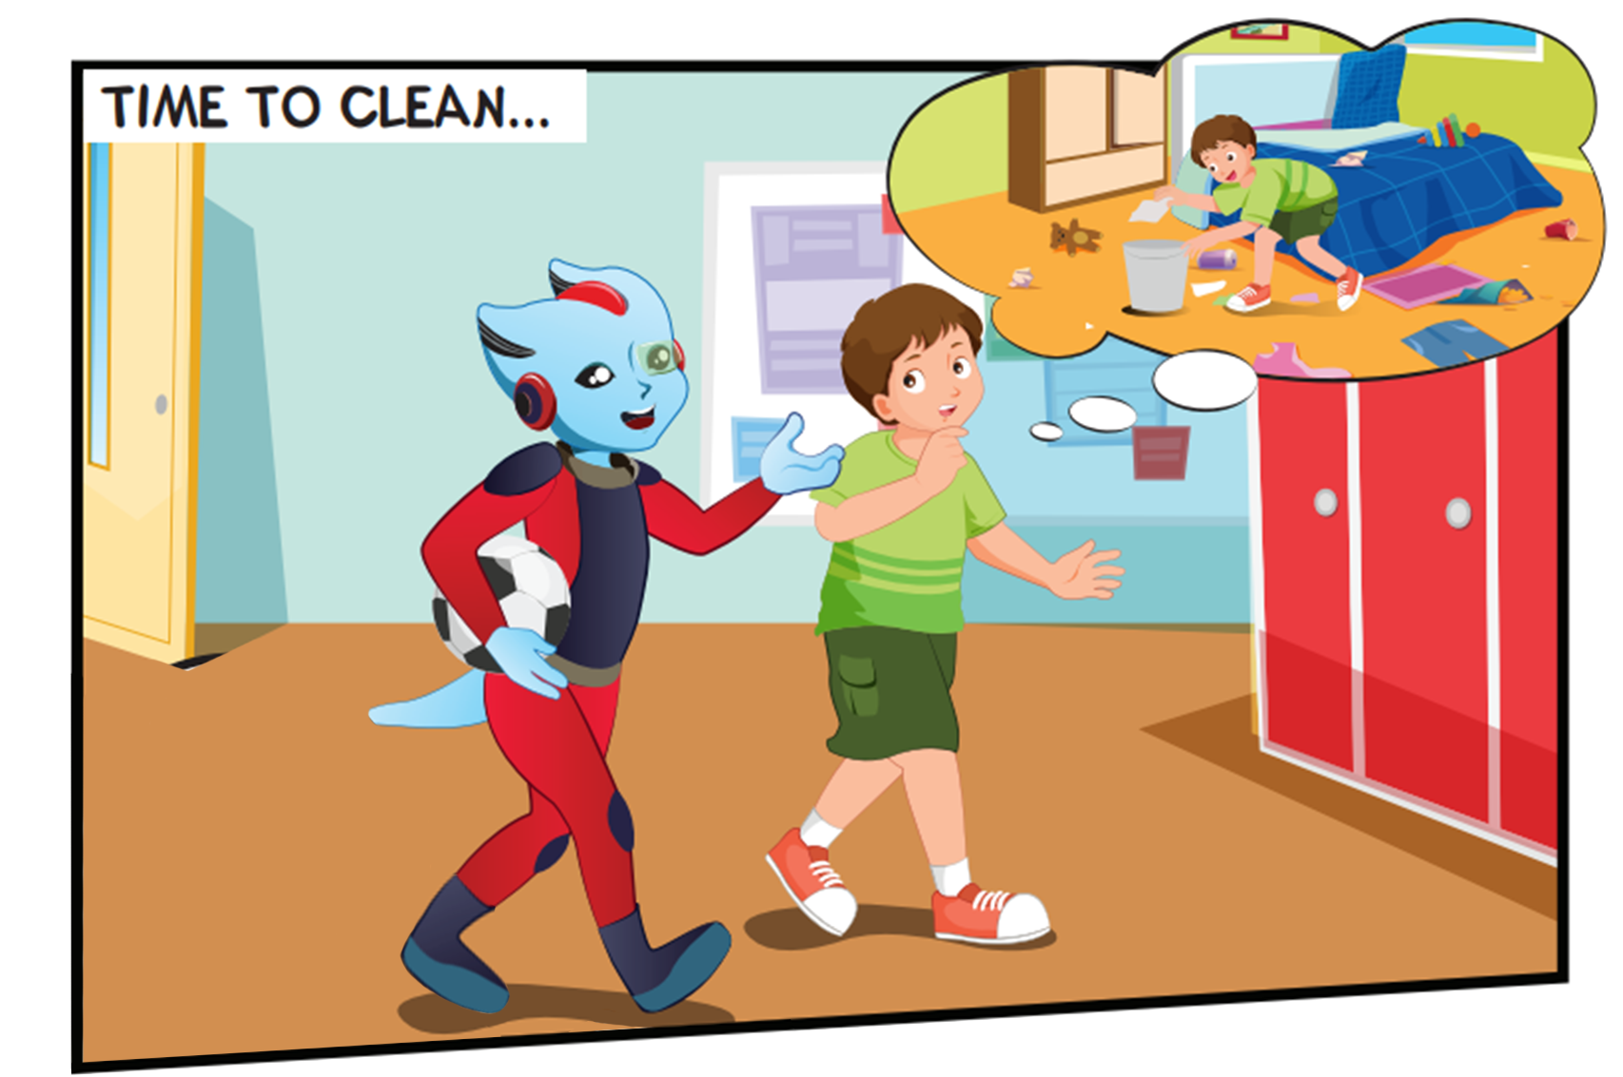
Where are they?
What are they doing?

Slide 8
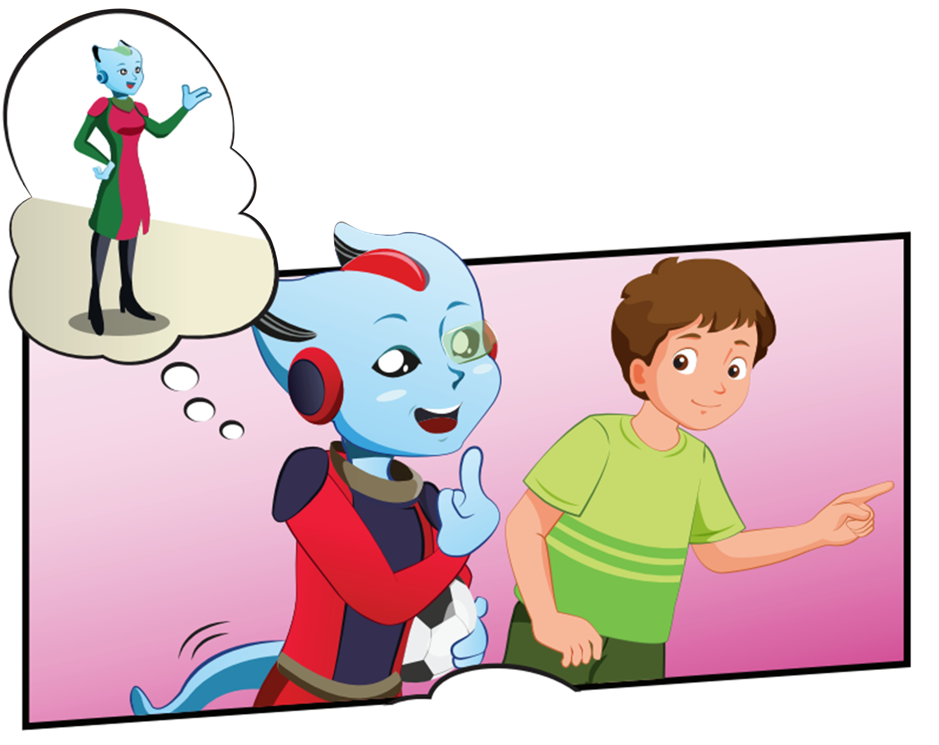
Who are they?
What are they doing?

Slide 9
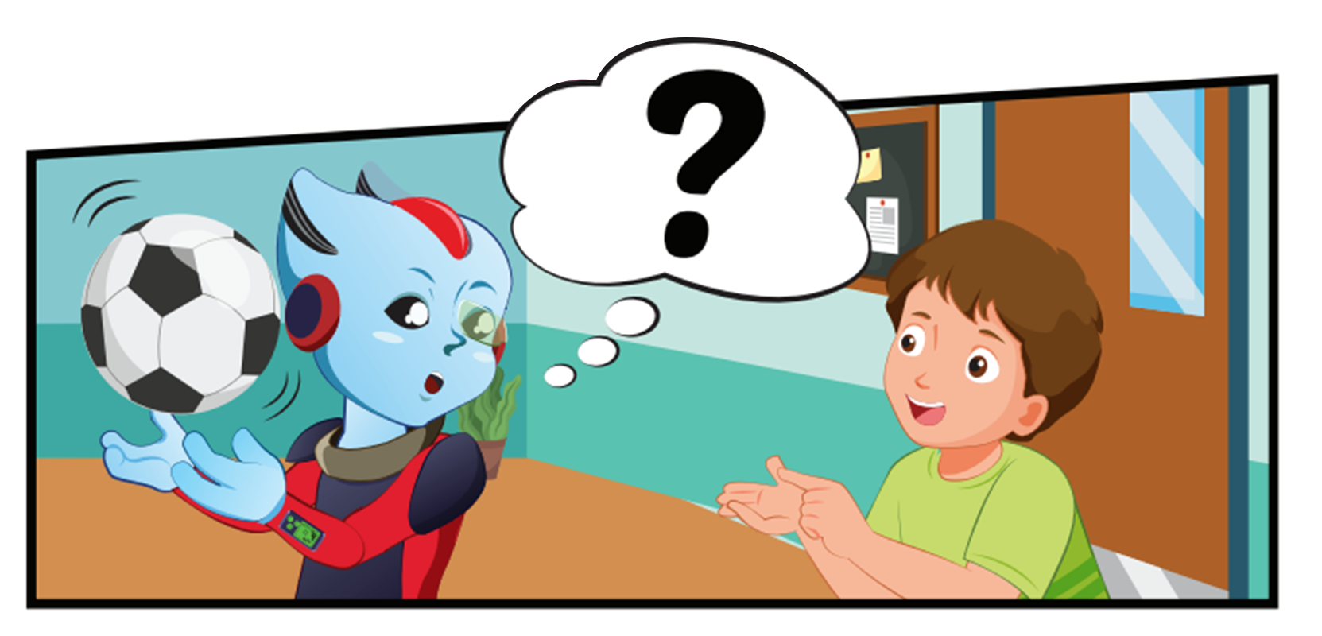
What is Alfie holding?

Slide 10
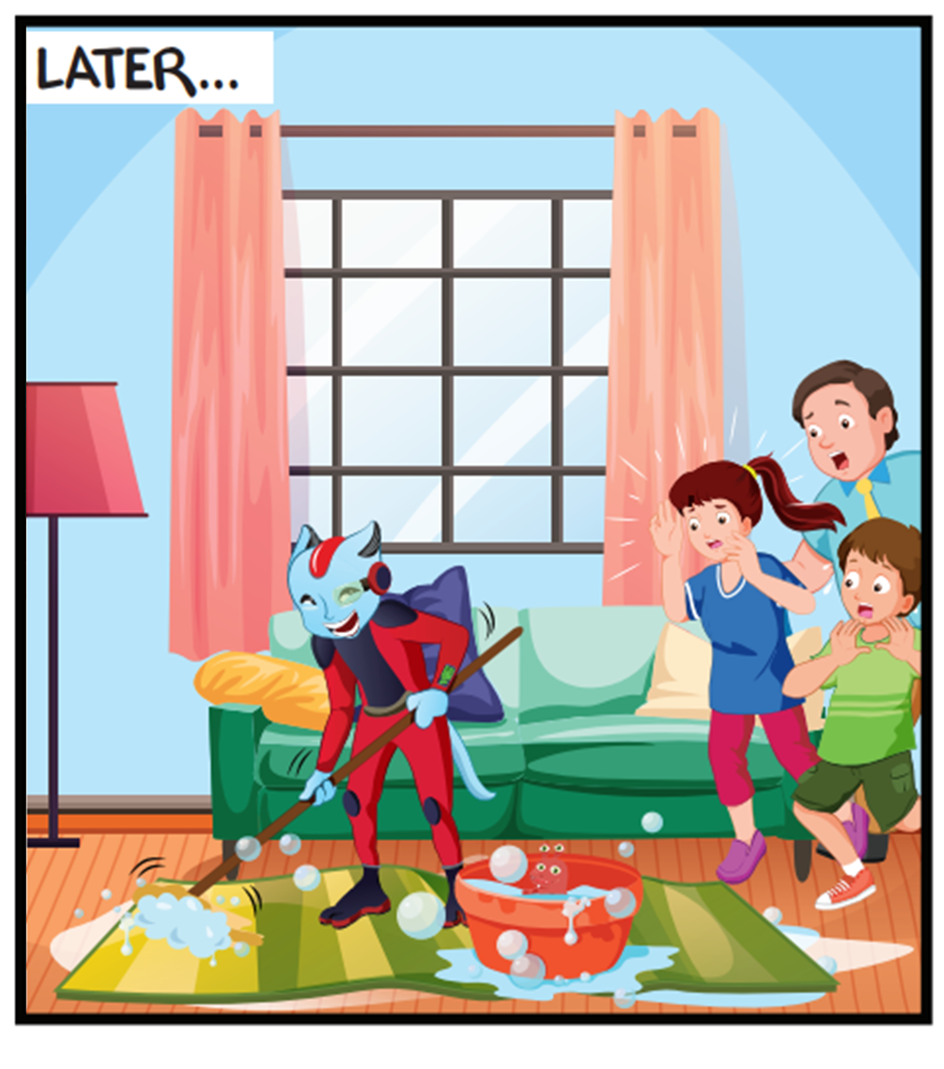
Where are they?
What are they doing?

Slide 11



How do you help at home, Alfie?
I mop the floor.
Ok, me too.

Slide 12
How does your sister help at home, Alfie?
She does the laundry.
Oh, my sister does that, too.

Slide 13
How do you help at home, Alfie?
I feed the cat.
Oh, that’s great!

Slide 14
How does your brother help at home, Alfie?
He sets the table.
Oh, my brother does that, too.

Slide 15
Today’s lesson
Vocabularies
sets, mops
floor, laundry
Structures/ Sentence patterns
How do you help at home?
I set the table.
How does your brother help at home?
He mops the floor.

