Slide 1

Unit 7. MY FAMILY
Lesson 3.1
Page 98

Slide 2
By the end of this lesson, students will be able to talk about chores they do.
Vocabularies
Set the table
Water the plants
Walk the dog
Feed the cat
Mop the floor
Do the laundry
Structures/ Sentence patterns
How do you help at home?
I set the table.
How does your brother help at home?
My brother waters the plants.

Slide 3
How to Play:
- Create 2 teams and answer the question quickly and correctly will get 1 point.
- The team with the most correct answers will win.

Slide 4

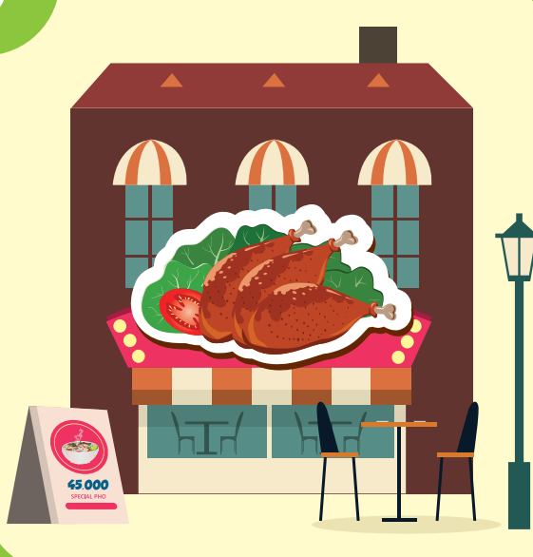

WHERE IS THIS?

Slide 5

New words
Set the table,
water the plants,
walk the dog,
feed the cat,
mop the floor,
do the laundry

Slide 6


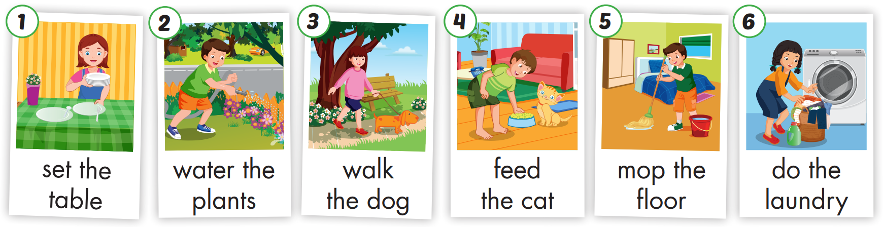

Slide 7
Structure

Slide 8

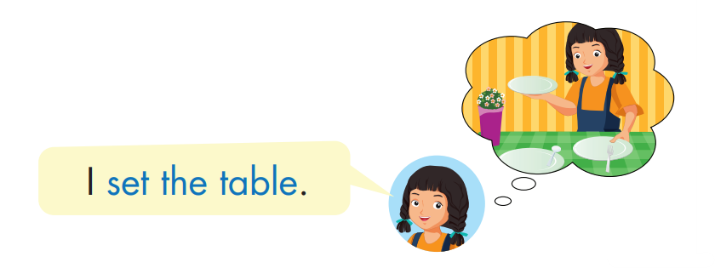
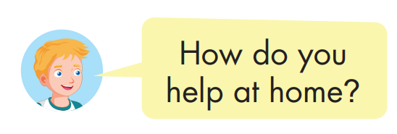
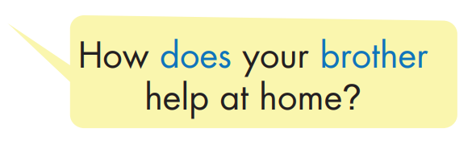
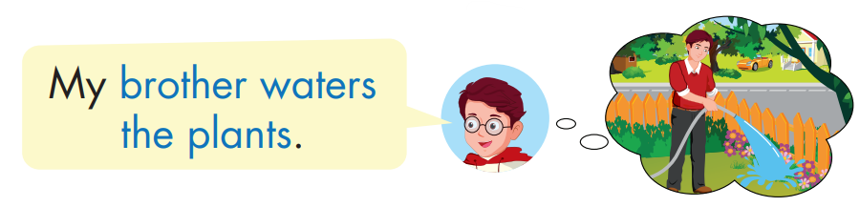

Slide 9
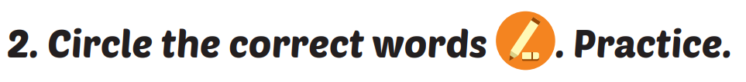



Slide 10
Today’s lesson
Vocabularies
Set the table
Water the plants
Walk the dog
Feed the cat
Mop the floor
Do the laundry
Structures/ Sentence patterns
How do you help at home?
I set the table.
How does your brother help at home?
My brother waters the plants.

