Slide 1

Unit 7: MY FAMILY
Lesson 2.1
Page 95

Slide 2
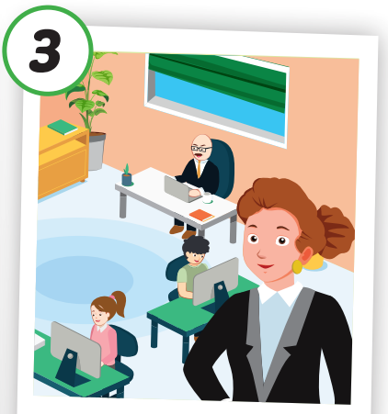
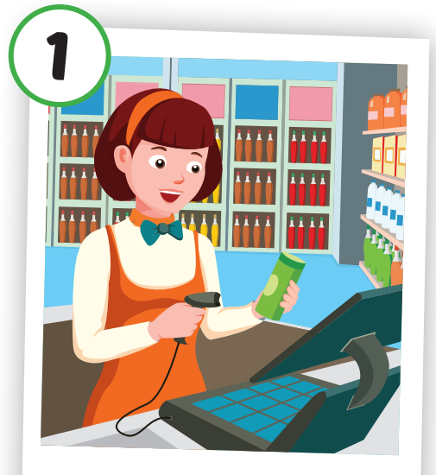
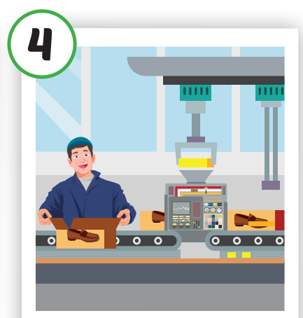
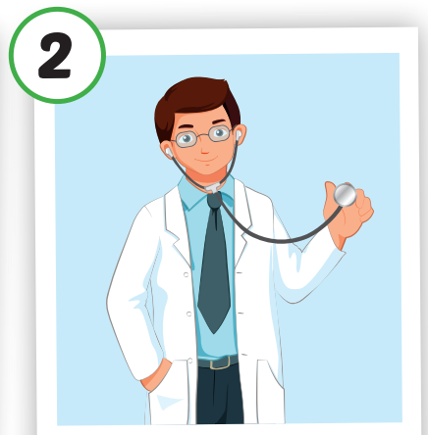
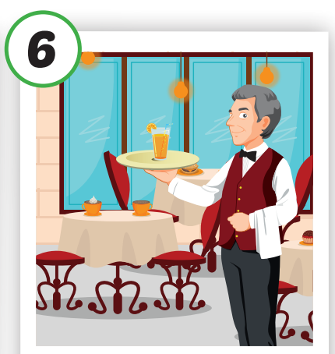

4
1
SPIN
3
2
2
5

Slide 3

New words
store,
hospital,
restaurant,
office,
farm,
bank.

Slide 4


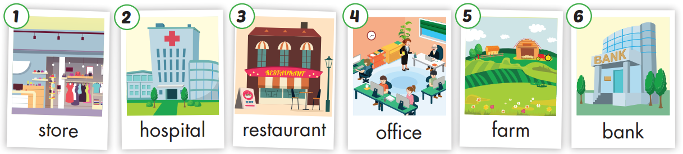

Slide 5

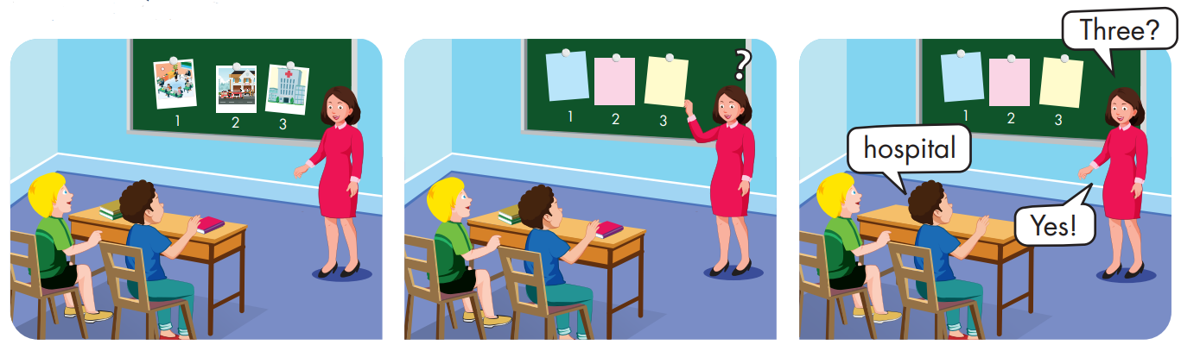

Slide 6
Structures:
Where does your father work?
My father works at a bank.
He's a cashier.

Slide 7

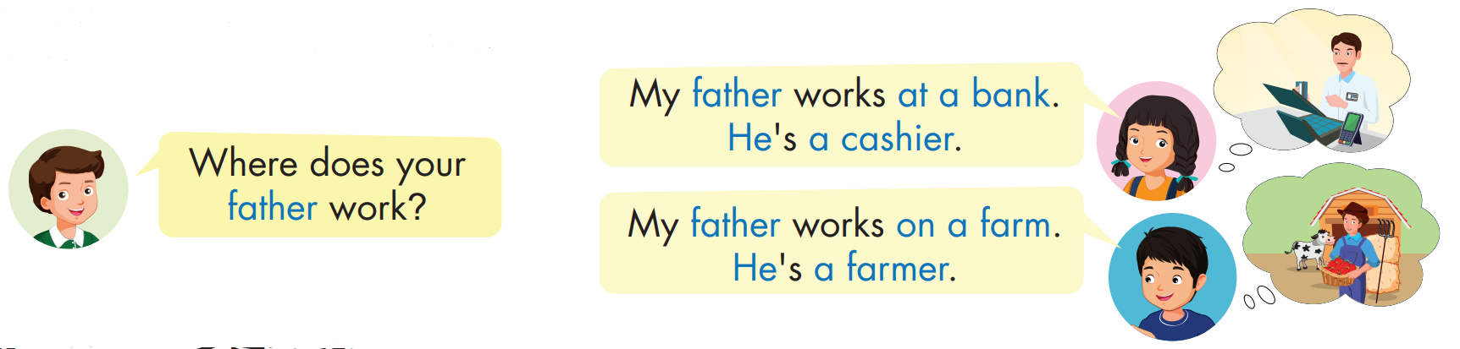

Click each English word to hear the sound.

Slide 8
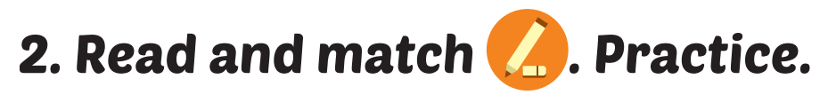
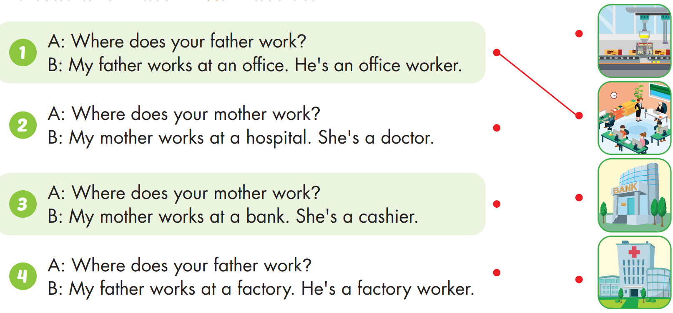

Slide 9

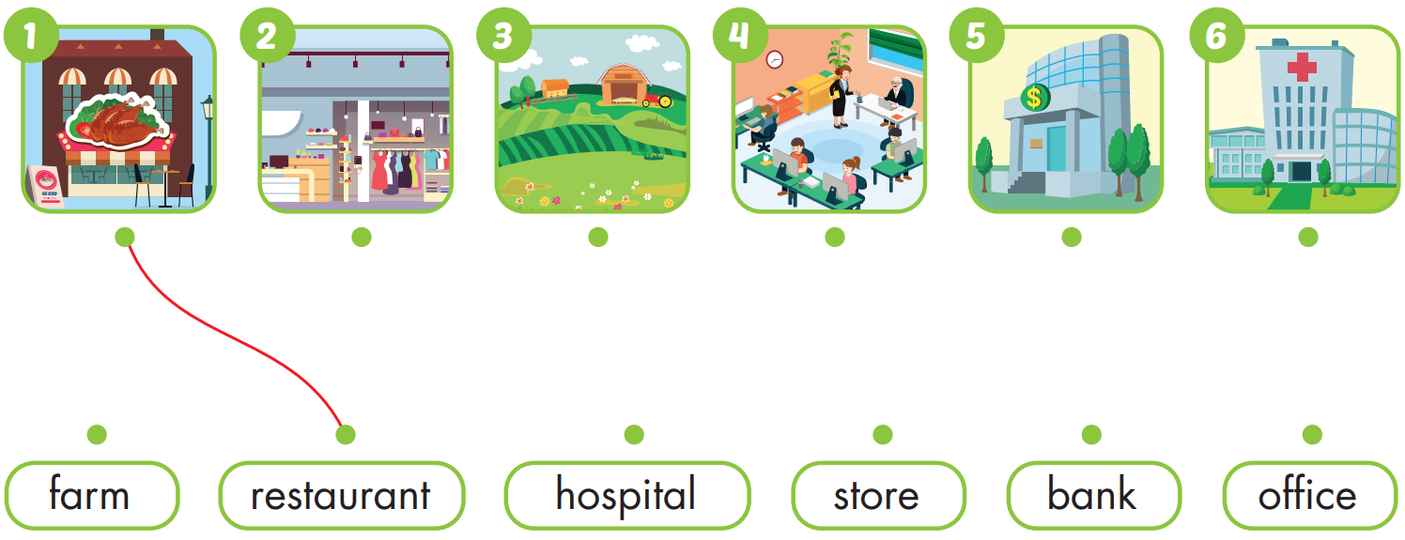
Practice

Slide 10

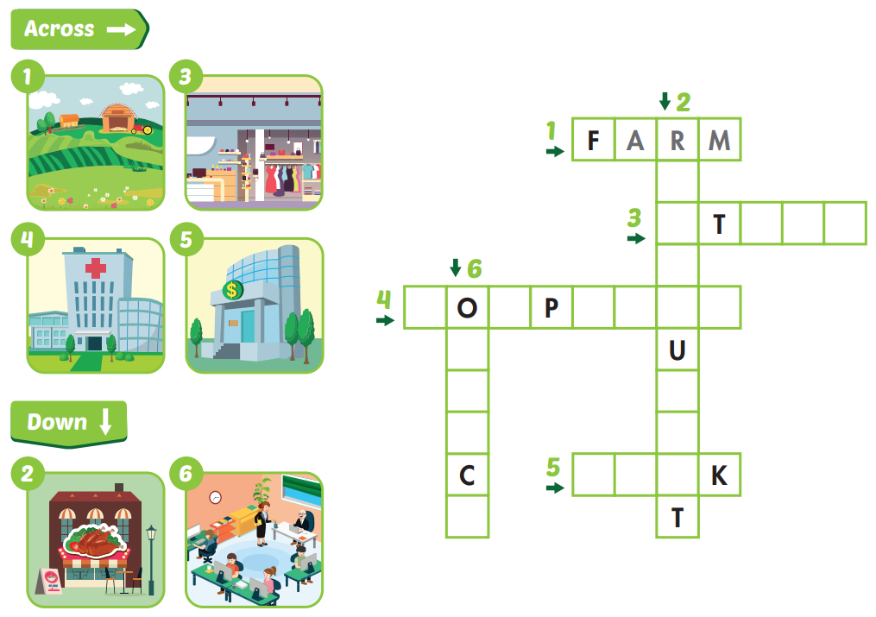
E
S
O
R
E
T
H
S
I
T
A
L
F
F
R
I
A
B
A
N
E

Slide 11
Lesson 3
Today’s lesson
Vocabularies
store, hospital, restaurant, office, farm, bank.
Structures/ Sentence patterns
Where does your father work?
My father works at a bank. He's a cashier.

