Slide 1

Unit 5: Getting Around
Lesson 2.1
Page 67

Slide 2
Objectives
By the end of this lesson, students will be able to…
Vocabulary: Pronounce and use the words related to the topic properly: near, behind, next to, opposite, in front of.
Structure: Where's the park? - It's next to the library.

Slide 3
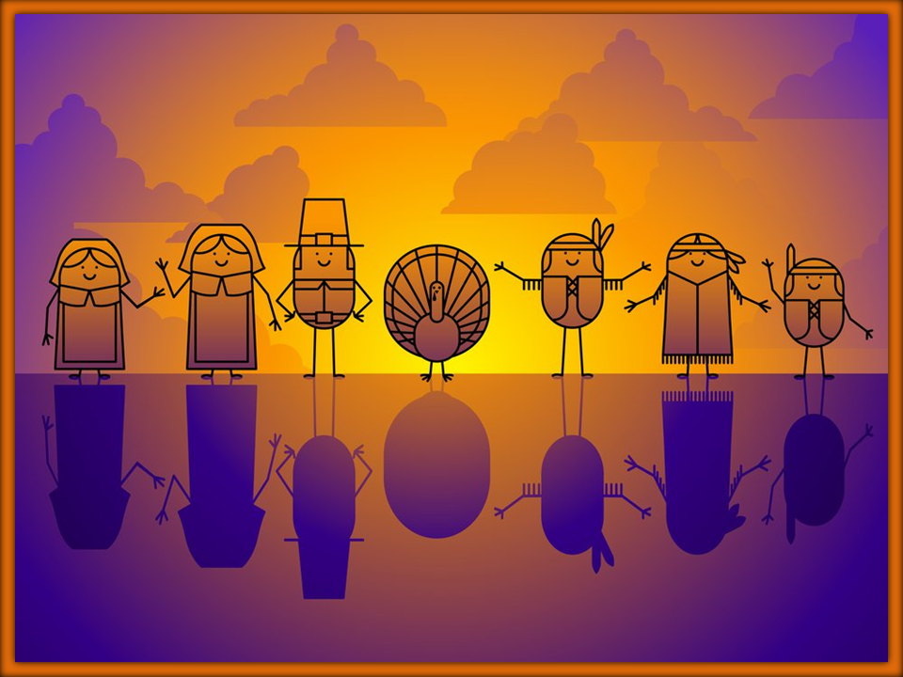




stop
Click on the right picture
NEXT

Slide 4

New words
near, behind, next to,
opposite, in front of

Slide 5

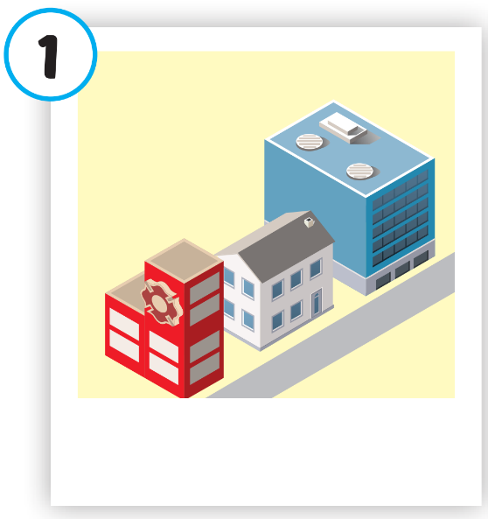
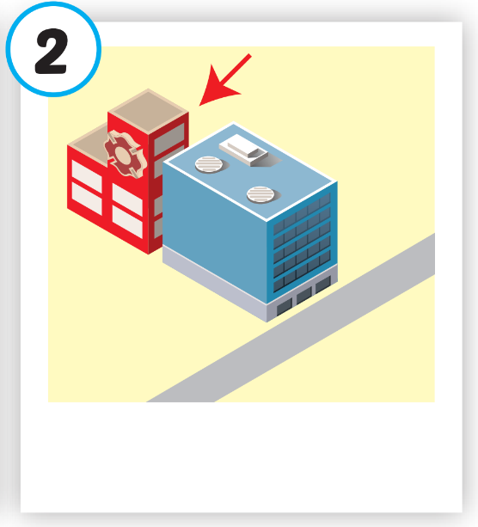
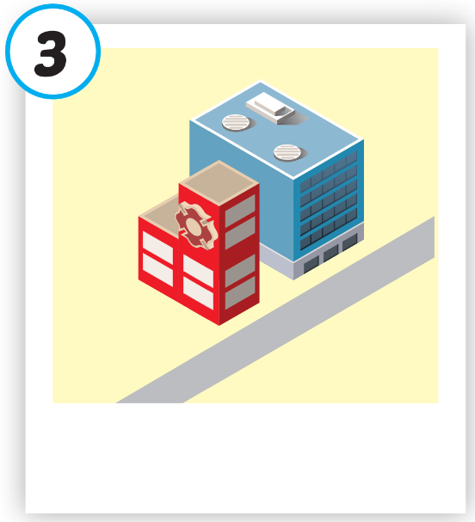
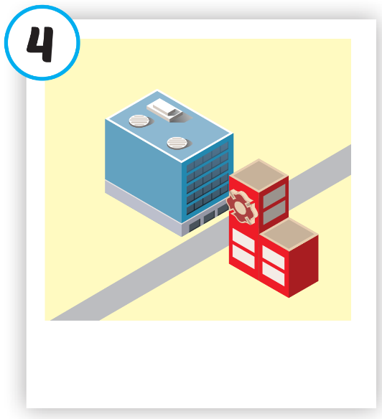
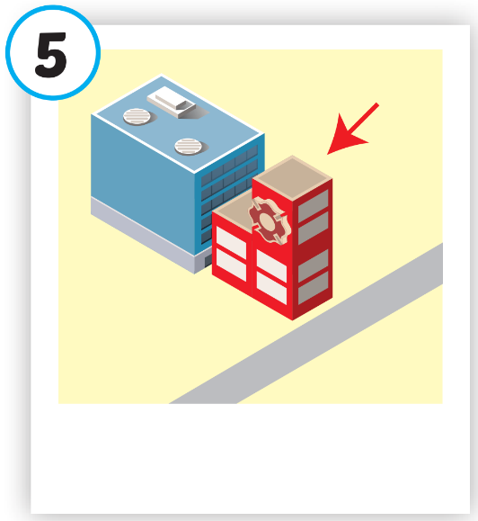





Click on each picture to hear the sound.
/nɪr/
gần
/bɪˈhaɪnd/
đằng sau
/nekst tə/
bên cạnh
/ˈɑːpəzɪt/
đối diện
/ɪn ˈfrʌnt əv/
phía trước
Notes:
Click vào hình A. 1. Listen and point. Repeat để cho cả audio full chạy

Slide 6



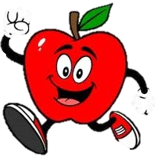
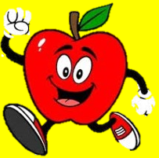

near
Which word is it?
NEXT
r
ar
fast
d
fa
ne
r
e
a
a
m
ak
fa
br
Check

Slide 7
Structure
Where's the park?
It's next to the library.

Slide 8
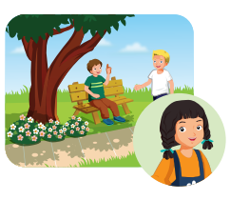
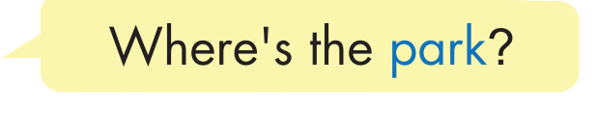
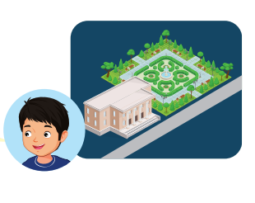
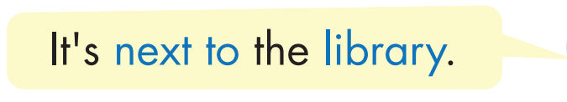
Structure

Slide 9


Slide 10
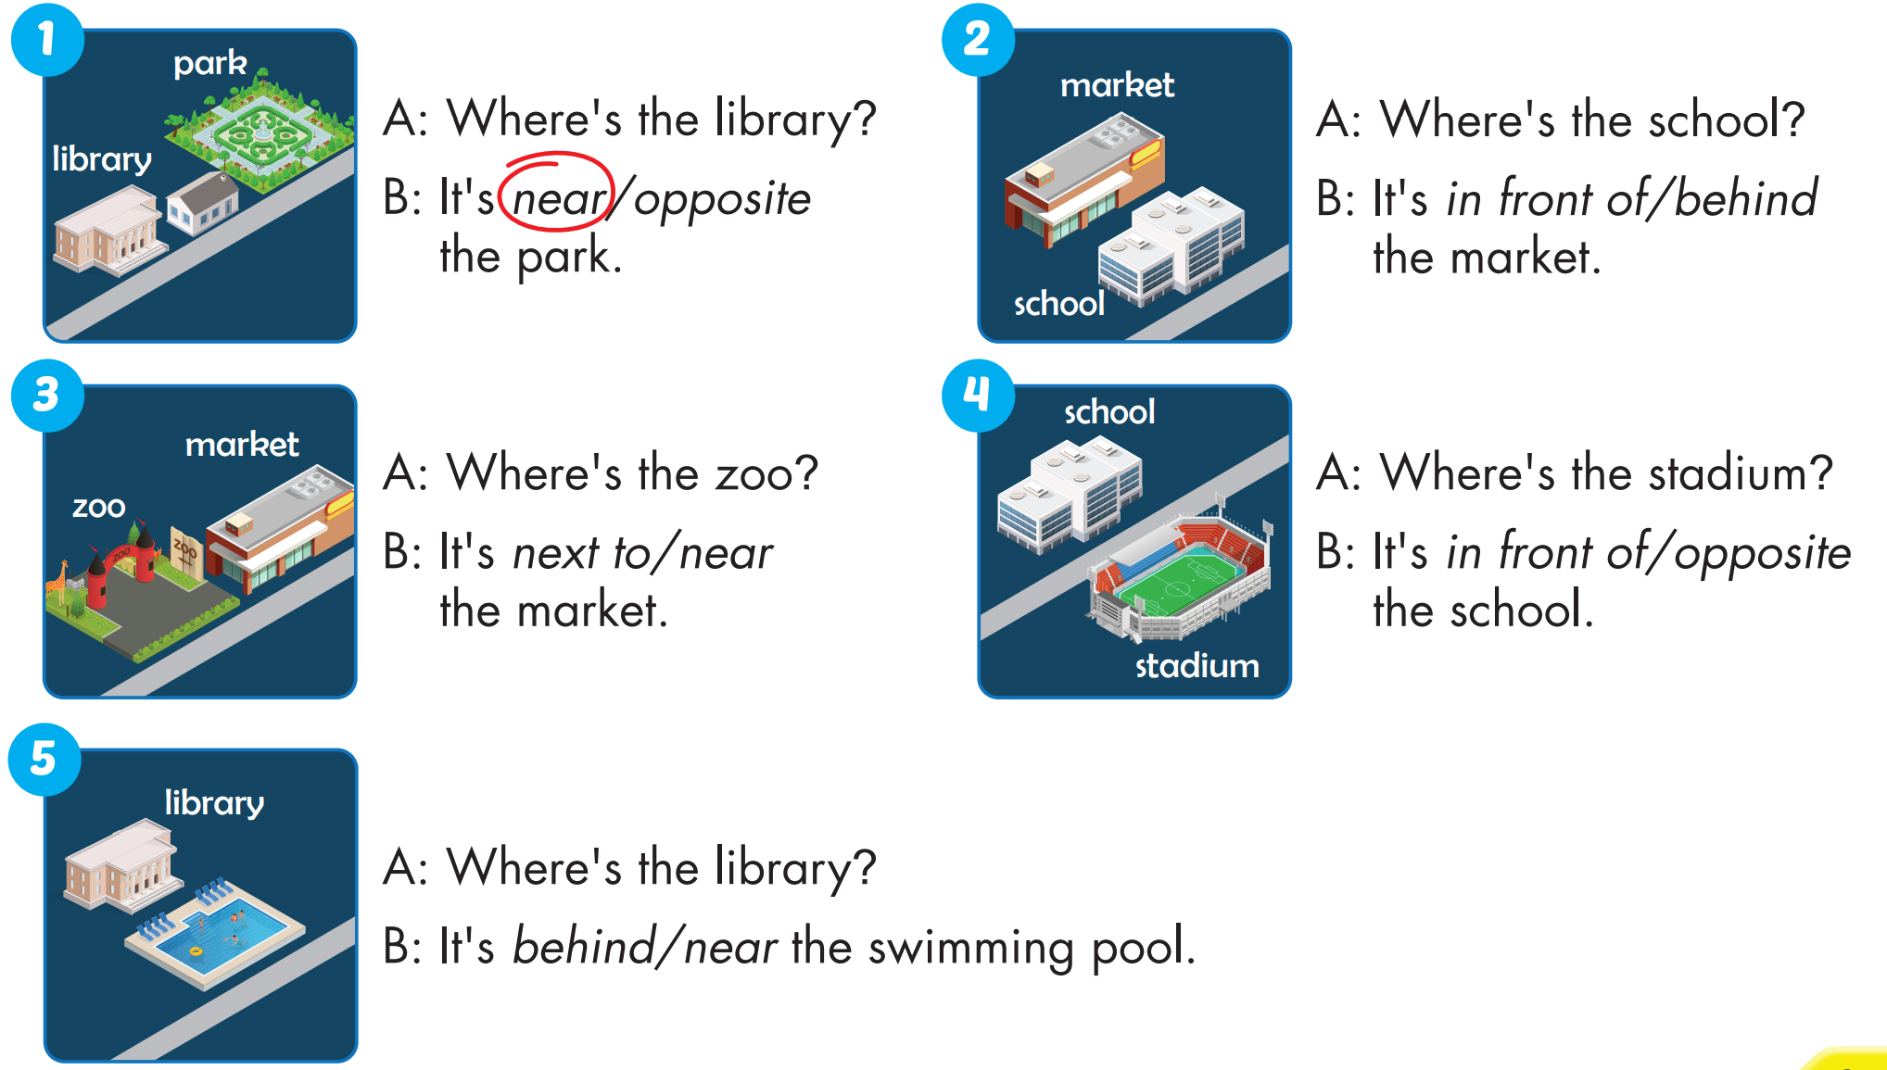


Slide 11
Today’s lesson
Vocabularies
near, behind, next to, opposite, in front of.
Structures/ Sentence patterns
Where's the park?
- It's next to the library.

