Slide 1

Unit 5: Getting Around
Lesson 1.1
Page 64

Slide 2

New words
stop, do not enter, turn left,
turn right, no parking.

Slide 3


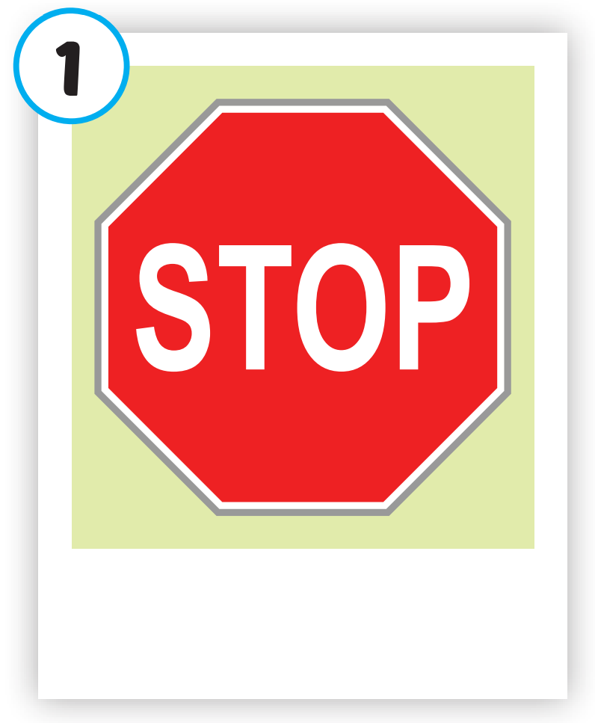
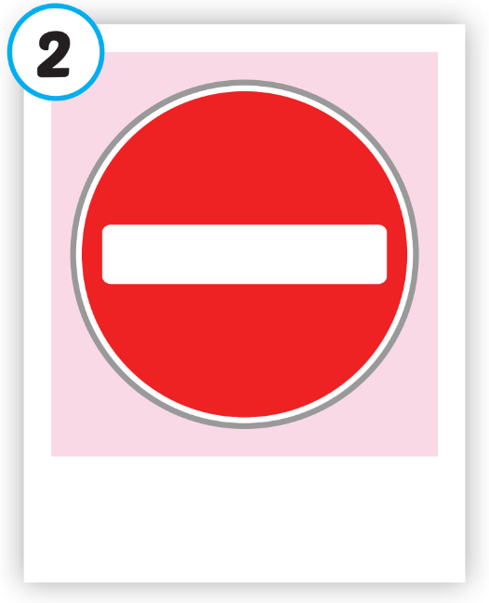
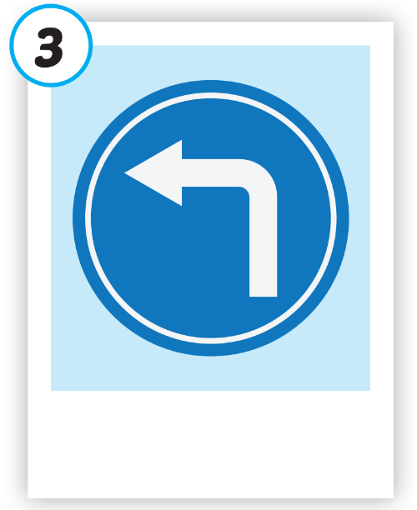
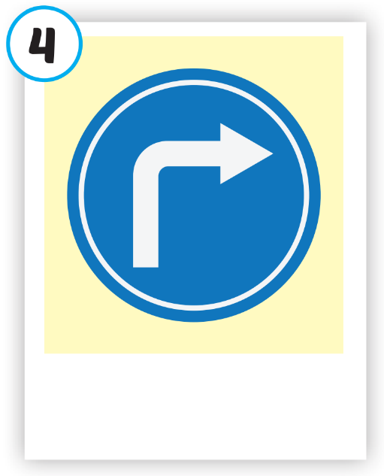
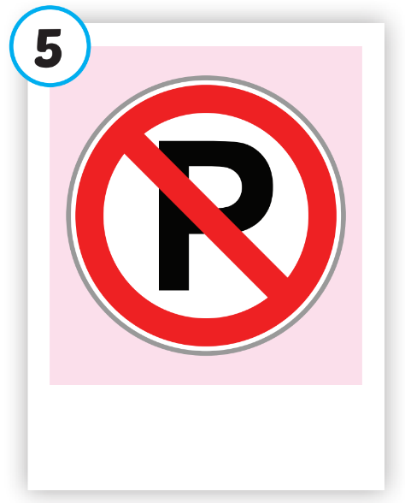





Click on each picture to hear the sound.
/stɑːp/
ngừng lại, dừng lại
/duː nɑːt ˈentər/
cấm vào
/tɜːrn left/
rẽ trái
/tɜːrn raɪt/
rẽ phải
/noʊ ˈpɑːrkɪŋ/
cấm đỗ xe

Slide 4





What disappears?
TIME’S UP
stop

Slide 5





What disappears?
TIME’S UP
no parking

Slide 6


What disappears?
do not enter
TIME’S UP

Slide 7
Structure
What does that sign mean?
It means "Stop".

Slide 8


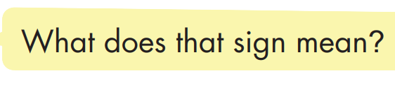
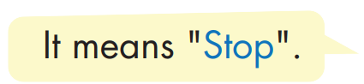

Structure

Slide 9
Today’s lesson
Vocabularies
stop, do not enter, turn left, turn right, no parking.
Structures/ Sentence patterns
What does that sign mean?
- It means "Stop".

