Slide 1

Unit 6: Clothes
Lesson 4.2
Page 92

Slide 2
Lesson Outline
Warm-up
Reading
Listening
Consolidation
Wrap-up

Slide 3
Objectives
By the end of this lesson, students will be able to talk about their school uniforms and read a paragraph about them.
Vocabulary: Uniform, polo shirt, sneakers, tie.
Structure: What do you wear at school?
- I wear a blue tie.
Do you like your uniform?
- Yes, I do.

Slide 4

WARM-UP

Slide 5
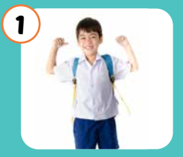
Look and write.
u
n f o r
m
i

Slide 6
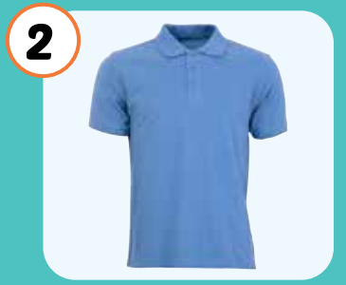
Look and write.
o l h i r t
p
o
s

Slide 7
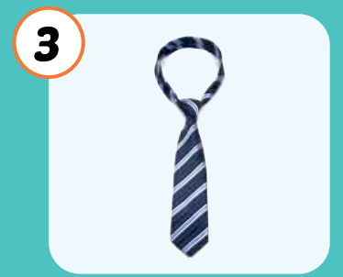
Look and write.
t i
e

Slide 8
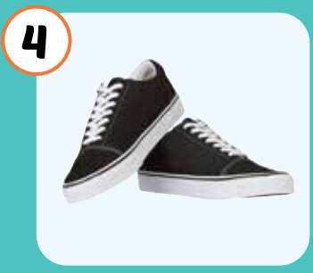
Look and write.
n a k e r
s
e
s

Slide 9

It’s time to learn …

Slide 10

Reading

Slide 11

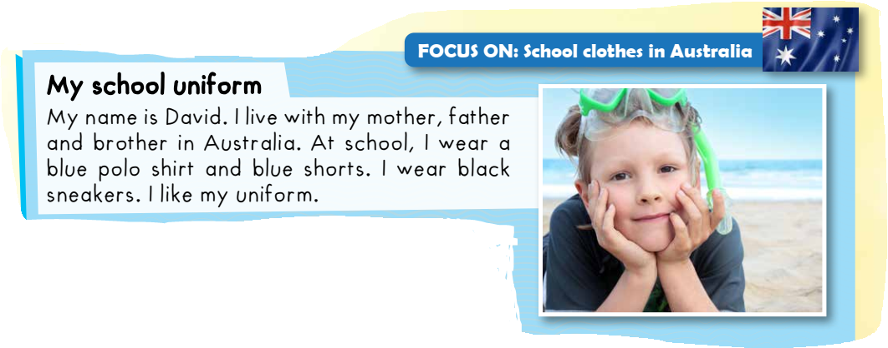


Slide 12


Slide 15

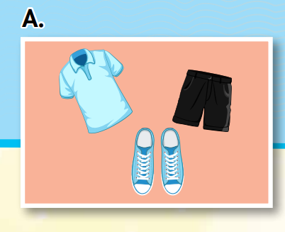
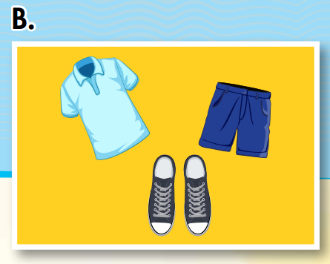
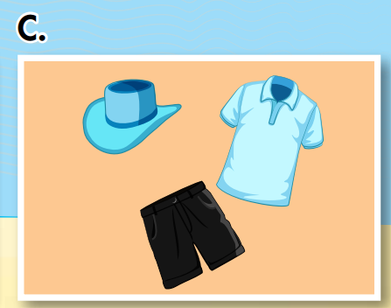
At school, I wear a blue polo shirt and black shorts. I wear blue sneakers. I like my uniform.

Slide 16

Listening

Slide 17




Slide 18

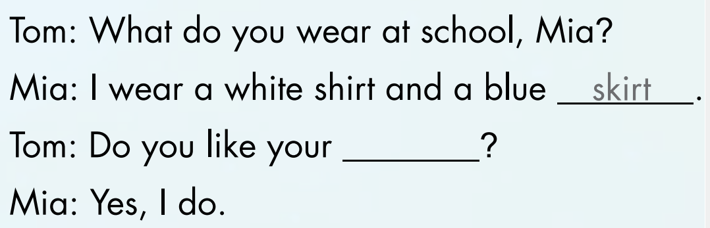
uniform

Slide 19
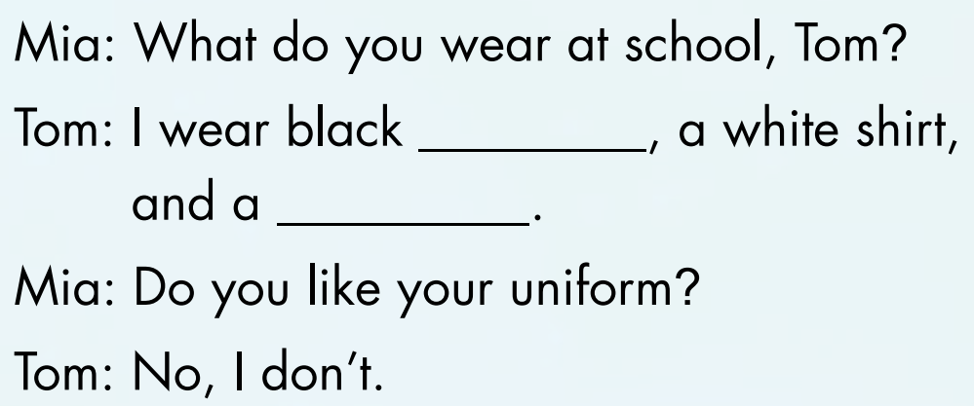
trousers
tie

Slide 20
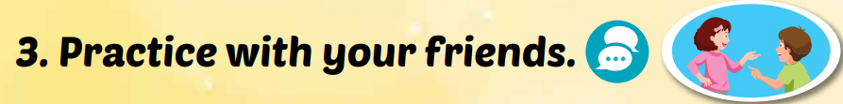
Tom: What do you wear at school, Mia? Mia: I wear a white shirt and a blue skirt. Tom: Do you like your uniform? Mia: Yes, I do.

Slide 21
Mia: What do you wear at school, Tom?
Tom: I wear black trousers, a white shirt,
and a tie.
Mia: Do you like your uniform?
Tom: No, I don’t.

Slide 22

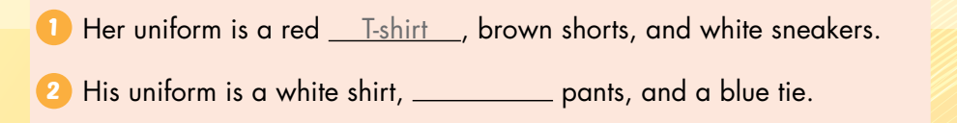
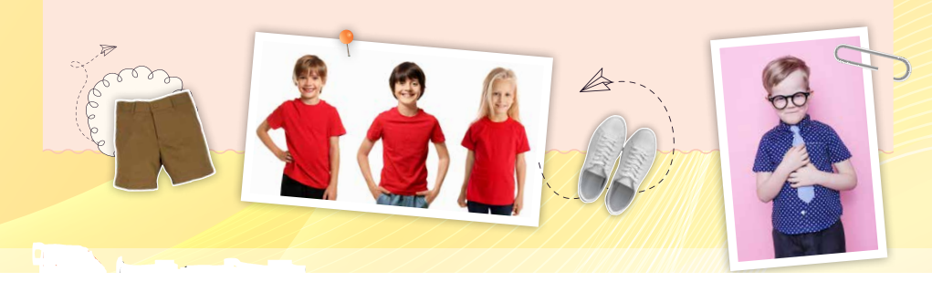
black

Slide 23
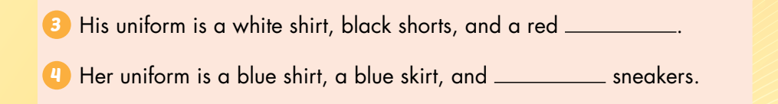
tie
red

Slide 24

CONSOLIDATION

Slide 25

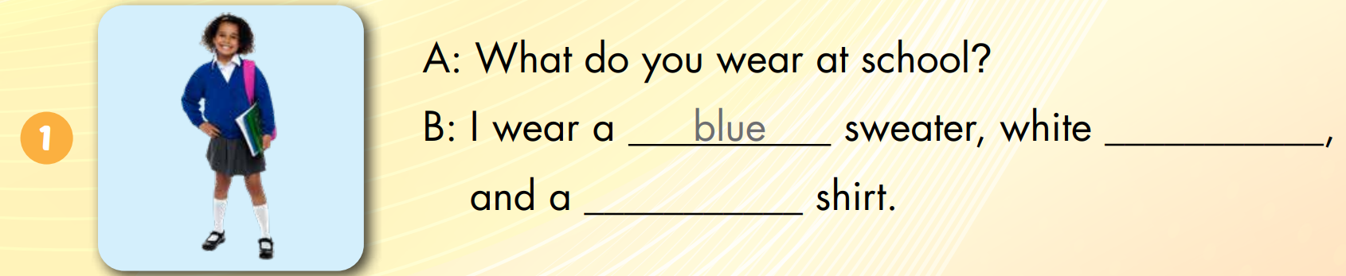
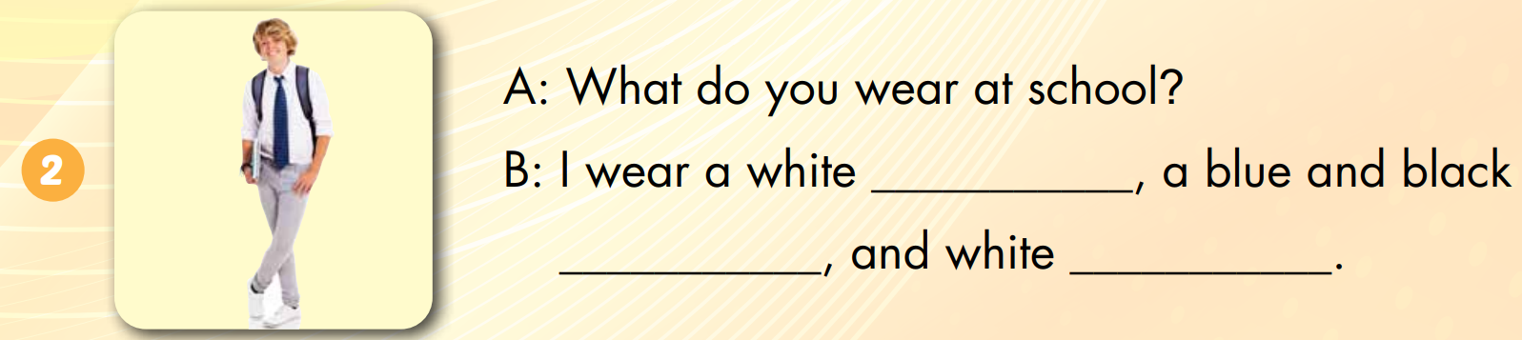
socks
white
shirt
tie
sneakers

Slide 26
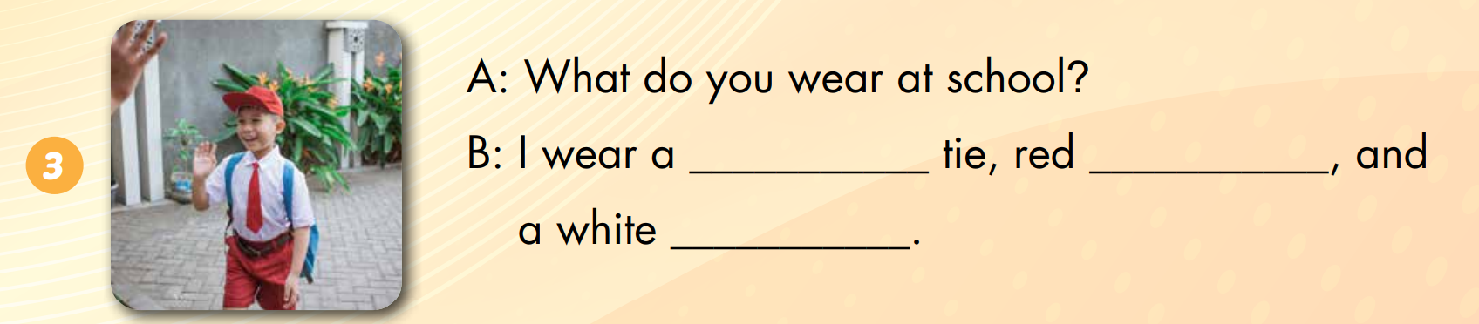
red
shorts
shirt

Slide 27

WRAP-UP

Slide 28
Today’s lesson
Vocabularies
Uniform
Polo shirt
Sneakers
Tie
Structures/ Sentence patterns
What do you wear at school?
- I wear a blue tie.
Do you like your uniform?
- Yes, I do.

Slide 29
Homework
Practice the vocabularies and structure, and make sentences using them.
Do the exercises in Tiếng Anh 3 i-Learn Smart Start WB (page 65).
Prepare the next lesson (page 93 SB).
Play the consolidation games in Tiếng Anh 3 i-Learn Smart Start DHA App on www.eduhome.com.vn

Slide 30

Enjoy your day!

