Slide 1

Unit 6: Clothes
Lesson 2.1
Page 85

Slide 2
Lesson Outline
Warm-up
Vocabulary
Structure
Consolidation
Wrap-up

Slide 3
Objectives
By the end of this lesson, students will be able to talk about what they are wearing.
Vocabulary: skirt, jacket, jeans, boots, T-shirt.
Structure: - What are you wearing?
- I’m wearing blue jeans./
I’m wearing a red jacket.

Slide 4

WARM-UP

Slide 5
Rearrange the letters to get the correct words.
dress
d
s
e
r
s
pants
t
p
n
s
a
shorts
h
o
r
s
t
s
socks
c
o
s
k
s
shirt
h
r
i
t
s

Slide 6
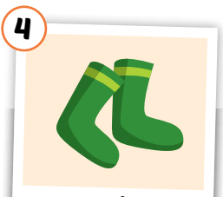
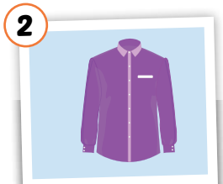
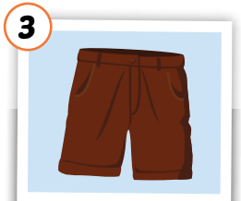
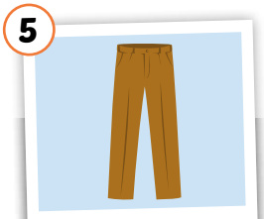
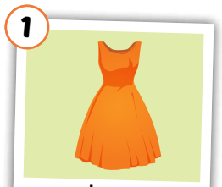
Look at the picture and read.

Slide 7
dress

Slide 8
shirt

Slide 9
shorts

Slide 10
socks

Slide 11
pants

Slide 12

It’s time to learn …

Slide 13

Vocabulary

Slide 14

New words
skirt,
jacket,
jeans,
boots,
T-shirt.

Slide 15



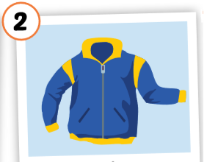
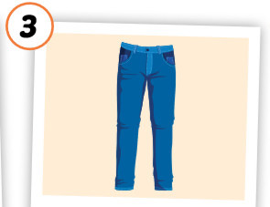
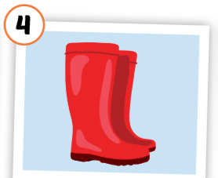
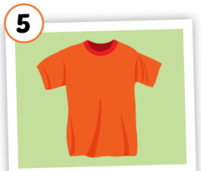
Click on each word to hear the sound.
skirt
jacket
jeans
boots
T-shirt
/skɜːrt/
Chân váy
/ˈdʒækɪt/
áo khoác
/dʒiːnz/
quần jean,
quần bò
/buːts/
đôi ủng
/ˈtiː ʃɜːrt/
áo thun

Slide 16
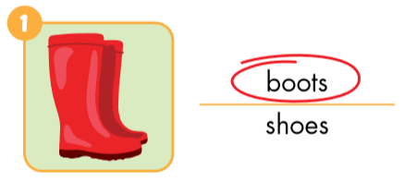
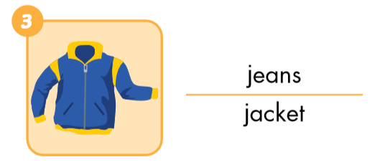
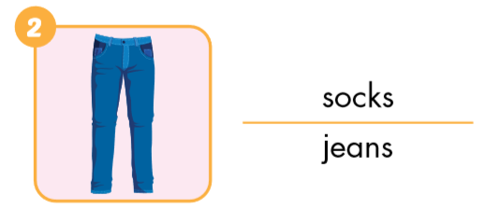
Look and circle.

Slide 17
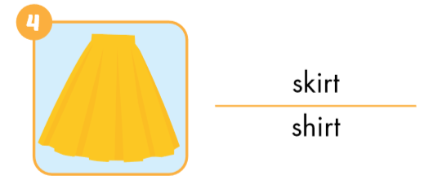
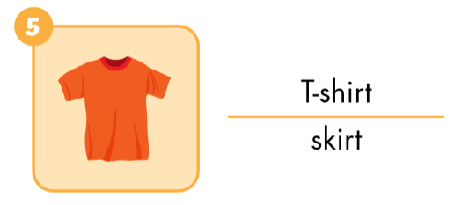
Look and circle.

Slide 18
Put the pictures in the right group.
yellow
blue
red
orange

Slide 19
Put the pictures in the right group.
1. a
2. some

Slide 20

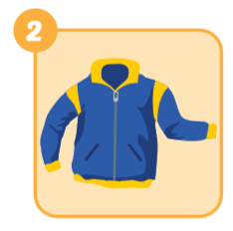
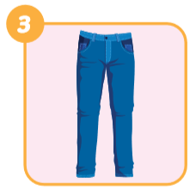
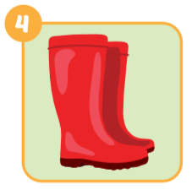
Look and write.
skirt
jacket
jeans
boots

Slide 21
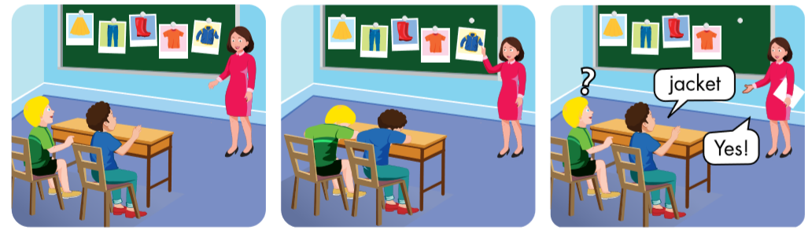

Slide 22
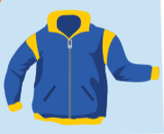

skirt
?

Slide 23

Yes.
jeans
No.

Slide 24

Practice

Slide 25
Structures
What are you wearing?
- I’m wearing blue jeans.
What are you wearing?
- I’m wearing a red jacket.

Slide 26



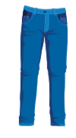
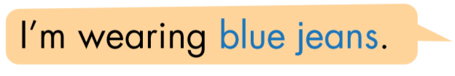
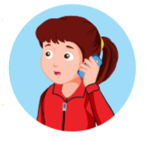


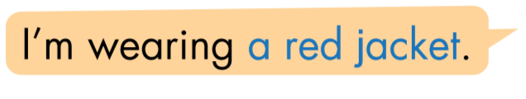
Click the earphone to hear the sound.

Slide 27
What are you wearing?
I’m wearing red boots.

Slide 28
What are you wearing?
I’m wearing a yellow skirt.

Slide 29
What are you wearing?
I’m wearing blue jeans.

Slide 30
What are you wearing?
I’m wearing a orange T-shirt.

Slide 31
What are you wearing?
I’m wearing a blue jacket.

Slide 32

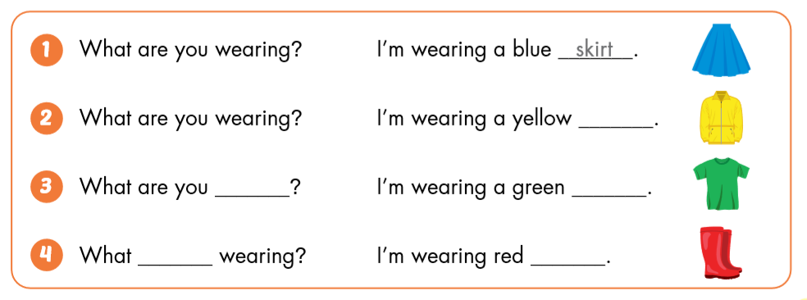
jacket
wearing
T- shirt
are you
boots

Slide 33

CONSOLIDATION

Slide 34
Draw lines.
T-shirt
boots
jacket
jeans
skirt

Slide 35

WRAP-UP

Slide 36
Today’s lesson
Vocabularies
dress
shirt
shorts
socks
pants
Structures/ Sentence patterns
What do you want?
- I want a dress.
What do you want?
- I want some shorts.

Slide 37
Homework
Practice the vocabularies and structure, and make sentences using them.
Do the exercises in Tiếng Anh 3 i-Learn Smart Start Workbook (page 60).
Prepare the next lesson (page 86 SB).
Play the consolidation games in Tiếng Anh 3 i-Learn Smart Start DHA App on www.eduhome.com.vn
Do the exercise in Tiếng Anh 3 i-Learn Smart Start Notebook (page 41).

Slide 38

Enjoy your day!

