Slide 1

Unit 6: Clothes
Lesson 1.3
Page 84

Slide 2
Lesson Outline
Warm-up
Practice
Speaking
Consolidation
Wrap-up

Slide 3
Objectives
By the end of this lesson, students will be able to talk about what clothes they want.
Vocabulary: Revision (dress, shirt, shorts, socks, pants).
Structure: What do you want? I want a shirt./I want some socks.

Slide 4

WARM-UP

Slide 5

shirt
SHOW

Slide 6

shorts
SHOW

Slide 7

Practice

Slide 8

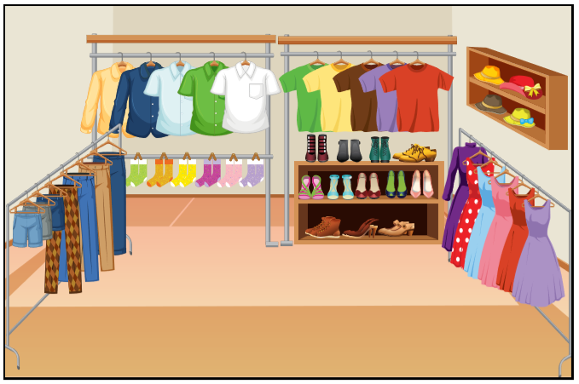
What do you want?
I want a shirt.


Slide 9
What do you want?
I want some socks.


Slide 10
What do you want?
I want a dress.


Slide 11
What do you want?
I want some pants.


Slide 12
What do you want?
I want some shoes.


Slide 13
What do you want?
I want a hat.


Slide 14

Speaking

Slide 15


What do you want?
I want a shirt.

Slide 16
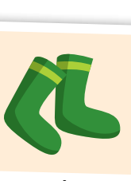
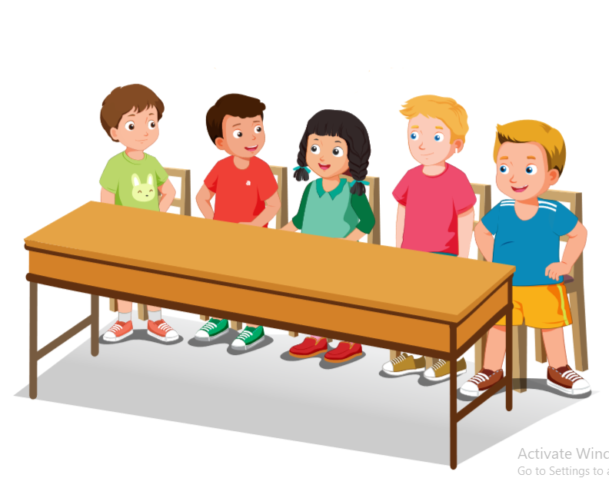
What do you want?
I want some socks.

Slide 17
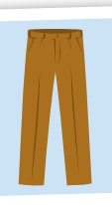
What do you want?
I want some pants.

Slide 18
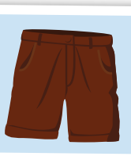
What do you want?
I want some shorts.

Slide 19
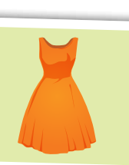
I want a dress.
What do you want?

Slide 20

What do you………….?
- …….................

Slide 21
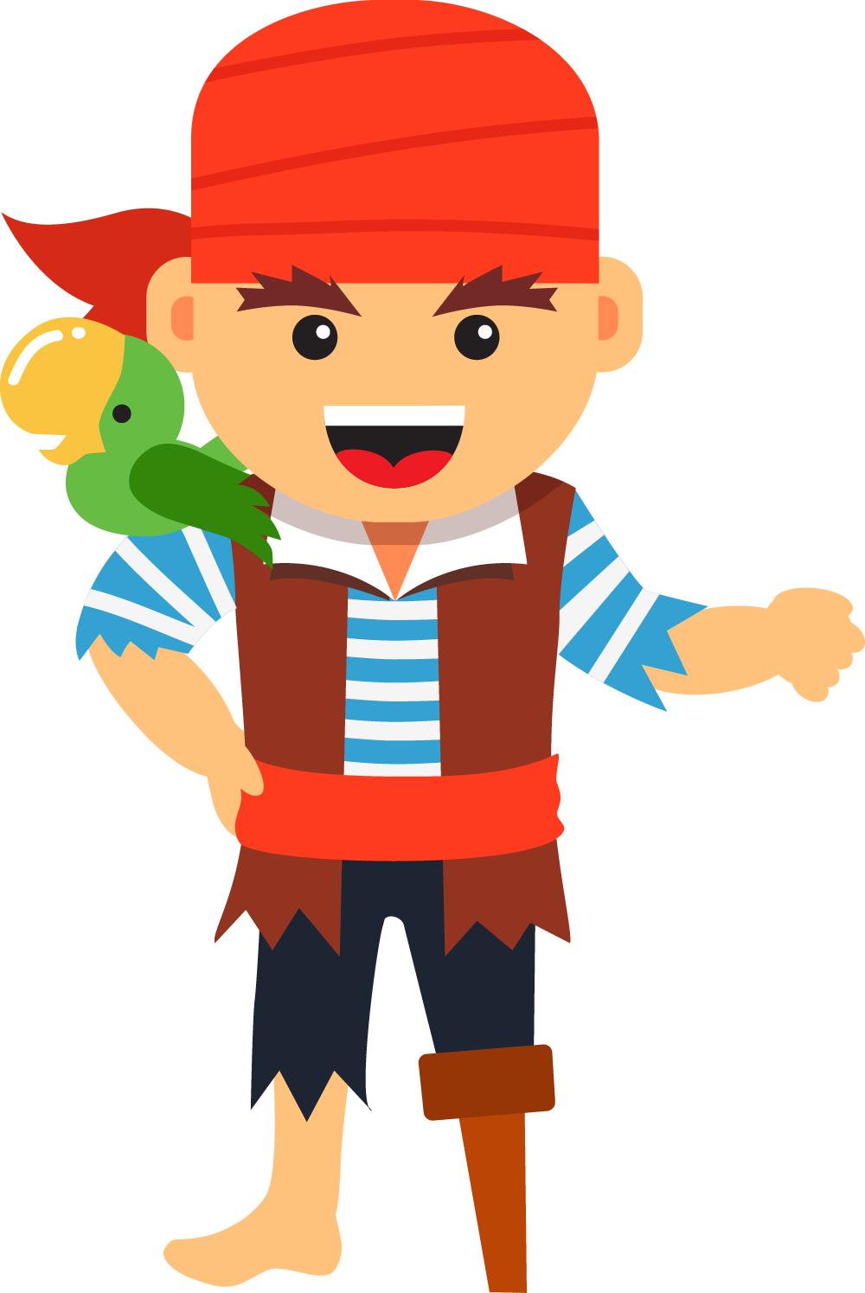
NEXT
Help me please!

Slide 22


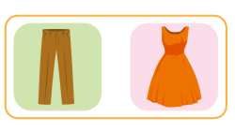
1
NEXT
What do you want?
What do you………….?
- …….................
ANSWER
I want a dress.

Slide 23
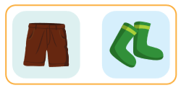
1
NEXT
2
What do you want?
What do you………….?
- …….................
ANSWER
I want some shorts.

Slide 24
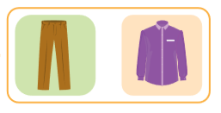
1
NEXT
2
3
What do you want?
What do you………….?
- …….................
ANSWER
I want some pants.

Slide 25
1
NEXT
2
3
What do you want?
4
What do you………….?
- …….................
ANSWER
I want some socks.

Slide 26
1
NEXT
2
3
What do you want?
4
What do you………….?
- …….................
5
ANSWER
I want a shirt.

Slide 27

1
END
2
Hurray!
We found the treasure! THANK YOU!
3
4
5
ANSWER

Slide 28

CONSOLIDATION

Slide 29
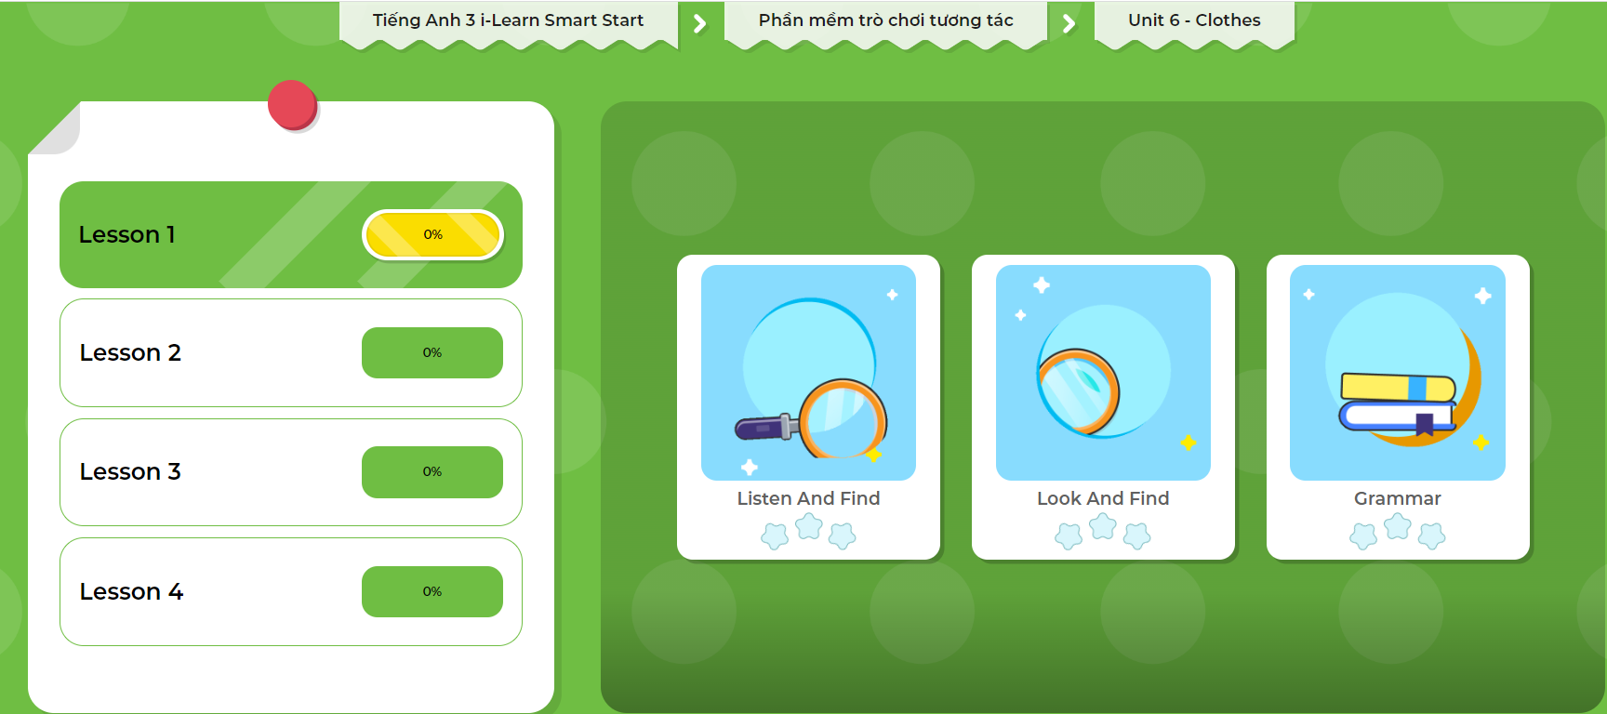
Click here to play the games!

Slide 30


What do you want?
I want some socks.

Slide 31
What do you want?
I want a shirt.

Slide 32

WRAP-UP

Slide 33
Today’s lesson
Structures/ Sentence patterns
What do you want?
- I want a dress.
What do you want?
- I want some shorts.

Slide 34
Homework
Practice the vocabularies and structure, and make sentences using them.
Do the exercises in Tiếng Anh 3 i-Learn Smart Start Workbook (page 59).
Prepare the next lesson (page 85 SB).
Play the consolidation games in Tiếng Anh 3 i-Learn Smart Start DHA App on www.eduhome.com.vn
Do the exercise in Tiếng Anh 3 i-Learn Smart Start Notebook (page 40).

Slide 35

Enjoy your day!

