Slide 1

Unit 5: Sports and hobbies
Lesson 2.3
Page 73

Slide 2
Lesson Outline
Warm-up
Speaking
Consolidation
Wrap-up

Slide 3
Objectives
By the end of this lesson, students will be able to talk (ask and answer) about what they are good at, using the words related to activities:
Vocabulary: hitting, kicking, catching, throwing
Structure: What are you good at?
- I'm good at kicking.

Slide 4

WARM-UP

Slide 5
Vocabulary Review

Slide 6
gickikn
k | i | c | k | i | n | g

Slide 7
actcginh
c | a | t | c | h | i | n | g

Slide 8
nitihtg
h | i | t | t | i | n | g

Slide 9
rhtoginw
t | h | r | o | w | i | n | g

Slide 10

It’s time to learn …

Slide 11

Speaking

Slide 12

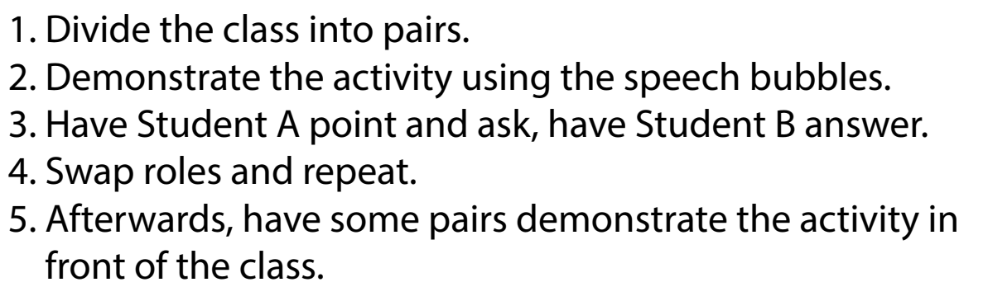

Slide 13

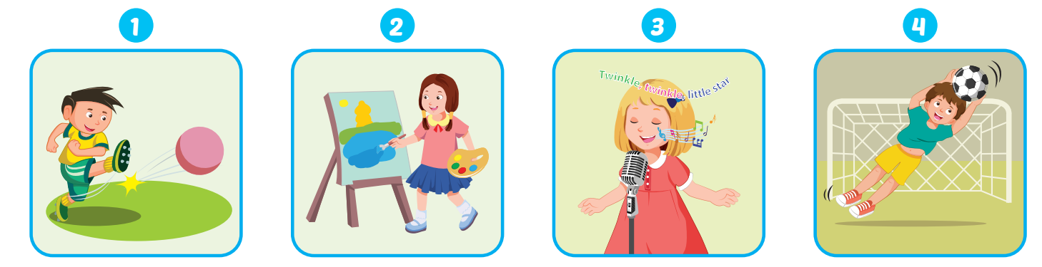

Slide 14
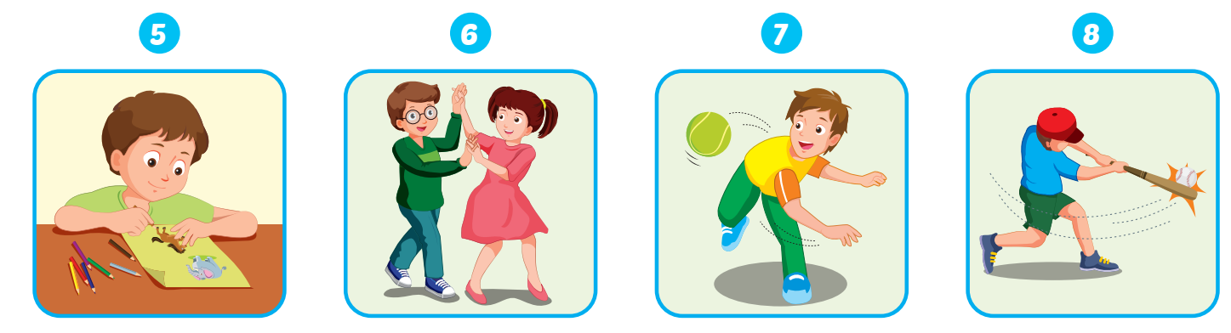

Slide 15

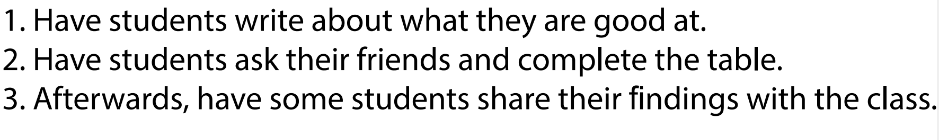

Slide 16

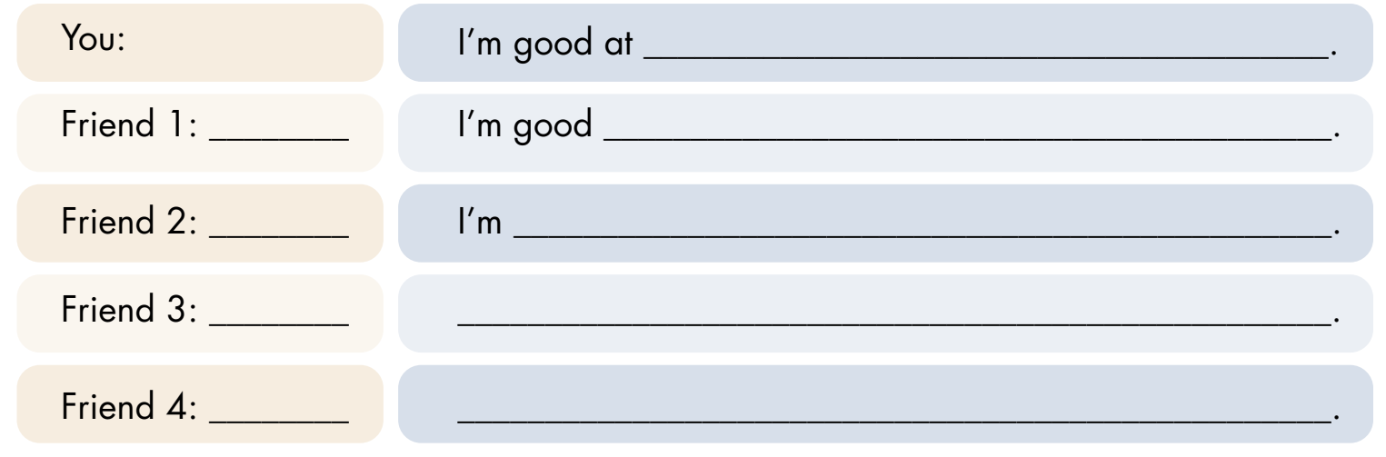

Slide 17

Practice

Slide 18

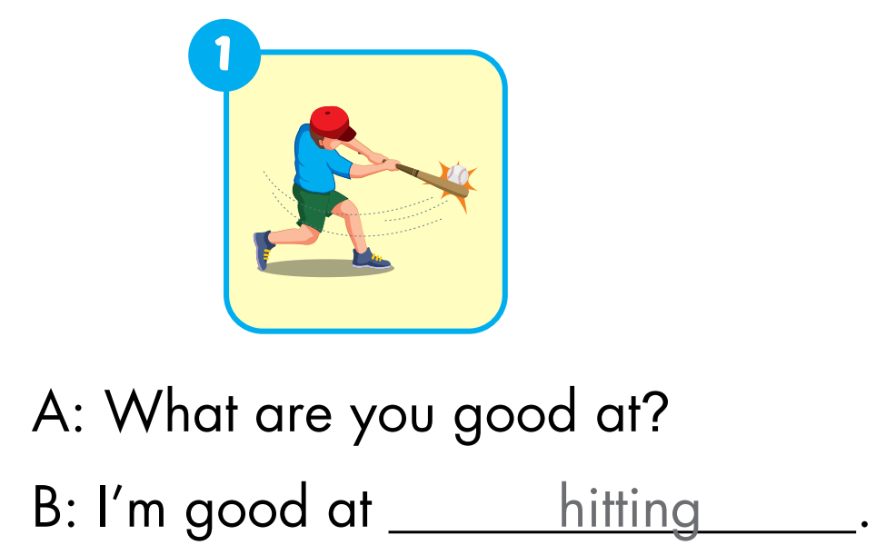
Extra Practice
WB, page 51.

Slide 19
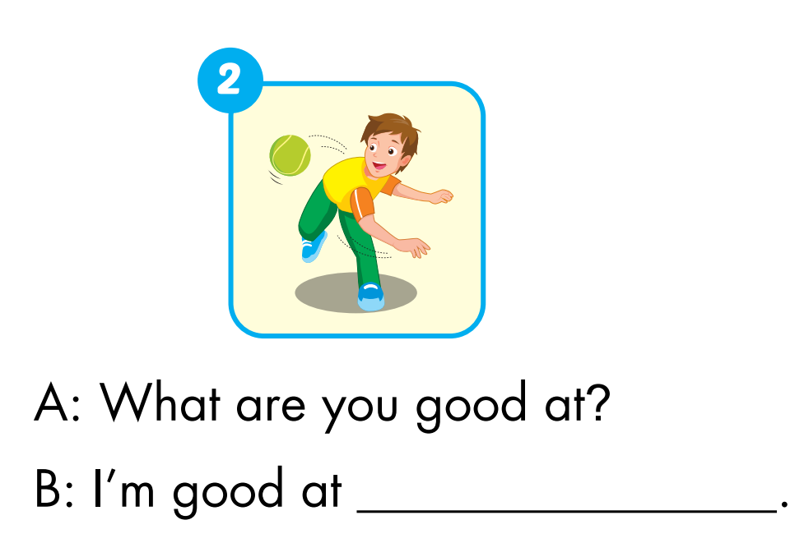
Extra Practice
WB, page 51.
throwing

Slide 20
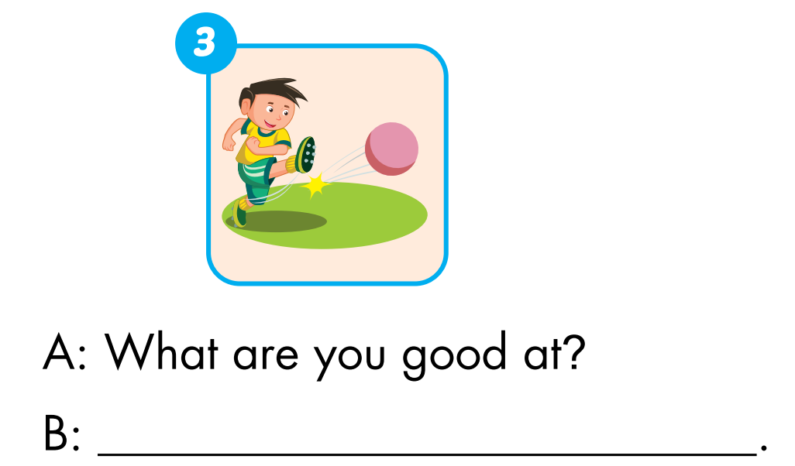
Extra Practice
WB, page 51.
I'm good at kicking

Slide 21
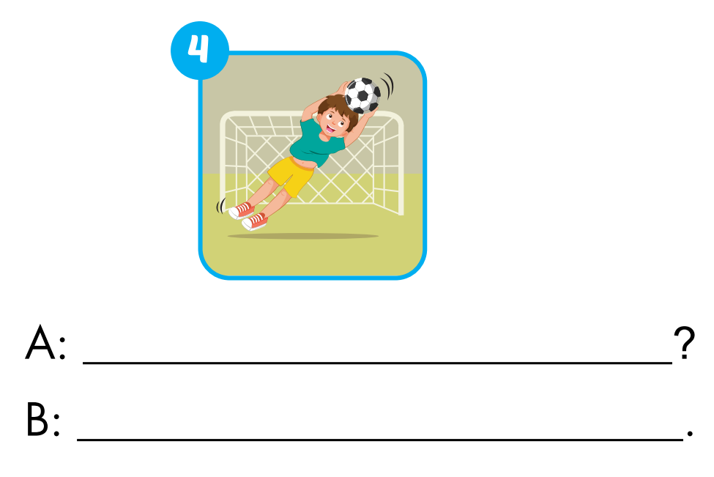
Extra Practice
WB, page 51.
What are you good at
I'm good at catching

Slide 22

CONSOLIDATION

Slide 23

TRUTH OR LIE?
How to play
Student A stands in front of the class.
Other students will ask "What are you good at?”
Student A will tell 1 truth and 1 lie.
Student B guesses Student A's lie.

Slide 24

WRAP-UP

Slide 25

Let’s play

Slide 26


How to play
. Listen to a sound
. Choose the correct answer

Slide 27

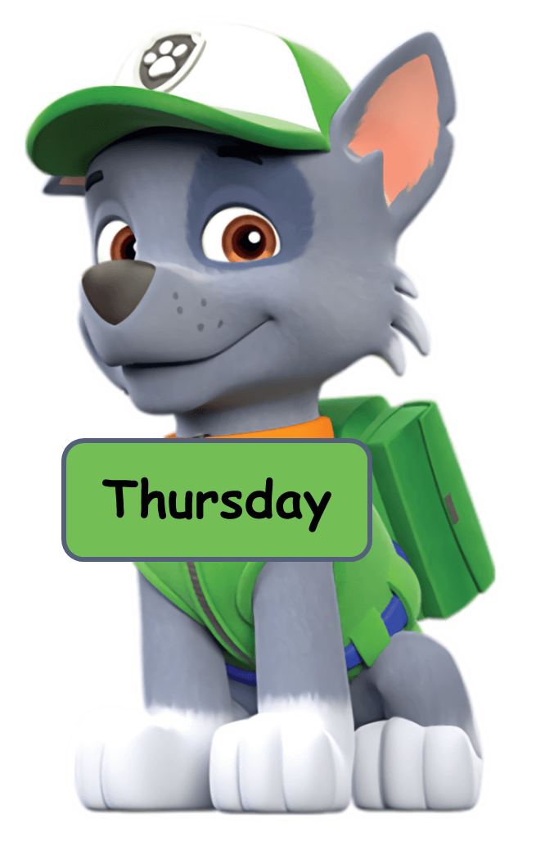




Click the dog having the correct answer.
Click here
kicking
throwing
catching
hitting

Slide 28
Click the dog having the correct answer.
Click here
kicking
throwing
catching
hitting

Slide 29
Click the dog having the correct answer.
Click here
hitting
catching
throwing
kicking

Slide 30


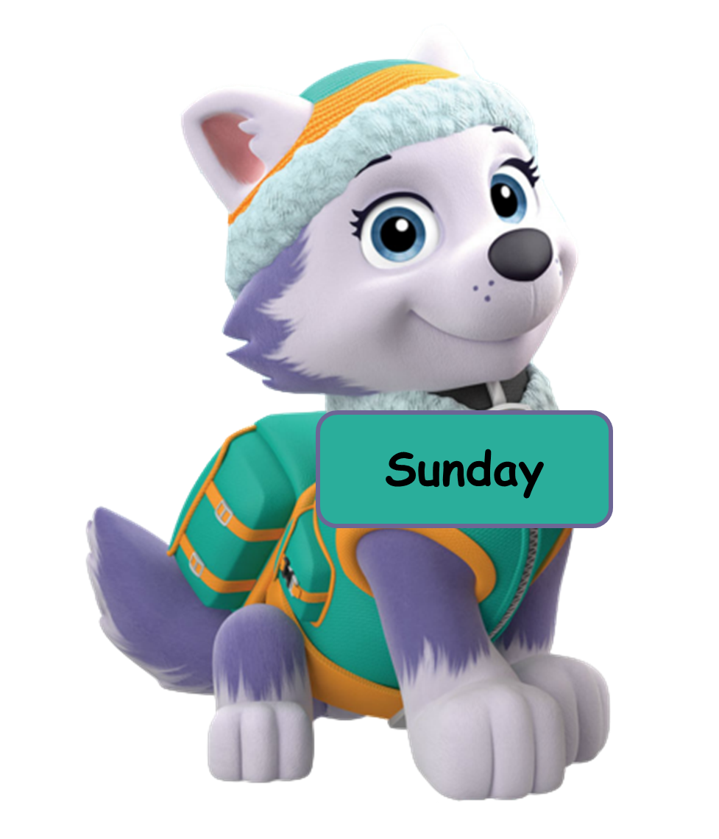
Click the dog having the correct answer.
Click here
throwing
kicking
hitting
catching

Slide 31
Click the dog having the correct answer.
Click here
Answer the question you hear.
I good at hitting.
I’m good hitting.
I am throwing.
I’m good at catching.
I’m good dancing.

Slide 32
Today’s lesson
Vocabularies
hitting
kicking
catching
throwing
Structures/ Sentence patterns
What are you good at?
- I'm good at kicking.

Slide 33
Homework
Practice the vocabularies/ structures and make sentences using them.
Do the exercises on page 51 WB.
Do the exercises in Tiếng Anh 3 i-Learn Smart Start Notebook on page 35.
Prepare the next lesson (page 74 SB).
Play the consolidation games in Tiếng Anh 3 i-Learn Smart Start DHA App on www.eduhome.com.vn

Slide 34

Lesson 3
Stay positive and have a nice day!

