Slide 1

Unit 4: HOME
Lesson 2.2
Page 56

Slide 2
Lesson Outline
Warm-up
Listening
Consolidation
Wrap-up

Slide 3
Objectives
By the end of this lesson, students will be able to ask What are you doing?, using the target language.
Vocabulary: eating, sleeping.
Structure: What’s he doing? He’s sleeping.

Slide 4

WARM UP

Slide 5
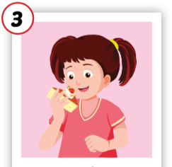
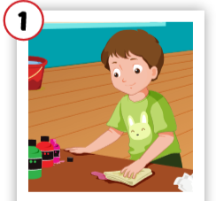
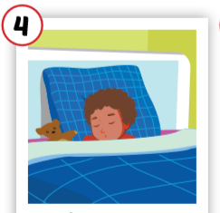
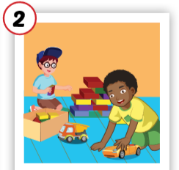
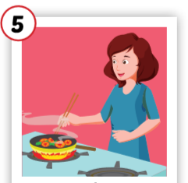
3
1
4
1
4
SPIN
3
2
2
2
5
5

Slide 6

It’s time to learn …

Slide 7


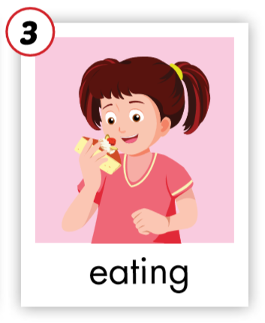
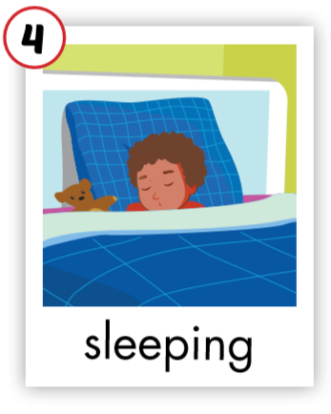
C. 1. Listen and repeat.
Click on each English word to hear the sound.
1
2

Slide 8


C. 2. Chant.
Click on the earphone to practice the chant.
/i:/ /i:/ /i:/
sleeping
eating
/i:/ /i:/ /i:/
/i:/ /i:/ /i:/

Slide 9

Listening

Slide 10

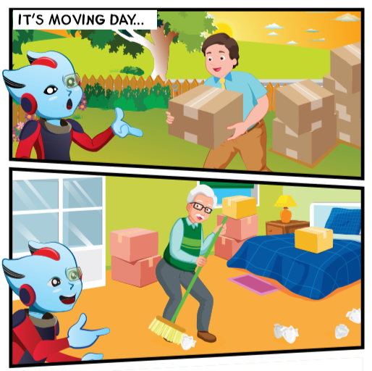
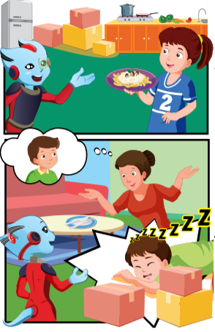
Click on the earphone to hear the sound.

Slide 11


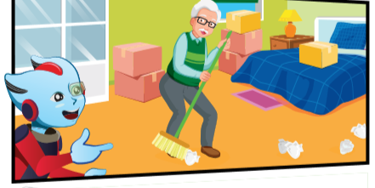

Click on the icon to hear the sound.
Hi, Mr. Brown. Where’s Grandpa Dan?
What’s he doing?
He’s in the bedroom.
He’s
cleaning.

Slide 12

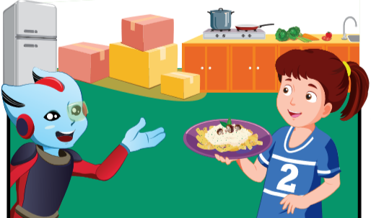
Click on the icon to hear the sound.
Grandpa Dan, where’s Lucy?
I think she’s in the kitchen.
What’s she doing?
She’s
cooking.

Slide 13

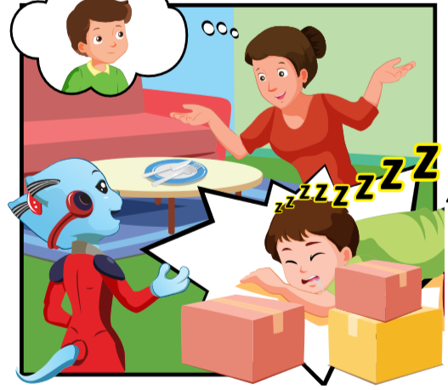
Click on the icon to hear the sound.
Hi, Alfie.
Hey, Lucy.
Where’s Mrs. Brown?
She’s in the living room.
What’s she doing?
She’s
eating.

Slide 14

Click on the earphone to hear the sound.
He’s in the yard.
Hi, Mrs. Brown. Where’s Ben?
He’s
playing.
What’s he doing?
I don’t know.
Oh. And where’s Tom?

Slide 15

Alfie: Hi, Mr. Brown. Where’s Grandpa Dan?
Sam: He’s in the bedroom.
Alfie: What’s he doing?
Sam: He’s cleaning.

Slide 16
Alfie: Hey, Lucy.
Lucy: Hi, Alfie.
Alfie: Where’s Mrs. Brown?
Sam: She’s in the living room.
Alfie: What’s she doing?
Sam: She’s eating.

Slide 17

Further Practice
Notes:
Workbook p. 41

Slide 18

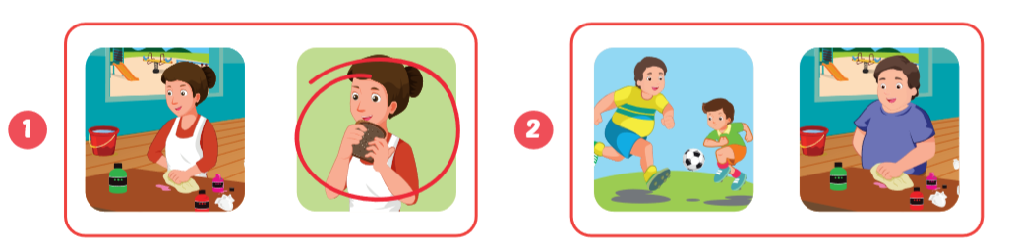
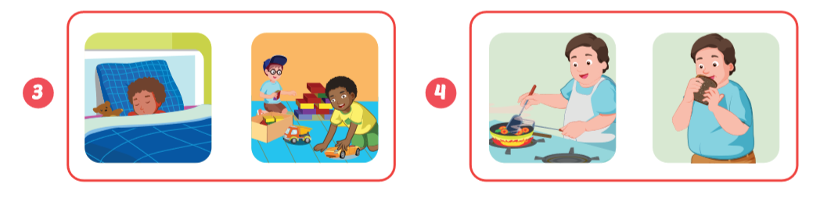
Click on the earphone to hear the sound.

Slide 19
Point and say.
She’s eating.
He’s cleaning.

Slide 20
Point and say.
He’s sleeping.
He’s cooking.

Slide 21

CONSOLIDATION

Slide 22
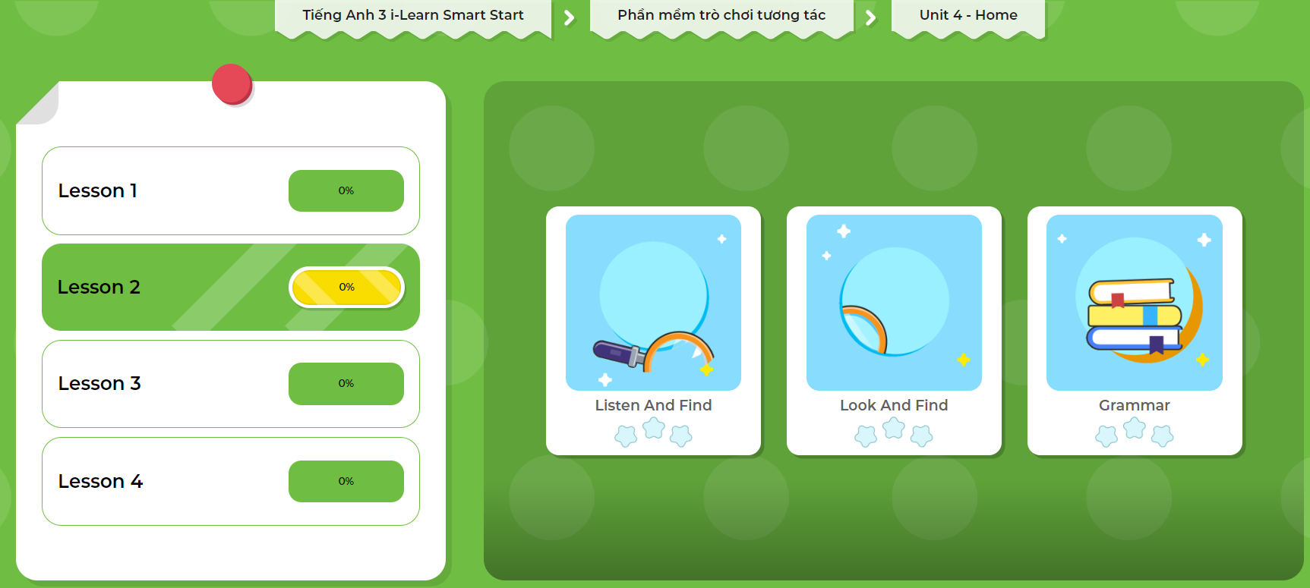
Extra Practice
DHA App
Let’s play!
Click here to play the game

Slide 23

Go around the class and ask 3 friends about what their parents are doing.
Name | cleaning | sleeping | eating
Trang’s father
Hoa’s mother
Tùng’s mother
Notes:
GV giới thiệu hoạt động HS sẽ đi vòng quanh lớp và hỏi ý kiến của 3 bạn về các loại động vật bạn yêu mến, thích, và không thích. GV chuẩn bị handout cho HS.

Slide 24

WRAP-UP

Slide 25
Today’s lesson
Vocabularies
bedroom
bathroom
Structures/ Sentence patterns
What’s he doing?
He’s cleaning.
What’s she doing?
She’s cooking.

Slide 26
Homework
Review the vocabularies and sentence patterns. Make sentences using them.
Do the exercises on page 41 (WB)
Prepare the next lesson (page 57 SB)
Play consolidation games in Tiếng Anh 3 i-Learn Smart Start DHA App on www.eduhome.com.vn

Slide 27
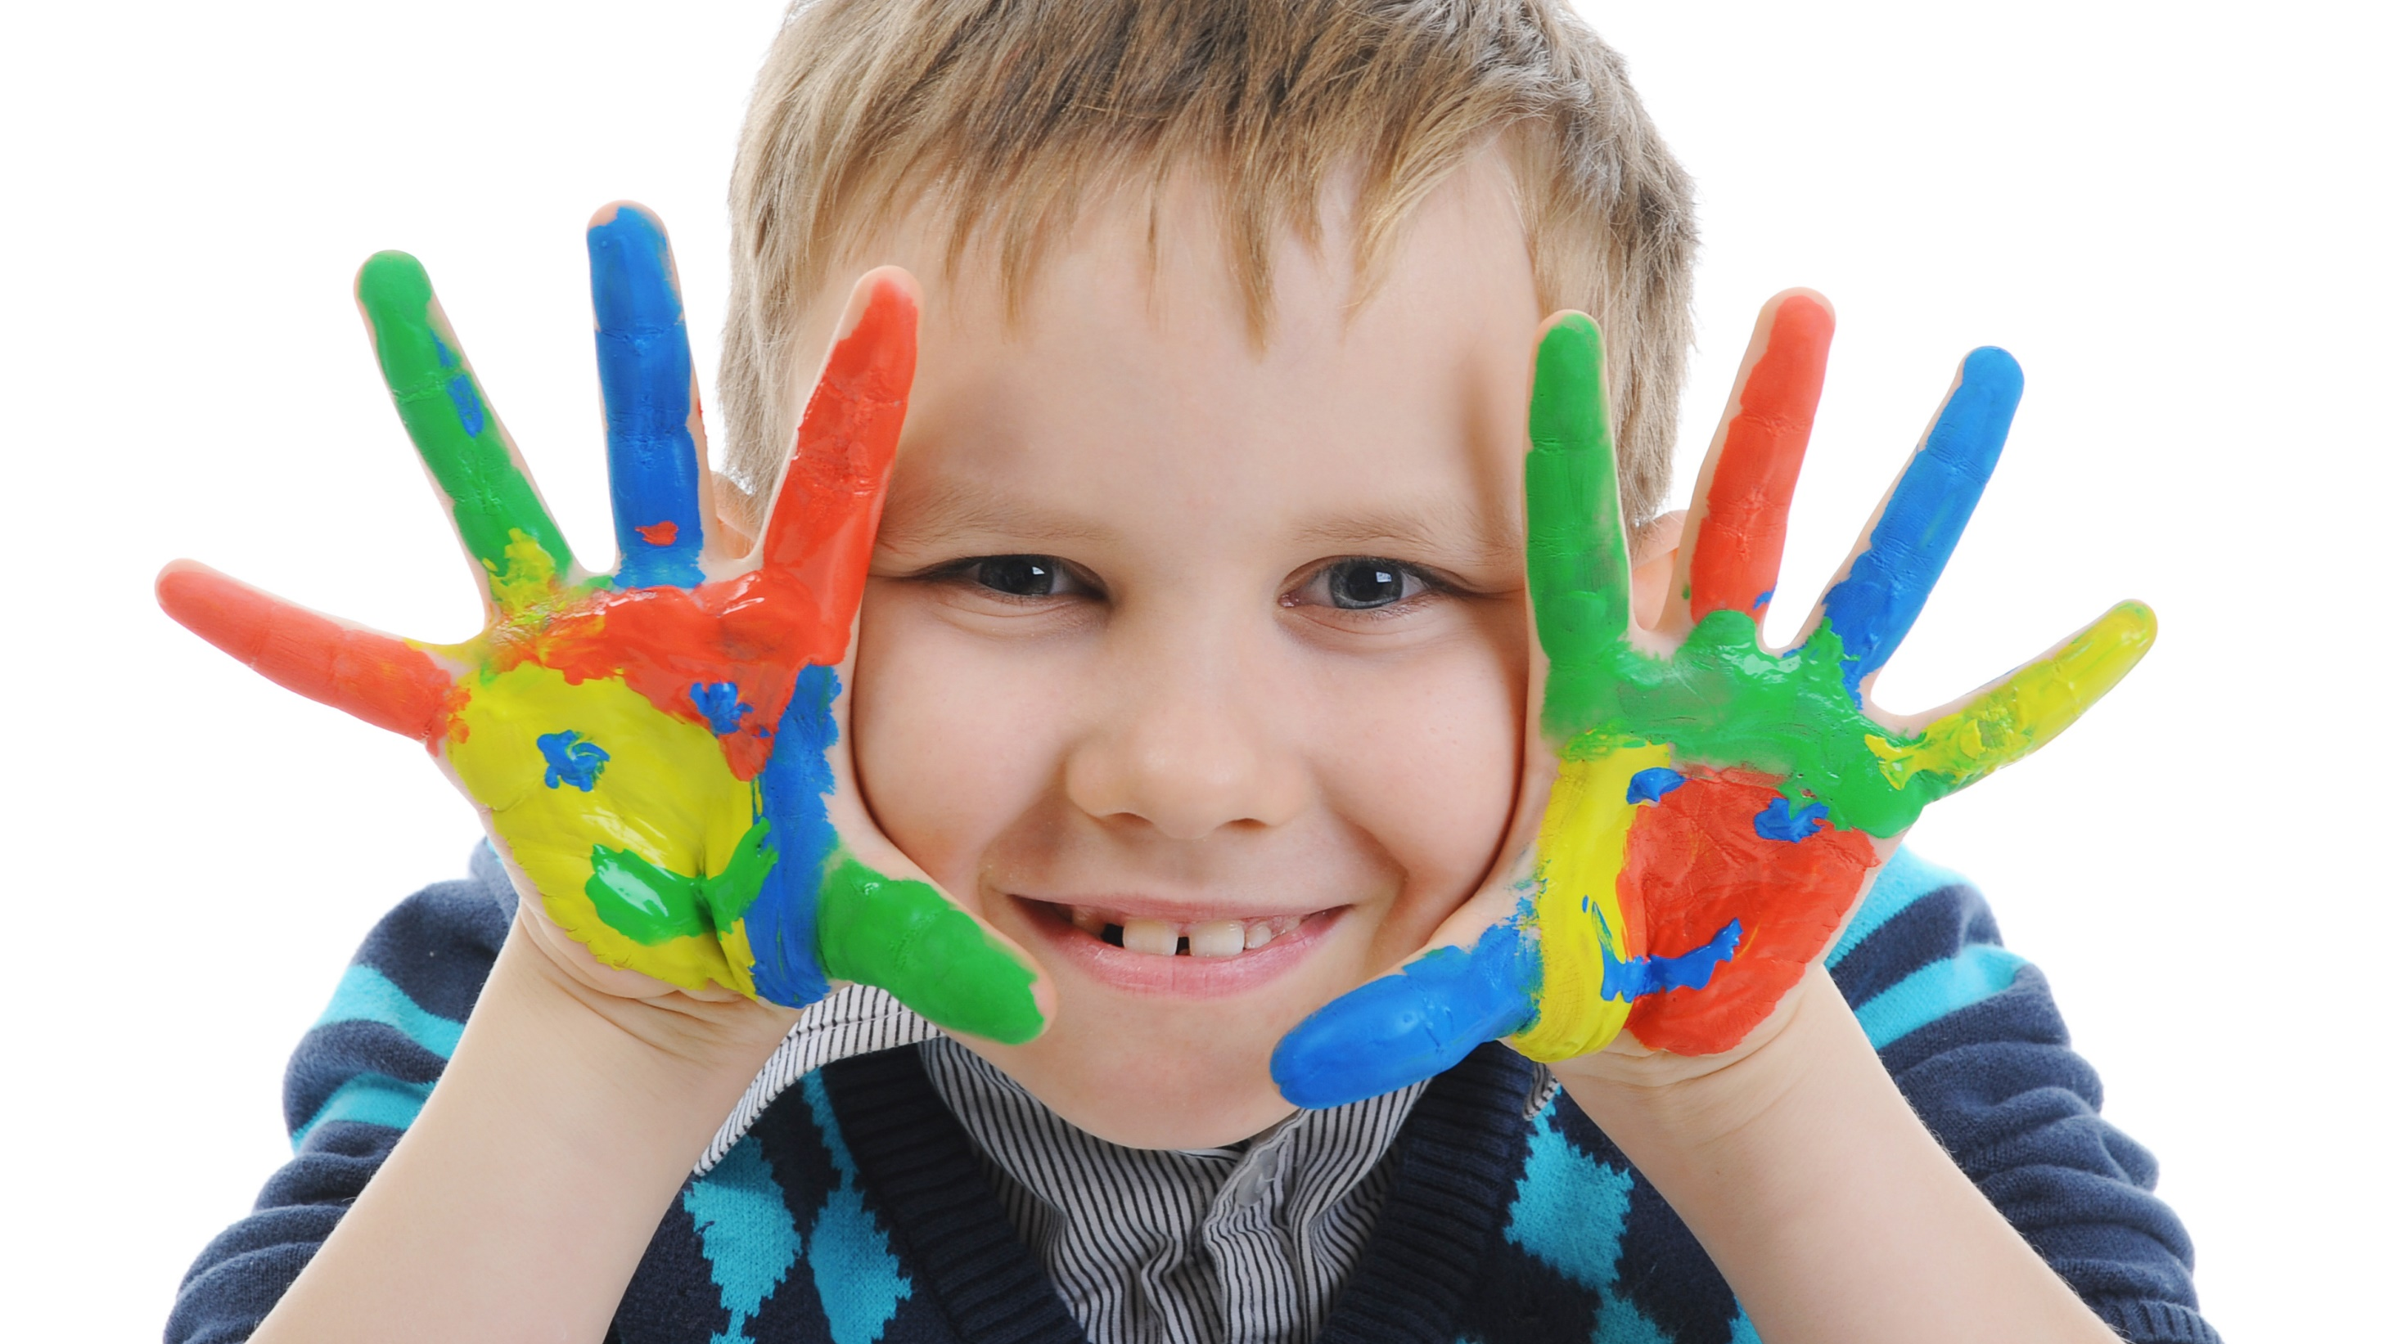
Enjoy your day!

