Slide 1

Unit 4: HOME
Lesson 1.3
Page 54

Slide 2
Lesson Outline
Warm-up
Practice
Speaking
Consolidation
Wrap-up

Slide 3
Objectives
By the end of this lesson, students will be able to use the target language to ask where people are.
Vocabulary: Revision (bedroom, bathroom, living room, kitchen, yard).
Structure: Where’s Tom? He’s in the living room.
Where’s Grandma? She’s in the bathroom.

Slide 4

WARM UP

Slide 5
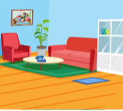

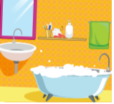

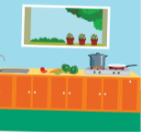

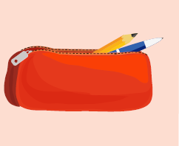

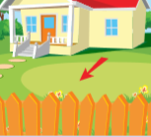
1
2
3
4
5
6
7
8
9
10
11
12
13
14
15
16
17
18
Notes:
T asks students to choose 2 squares (two numbers) to make a pair. Then students make sentences (I have…. or He’s in the ….). If not, close them and try again.

Slide 6

It’s time to learn …

Slide 7

Practice

Slide 8

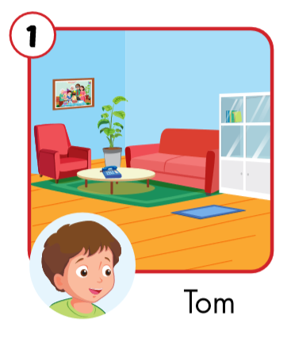
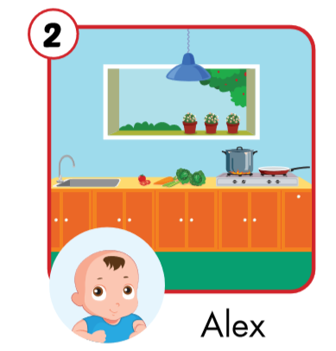
Where’s Tom?
Where’s Alex?
He’s in the living room.
He’s in the kitchen.

Slide 9
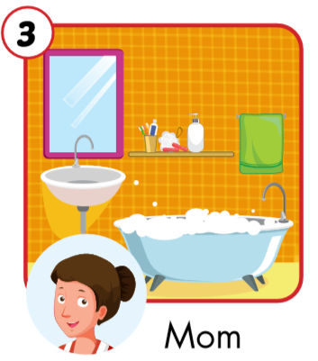
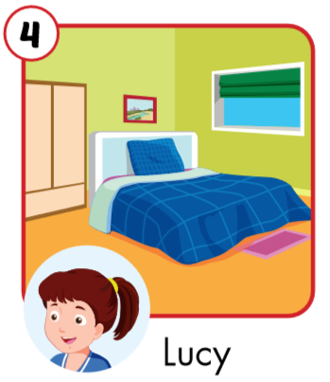
Where’s Mom?
Where’s Lucy?
She’s in the bathroom.
She’s in the bedroom.

Slide 10
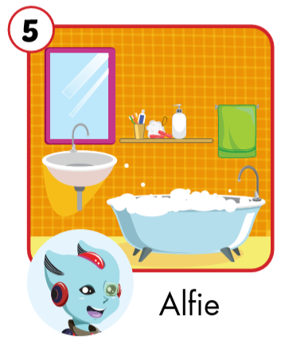
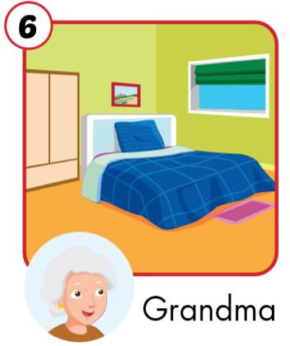
Where’s Alfie?
Where’s Grandma?
He’s in the bathroom.
She’s in the bedroom.

Slide 11
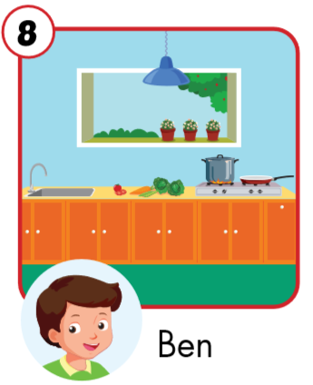
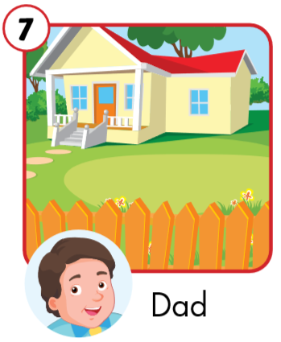
Where’s Ben?
Where’s Dad?
He’s in the yard.
He’s in the kitchen.

Slide 12

Speaking

Slide 13

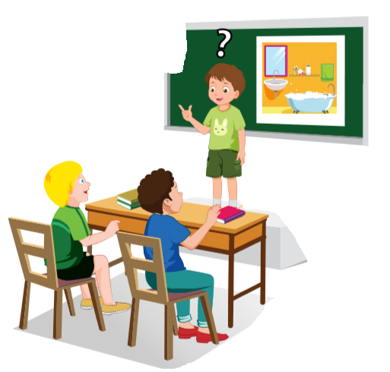
She’s in the yard.
She’s in the bathroom.
Where’s Grandma?
No.
Yes.

Slide 14
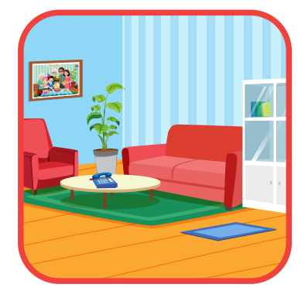
She’s in the living room.
She’s in the bedroom.
Where’s Mom?
No.
Yes.

Slide 15
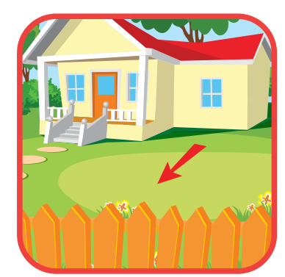
He’s in the yard.
Where’s Dad?
Yes.

Slide 16

Make sentences.
living room
Tom’s in the living room.

Slide 17

Make sentences.
kitchen
Alex’s in the kitchen.

Slide 18

Make sentences.
bathroom
Mom’s in the bathroom.

Slide 19

Make sentences.
bedroom
Lucy’s in the bedroom.

Slide 20

Make sentences.
bathroom
Alfie’s in the bathroom.

Slide 21

Further Practice

Slide 22

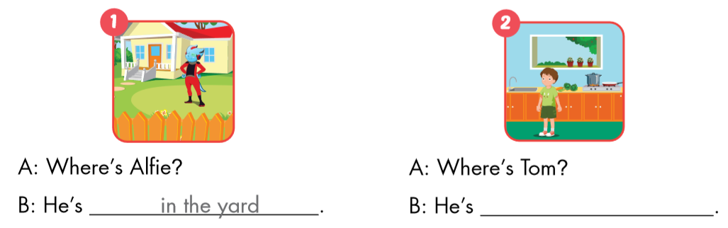
WB, p. 39
in the yard.
in the kitchen.

Slide 23
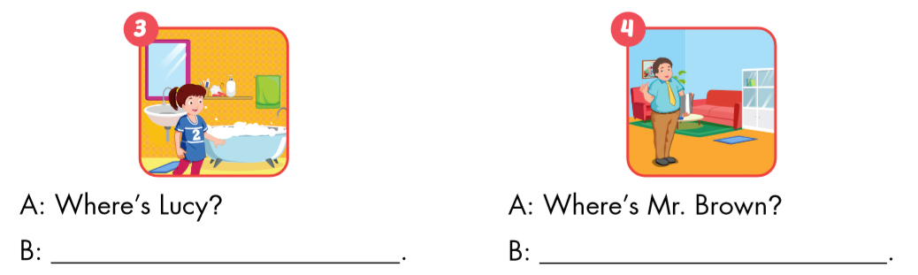
She’s in the bathroom.
He’s in the living room.

Slide 24

CONSOLIDATION

Slide 25

Guess the picture and make a sentence.
bedroom
Grandma / bedroom.
Grandma’s in the bedroom.

Slide 26

Guess the picture and make a sentence.
yard
Dad / yard.
Dad’s in the yard.

Slide 27

Guess the picture and make a sentence.
kitchen
Ben / kitchen.
Ben’s in the kitchen.

Slide 28
Today’s lesson
Vocabularies
Revision
(bedroom, yard, kitchen, bathroom,
living room)
Structures/ Sentence patterns
Where’s Dad?
He’s in the yard.
Where’s Grandma?
She’s in the kitchen.

Slide 29
Homework
Review the vocabularies and sentence patterns. Make sentences using them.
Do the exercises on page 39 (WB)
Prepare the next lesson (page 55 SB)
Play the consolidation games in Tiếng Anh 3 i-Learn Smart Start DHA App on www.eduhome.com.vn
Do the exercises in Tiếng Anh 3 i-Learn Smart Start Notebook on page 28.

Slide 30

Have a nice day!

