Slide 1






















Slide 2
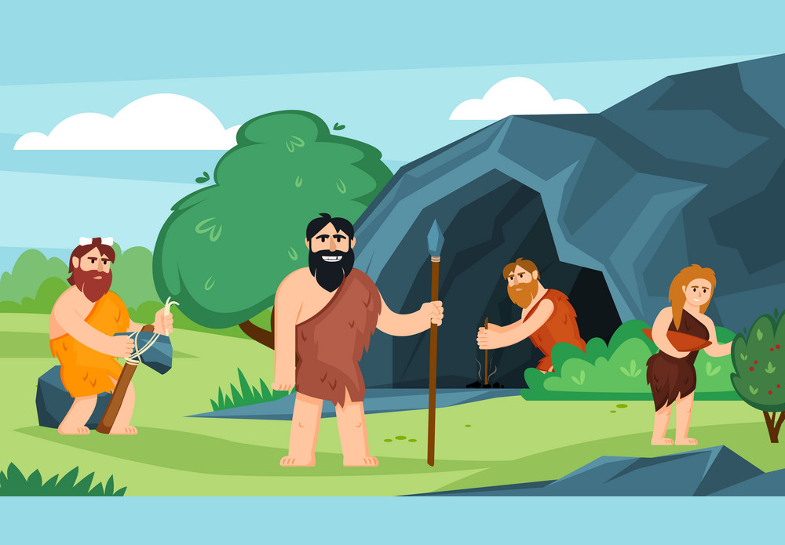

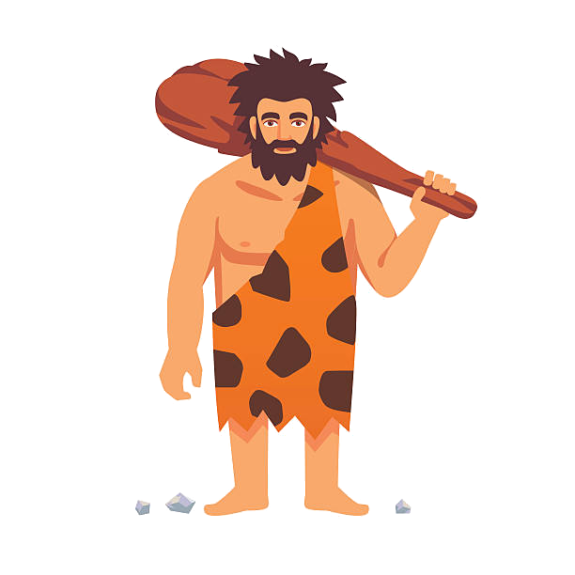
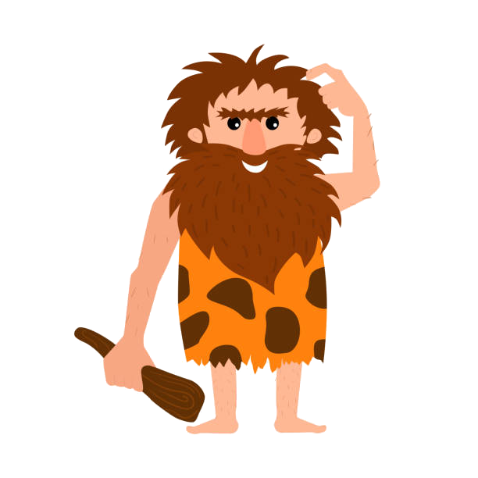
Unit 11: Before out time
Lesson 3
Task 1, 2, 3

Slide 3
1. Warm up
Catch the words

Slide 4
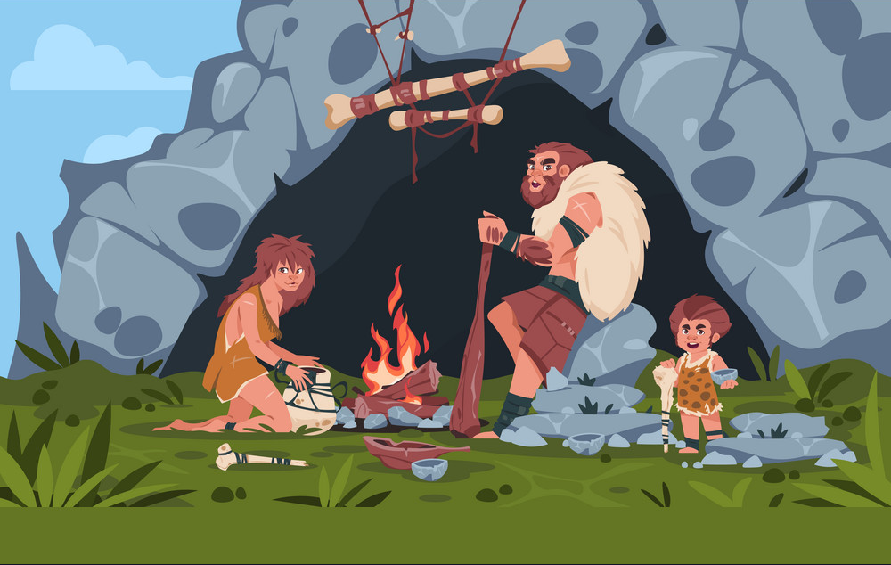

Notes:
Catch the words game
Each team will stand in lines. The first SS will be given a word and they must draw a picture according to that word.
After finishing, the picture will be passed down to the next one to re-draw. The last SS will write down the answer on the paper. Each turn will last for 1’30s.

Slide 5
2. PRESENTATION

Slide 6


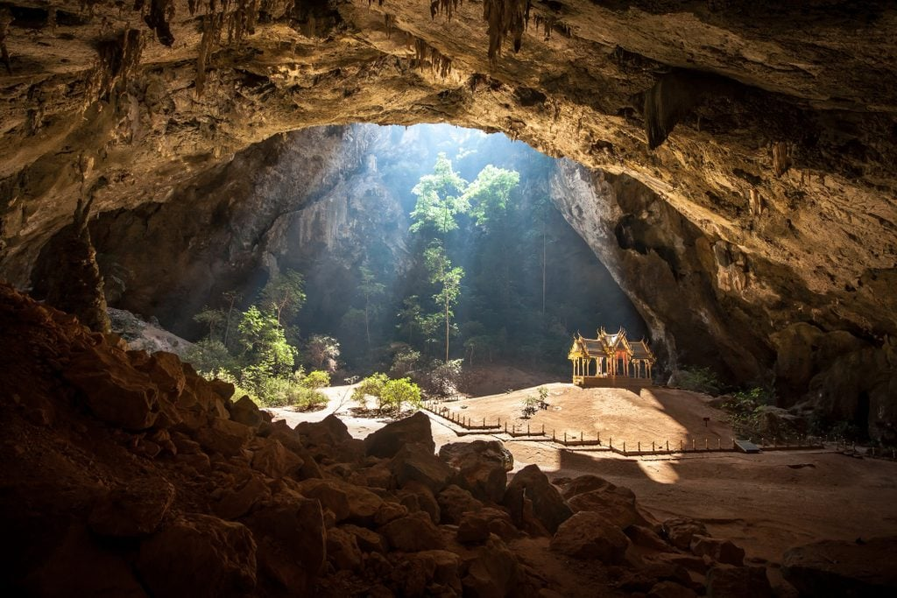
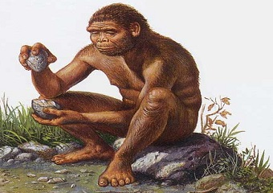
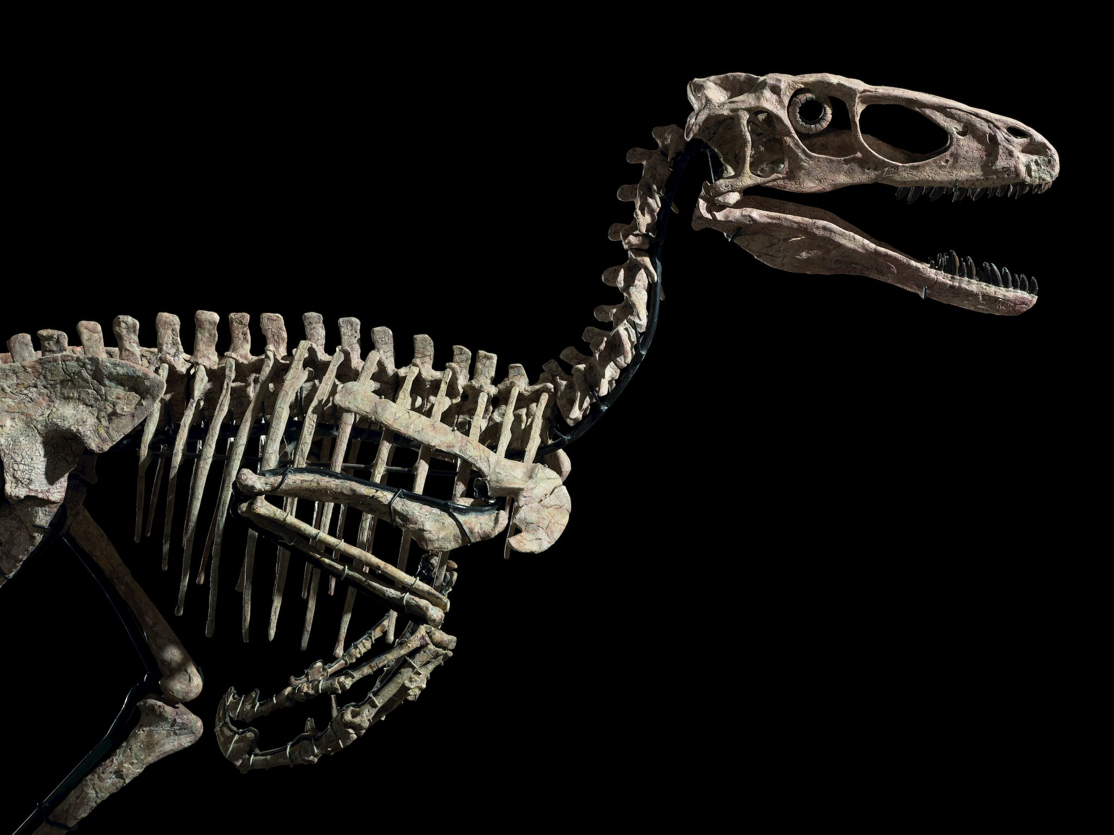
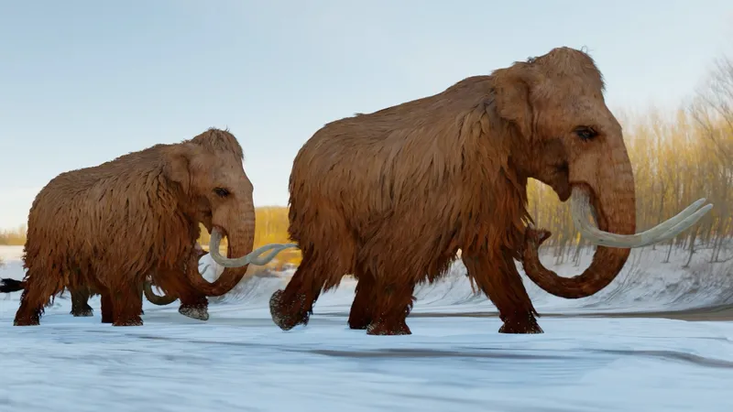
1. Listen and point. Repeat. TR 11.9
Cave
Early people
Dinosaur bones
Mammoth

Slide 7
3. PRACTICE

Slide 8
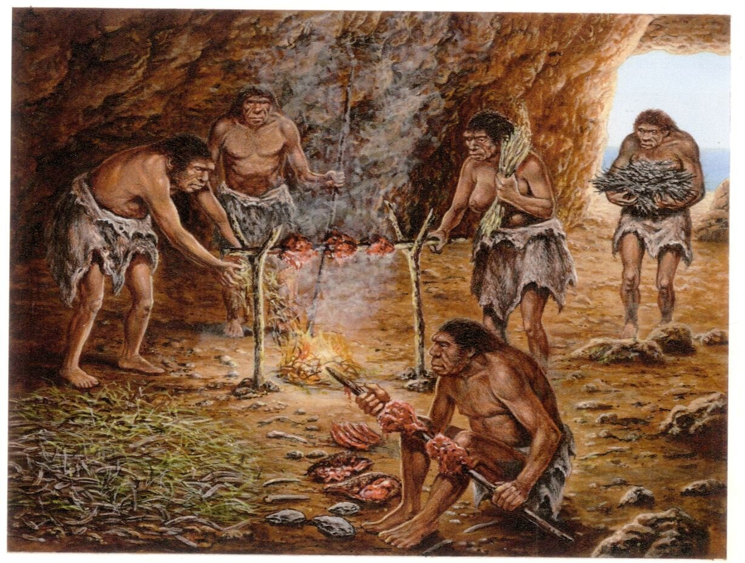
2. Listen and circle. TR 11.10
1 Eαrly People were tall/ small.
2 Eαrly People were in houses/ dark caves.
3 The dinosaur bones were smαll/ big.

Slide 9
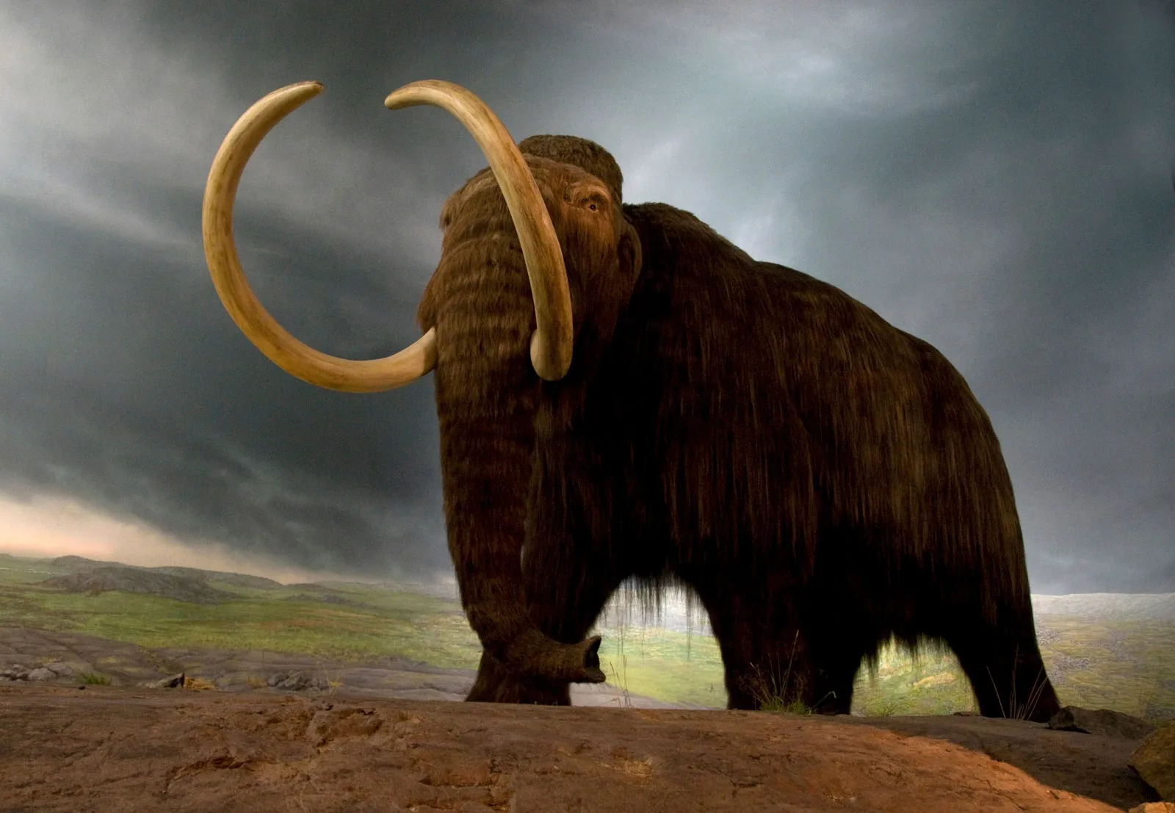

3. Look and sαy.
- This was a mammoth.
- It was big.
- mammoth
- big

Slide 10
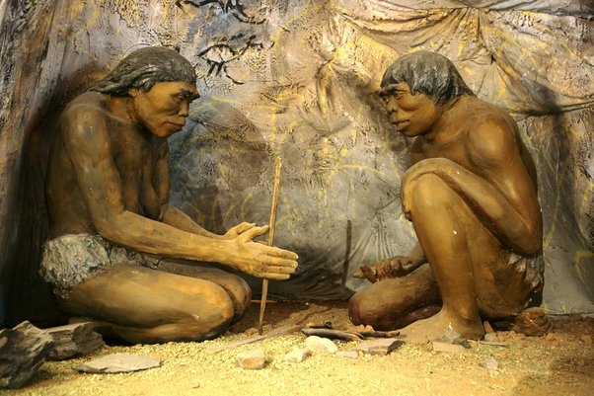
3. Look and sαy.
- These were early people.
- They were small.
- Early people
- Small

Slide 11
3. Look and sαy.
- These were dinosaur bones.
- They were big.
dinosaur
big

Slide 12
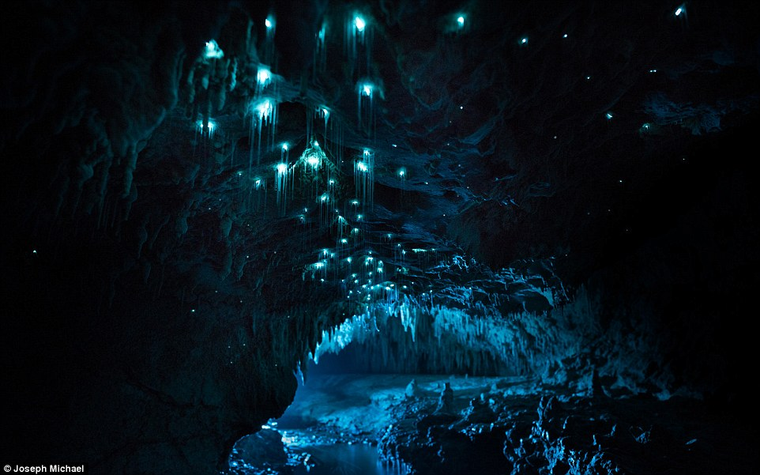
3. Look and sαy.
- This was a cave.
- It was dark.
cave
dark

Slide 13
4. PRODUCTION

Slide 14
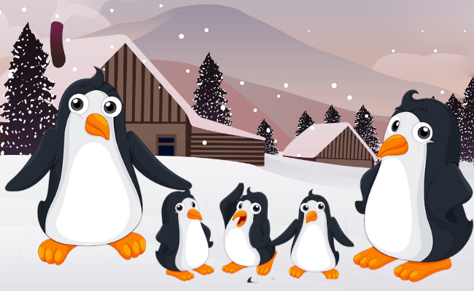

Learning with penguins
Notes:
Learning with penguins
T divides the class into 2 groups. Each group will choose a name and play rock, scissors, paper to decide which group goes first.
The two groups will take turns to answer the questions. If the answer is correct, they will get the score. If not, the chance is given to the other team.
When the game finishes, the group with higher score will win.

Slide 15
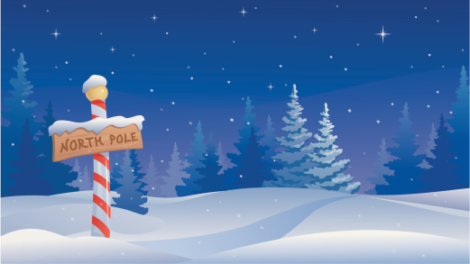








NEXT
Notes:
Click on a penguin to open the question

Slide 16

What’s this?
It was a mammoth.
BACK

Slide 17

Fill in the blank:
_____ people
Early people
BACK

Slide 18
Listen:
cave
BACK

Slide 19
What’s missing?
Di_os__r bones
Dinosaur bones
BACK

Slide 20
Listen and fill in the blank:
Early ______
Early people
BACK

Slide 21
Unscramble the letters:
a/v/c/e
cave
BACK

Slide 22
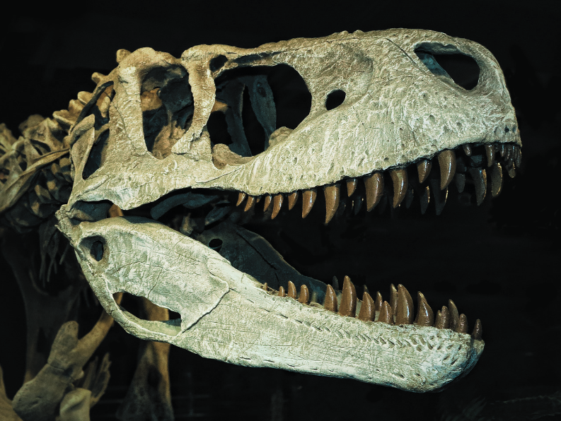
What were these?
These were dinosaur bones.
BACK

Slide 23
Unscramble the word:
m/m/m/a/t/o/h
mammoth
BACK

Slide 24
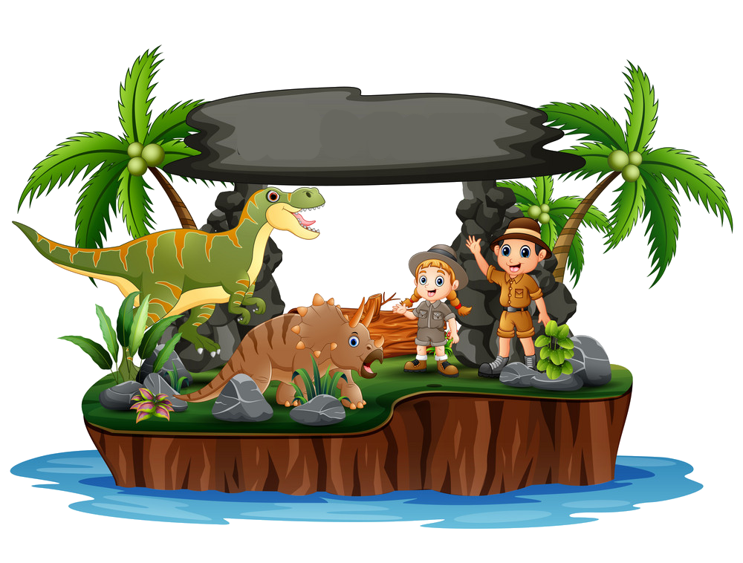
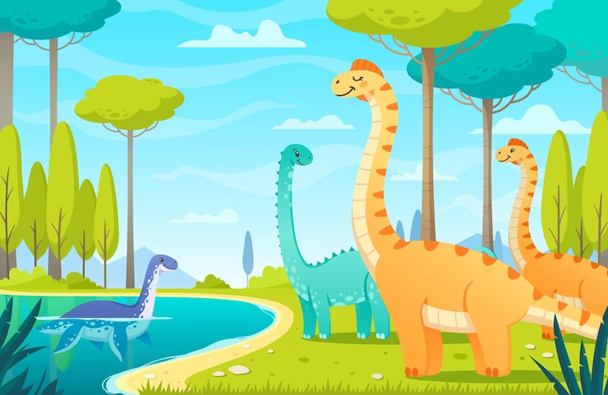
5. ASSESSMENT

Slide 25
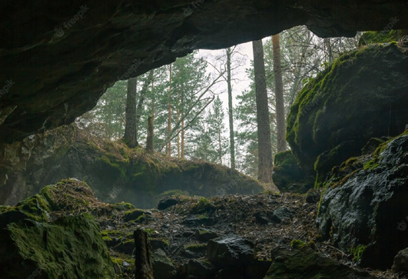
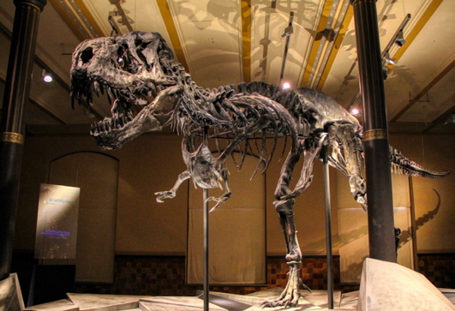
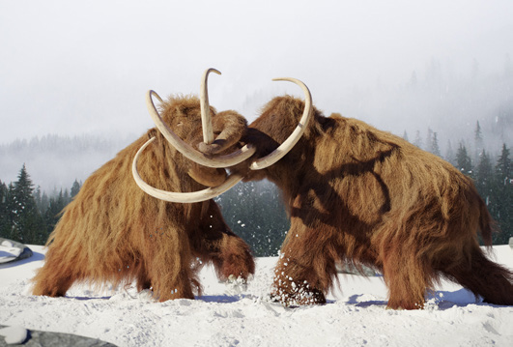
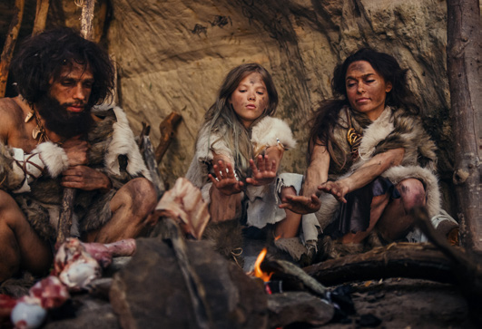
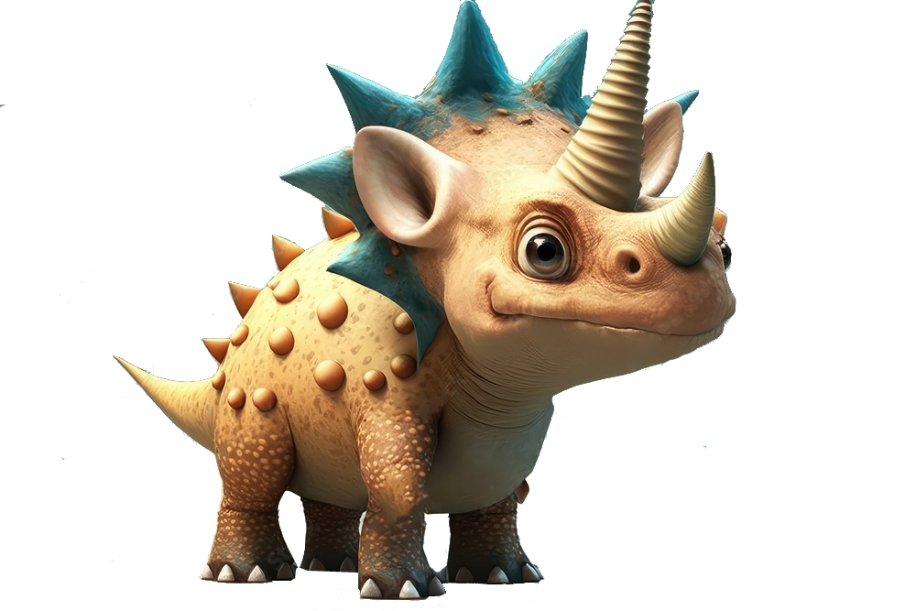
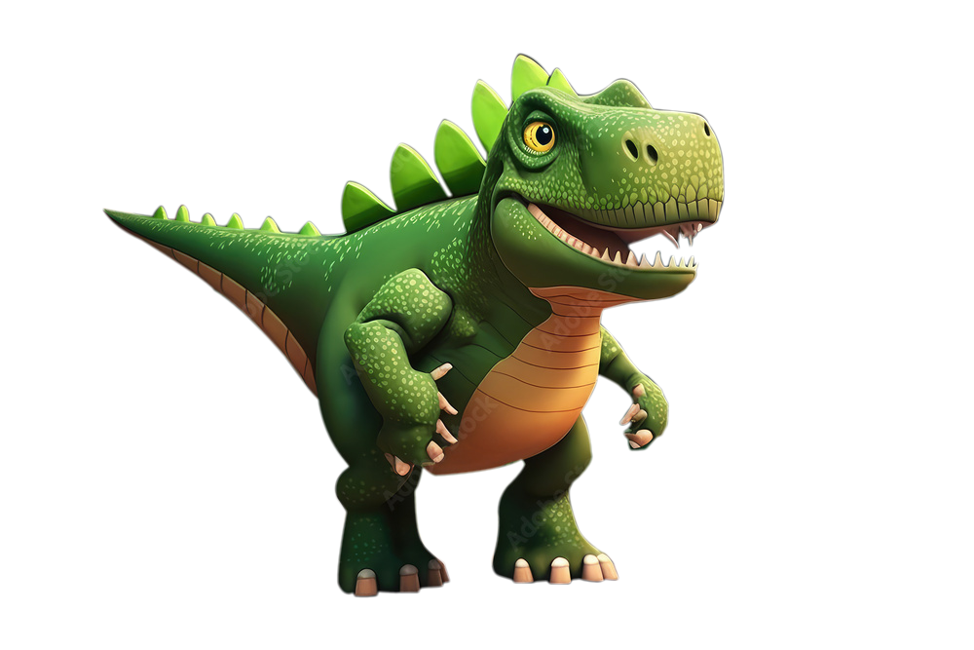
Circle
cave / dinosaur bones
dinosaur bones / mammoth
mammoth/ eαrly people
eαrly people / long mαn

Slide 26
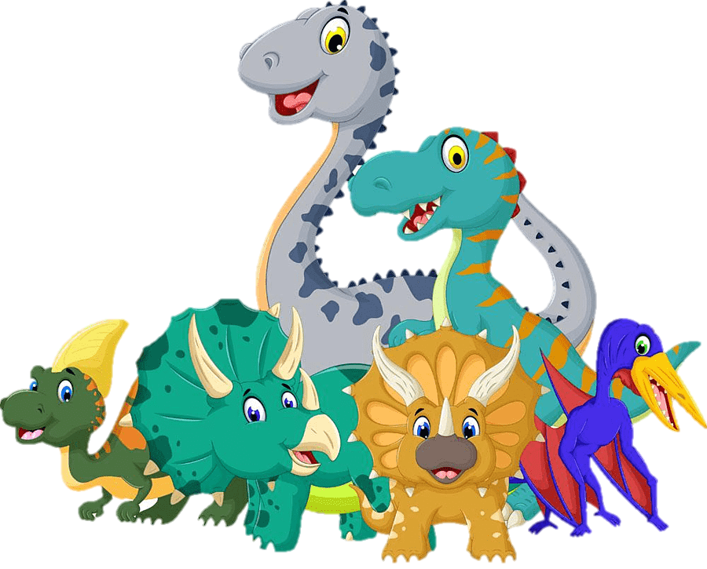

UNIT 11: BEFORE OUR TIME
LESSON 3: PERIOD 1
What we learnt today:
Vocabulary:
cave, early people,
dinosaur bones, mammoth

Slide 27




Thank you & goodbye!

