Slide 1




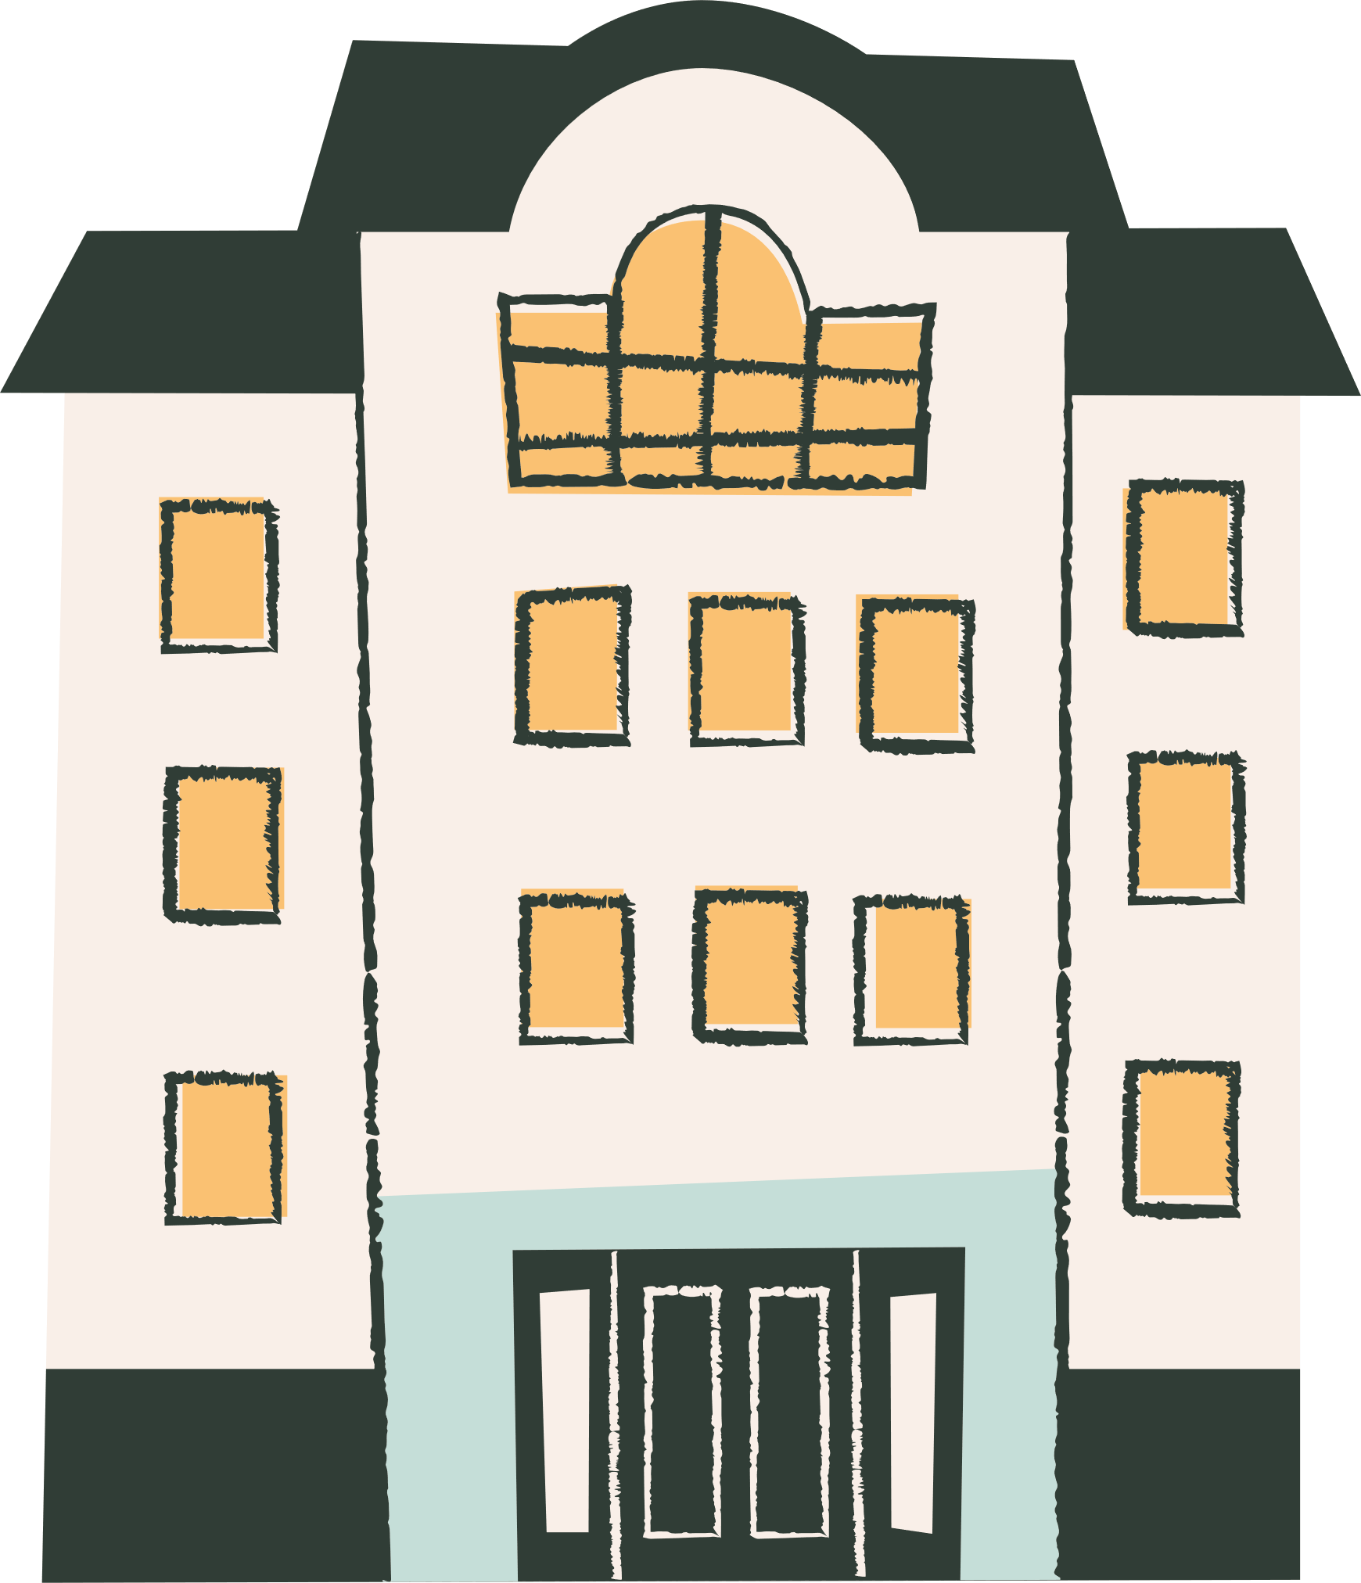
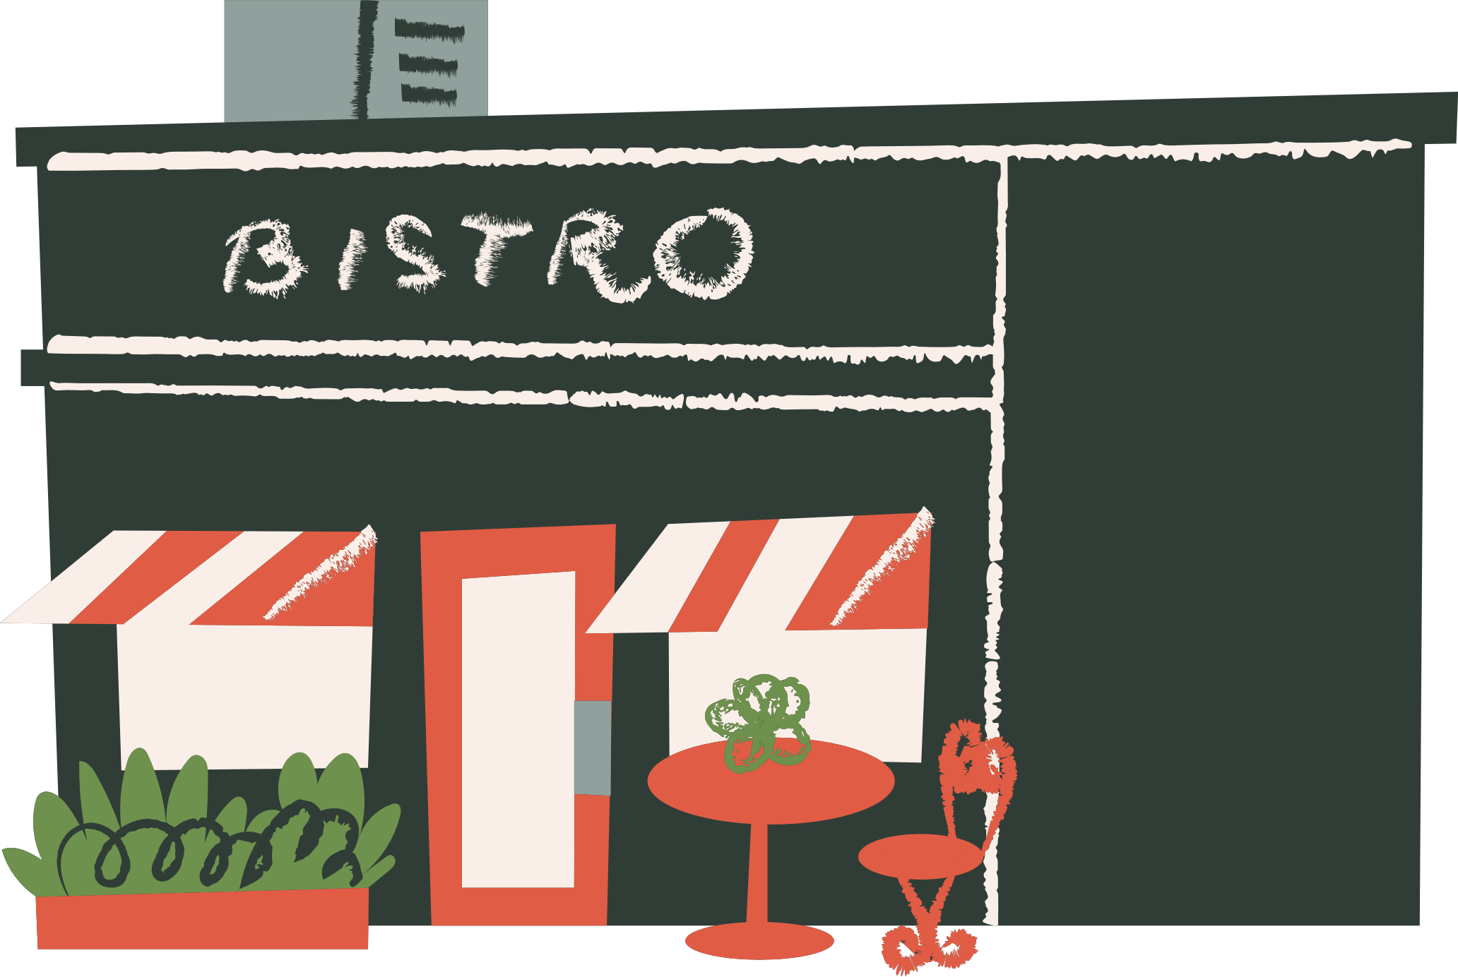


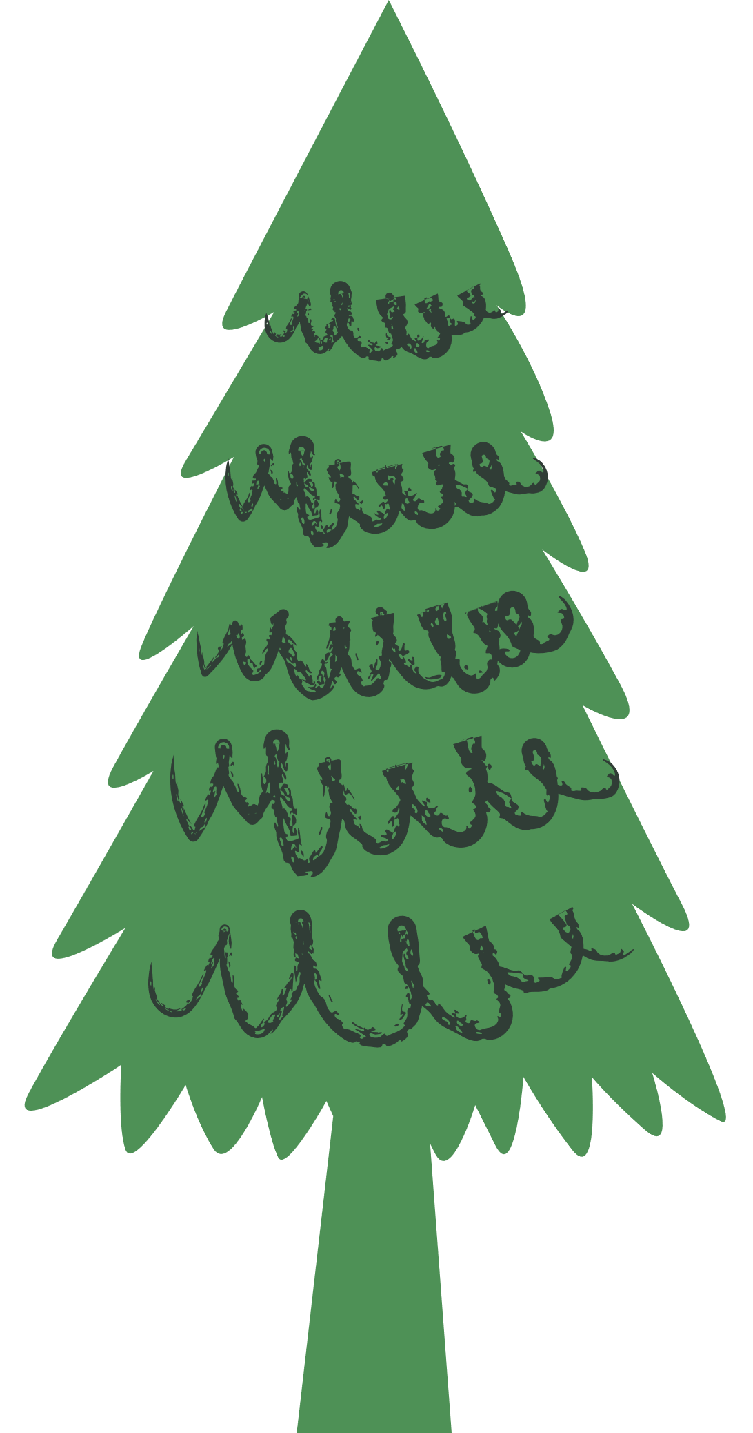




Unit 8
People and Places
LESSON 2
Part 4, 5, 6

Slide 2





01
Warm-up
Can you guess?

Slide 3

02
Presentation

Slide 4
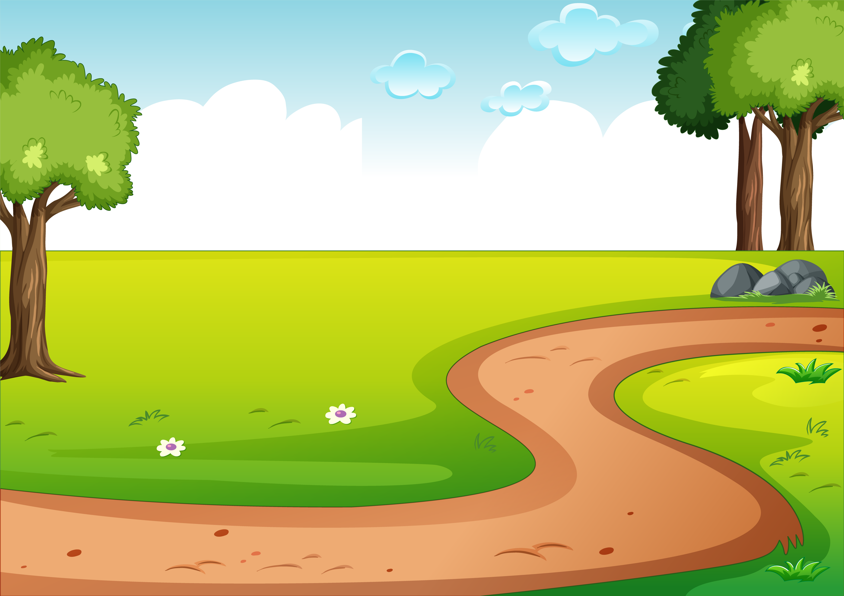
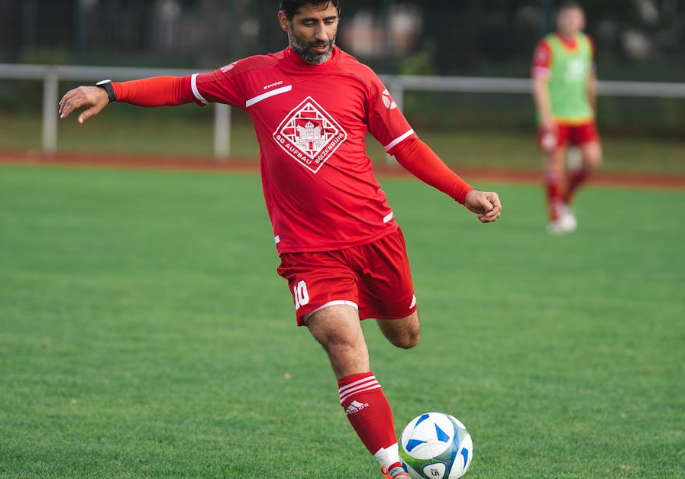

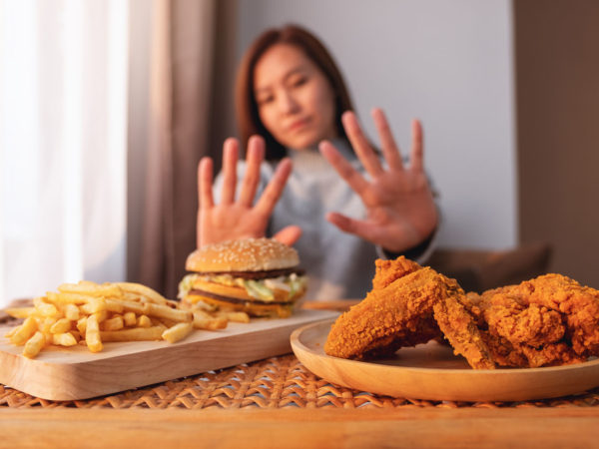

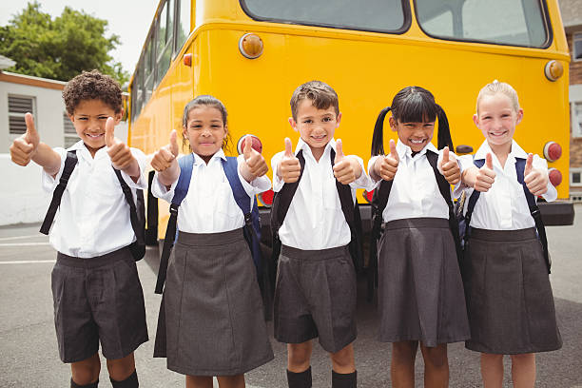
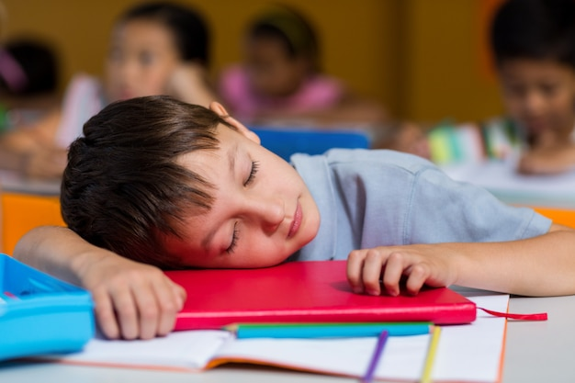
4. Look at the pictures and complete the sentences with must or mustn’t.
1. You ______ kick the ball.
You ______ touch the ball with your hands.
must
mustn’t
2. You ______ eat a lot of junk food.
You ______ eat more fruit.
mustn’t
must
3. They ______ wear white shirts to school.
Girls ______ wear grey skirts.
must
must
4. He ______ pay attention.
He ______ fall asleep at school.
must
mustn’t

Slide 5
03
Practice

Slide 6
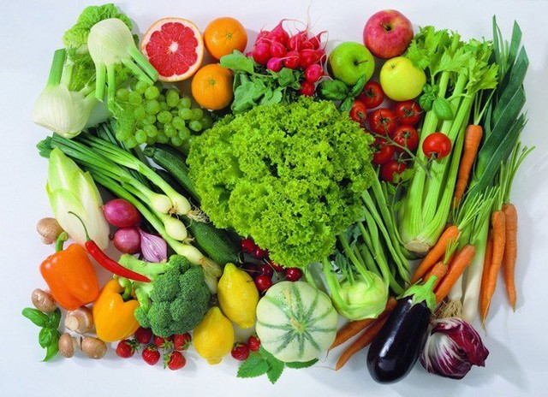
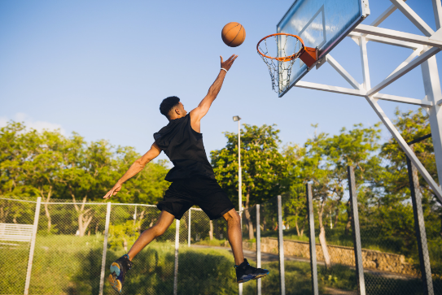
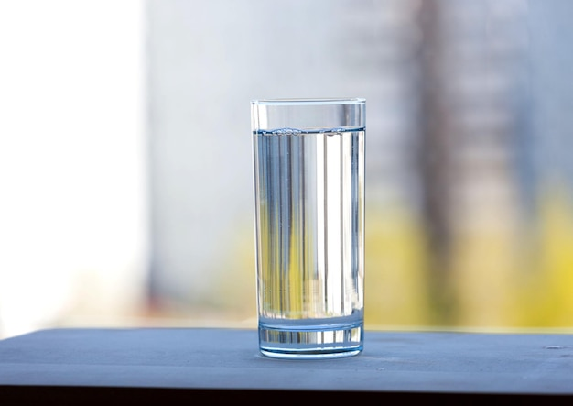
5. Look, write, and say.
What must basketball players do? What mustn’t they do?
1. eat a lot of vegetable
________________________.
They must eat a lot of vegetables
2. practice every day
________________________.
They must practice every day
3. drink lots of water
________________________.
They must drink lots of water

Slide 7
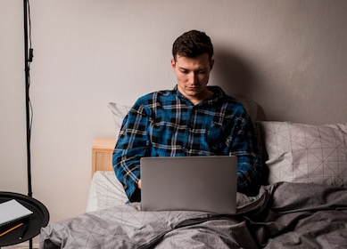
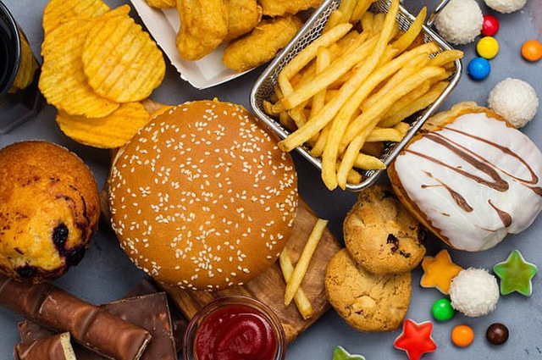
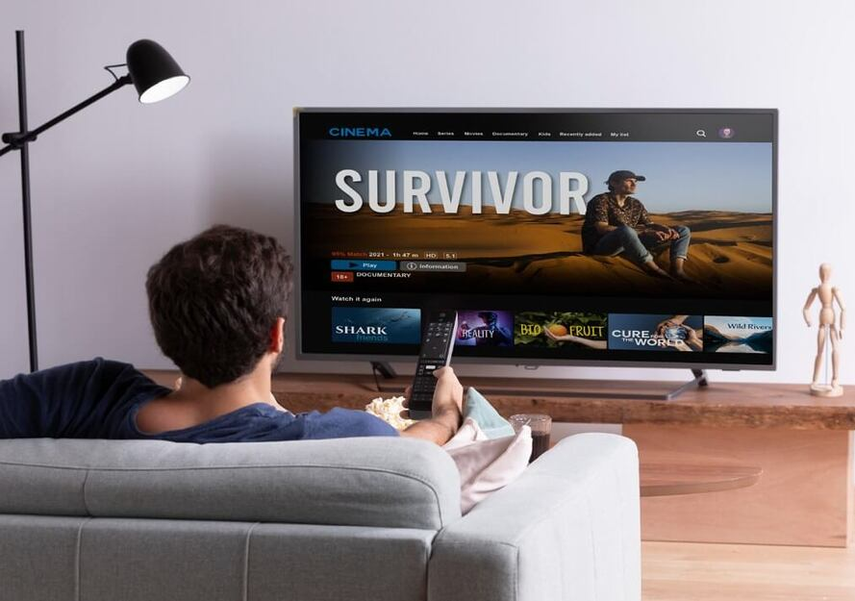
5. Look, write, and say.
What must a basketball player do? What mustn’t they do?
4. go to bed late
________________________.
They mustn’t go to bed late
5. eat junk food
________________________.
They mustn’t eat junk food
6. watch TV all day
________________________.
They mustn’t watch TV all day

Slide 8
04
Production

Slide 9
6. Write and say. What must or mustn’t we do at school?
Use the verbs in the box to help you.
eat run play clean sleep write climb do use
must
mustn’t
We must clean the board.
We must ____
We mustn’t climb the trees.
We mustn’t ___

Slide 10
05
Wrap-up &
Assessment

Slide 11

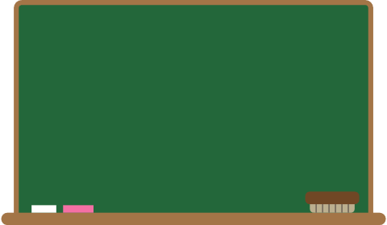
WRAP-UP
What have we learnt today ?
Modal verb: must, mustn’t
Structure: must / mustn’t + infinitive Verb
Examples:
- Food doesn’t stay on plates, so scientists must eat food from packages.
- There isn’t a fridge on the ISS, so they mustn’t keep fruit and vegetables for long.

