Slide 1









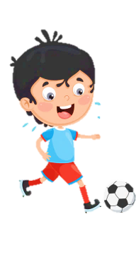













Slide 2
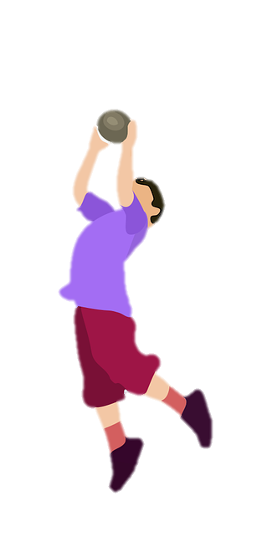
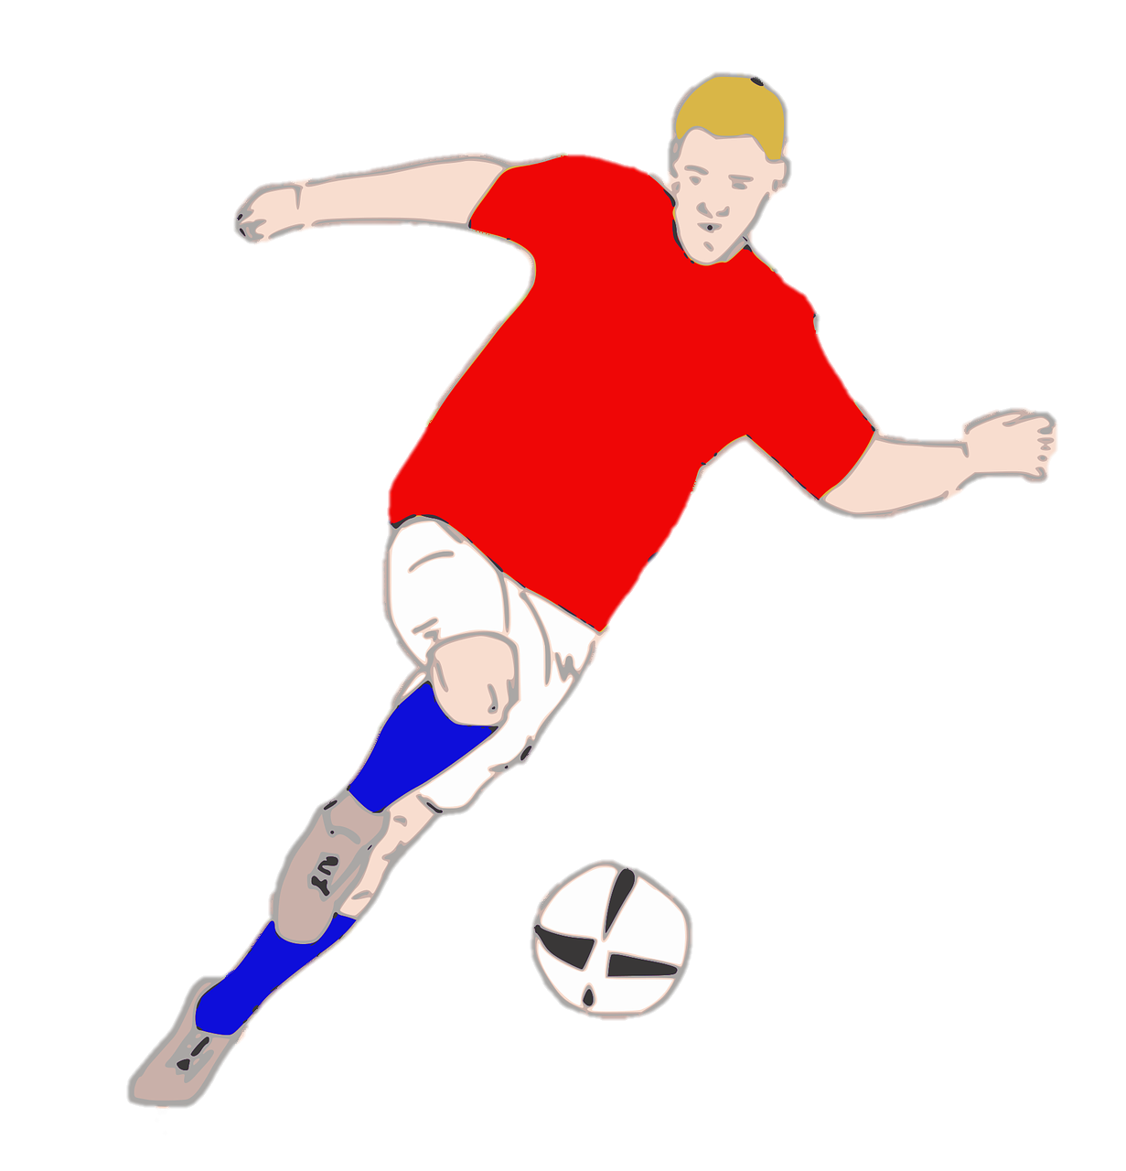
Unit 7:
SPORTS
Lesson 1 – Part 4, 5, 6

Slide 3





Table of contents
01
02
Warm-up
Presentation
04
05
Production
Wrap-up &
Assessment
03
Practice

Slide 4
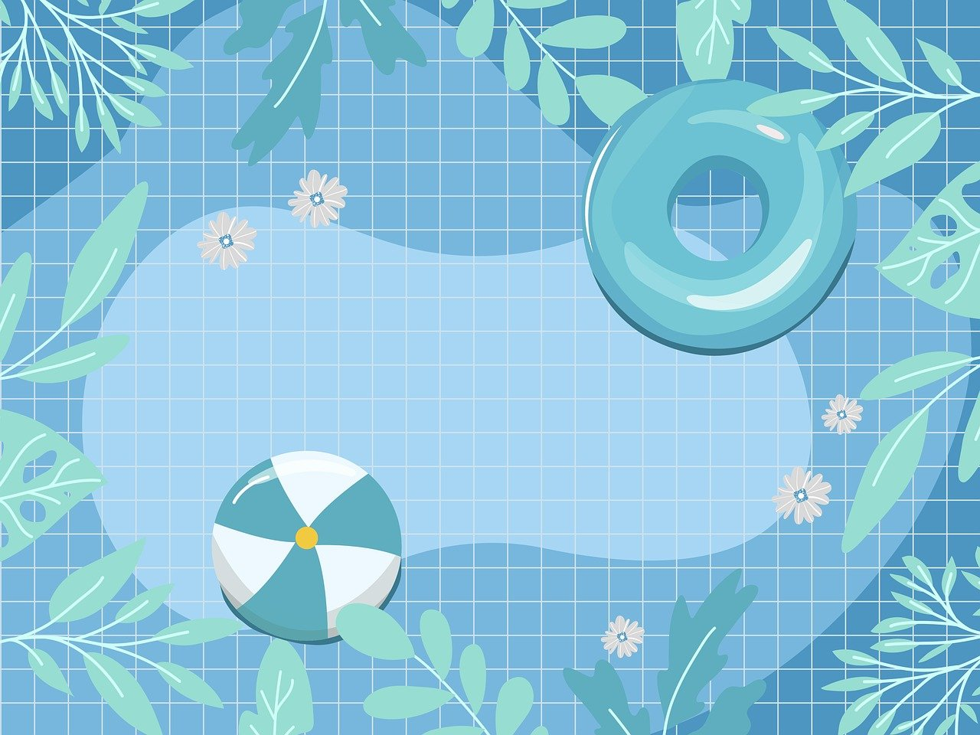
1
Warm-up
Reorder the letters to make meaningful words.

Slide 5
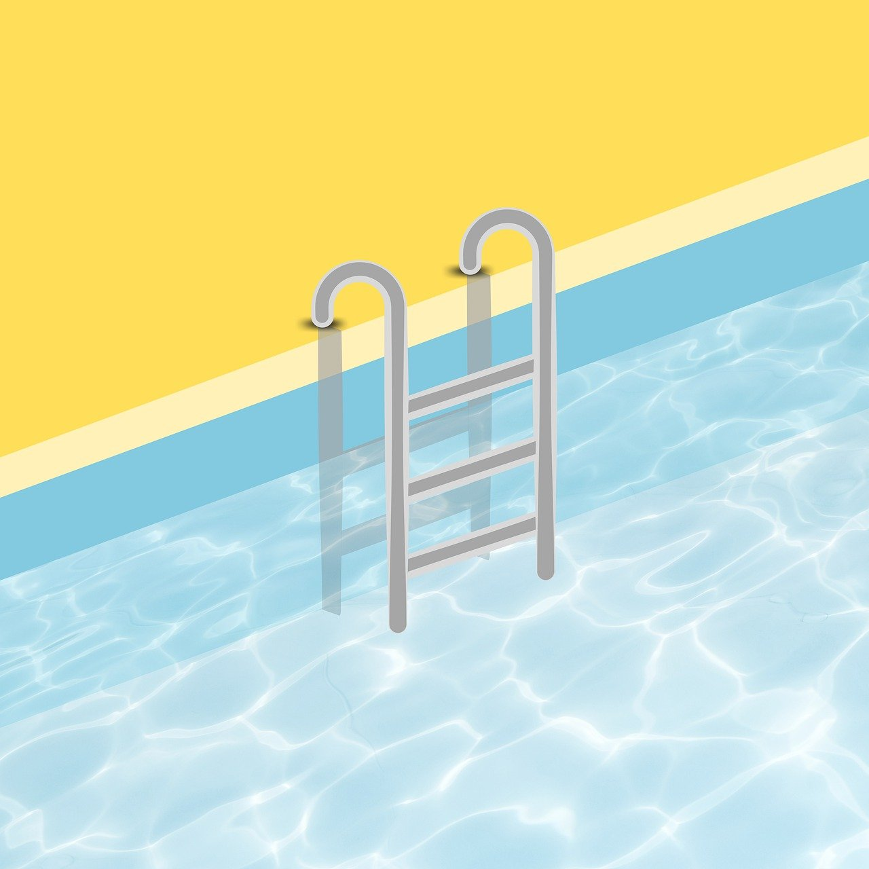
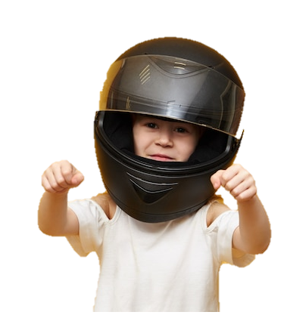
What is it?
tmhlee
It’s a helmet.

Slide 6
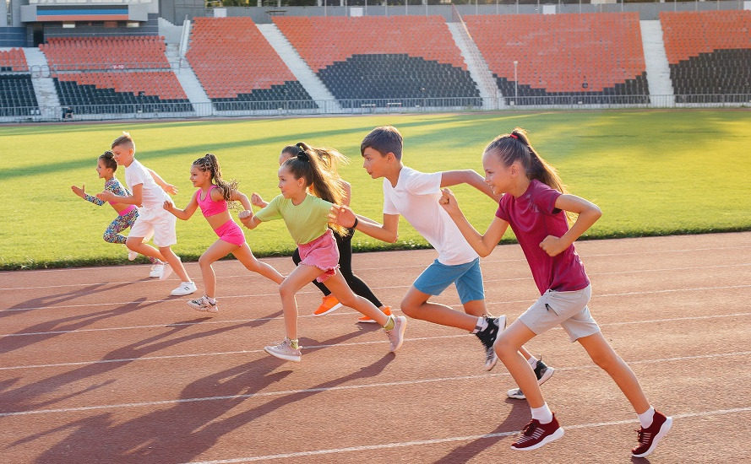
How are they?
tfsa
They’re fast.

Slide 7
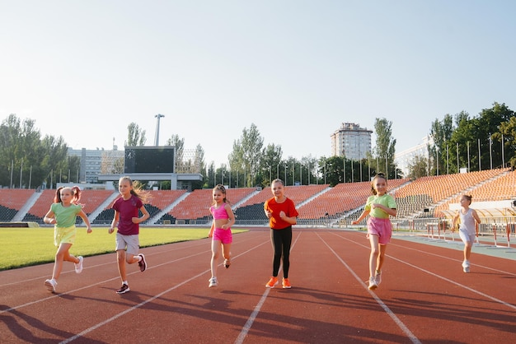
What is it?
acre
It’s a race.

Slide 8
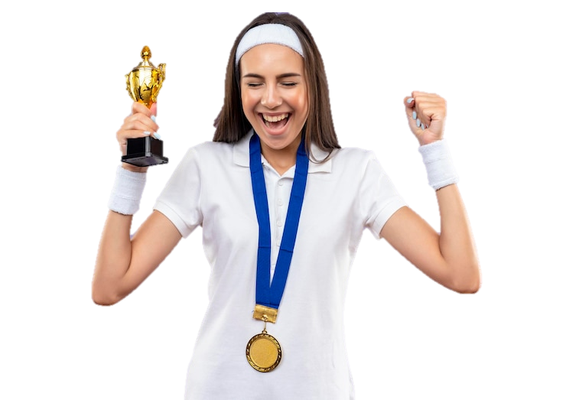
Do you win this competition?
Yes, I do. I win this competition.
inw

Slide 9

What do you do?
I jump.
pumj

Slide 10
2
Presentation

Slide 11

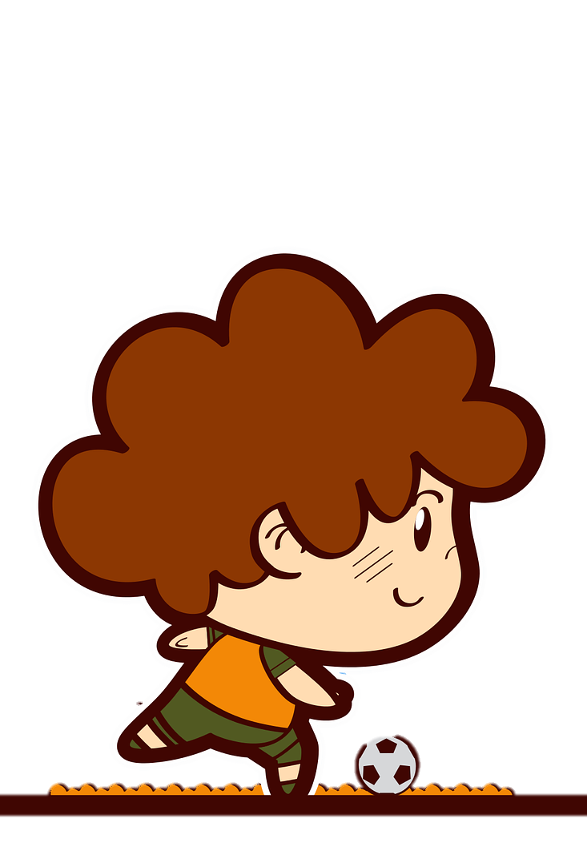

Present continuous
What is he doing now?
- He is playing football.
Describe things happen now, at present
or at the moment, etc.

Slide 12


Present continuous
What + to be + S + V-ing?
am
I
What
You
We
They
+ are
+
+ V-ing ?
He
She
It
is

Slide 13

Present continuous
S + to be + V-ing.
I
+ am
You
We
They
+ are
+ V-ing
He
She
It
+ is
S + to be + not + V-ing.

Slide 14

Spelling rules
She is ______ now (write) .
write
+
=
ing
writing
writing

Slide 15
Spelling rules
have
+
=
ing
having
ride
+
=
ing
riding
prepare
+
=
ing
preparing

Slide 16

Spelling rules
I am ________ at the moment. (swim)
m
ing
swimming
swim
+
+
=
swimming

Slide 17
Spelling rules
run
n
ing
running
+
+
=
jog
g
ing
jogging
+
+
=
cut
t
ing
=
cutting
+
+

Slide 18
3
Practice

Slide 19

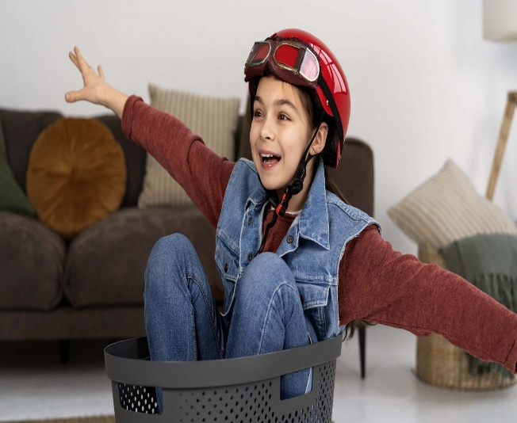
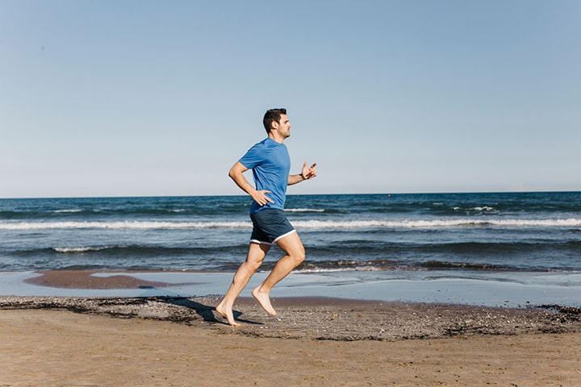
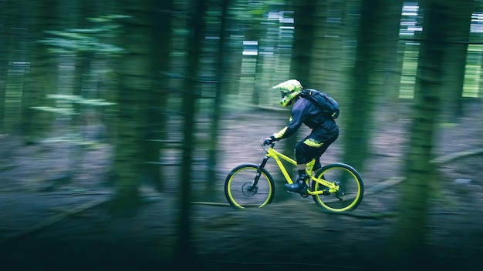
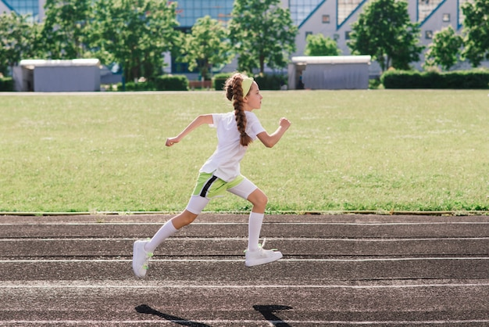
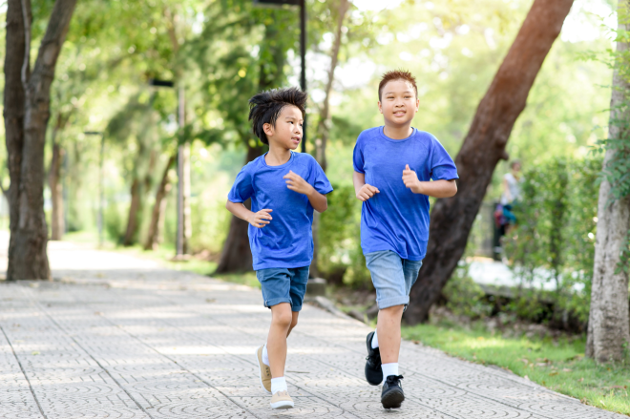
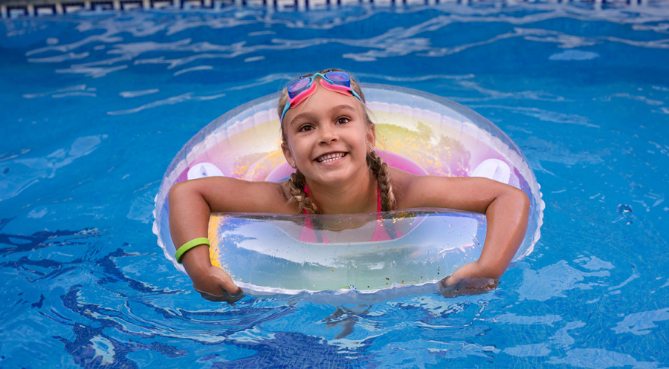
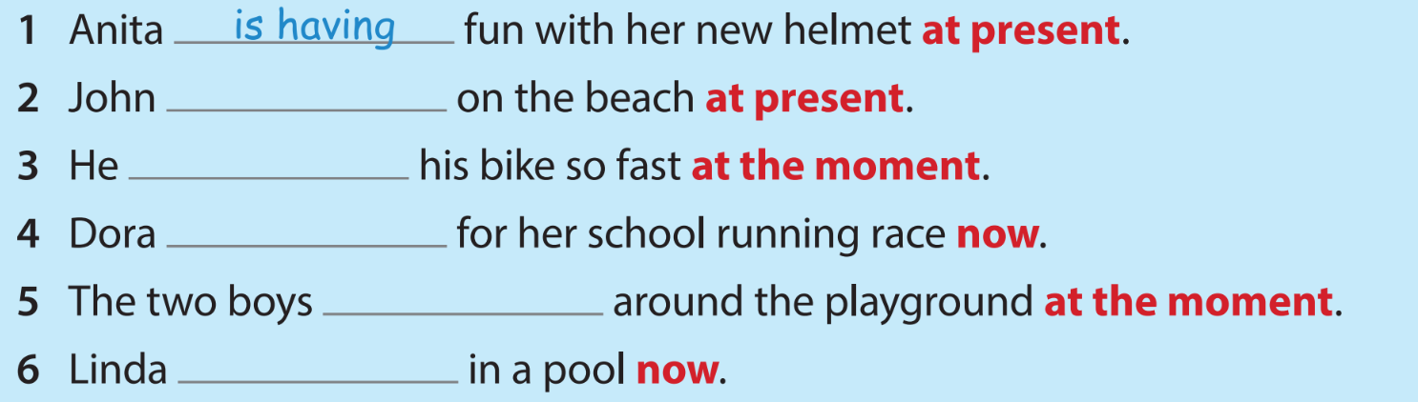
4 Listen and write.
1
2
3
4
5
6
is running
is riding
is preparing
are jogging
is swimming

Slide 20
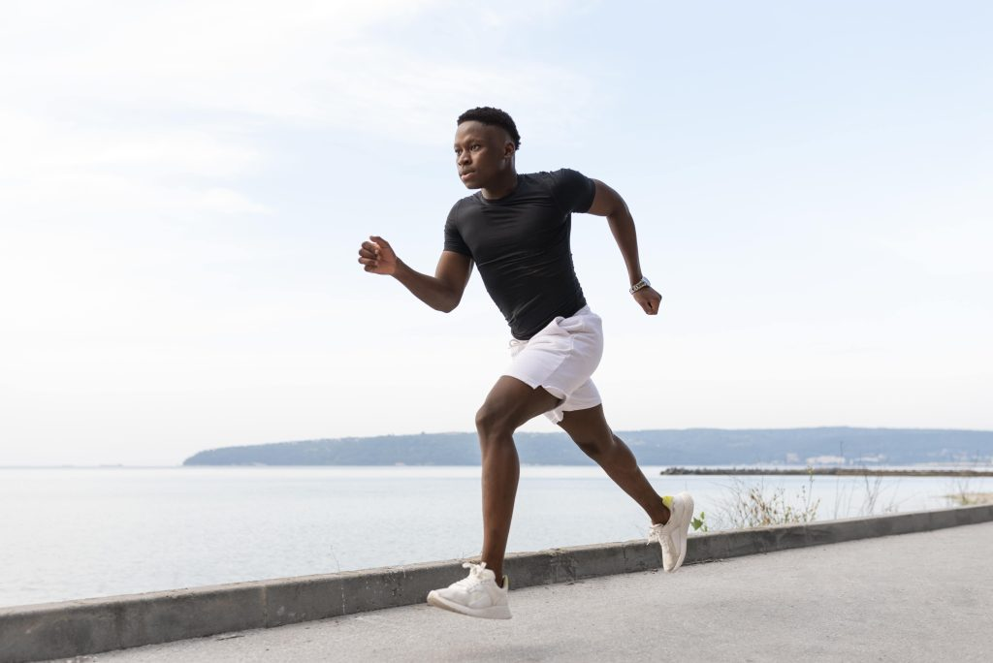
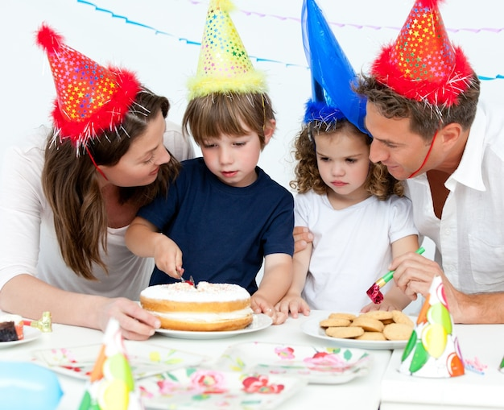
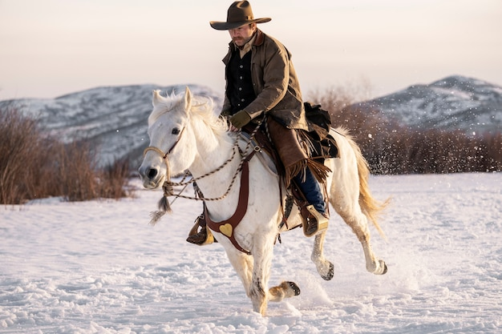
5 Look and write.
running
cutting
riding
1 He is ______ now.
(run)
2 He is ______
a cake now. (cut)
3 He is ______ a
horse at present.
(ride)

Slide 21
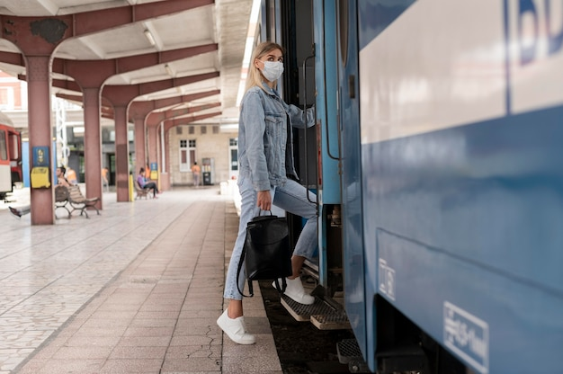

5 Look and write.
stepping
writing
4 She is ______ onto the
train at the moment. (step)
5 She is _______ a letter
now. (write)

Slide 22
4
Production

Slide 23

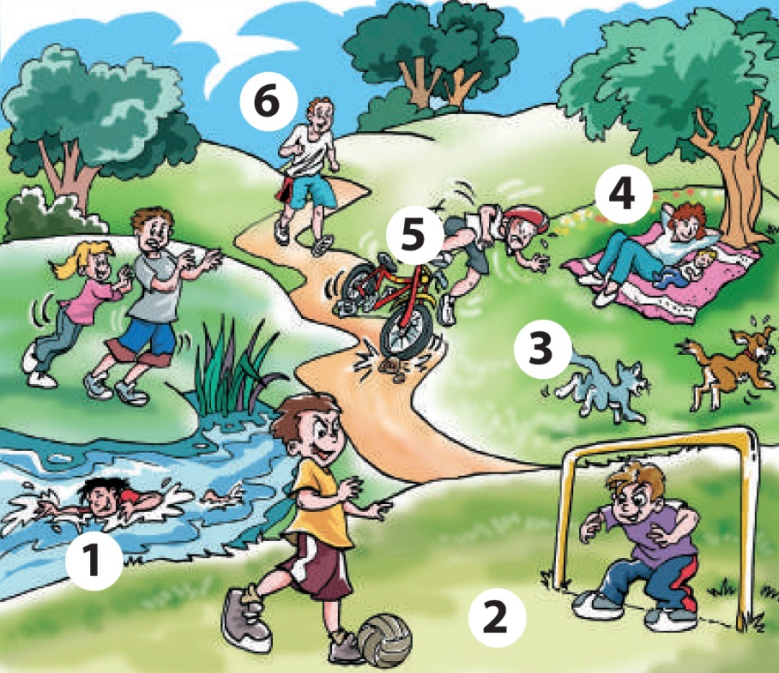
6 Point, ask and answer.
What are they doing?
Look at number 1.
What is this girl doing?
She is swimming.

Slide 24
6 Point, ask and answer.
What are they doing?
Look at number 2.
What are these boys doing?
They are playing football.

Slide 25
6 Point, ask and answer.
What are they doing?
Look at number 3.
What are the cat and the dog doing?
The cat is running after the dog.

Slide 26
6 Point, ask and answer.
What are they doing?
Look at number 4.
What are they doing?
They are lying under the tree.

Slide 27
6 Point, ask and answer.
What are they doing?
Look at number 5.
What is this boy doing?
He is falling off the bike.

Slide 28
6 Point, ask and answer.
What are they doing?
Look at number 6.
What is this man doing?
He is running.

Slide 29
5
Wrap-up & Assessment

Slide 30
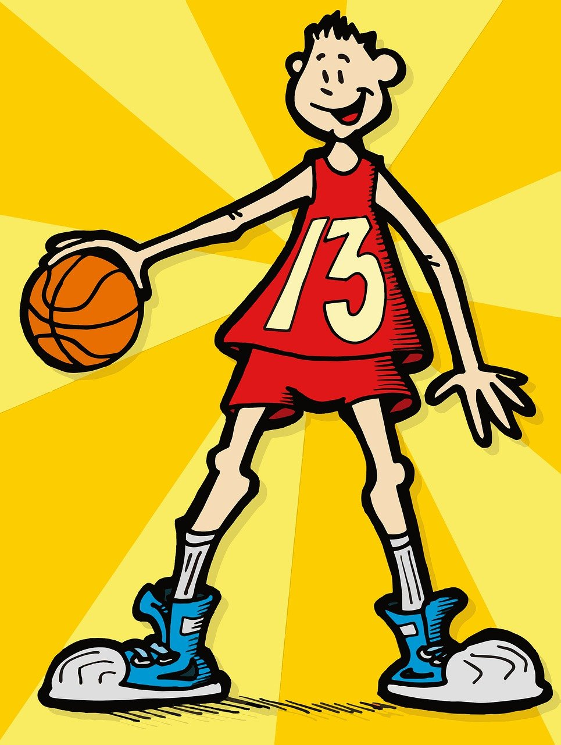
Find and correct the mistake.
He playing basketball at present.
He is playing basketball at present.

Slide 31
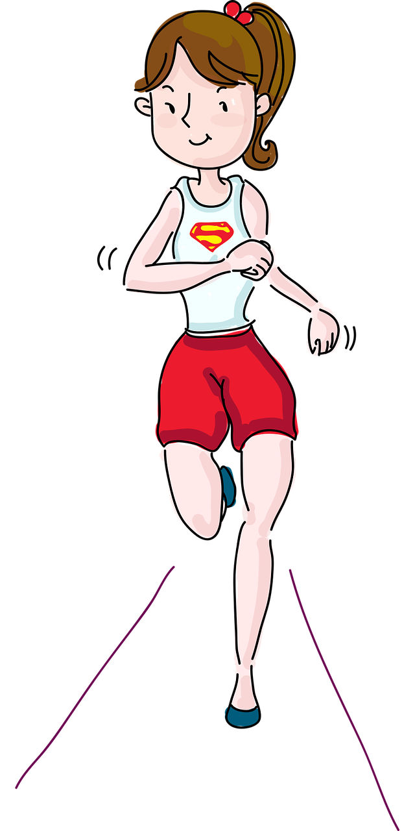
Find and correct the mistake.
She is runing in the park.
=> She is running in the park.

Slide 32
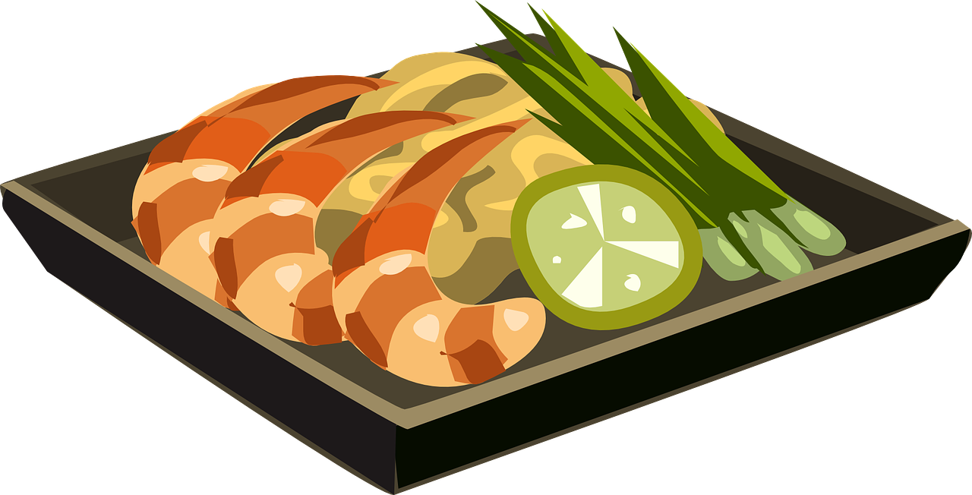
Find and correct the mistake.
They are haveing dinner now.
=> They are having dinner now.

Slide 33
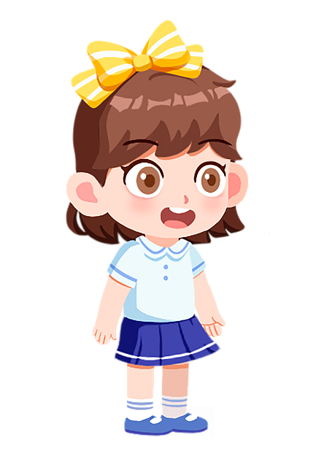
Find and correct the mistake.
What is you doing now?
=> What are you doing now?

Slide 34
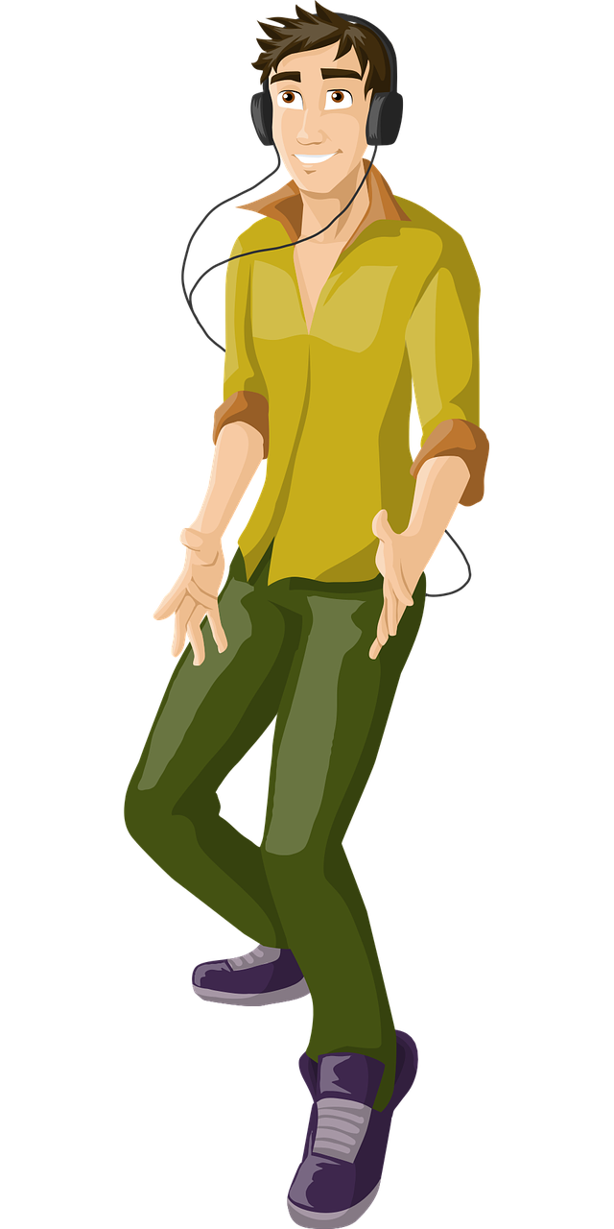
Find and correct the mistake.
He dances at the moment.
=> He is dancing at the moment.

Slide 35


Wrap-up
Unit 7: Sports
Lesson 1 – Part 4,5,6
What have we learnt today?
Grammar: Present continuous
I am running now.
She / He is running now.
You / We / They are running now.

Slide 36

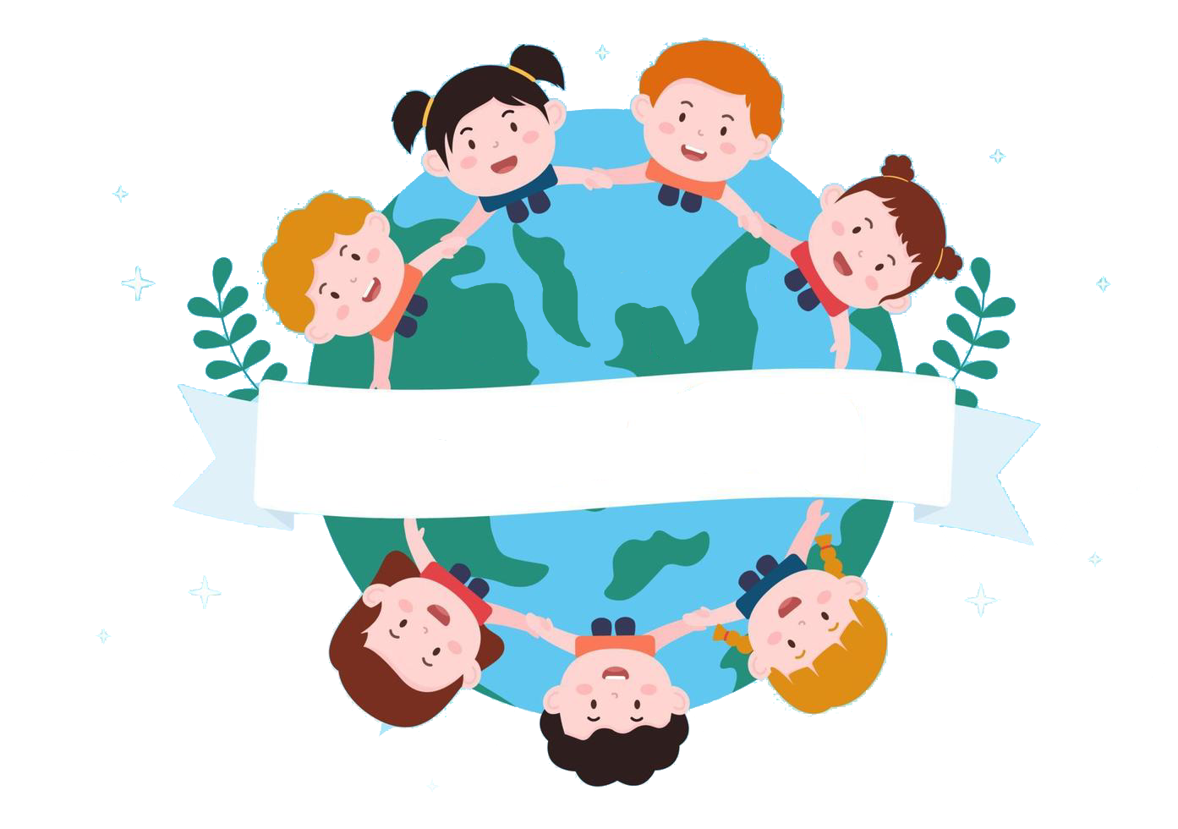
Thank you
& goodbye!

