Slide 1








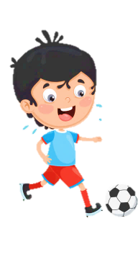













Slide 2
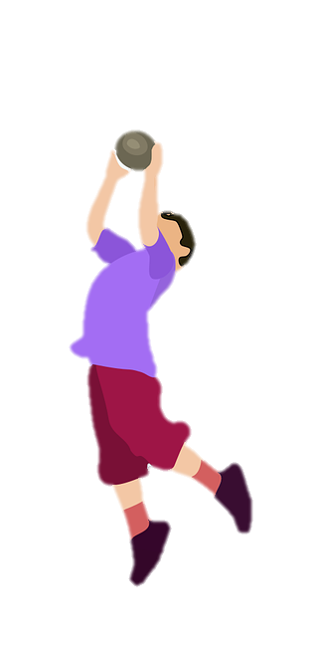
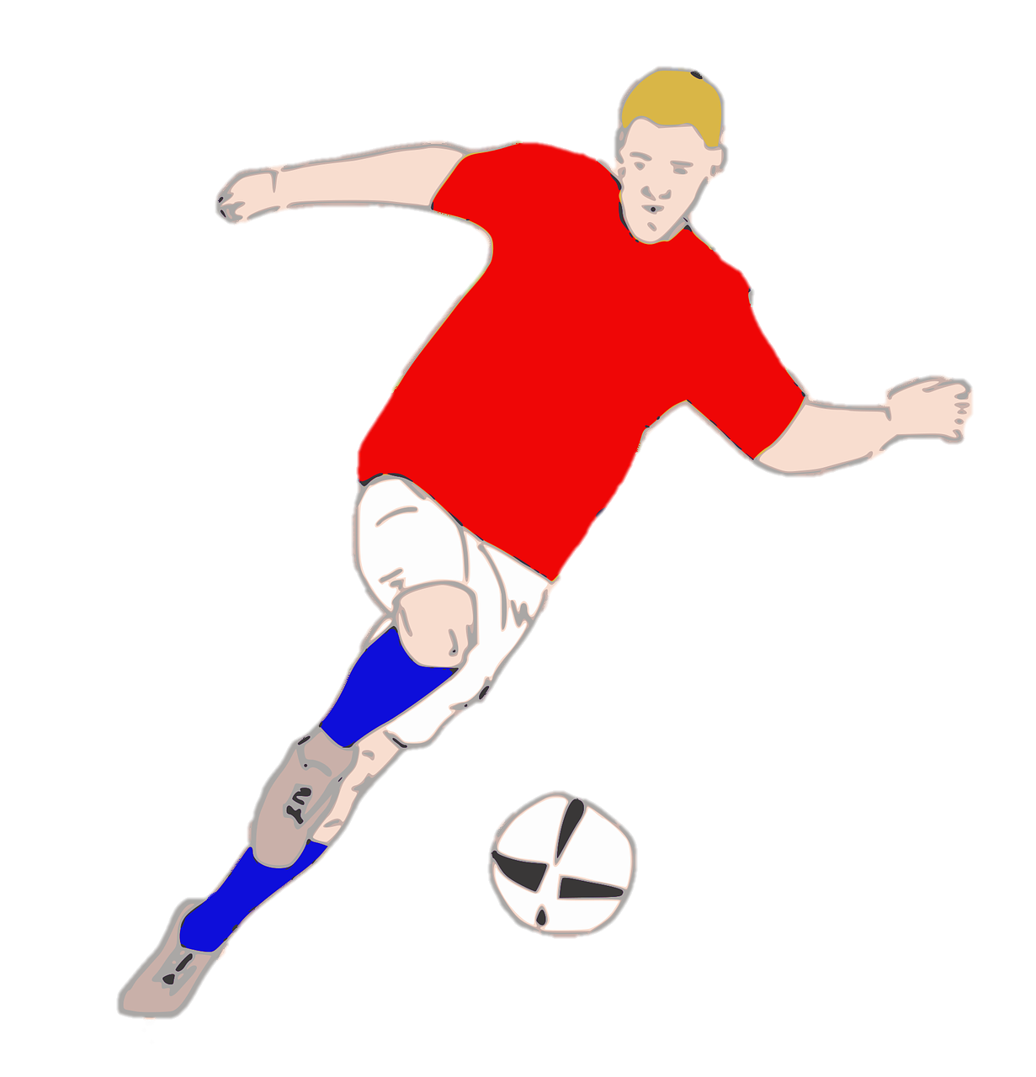
Unit 7:
SPORTS
Lesson 1 – Part 1, 2, 3

Slide 3





Table of contents
01
02
Warm-up
Presentation
04
05
Wrap-up &
Assessment
Production
03
Practice

Slide 4
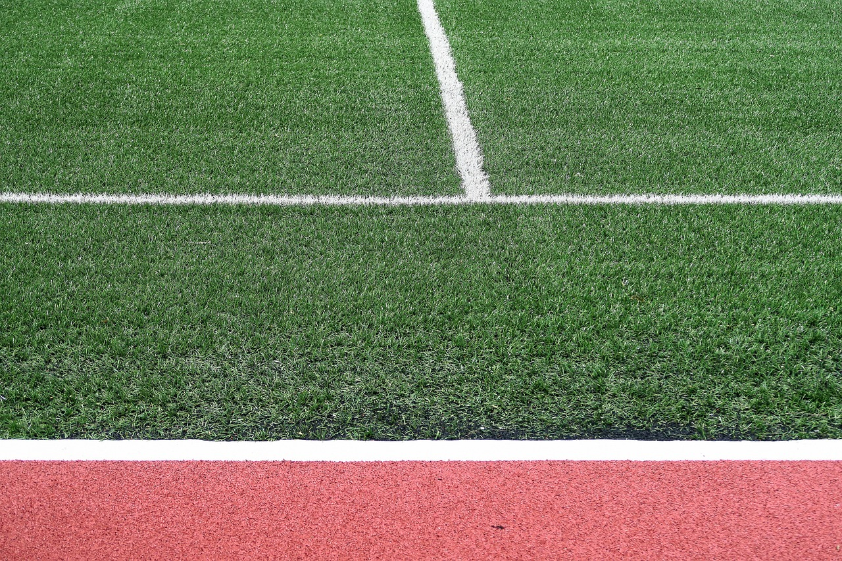

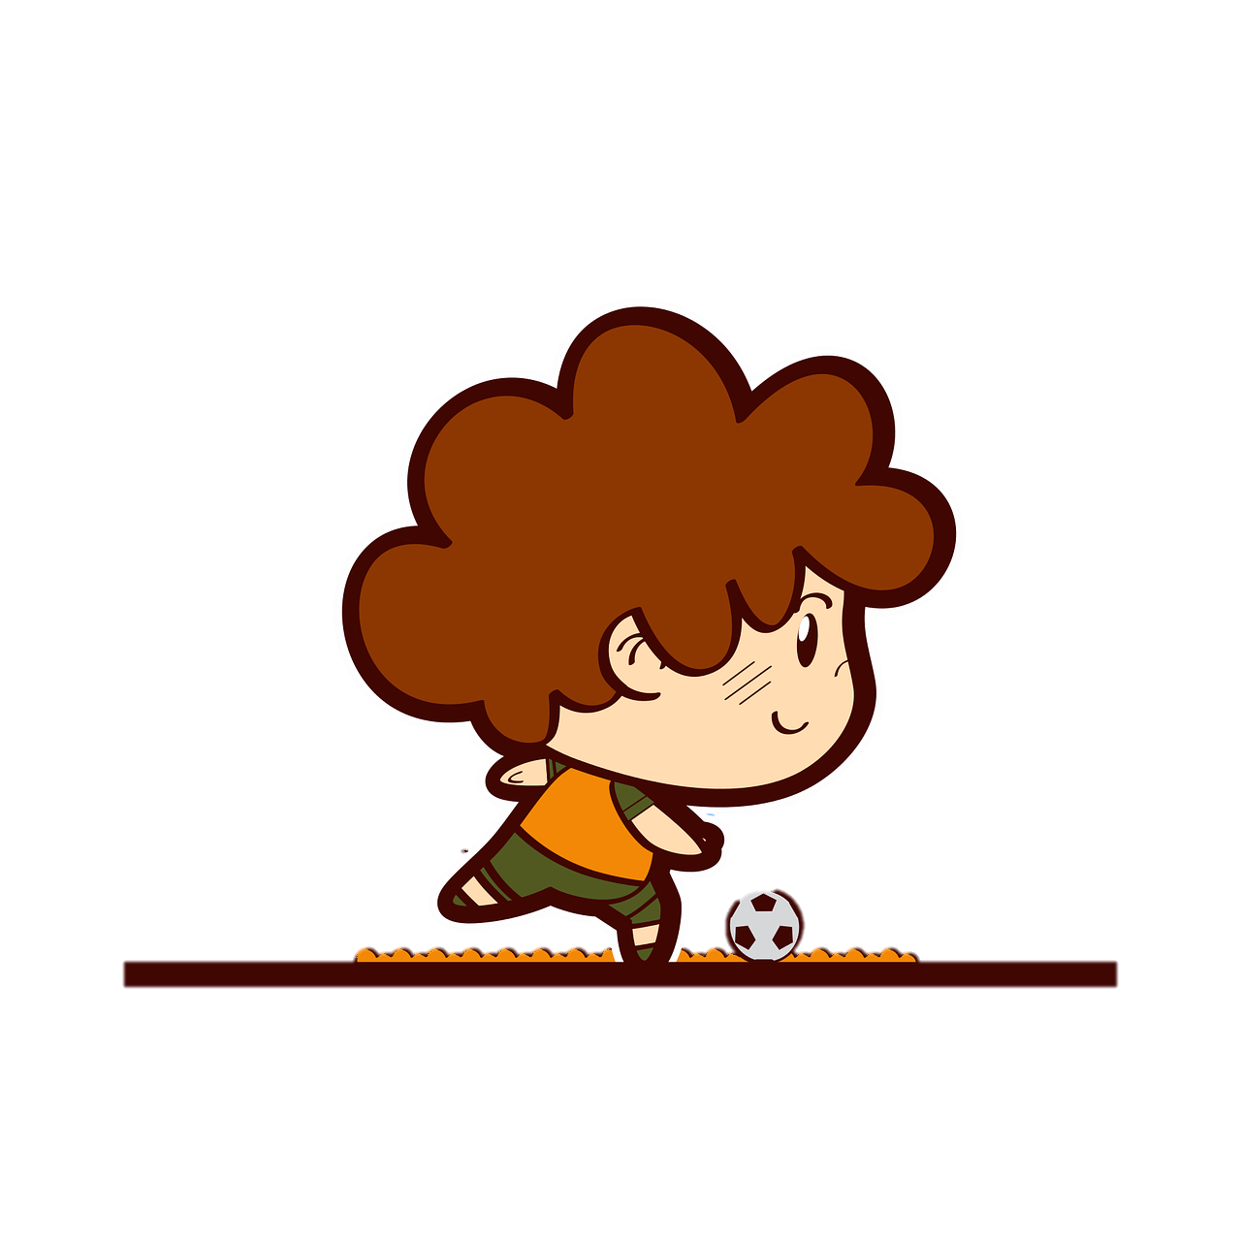
1
Warm-up
https://www.youtube.com/watch?v=zg3kyPGgzJg

Slide 5
2
Presentation

Slide 6

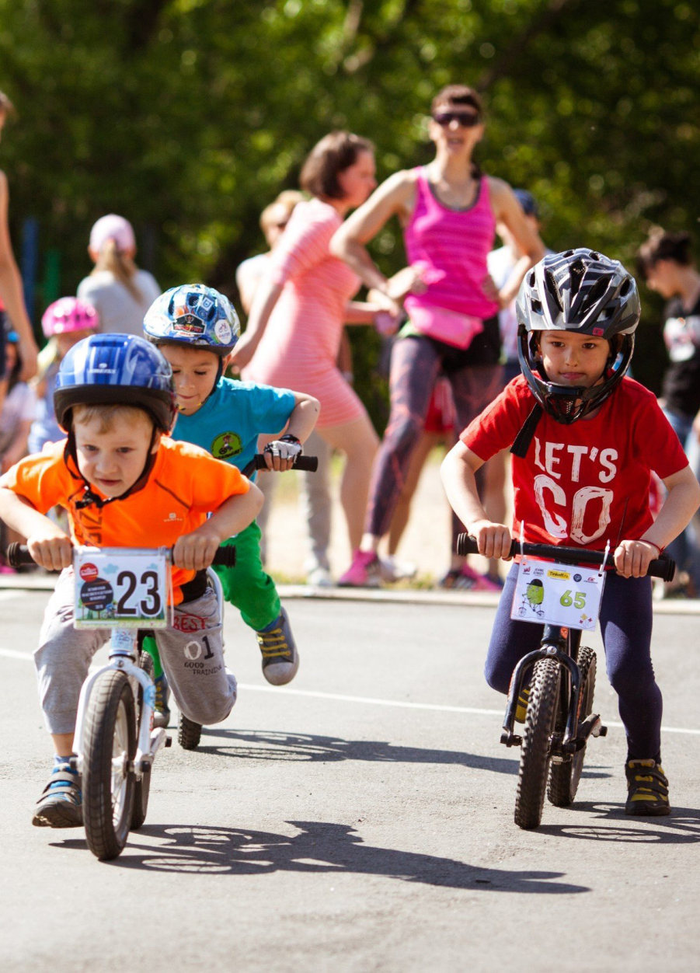

A cycling competition for kids
1 Look at the photo.
What sport are they doing?
Cycling.

Slide 7
Which words describe the sport in the picture? Tick.
amazing difficult
boring easy
fast fun
different slow

Slide 8
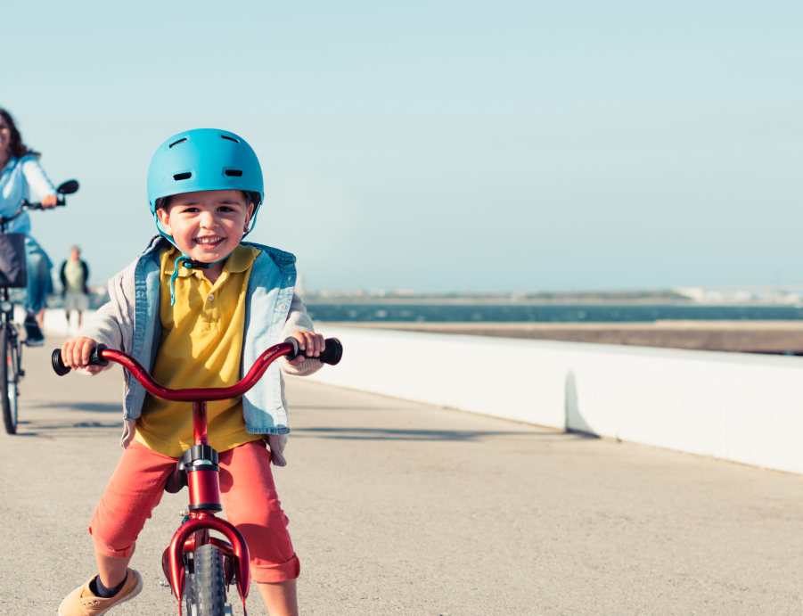

1 Listen and read.
Ahmed: Hey, Nur. What are you doing?
Nur: I’m reading about this year’s Our Town Bike Race.
Ahmed: Let’s enter the race together.
Nur: You’re joking!
Ahmed: No, I’m not. I’m sure you can do it.
Nur: I don’t think I am good enough. Many racers are very fast. They jump, too!
Ahmed: I’m taking lessons. We’re practising jumps at the moment. You can join us.
Nur: Hmm… Maybe I need a better helmet.
Ahmed: Nur, are you scared?
Nur: Me? No way! I just don’t want to come in last.
Ahmed: Great! We may not win the race, but we can still have fun.

Slide 9
Who is reading about this year’s race?
Ahmed: Hey, Nur. What are you doing?
Nur: I’m reading about this year’s Our Town Bike Race.
Ahmed: Let’s enter the race together.
Nur: You’re joking!
Ahmed: No, I’m not. I’m sure you can do it.
Nur: I don’t think I am good enough. Many racers are very fast. They jump, too!
Ahmed: I’m taking lessons. We’re practicing jumps at the moment. You can join us.
Nur: Hmm… Maybe I need a better helmet.
Ahmed: Nur, are you scared?
Nur: Me? No way! I just don’t want to come in last.
Ahmed: Great! We may not win the race, but we can still have fun.
It’s Nur.

Slide 10
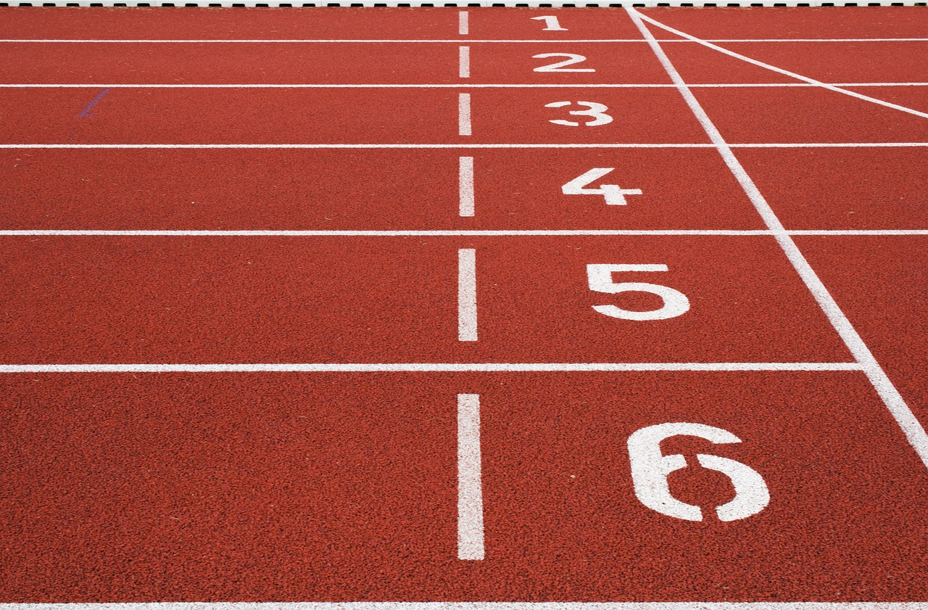
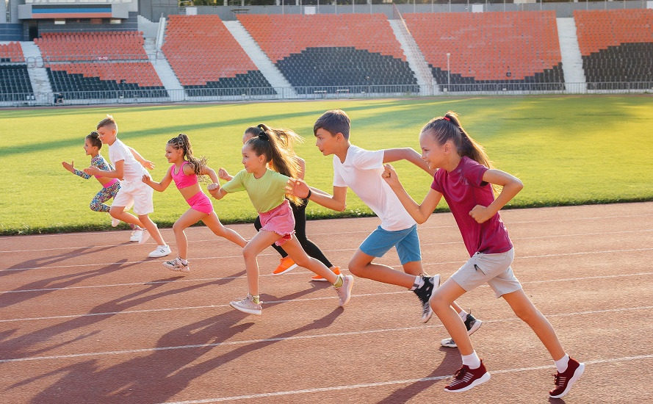
fast
Notes:
T clicks the word to repeat the pronunciation.

Slide 11
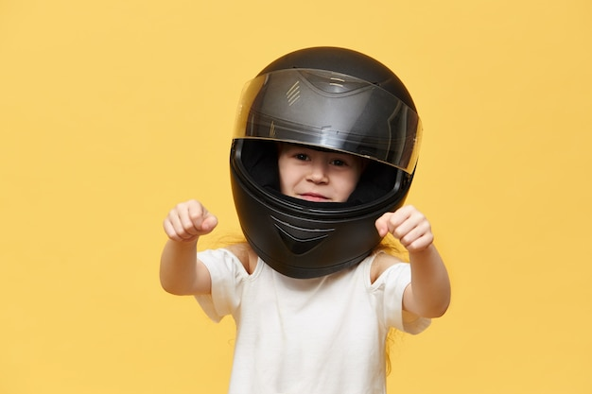
helmet

Slide 12

jump

Slide 13
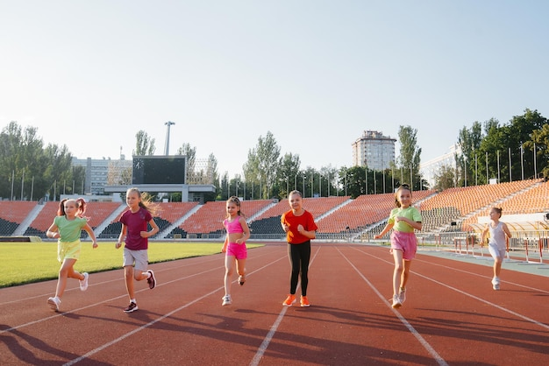
race

Slide 14

win

Slide 15






2 Listen, point and repeat.

Slide 16
3
Practice

Slide 17

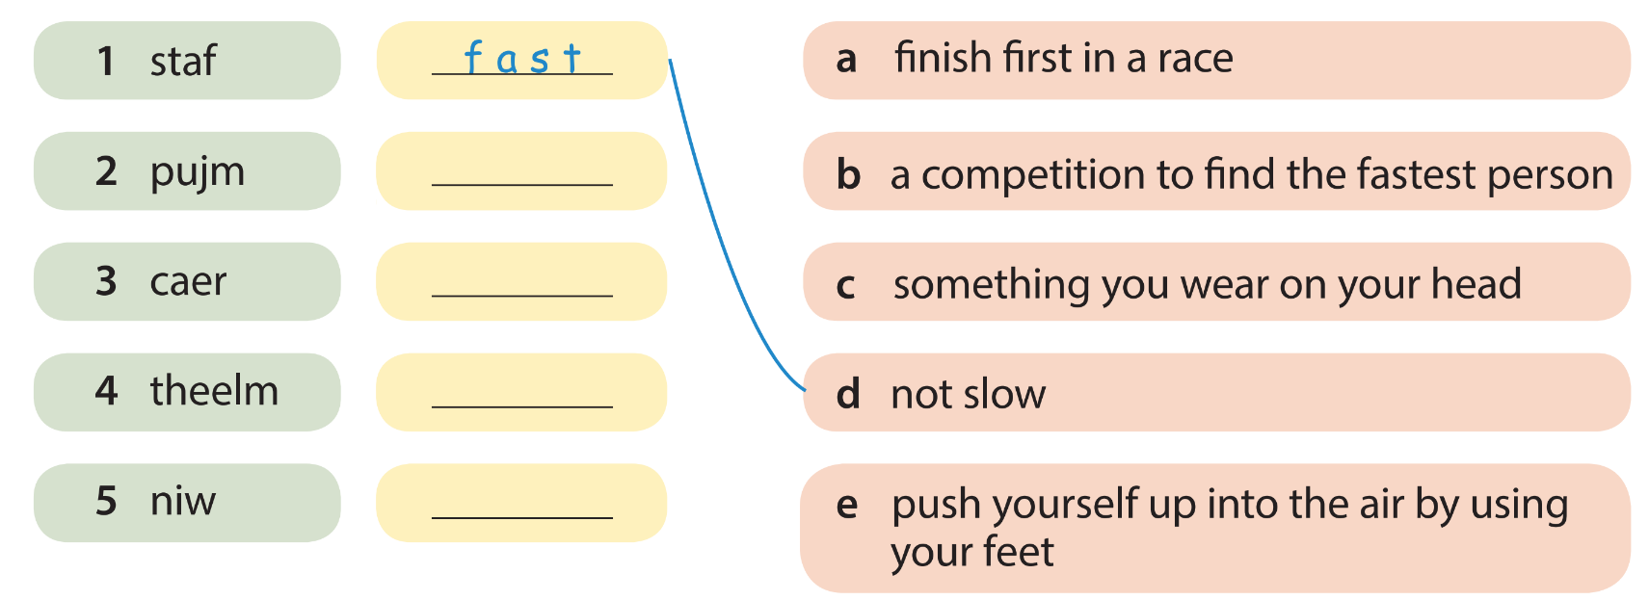
3 Unscramble. Then match.
jump
race
helmet
win

Slide 18
4
Production

Slide 19
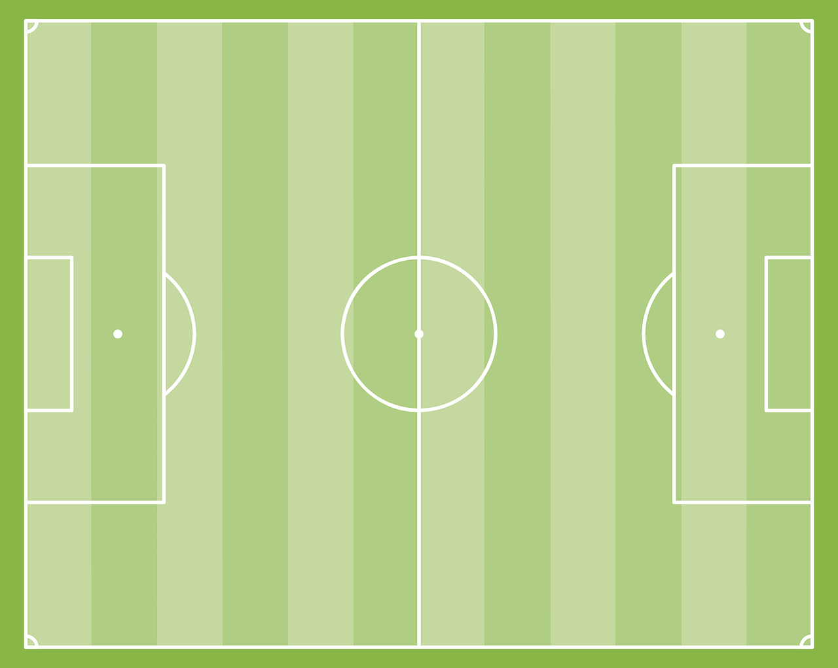
Let’s play
“Who has better memory?”!
There are 9 pictures.
We only have a few minutes to remember all of them before they are hidden away.
Whoever remember more pictures will be the winner!

Slide 20
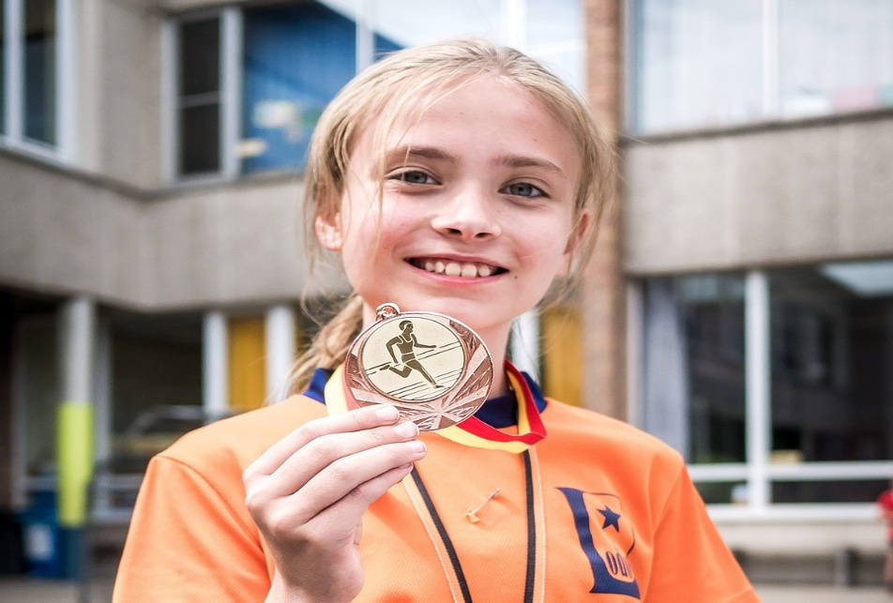
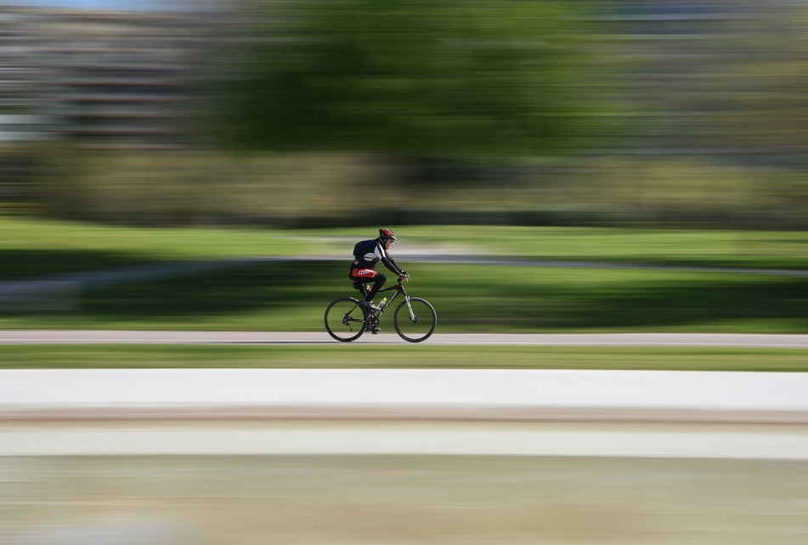
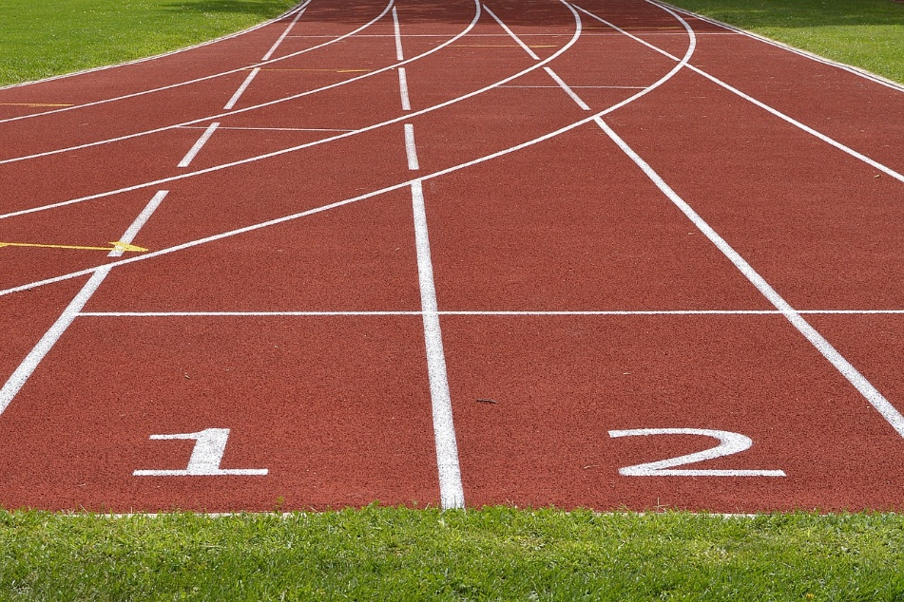
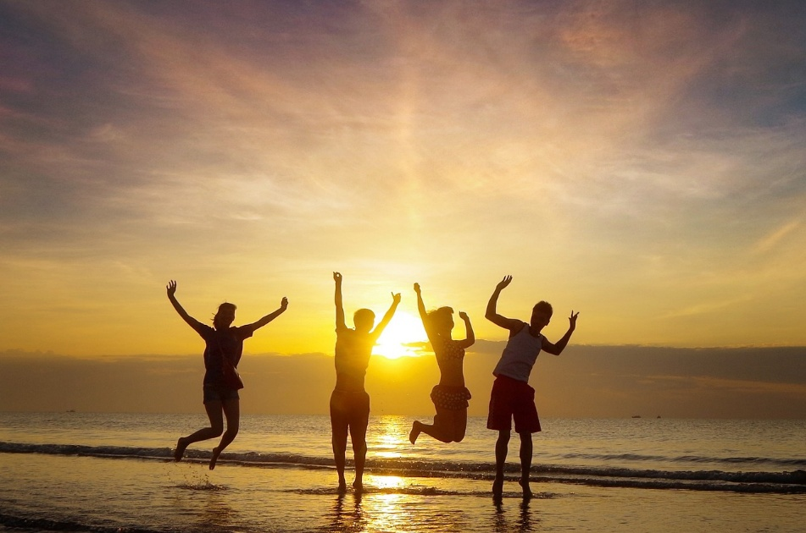
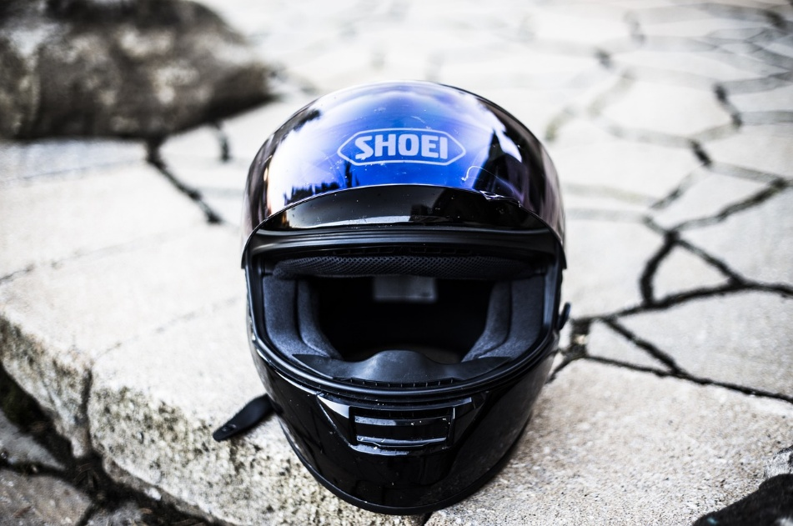
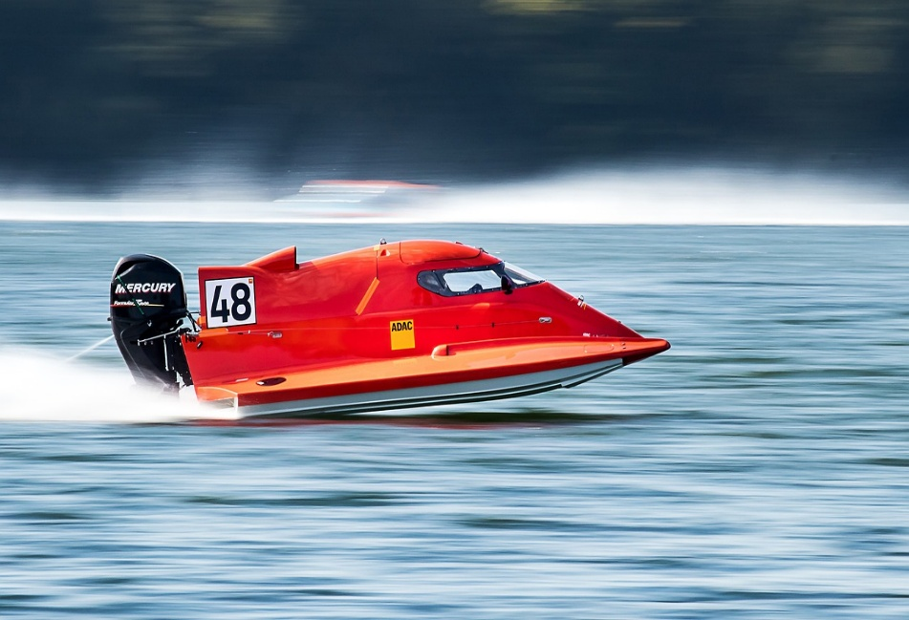
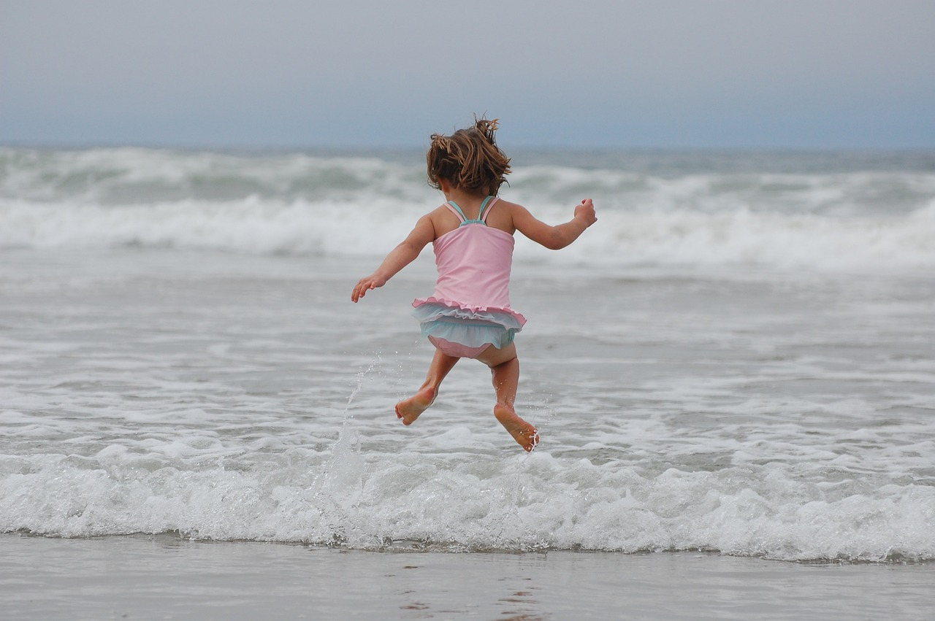
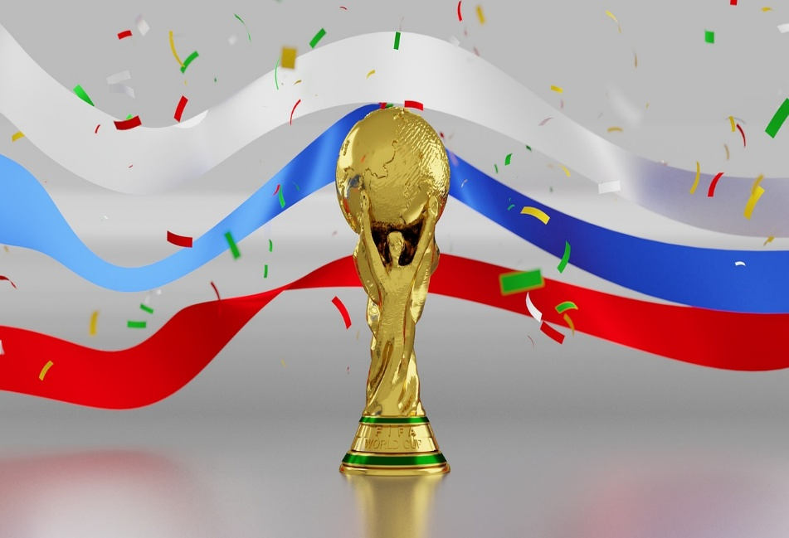
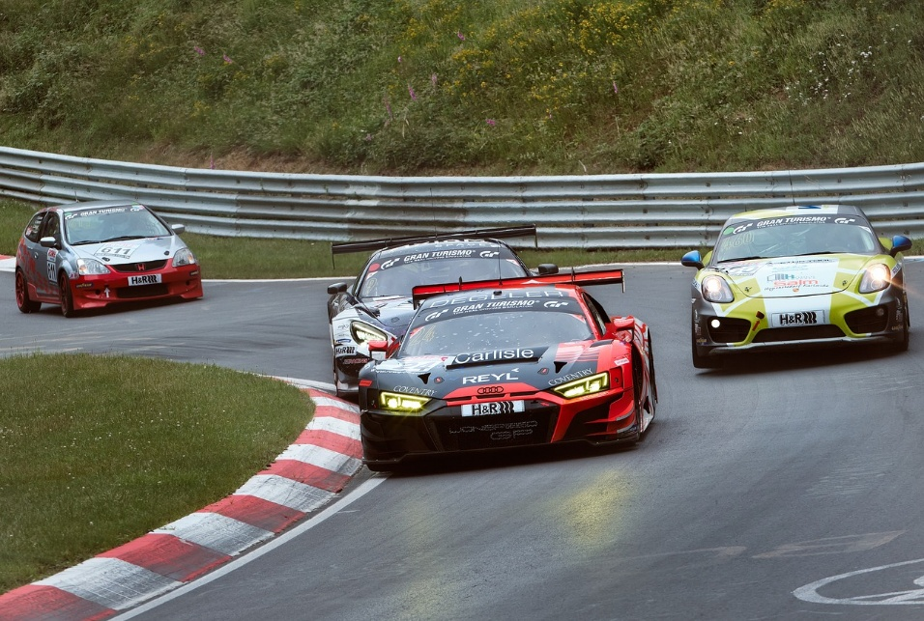
1
2
3
Hide all
win
fast
race
Show all
4
5
6
jump
helmet
fast
7
8
9
jump
win
race
Notes:
T clicks ‘Hide all’ to hide all the pictures, clicks ‘Show all’ to show all the pictures, clicks the number to show just one picture, click the picture to show the word.

Slide 21
5
Wrap-up &
Assessment

Slide 22
Fill in the missing letters.
m
u
j_ _p

Slide 23

Fill in the missing letters.
s
t
fa_ _

Slide 24
Fill in the missing letters.
w
n
_i_

Slide 25
Fill in the missing letters.
r
e
_ac_

Slide 26
Fill in the missing letters.
h
l
t
_e_me_

Slide 27


Wrap-up
Unit 7: Sports
Lesson 1 – Part 1,2,3
What have we learnt today?
Vocabulary: fast, helmet, jump, race, win

Slide 28


Thank you
& goodbye!

